Slide 1

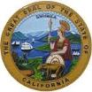








California Environmental Protection Agency
Cal/EPA
  Oil by Rail Risk and Response Map
  Gina Solomon, M.D., M.P.H.
  Deputy Secretary for Science and Health
IEPR Workshop – Trends in Sources of Crude Oil

Slide 2
California Environmental Protection Agency
Cal/EPA
Purpose:
Identify areas along rail routes with potential high vulnerability;
Identify the locations of emergency response teams relative to the vulnerable areas.
Rail Vulnerabilities: High Hazard Areas; Earthquake faults
Human Vulnerabilities: Population; Schools; Hospitals
Ecological Vulnerabilities: Water crossings; Sensitive species and habitats
IEPR Workshop – Trends in Sources of Crude Oil

Slide 6
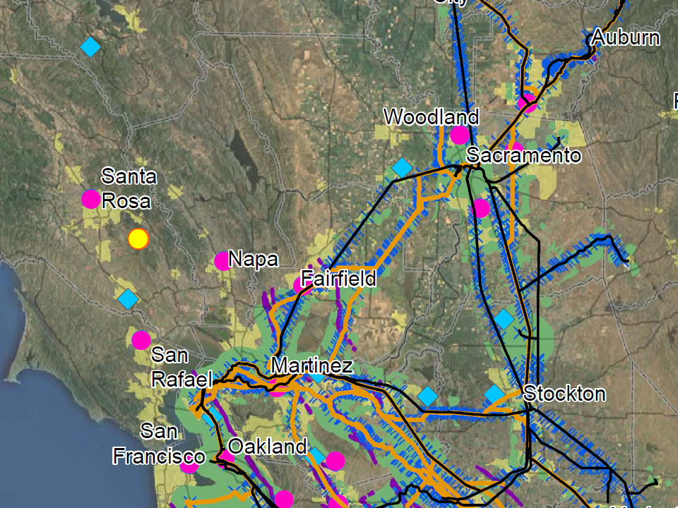

Slide 9
