Slide 1
Geographic Information Systems
(Including GPS and Remote Sensing)
Applications in Oil Spill Response
Judd Muskat
OSPR GIS Coordinator
Judd.muskat@wildlife.ca.gov
Environmental Response to Oil Spills. San Diego, California. March 2014

Slide 2
What I Will Cover
Geographic Information Systems
  Basic Concepts & examples
Global Positioning Systems
  Basic Concepts
Remote Sensing
  Examples
Information Dissemination – ERMA Southwest
  Template for a National Common Operating Picture (COP)

Slide 3
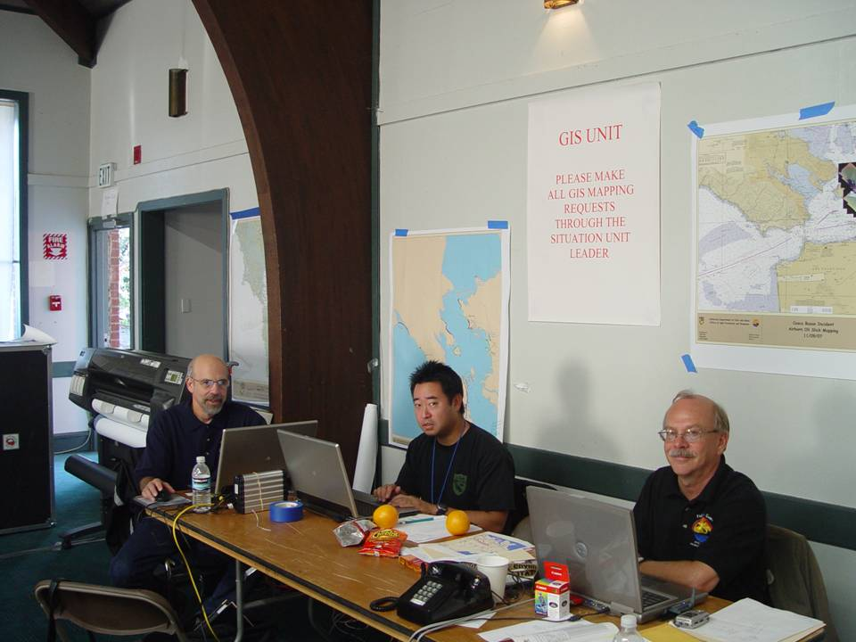
What is a GIS?
Computer Hardware, Specialized Software, Data and Trained Personnel
Data Collection, DB Dev, Digital Archiving
  Electronic Field Data Capture
    Mobile GIS
    Remote Sensing
Data Analysis and Display
  Situational Awareness Maps
    Degree of Shoreline Oiling (SCAT)
    Resources at Risk
    Operational Planning
Notes:
GIS is a system of computer software, hardware, data, and personnel to help manipulate, analyze and present information that is tied to a spatial location
Roles and Responsibilities:
GIS Specialist is responsible for compiling updated spill information and providing various map products for the incident.
The GIS team works for the Situation Unit Leader to ensure accurate and rapid dissemination of oil spill information to the ICS
Cosco Busan command post. Six GIS specialists on-site (three DFG, one NOAA, one O’Brians, 1 Contractor), two GIS specialists at remote locations (1 @ OSPR HQ, 1 @ NOAA/NRDA).
.
Special Request Maps
Various maps can be created to assist all disciplines within the UC. This map was created using waypoints collected by field staff.
Cleanup status maps
Field base maps
Resources at Risk
Other ad hoc requests

Slide 4
GIS is NOT*
(*UNLESS THE REQUEST COMES THROUGH THE SECTION LEADER)
IT Support (Logistics)
Meeting Poster Makers (Documentation Unit)
Copy Makers (Documentation Unit)
Word/PDF File Print-Out (Documentation Unit)
Anything Clerical…
  Please See The Documentation Unit

Slide 5
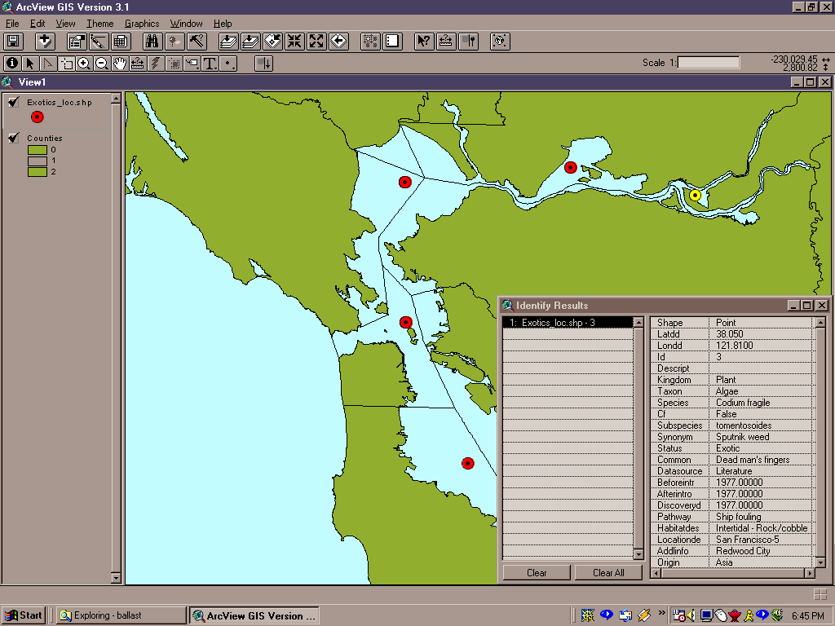
How Does GIS Work?
Stores Feature Data (Area, Point or Line) with Spatial Coordinates
Links Map Feature to Data Base Table
Ability to Layer Additional Data (Remote Sensing, Environmental, Parcel, etc)
Digital Data Analysis
Notes:
Simple GIS map
map composed of linear, polygonal and point elements
individual map elements correspond to a database record

Slide 6
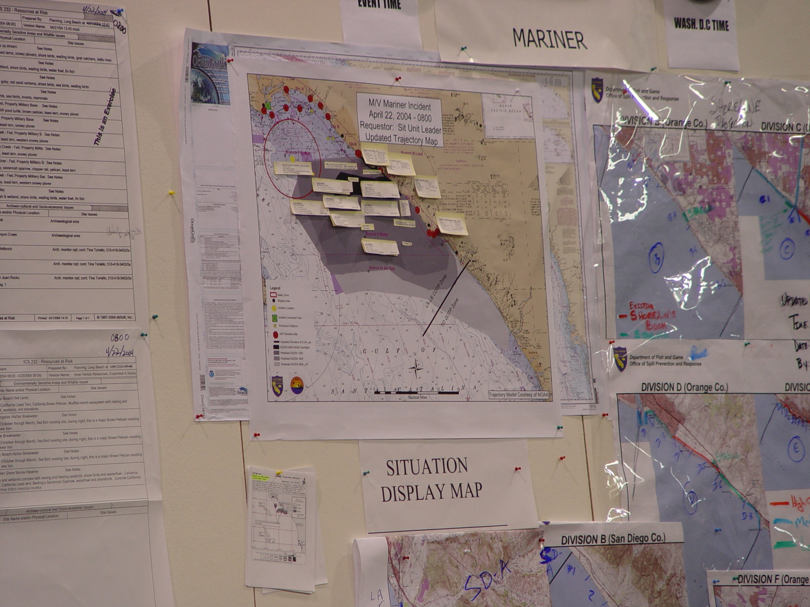
Why Have GIS On-Site?
  Provide map products to the Unified Command, Sections, Branches & Public
  Ability to incorporate and manage convergent data generated by the response
  Quickly display and analyze field data
  The Inherent data management, analysis, and display capabilities Makes GIS an important and valuable tool for oil spill response
Notes:
Why Use GIS
Data management tool
Organize
Visualize
Overlay
Analyze

Slide 7
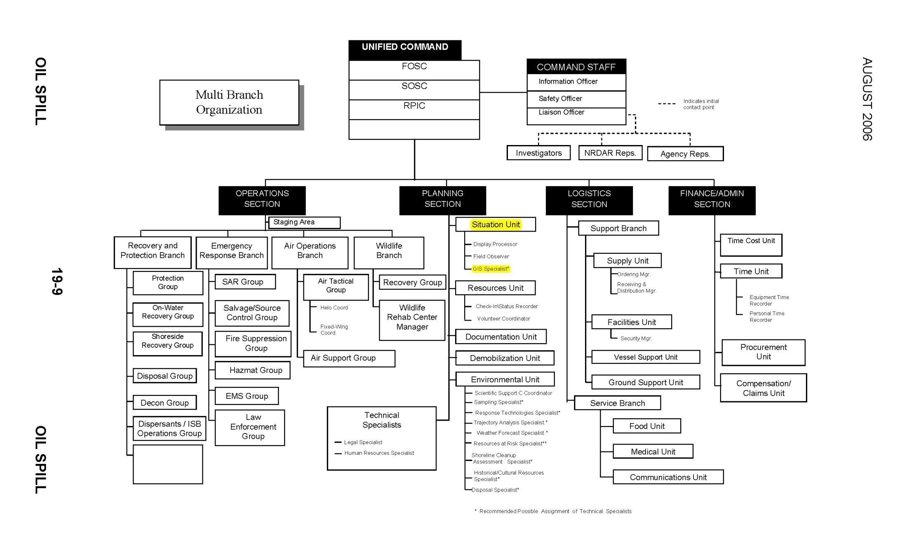
Incident Management Handbook
August 2006
GIS is Located within the Situation Unit
Notes:
Org Chart from current Department of Homeland Security, USCG incident management handbook
Situation Unit or Environmental Unit ---- GIS Unit

Slide 8
Reality
GIS Support
Notes:
Org Chart from current Department of Homeland Security, USCG incident management handbook
Situation Unit or Environmental Unit ---- GIS Unit

Slide 9
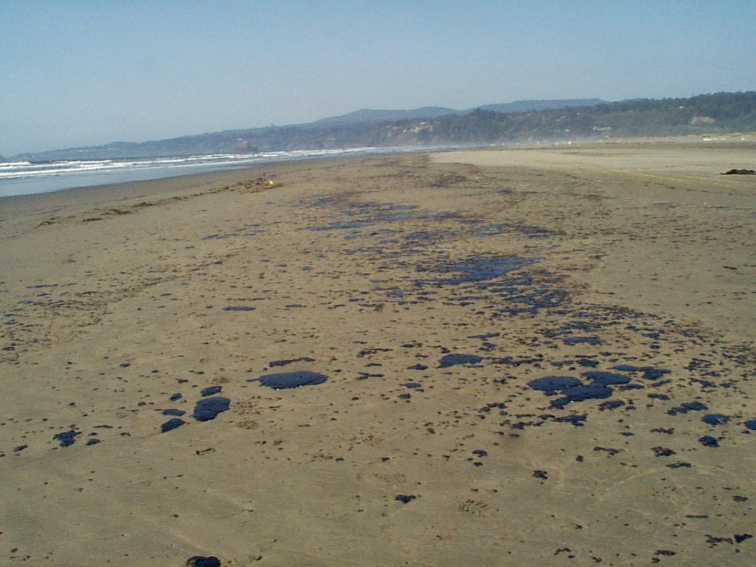
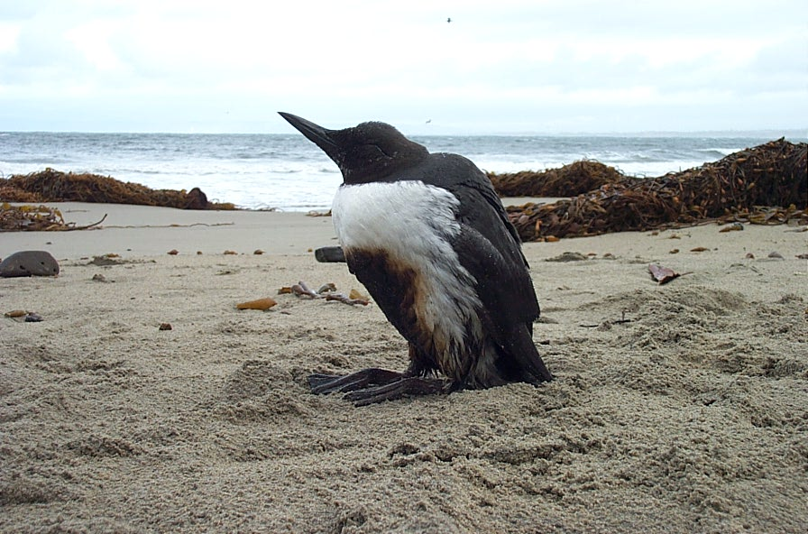
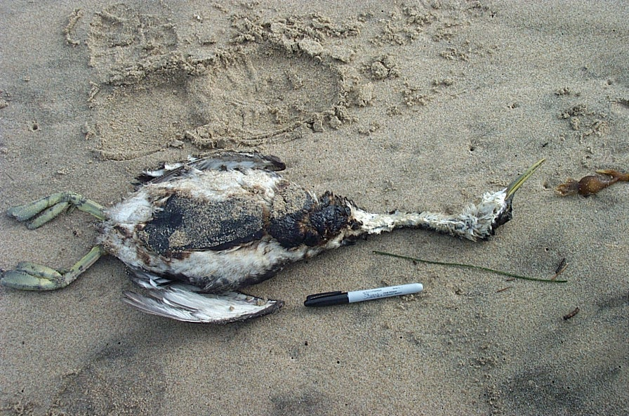
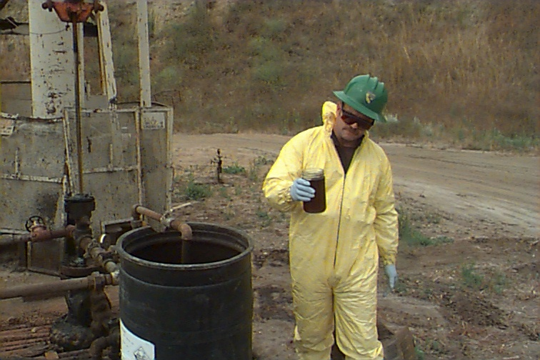
Degree of Oiling
Oiled/live Wildlife
Sample Response Map Products
Sampling Locations
Oiled/dead Wildlife
Notes:
Incident Specific Data Library
Data sets that are developed at the time of the incident
Extent and degree of oiling
Location of live/dead wildlife
Location of samples

Slide 10
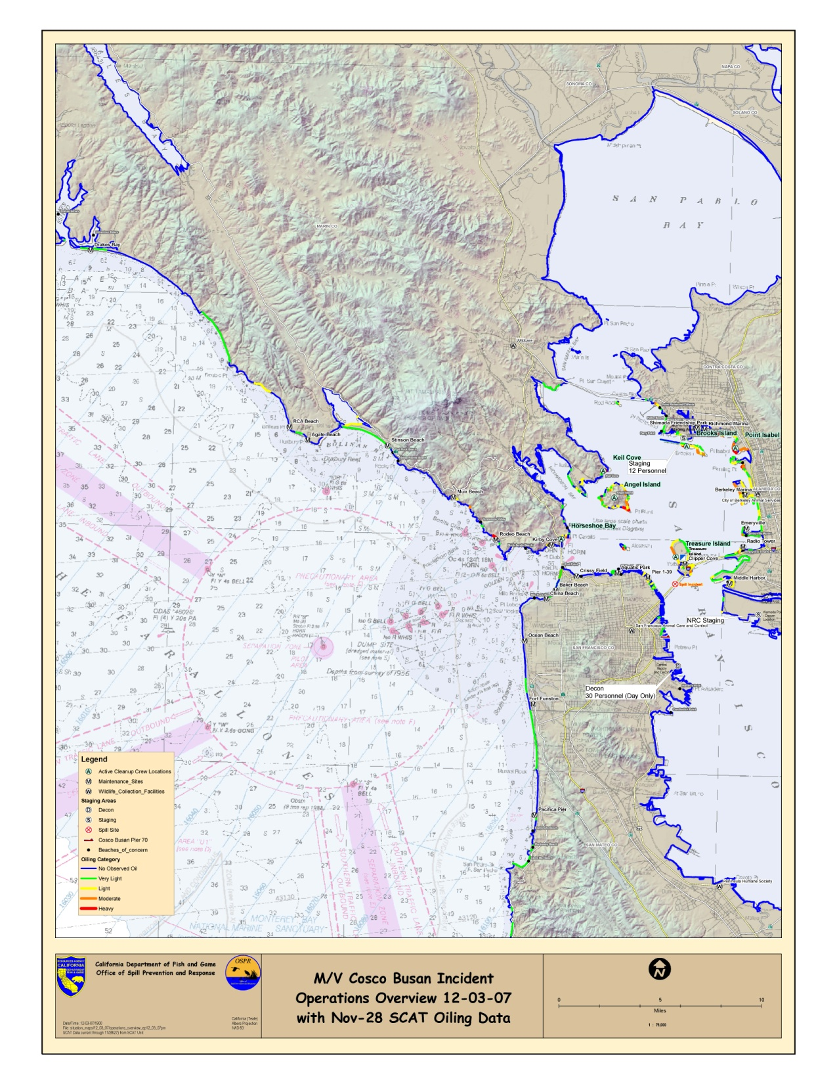
Degree of Oiling

Slide 11
Degree of Oiling

Slide 12
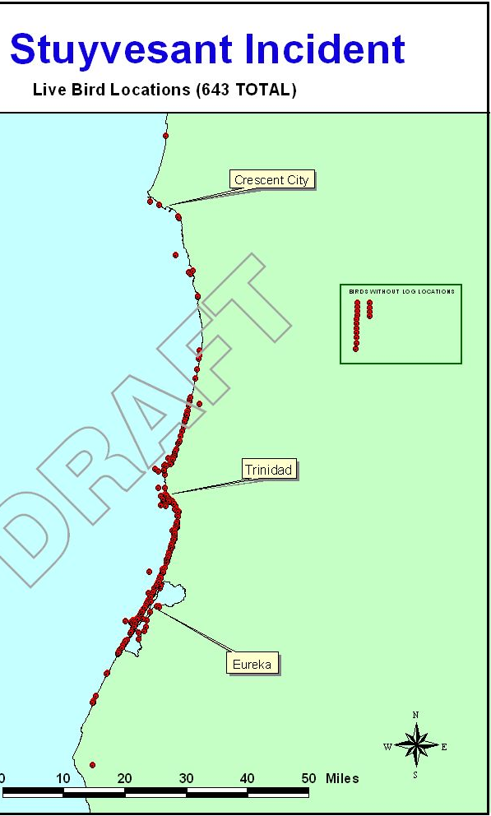
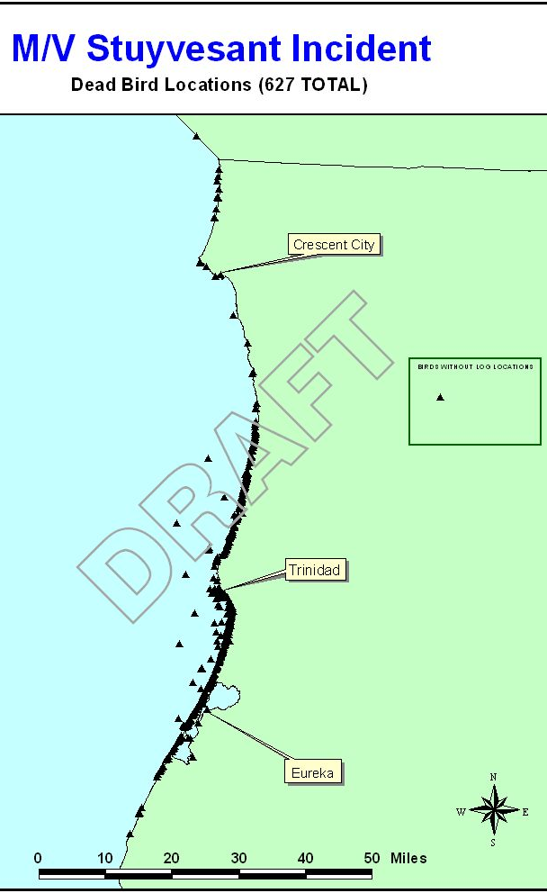
Notes:
Wildlife Impact Maps
Recovery teams capture live and dead wildlife
The location of captures are documented using GPS or by descriptive text (Clam beach)
Data is integrated into the GIS electronically or manually

Slide 13
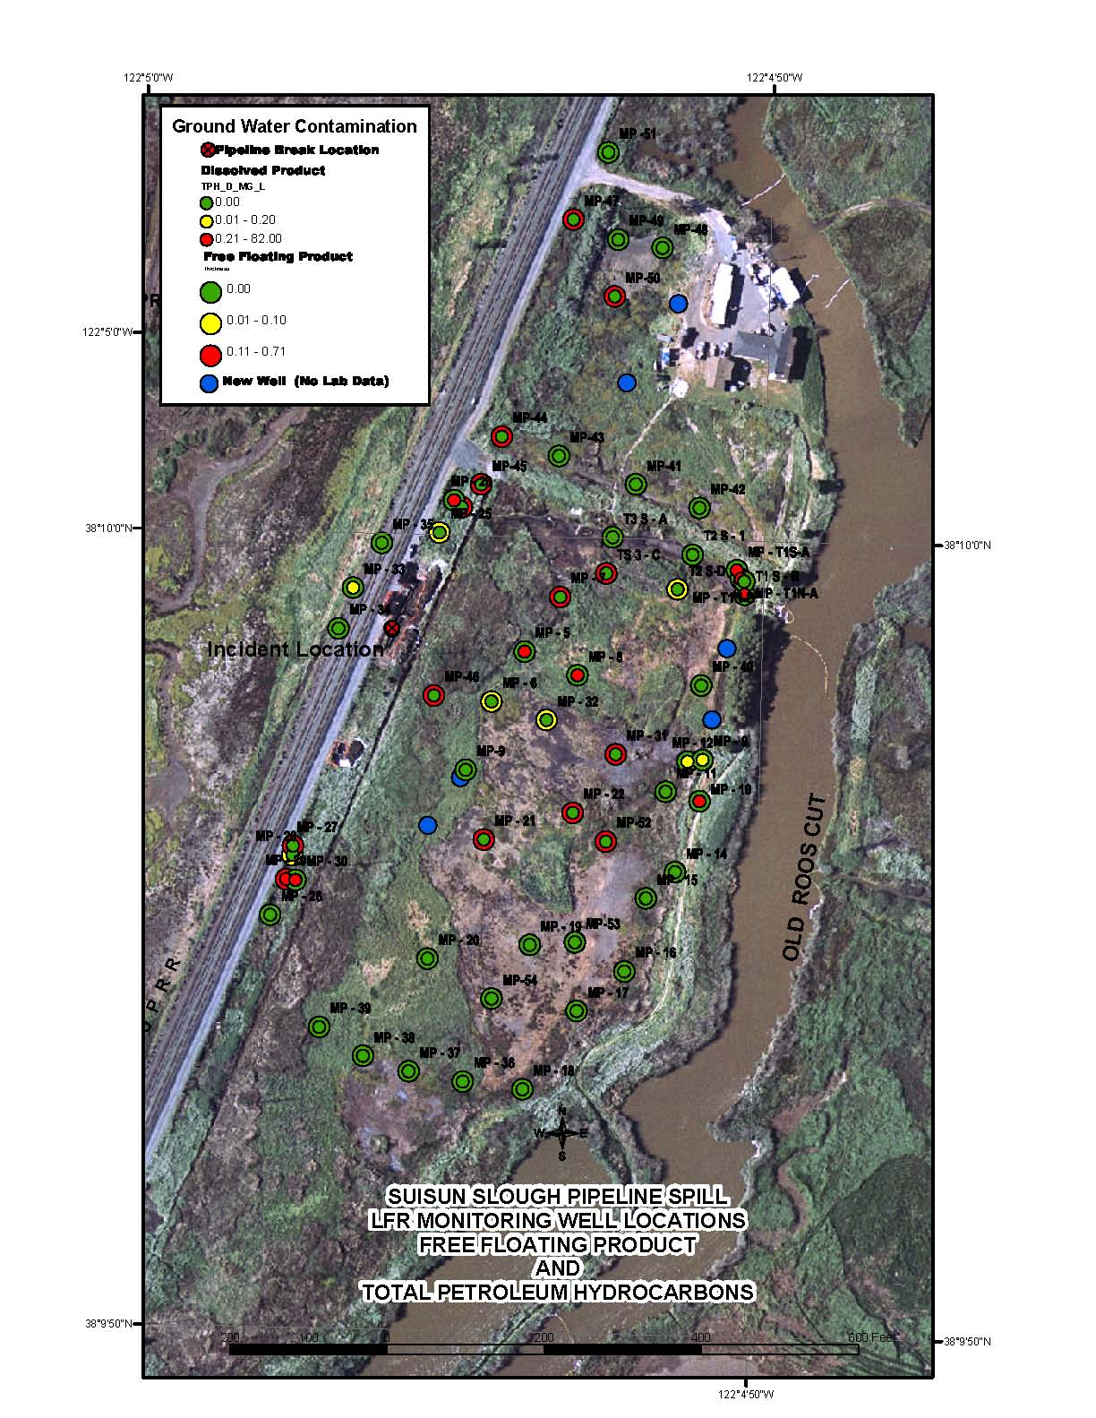
Notes:
Map of Sample locations
Groundwater monitoring wells at Suisun Marsh

Slide 14
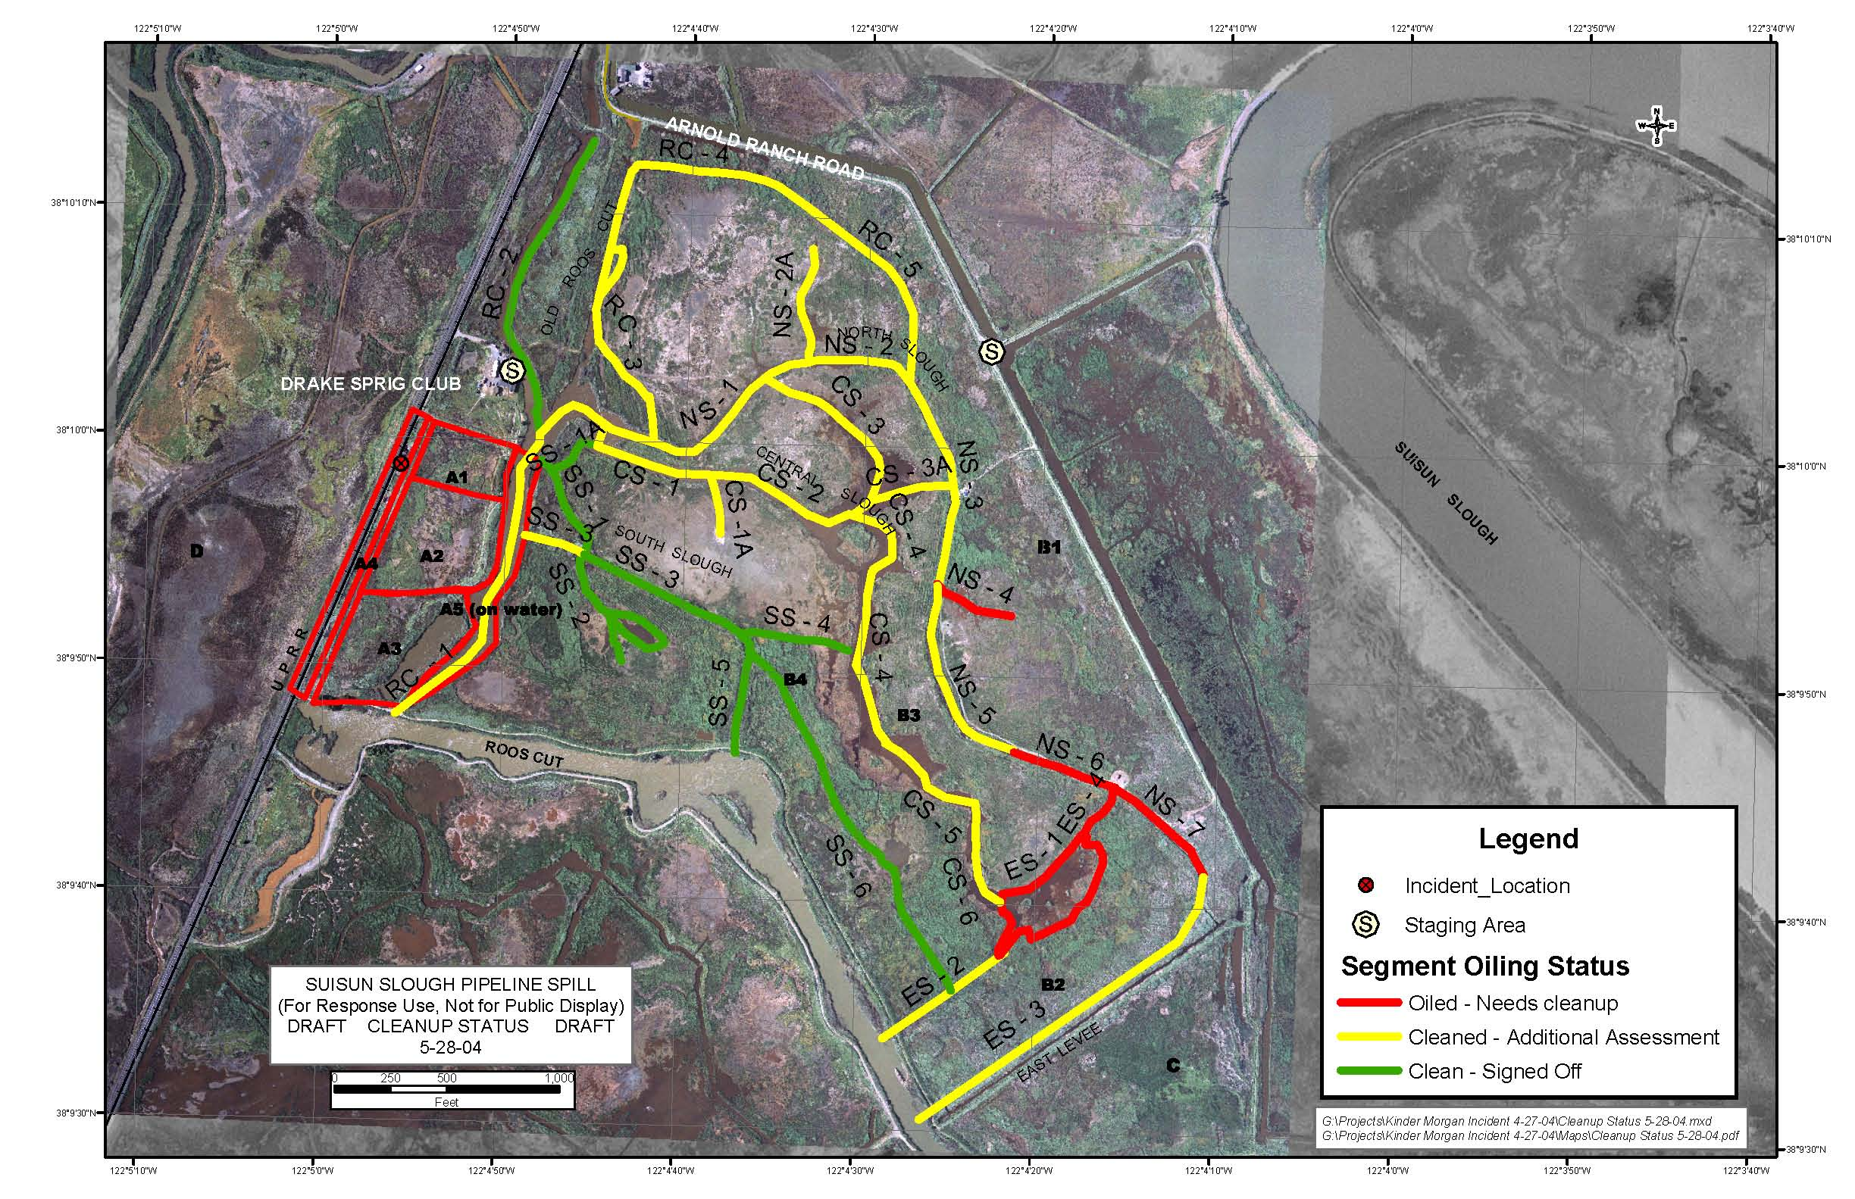
Suisun Marsh Pipeline Rupture
(Cleanup Status Map)
Notes:
Roles and Responsibilities:
GIS Specialist is responsible for compiling updated spill information and providing various map products for the incident.
The GIS team works for the Situation Unit Leader to ensure accurate and rapid dissemination of oil spill information to the ICS.
Special Request Maps
Various maps can be created to assist all disciplines within the UC. This map was created using waypoints collected by field staff.
Cleanup status maps
Field base maps
Resources at Risk
Other ad hoc requests

Slide 15
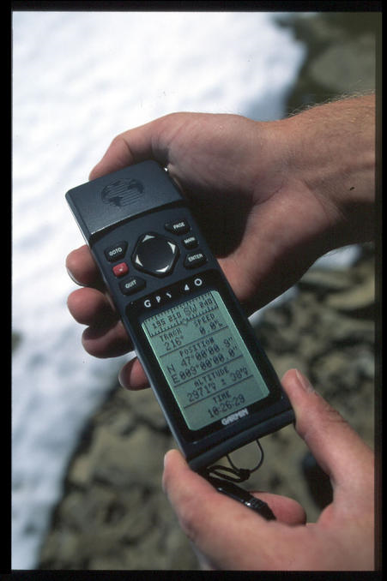
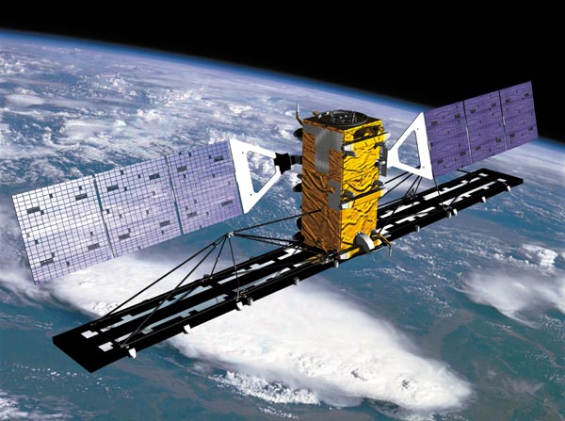
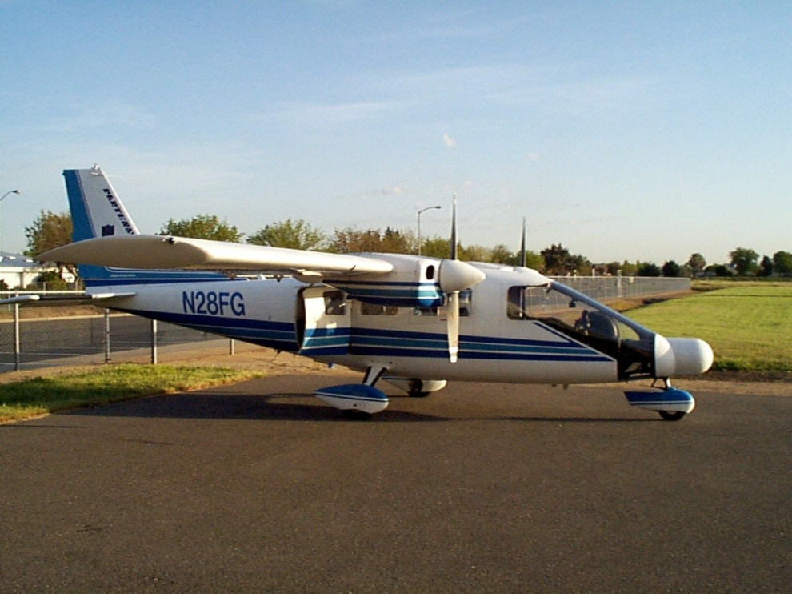

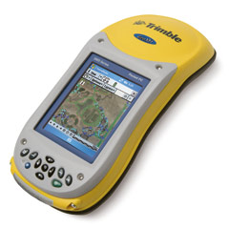
Data Collection Tools & Resources
GPS Receivers and Mobile Devices
Remote Sensing
  Satellite
  Airborne
Notes:
Resources
Various electronic tools and resources are employed to capture field data and document the pollution incident

Slide 16
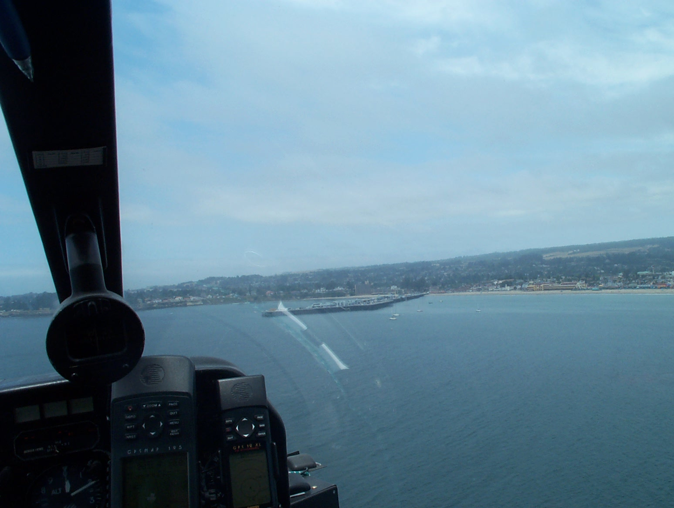
Global Positioning System Review
Satellite Based Navigation
All Weather System
Basic Receiver Accurate to 15 meters
WAAS (Wide Area Augmentation System) Can Improve Accuracy <3m
Four GPS satellite signals are used to compute accurate position
(FOR OIL SPILL RESPONSE) Set GPS to Decimal Degrees (hddd.ddddd), Set Datum – WGS84

Slide 17
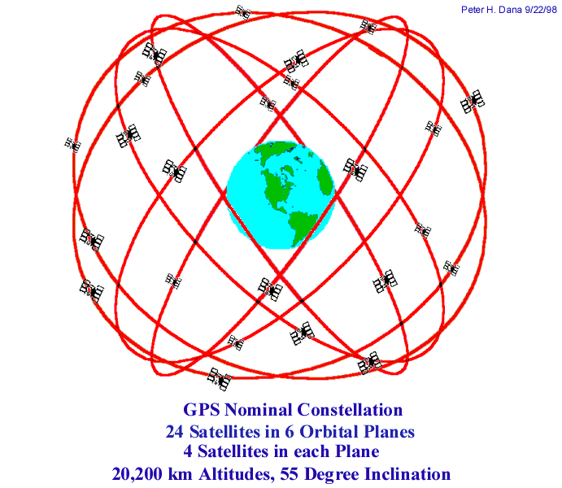
Notes:
GPS Satellite constellation

Slide 18
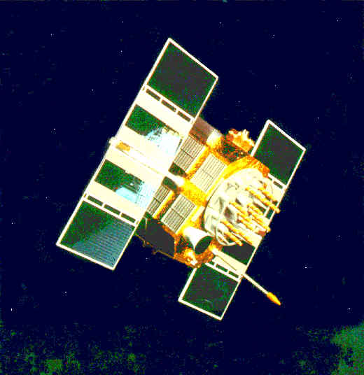
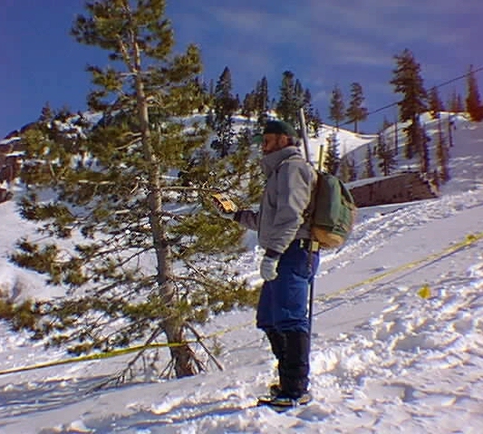
GPS: How It Works
Finding Distance by Measuring Time
When first turned on the GPS receiver synchronizes it’s internal clock with the first satellite it contacts, then downloads the satellite almanac.
Satellites are in well defined, predictable orbits.
Notes:
First
GPS receiver searches for GPS radio signals
Synchronizes clock to GPS time (not ZULU) and downloads current almanac
Locates all other available satellites
Receiver calculates it’s position based on the time/location information contained in the radio pulses

Slide 19
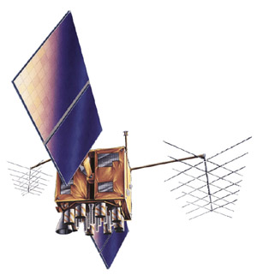
GPS: Finding Distance by Measuring Time
u
A
B
GPS Satellite
x
4:00 p.m. >>
<< 7/100 of a second
after 4:00 p.m.
Receiver:
G J K E T Y U O W V W T D H K …
Clocks synchronized
Satellite:
G J K E T Y U O W ...

Slide 20
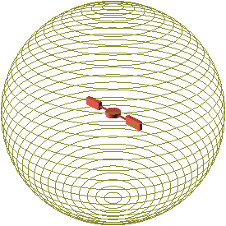

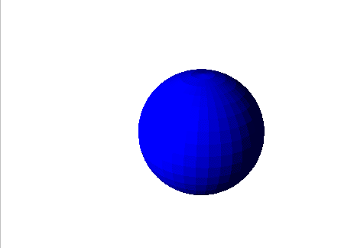
Satellite Location
Given 1 satellite …
We can locate our position on the surface of a sphere

Slide 21
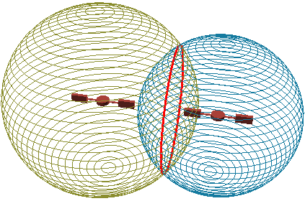
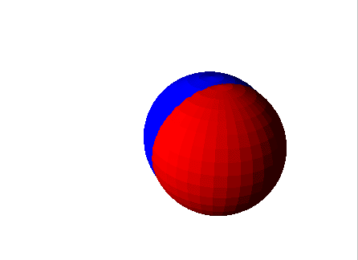

Satellite Location
Given 2 satellites …
We can locate our position on the intersection of 2 spheres (a circle)
jgrummom@alleninst.com

Slide 22
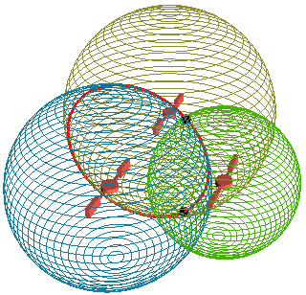
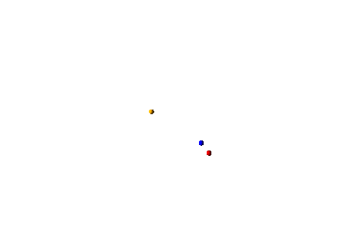
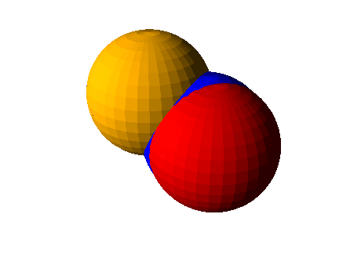
Satellite Location
Given 3 satellites …
We can locate our position on the intersection of 3 spheres
(2 points)

Slide 23
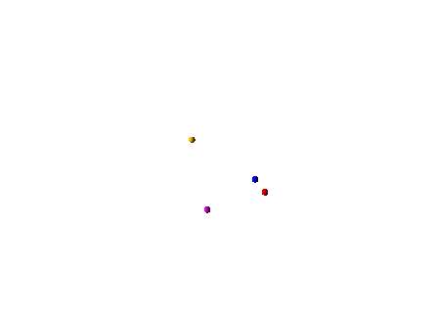
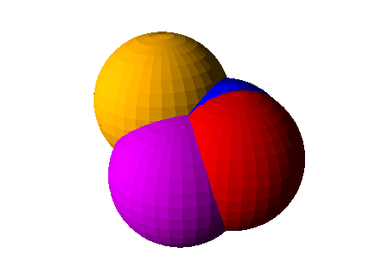
Satellite Location
Given 4 satellites …
We can locate our position on the intersection of 4 spheres
(1 pt)

Slide 24
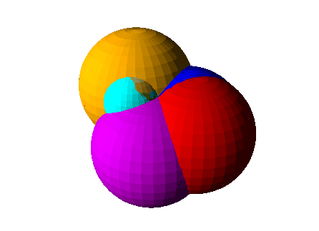
Satellite Location
The point can be located on the earth’s surface

Slide 25
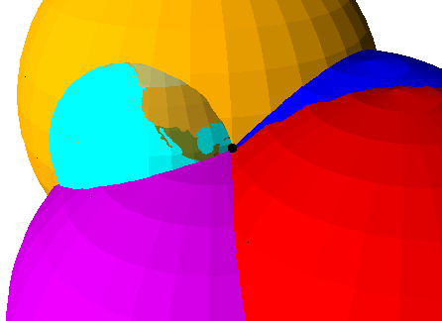
Satellite Location
The precise position is determined

Slide 26
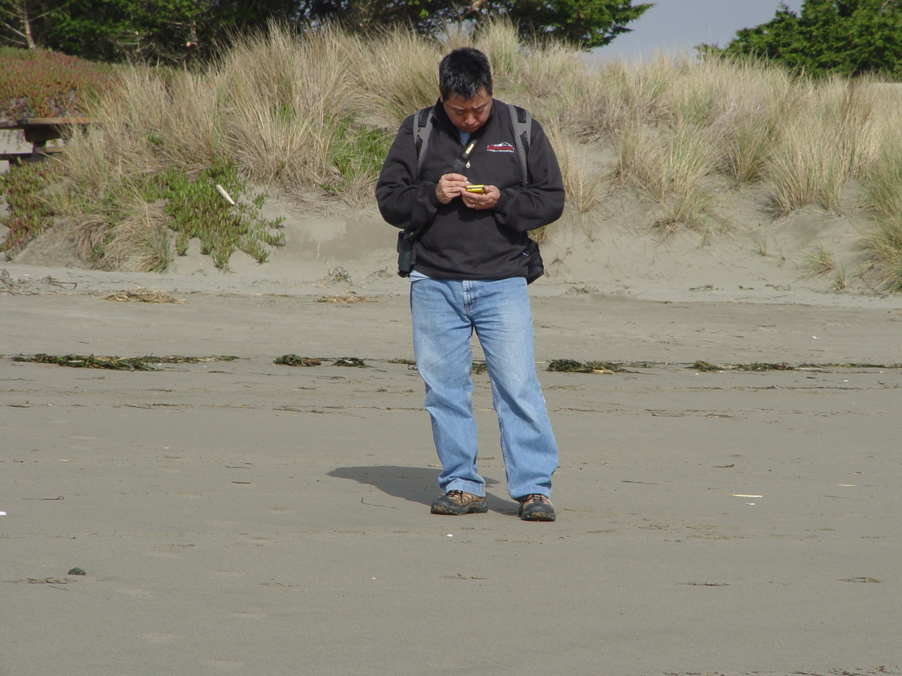
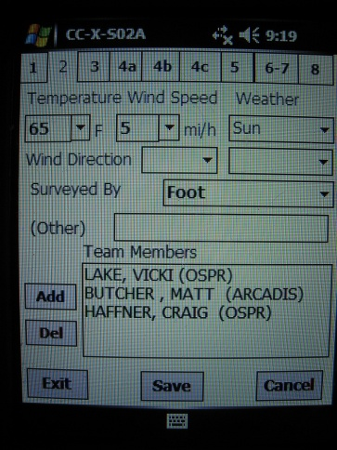
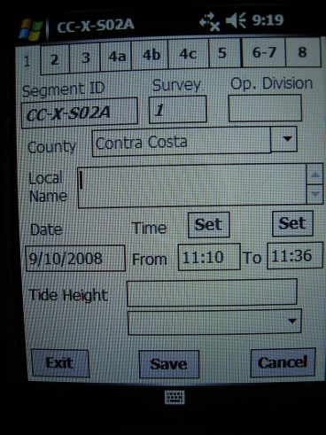
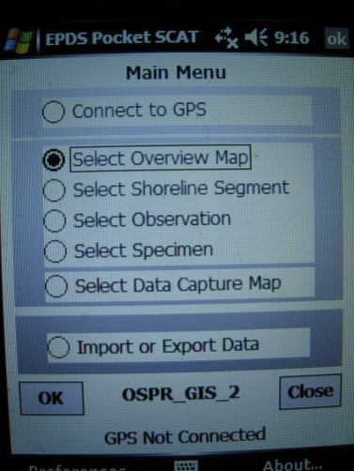
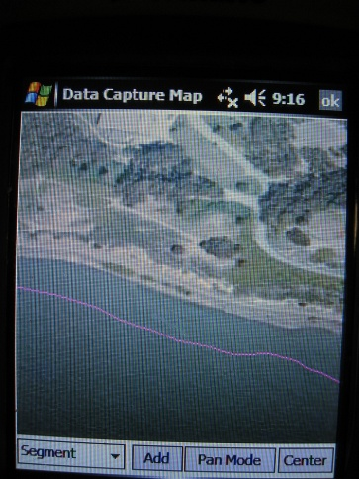
Electronic Field Data Capture
EPDS PocketSCAT

Slide 27
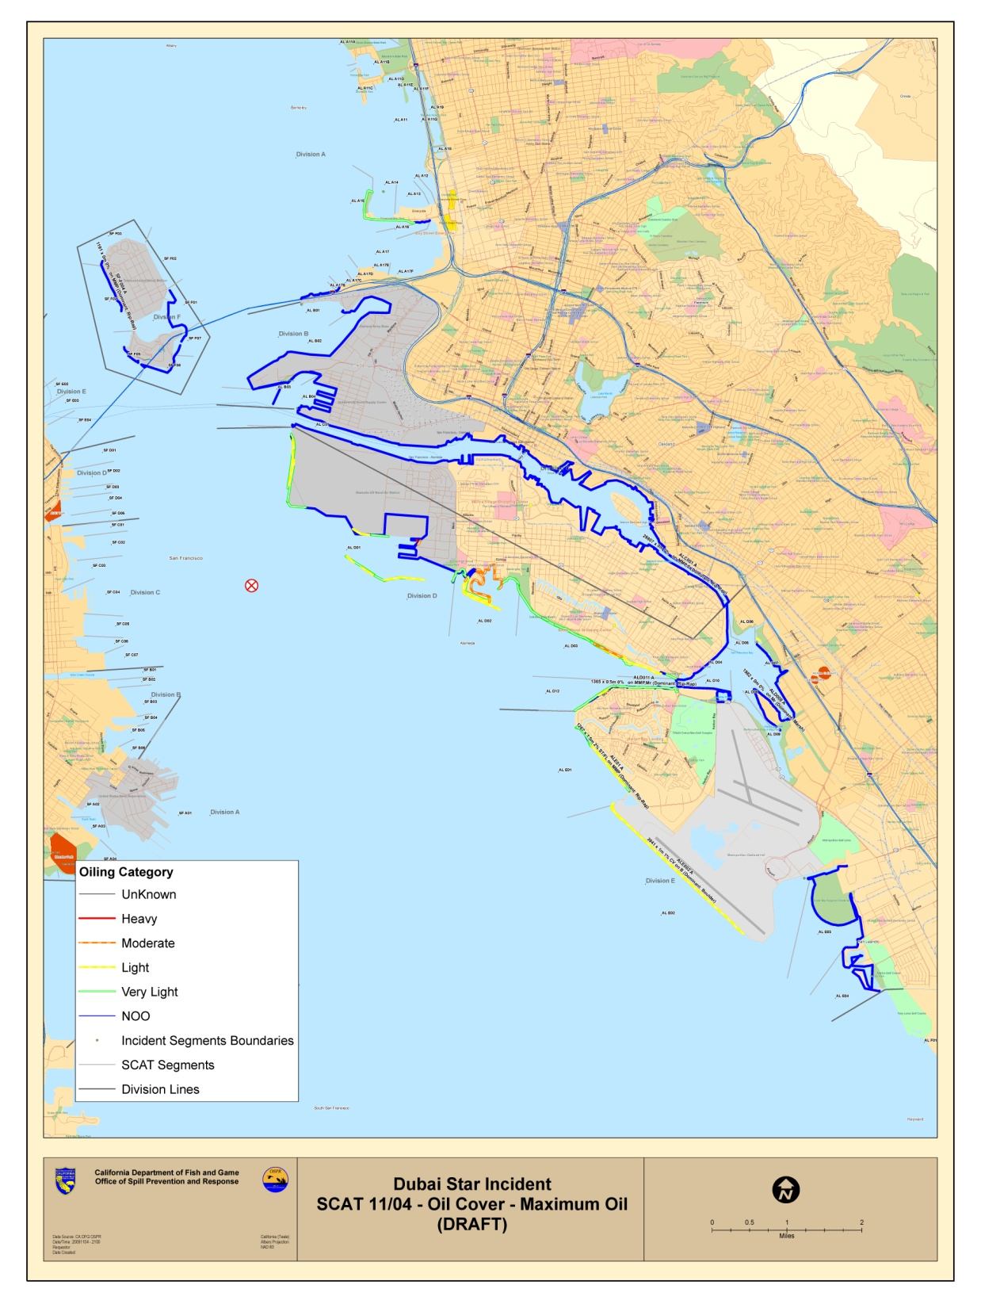
EPDS ShoreAssess
SCAT data can downloaded from the handheld computer in the field and transmitted to the ICP. ShoreAssess extension to ArcMap provides for SCAT data integration into the GIS

Slide 28
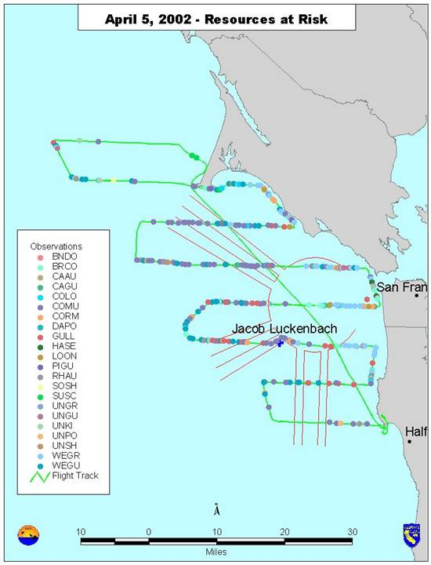
Resources
at Risk
Today all recon overflights are GPS based and include aircraft trackline with specific species sightings marked as GPS waypoints
Notes:
Track lines as well as individual observations recorded with GPS

Slide 29
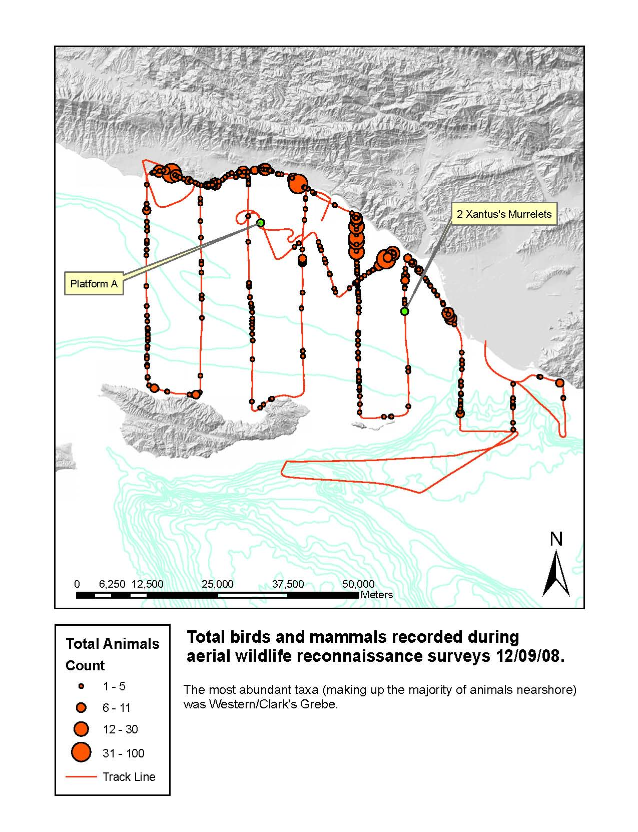
Resources
at Risk
Biological resources plotted in total numbers rather than by species.
Notes:
Track lines, observation waypoints and filled grid cells overlain on satellite image

Slide 30
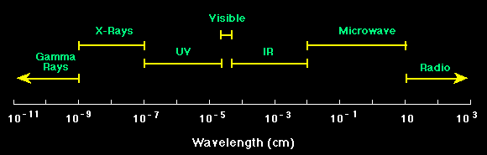
Remote Sensing Oil Spill Response
Remote sensing sensors used in oil spill response operate in the Ultra Violet through Visible (what the human eye sees), Infra red, Thermal Infra Red and microwave regions of the electromagnetic spectrum
The Electromagnetic Spectrum

Slide 31
Deepwater Horizon - Most Frequently Used Remote Sensing Systems
Satellite
  Synthetic Aperture Radar (SAR), Envisat, Radarsat Satellites –(microwave)
  MODIS Multispectral Sensor, NASA Terra and Aqua Satellites (UV – IR)
Airborne
  Side Looking Airborn Radar (SLAR), Transport Canada, Icelandic coast Guard (Microwave)
  Ocean Imaging Multispectral (Visible,Thermal IR)

Slide 32
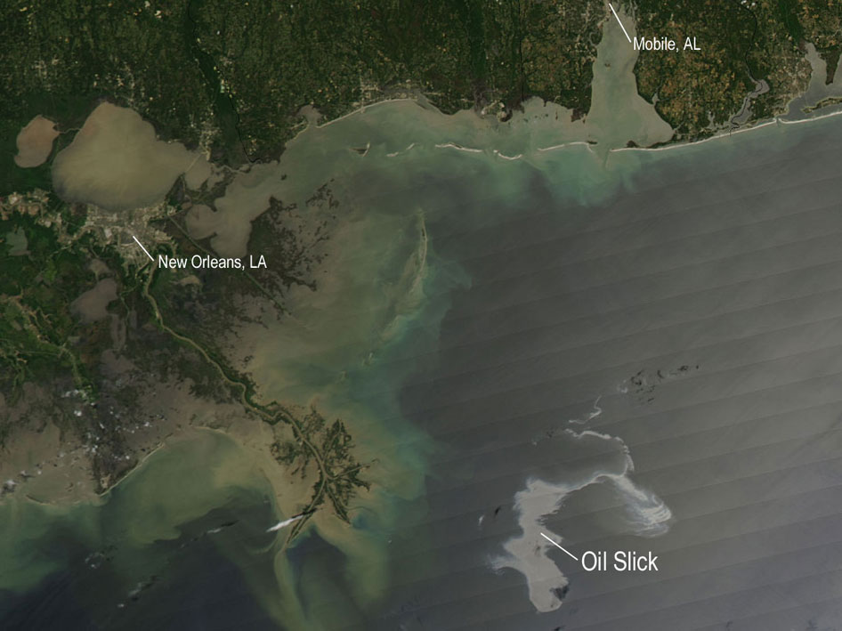
MODIS (Moderate Resolution Imaging Spectroradiometer)
Shows overall footprint of the slick but cannot distinguish thick oil from sheen
Needs daylight and cloud free sky
(Note heavy sediment load, upstream flooding helped keep the oil offshore)

Slide 33
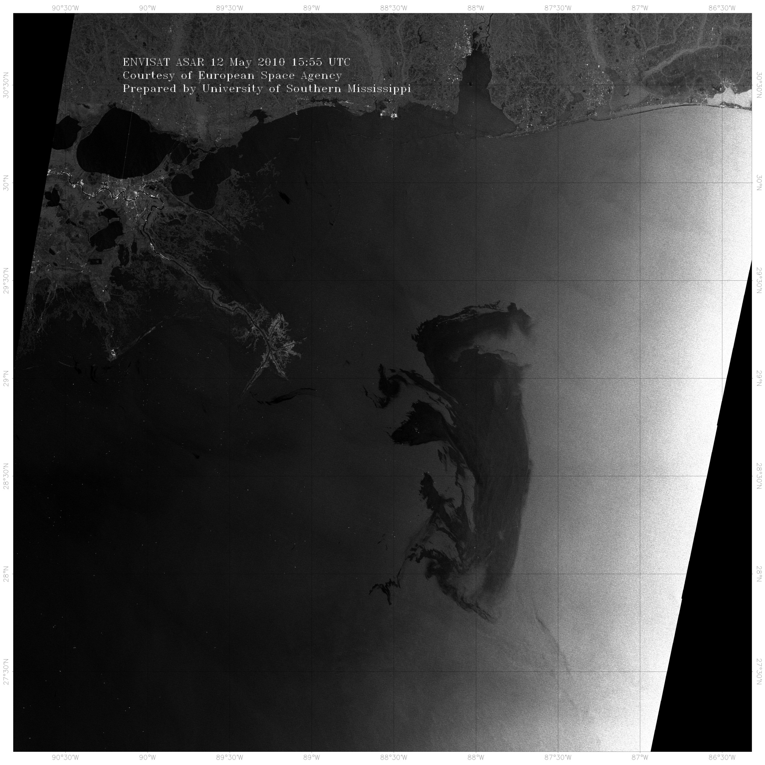

Slide 34
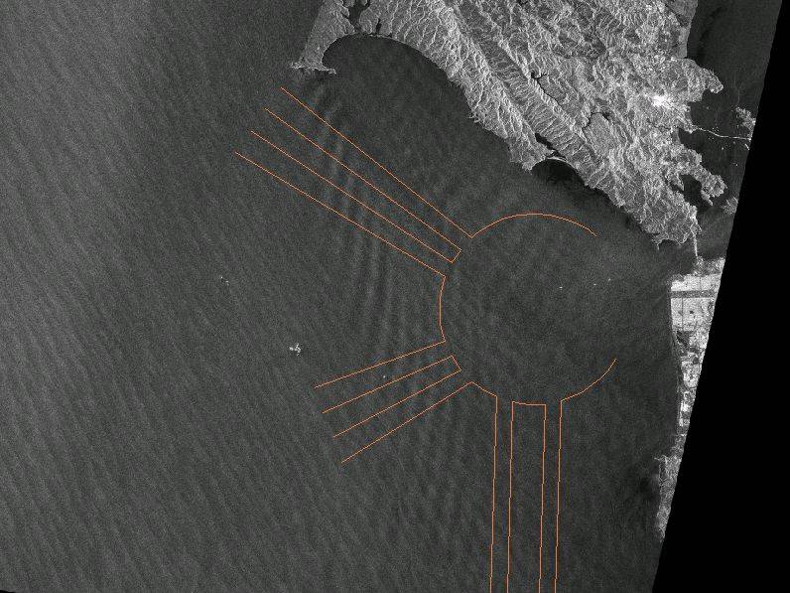
Satellite Imaging Radar
RADARSAT-1
Synthetic Aperture Radar
July 5, 2003 0605hrs
Pt. Reyes
Radar – provides own source on energy, can operate independent of daylight, “sees” through fog

Slide 35
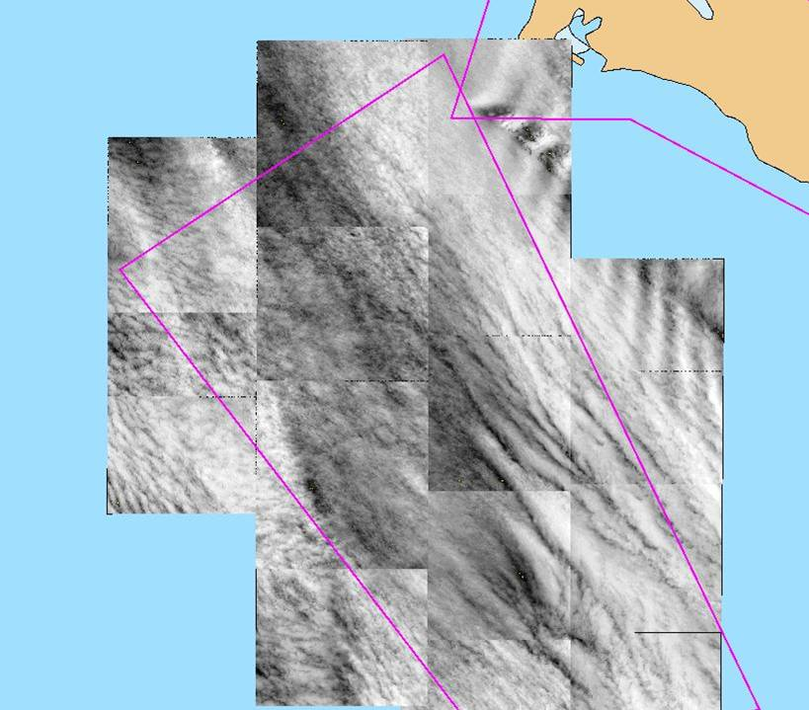
IKONOS (Optical Sensor, Measures reflected sunlight)
July 5, 2003 1103hrs
Pt. Reyes
Optical sensors measure reflected light, not useful in fog

Slide 36
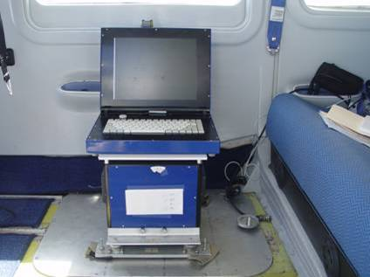
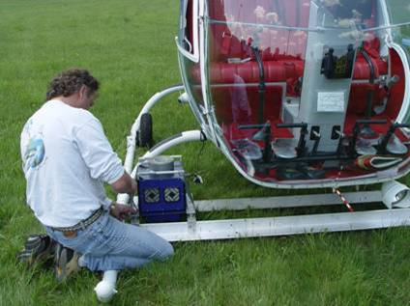
OSPR Airborne Remote Sensing Research
PROJECT OBJECTIVE: DEVELOP AN OPERATIONAL AERIAL IMAGING TECHNOLOGY THAT WOULD ENABLE REAL-TIME OIL SPILL MAPPING IN GIS FORMAT, ELIMINATE FALSE TARGETS, WITH AN EASILY DEPLOYABLE AND PORTABLE SENSOR
Ocean Imaging’s DMSC-MK2 Four Channel Aerial Sensor

Slide 37
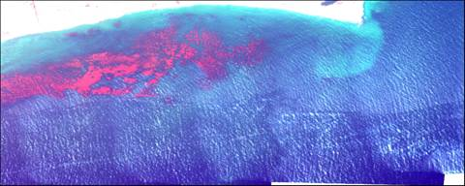
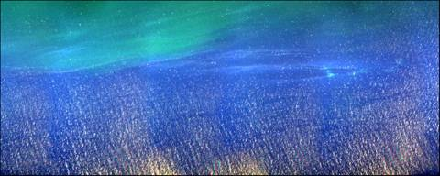

Examples of multispectral differentiation between oil slicks and potential false targets caused by kelp, suspended sediment and sun glint
Sediment
Kelp
Oil
Suspended Sediment
Oil
Oil
Sun Glint

Slide 38



Algorithm Validation and Refinement
Ohmsett Test Tank (The National Oil Spill Response Research & Renewable Energy Test Facility)

Slide 39



Slide 40


Slide 41

Deepwater Horizon (MC-252)
Ocean Imaging Sensor Data and Airborne SLAR
SLAR can image the entire oil slick footprint. The OI sensor package measures thickness variations within the slick thus depicting recoverable oil vs. non-recoverable sheen. The OI system has a much smaller imaging footprint so their mission was more strategic , specifically image the source (blownout wellhead) and the leading edge of the slick.

Slide 43

What is a Common Operational Picture?
Visual Display of Situational Awareness
Based in the Situation Unit
Sole Source of “Official” Response Situational Awareness

Slide 44
Environmental Response Management Application (ERMA)
Developed by NOAA (OR&R) and UNH
Specifically Designed as a Oil Spill Response Tool
California’s COP of Choice (Southwest ERMA)
Valuable Planning Tool
  OSPR Populated W/ACP Data Layers And
  Provided Input On Improving Application For Spill Responders
Provides Interactive Map Display Capabilities to Responders on local Desktop, Tablet…
Web Based, with No Proprietary Software Needed for Use
Several Credential Based Levels of Access

Slide 45

Southwest ERMA
Planning Tool and COP

Slide 46

Southwest ERMA
Planning Tool and COP

Slide 47

Must ERMA be the COP
NO
COP Determined Early in the Response by UC

Slide 48
How Many COPs can be Used for a Response
One - Authorized by UC as Official Display of Situational Awareness for the Response – One Source for Official Response Information
Many - Individual “In-House” Data Viewers for Local Display “In-House” Only
  A Signed Data Sharing Agreement Will Assure All Parties Have Same Data Sets.
DO NOT WANT COMPETING COPs in the ICP
  LEADS TO CONFUSION

Slide 49

Flow of Data From the Field/Data Management
Notes:
This figure diagrams the flow of information from the field through the Planning and Operations Sections to the Situation Unit. There the field data is verified, processed and digitally archived by the GIS Unit. The data/information is then posted to the COP for dissemination to responders and displayed in the ICP for situational awareness.

Slide 50

Questions?
Thank You
Judd Muskat
California Department of Fish and Game
Office of Spill Prevention and Response
jmuskat@ospr.dfg.ca.gov

