Slide 1
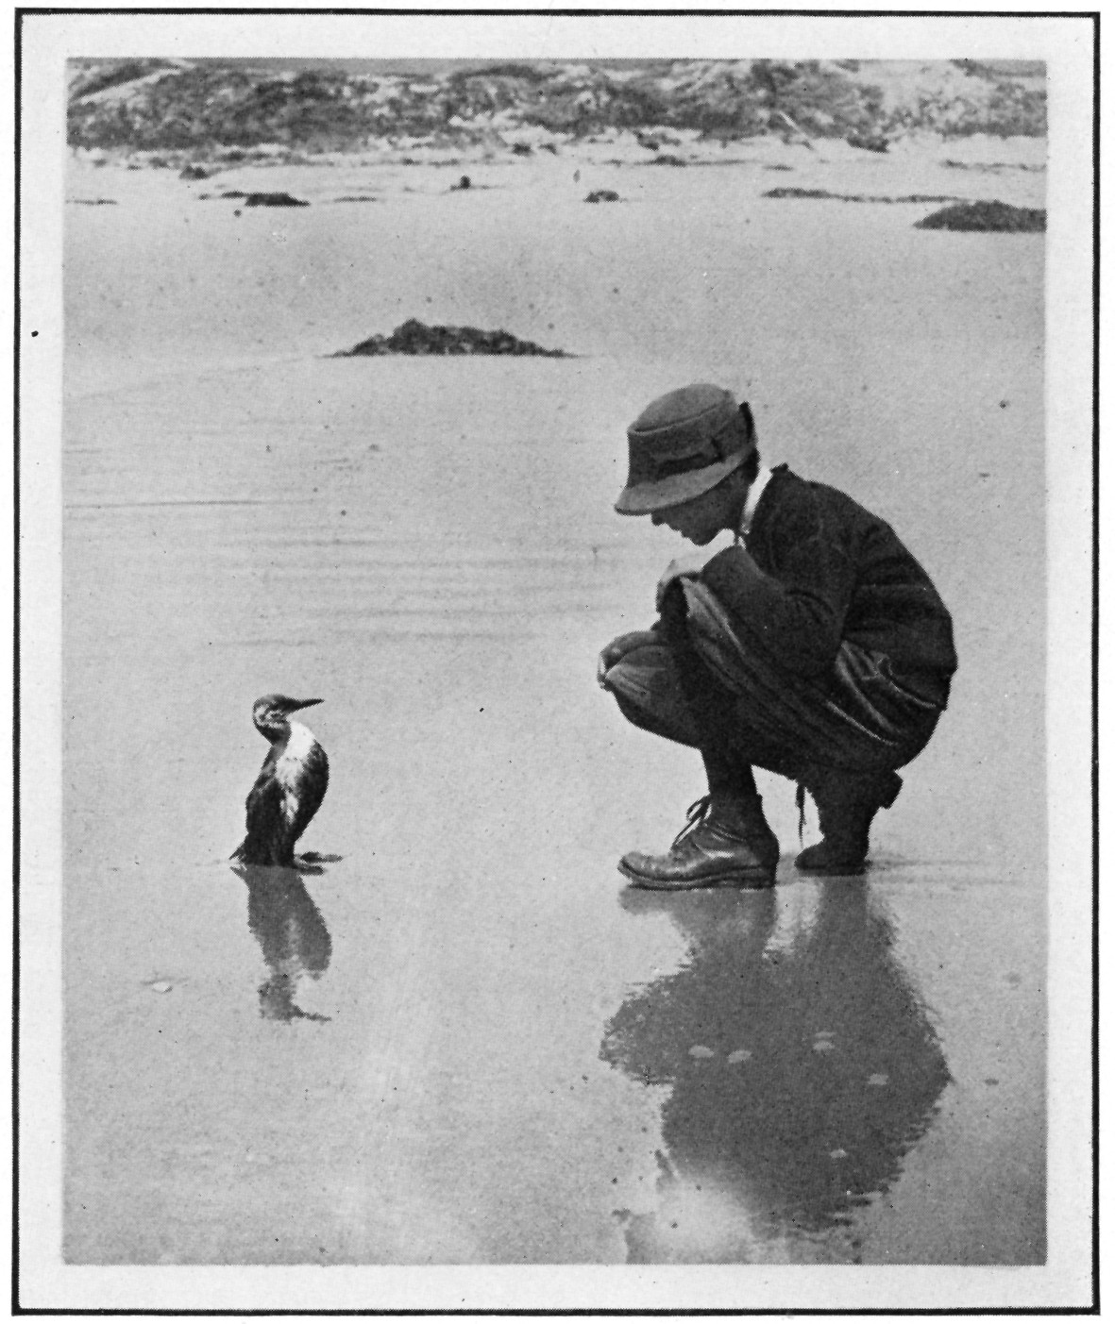
NRDA Training
EROS
Matt Zafonte,
Steve Hampton,
Kathy Verrue-Slater,
Bruce Joab
CDFW-OSPR
Santa Barbara, 1923

Slide 2
Goals
Not…
  How to respond to spills
Instead…
  How Natural Resource Damage Assessment (NRDA) translates spill injuries to restoration projects

Slide 3
Overview
What is Natural Resource Damage Assessment (NRDA)?
Methodology
“Large Spills”
“Small Spills”
Questions and Answers
Notes:
NOTE: MENTION THAT THIS IS CALIFORNIA’S TAKE ON THE NRDA PROCESS. THE METHODS ARE CONSISTENT WITH WHAT IS BEING DONE BY NOAA AT THE FEDERAL LEVEL, WE DO MANY SMALLER CASES AND OFTEN UTILIZE STATE LAW.

Slide 4
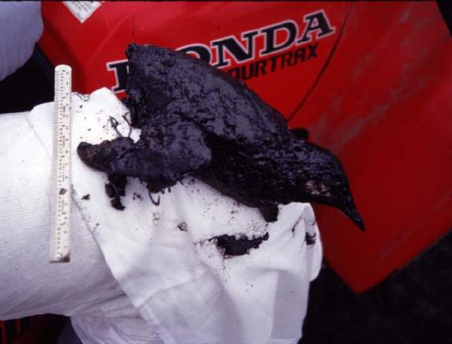
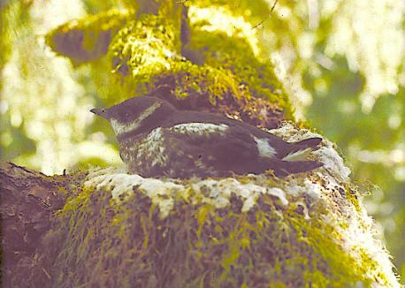
WHAT IS NRDA?
Level of Resource
Services
Primary Restoration
Initial
Level
(Baseline)
Injury
Compensatory
Restoration
Injury
(Recovery)
Project
Benefits
Time

Slide 5
DEFINITION:
Natural Resource Damages (n.):
Compensation for natural resource injuries
“Injuries” versus “Damages”
Damages based upon amount of restoration needed to “make the environment and public whole” (OPA 90 Rule, CERCLA)
Notes:
Despite the best intentions of Responsible Parties and the best efforts of the Unified Command, the release of oil to the environment can result in natural resource injuries…
Compensation = Civil Damages, Projects, Restitution (criminal proceeding)
OPA 90 = Oil Pollution Act of 1990
CERCLA = Comprehensive Environmental Response, Compensation, and Liability Act

Slide 6
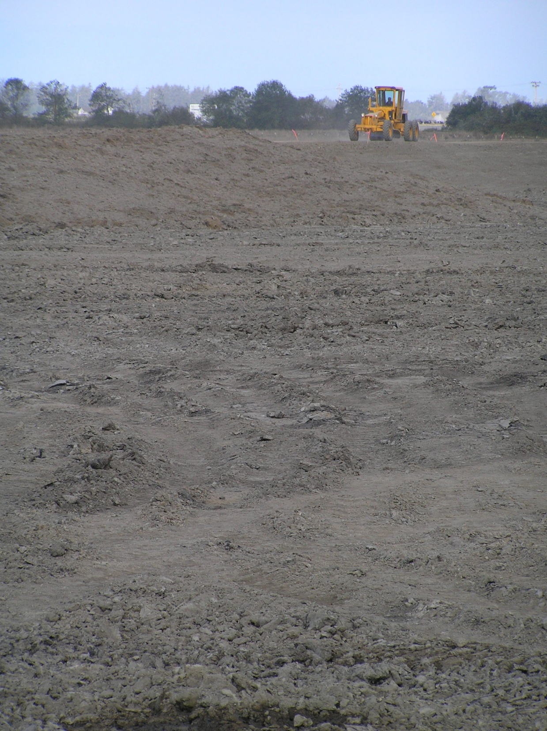
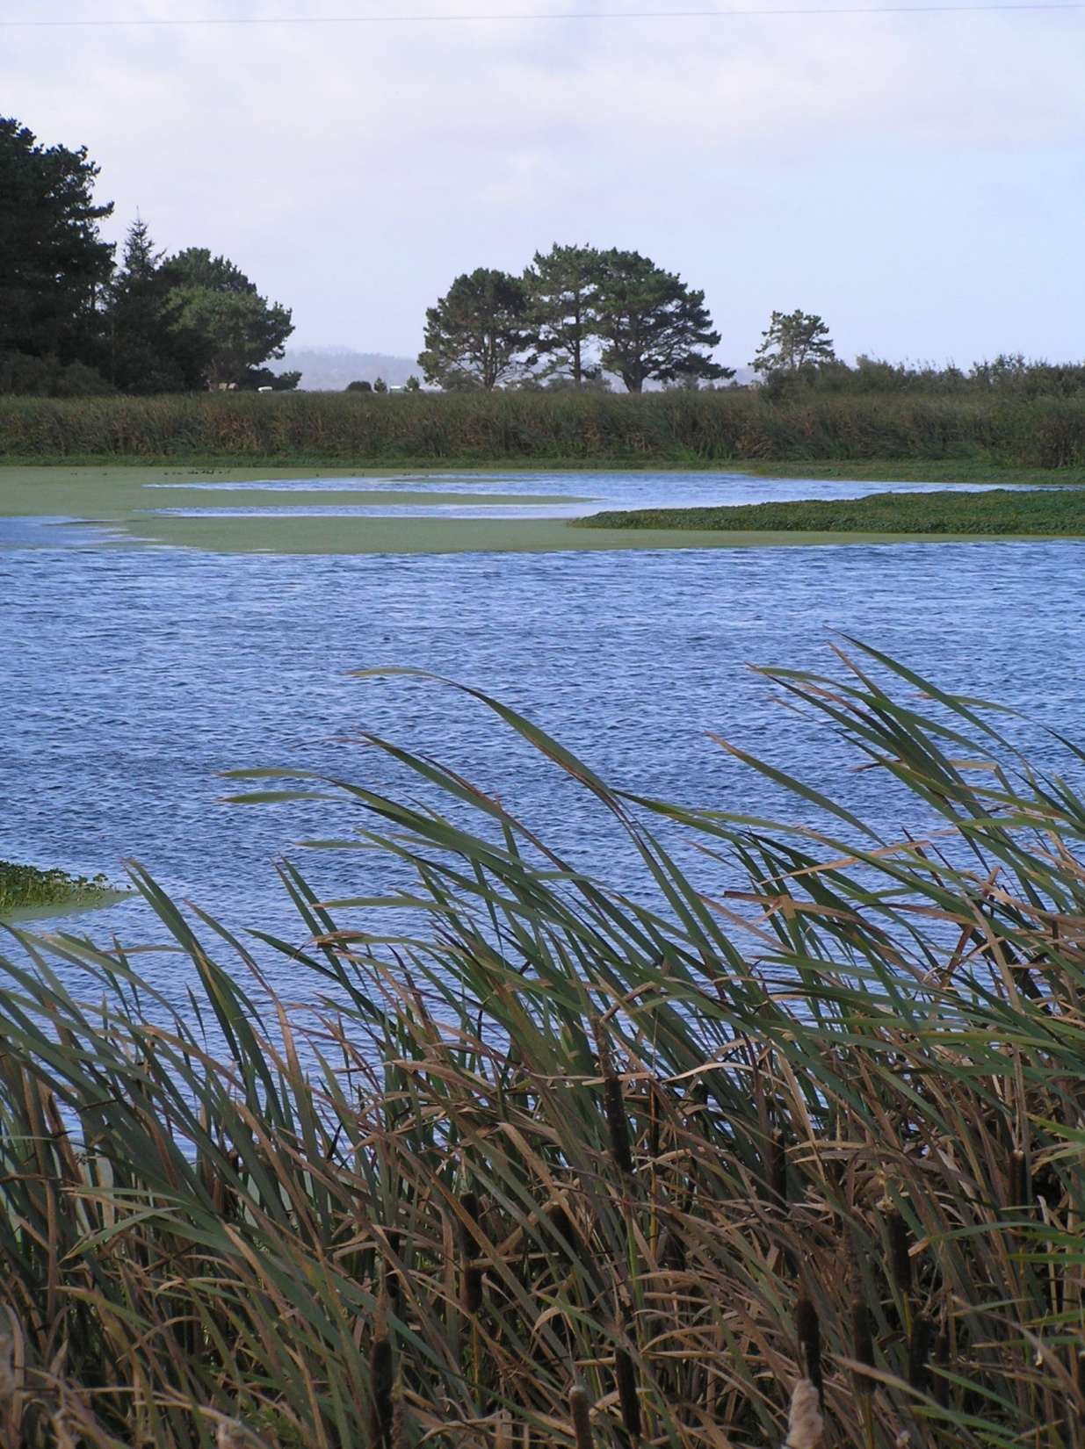
Restoration
Turning this…
… into this.

Slide 7
Potential Components of an Oil Spill Settlement
FINES, PENALTIES
COST RECOVERY
NATURAL RESOURCE DAMAGES
THIRD
PARTY
CLAIMS?
Notes:
Fines and Penalties
Punishment for criminal or negligent conduct (although some statutes are “strict liability”)
Ranges in fine/penalty size are typically determined in statute (at least for those penalties pursued by DFG)
Specific amount generally depends on conduct/behavior of the RP

Slide 8
Legal Foundations
Federal Law
  OPA 90 (oil spills)
  CERCLA (hazardous materials)
California Law
  Lempert-Keene-Seastrand (marine oil spills)
  Fish and Game Code (2014, 5650, 12016)
*Partial list of Relevant Laws
Notes:
As a trustee for fish and wildlife resources for the state, DFG has the responsibility to collect damages where feasible. There is authority to collect damages under the following laws.
OPA 90 = Oil Pollution Act of 1990. Strict liability for damages. Exclusion for Public Vessels, Permitted releases, or spills from an offshore facility subject to TAPA “Trans-Alaska Pipeline Authorization Act”. Liability arises when any volume of oil is discharged into navigable waters or adjoining shorelines. Limitations on liability for vessels based on gross tonnage. NPFC – Available to pay for assessment costs and reimburse damages. NRDA regs prepared by NOAA – Restoration focused
CERCLA = Comprehensive Environmental Response, Compensation, and Liability Act. Superfund law. Strict liability for damages. RPs include persons responsible for contamination and current owners and operators of contaminated sites. Trustees may seek damages for lost use back to 1980.
Lempert-Keene-Seastrand = Lempert-Keene-Seastrand Oil Spill Prevention and Response Act (created OSPR, is in the Government Code). Strict Liability for Damages. No limitations on liability. No Public Vessel exclusion. Defenses are similar to OPA – Act of God, Act of War, Third Party responsible for the spill. Spill is defined as 42 gallons or 1 barrel in marine water.
FG 2014 = DFG can get damages for illegal or negligent Take of fish or wildlife. Requires demonstrating illegal activity (i.e., 5650 violation), or negligent action. Measure of damages is the amount that will compensate for the detriment proximately caused by the destruction of fish and wildlife. Detriment Proximately caused is basically what kinds of harm are a forseable result.
FG 5650 = Strict liability statute for petroleum product or any release of deleterious to fish, plant life, or bird life. Violation establishes unlawful activity for purposes of FG 2014
FG 12016 = DFG can get damages for injury to fish, wildlife and habitat from any person who discharges or deposits any substance or material into waters of the state or in a location that threatens waters of the state. So the harmful substance doesn’t actually have to be deposited into waters of the state. Don’t need evidence of Take (i.e., “dead bodies”).
Not on this slide: Harbors and Navigation Code 151 = Damages of intentional/negligent deposit of oil in State waters. Not limited to navigable waters. Used in American Trader case, a pre-OPA, pre-Lempert-Keene spill. Liability is to any agency responsible for cleaning-up and abating the oil discharge.

Slide 9
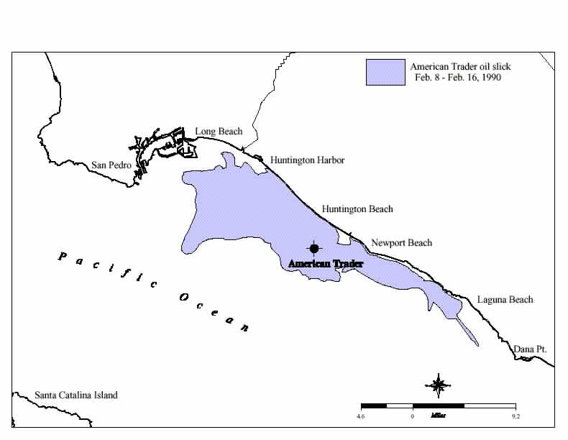
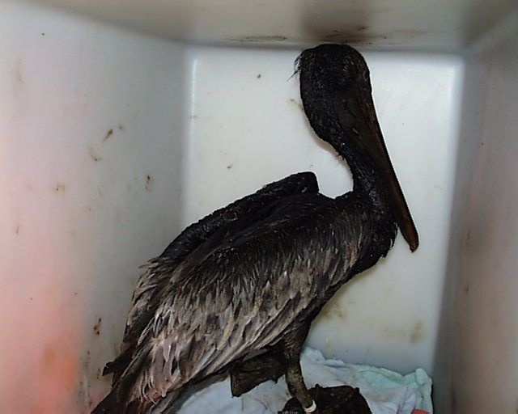
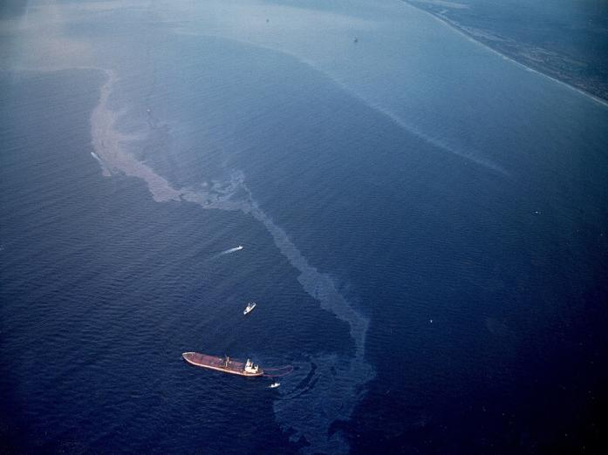
American Trader/Orange County
Notes:
9
NRDA is probably best known in association with major oil spills and impacts to oiled wildlife. The American Trader spill occurred in Southern California in 1990 and was the impetus for the creation of OSPR.

Slide 10
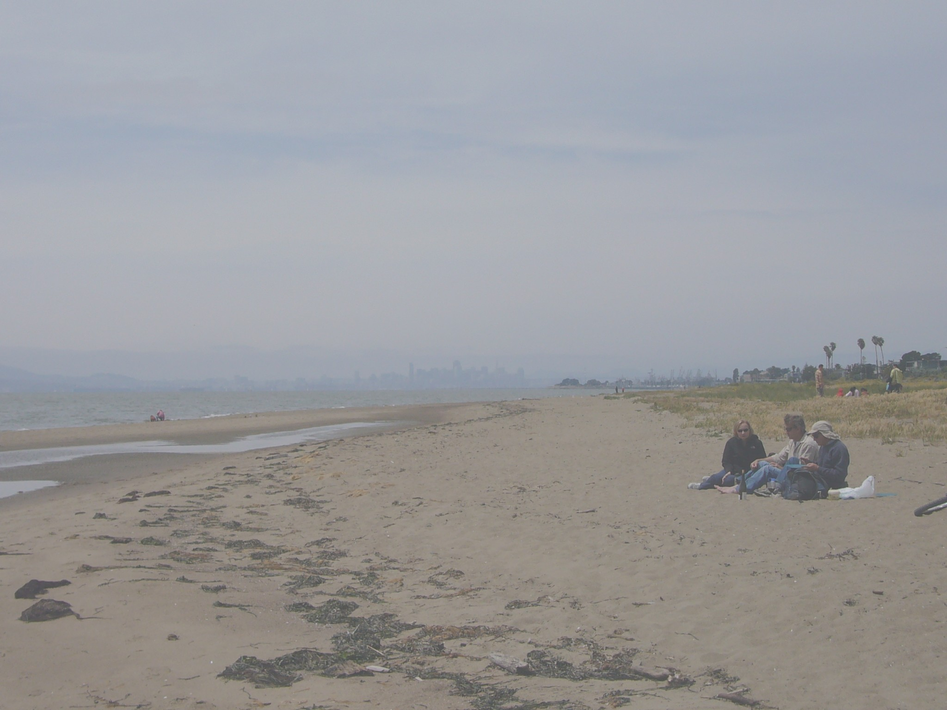
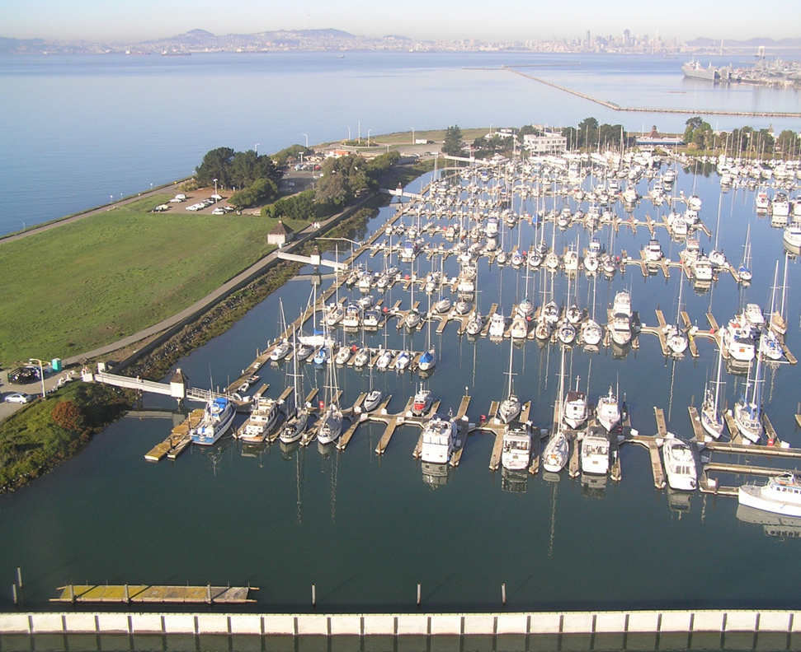
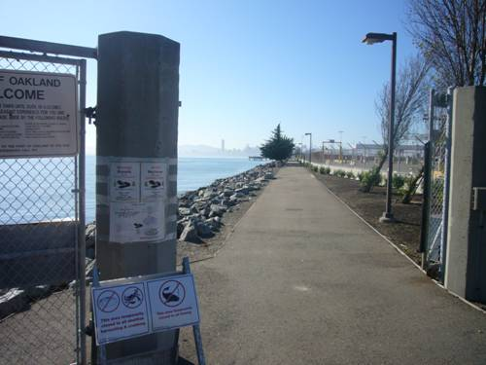
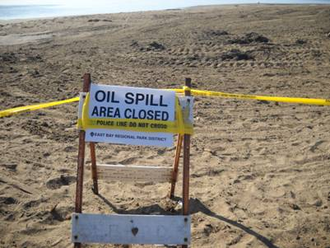
Dubai Star and Cosco Busan
(San Francisco Bay)
Notes:
However, in major oil spills, populated beaches can be closed, sport fishing can be temporarily banned, and people may generally stay off the water. In these situations, lost recreation values can be significant portions of our claims

Slide 11
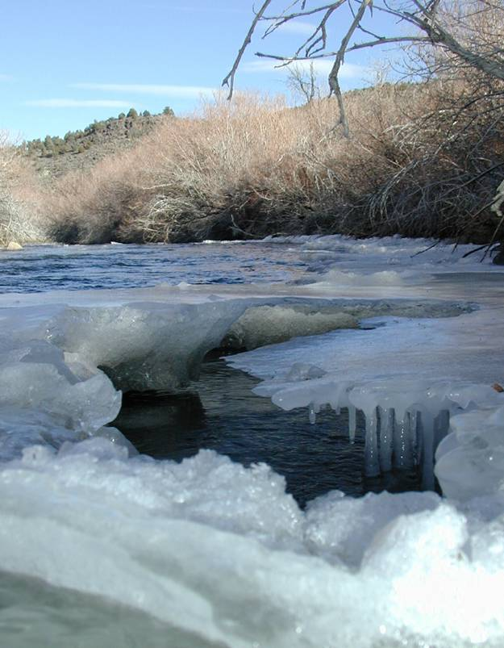
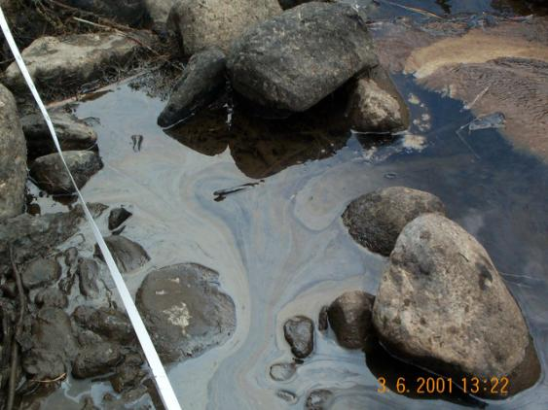
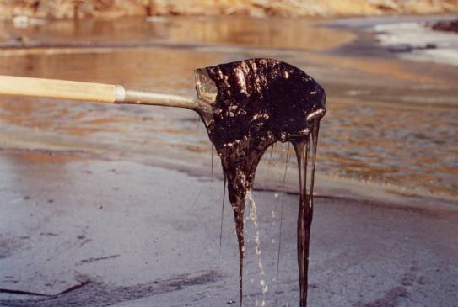
East Walker River
(Eastern Sierra Nevada Mtns)
Notes:
11
Not every oil spill case is a marine case. We’ve worked on NRDA all over the state. East Walker River, for example, was in the eastern sierras, and impacts even crossed into the state of Nevada.

Slide 12
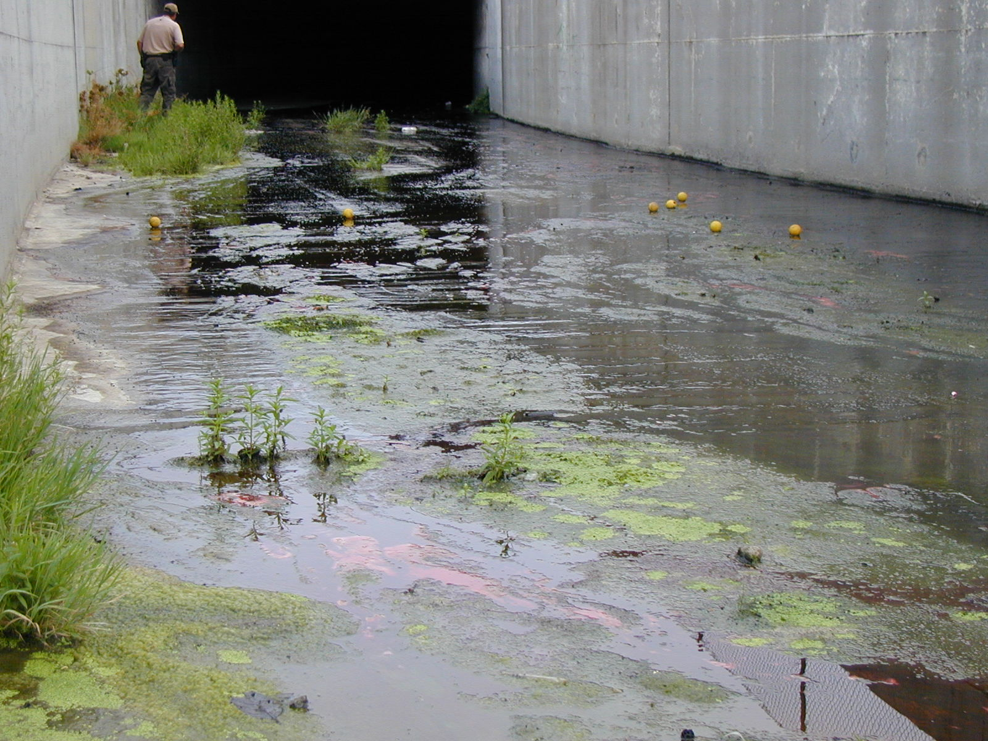
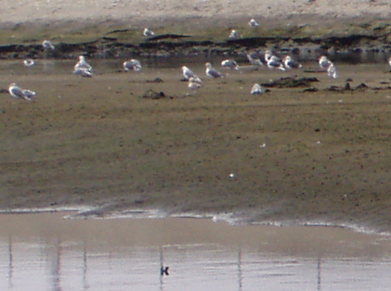
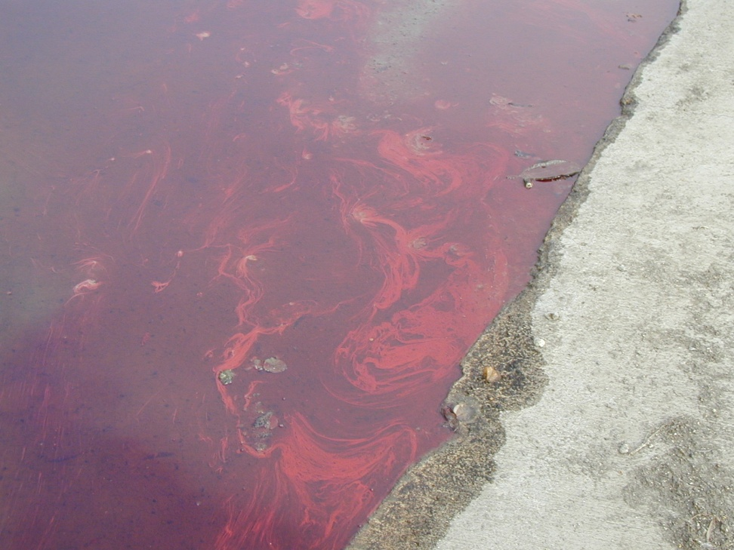
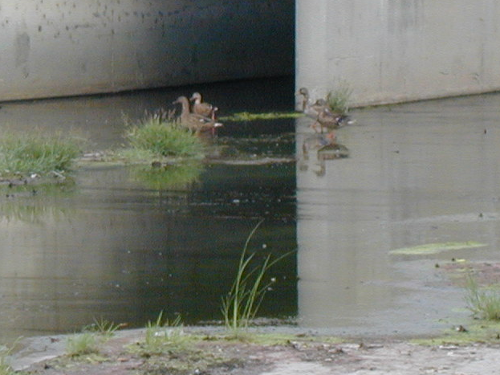
CENTINELA CREEK
(Los Angeles County)
Original Photo: Corey Kong
Original Photo: Walter Nordhausen
Photo: Walter Nordhausen
Original Photo: Walter Nordhausen
Notes:
Not all our cases are in “pristine habitat”. We’ve had cases in concrete lined streams in LA County. While not pretty, this habitat can be extremely valuable because it is some of the last available urban habitat for local wildlife species.

Slide 13
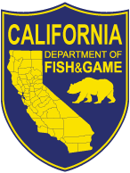
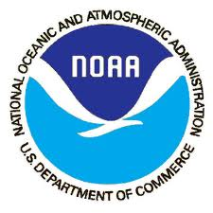


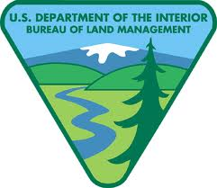


Trustees in California
Most Active
  DFG
  NOAA
  USFWS
Others
  NPS
  BLM
  State Parks
  State Lands
  DoD
  Tribes
Notes:
Define “Trustee”: An agency responsible for protecting or managing a resource for the people of the state or the nation as whole.

Slide 14
The NRDA Process
SPILL
DATA COLLECTION
INJURY
QUANTIFICATION
NEXUS
RESTORATION
SCALING/DAMAGE
QUANTIFICATION
SETTLEMENT
RESTORATION
Notes:
Injury Quantification = Quantification + Determination
After “Restoration Scaling/Damage Quantification”, it is worthwhile noting that the OPA Rule/Federal process contemplates Selecting Restoration Alternatives and Developing a Restoration Plan which goes out to public review. Then you present a demand to the RP. And if the RP does not agree to the demand in 90 days, the Trustees may file a claim with the fund center or file suit. Of course, we can settle at any time and we usually do prior to developing a Restoration Plan.

Slide 15
NRDA Myths?
Trustees are only interested in “cash out” settlements
Settlement money is used to fund the Trustee's own office or to fill coffers during budget shortfalls
Natural resource damages is usually much more than response costs
NRDA is a black box of smoke and mirrors and there is no standard method for calculating damages

Slide 16
Points to Remember
Natural Resource Damages are only one piece of an oil settlement
“Damages” is a legal term
NRDA can apply to a broad range of cases and resources
Goal is restoration

Slide 17
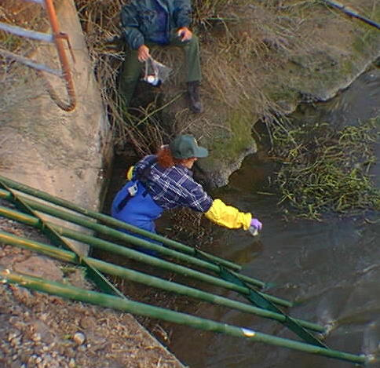
Natural Resource Damage Assessment: Methodology
Level of Resource
Services
Initial
Level
Injury
Project
Benefits
Time

Slide 18
Methodology
SPILL
DATA COLLECTION
INJURY
QUANTIFICATION
RESTORATION
SCALING/DAMAGE
QUANTIFICATION
SETTLEMENT
RESTORATION

Slide 19
Data Collection and Injury Determination
Central Questions
  What was injured?
  How much? (# animals, # of acres)
  How badly?
  For how long?
SPILL
SPILL
DATA COLLECTION
DATA COLLECTION
INJURY
QUANTIFICATION
INJURY
QUANTIFICATION
RESTORATION
SCALING/DAMAGE
QUANTIFICATION
RESTORATION
SCALING/DAMAGE
QUANTIFICATION
SETTLEMENT
SETTLEMENT
RESTORATION
RESTORATION

Slide 20
Data Collection and Injury Determination
Data Collection During the Spill
  Response Data (e.g., SCAT, wildlife intake)
  Investigation Reports
  NRDA Sampling, Surveys, Documentation
SPILL
DATA COLLECTION
INJURY
QUANTIFICATION
RESTORATION
SCALING/DAMAGE
QUANTIFICATION
SETTLEMENT
RESTORATION

Slide 21
Data Collection and Injury Determination
Later activities: “Putting it all together”
  Modeling
  Subsequent studies
SPILL
DATA COLLECTION
INJURY
QUANTIFICATION
RESTORATION
SCALING/DAMAGE
QUANTIFICATION
SETTLEMENT
RESTORATION

Slide 22
Restoration Scaling/Damage Quantification
How do we translate injury quantification to public compensation?
SPILL
DATA COLLECTION
INJURY
QUANTIFICATION
RESTORATION
SCALING/DAMAGE
QUANTIFICATION
SETTLEMENT
RESTORATION

Slide 23
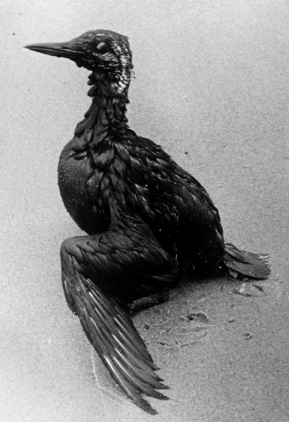
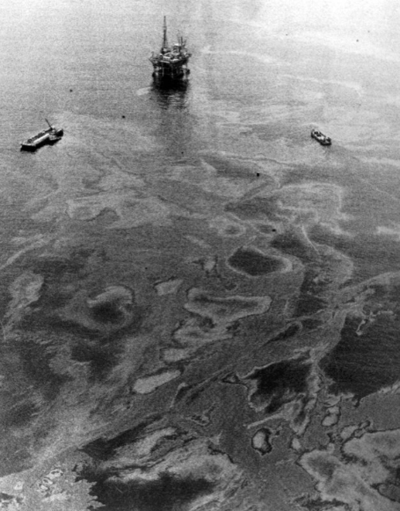
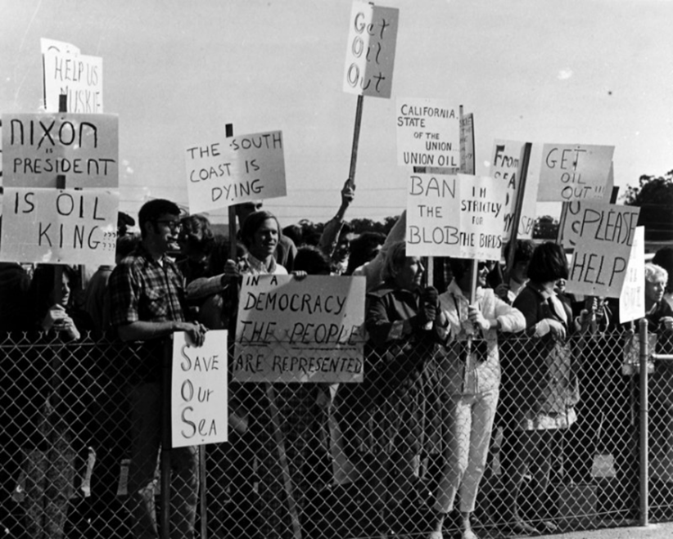
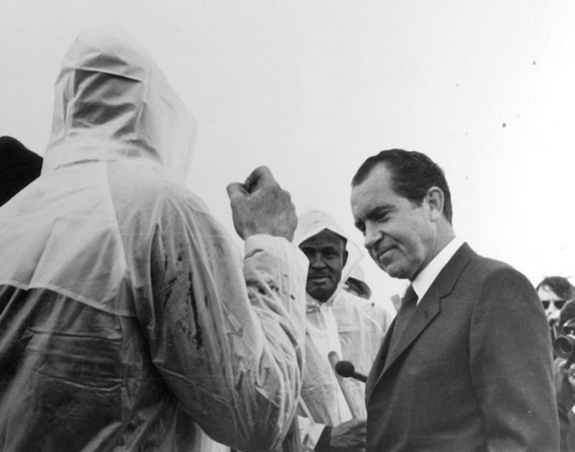
Santa Barbara Oil Spill, 1969
Blowout at Union Oil’s Platform A
Significant wildlife impacts
Public and political interest
Photos: Dick Smith collection, UCSB
Notes:
Initial “gusher” lasted for 12 days, spilling 50-70k barrels (or 2-3 million gallons). [Source: Kallman and Wheeler. 1984. Coastal Crude: in a Sea of Conflict. Blake Printery and Publishing Co. San Louis Obispo, CA.
Pictures from the Dick Smith collection, UCSB (1969-1971), see link at: http://www2.bren.ucsb.edu/~dhardy/1969_Santa_Barbara_Oil_Spill/Photos/Pages/Wildlife.html

Slide 24
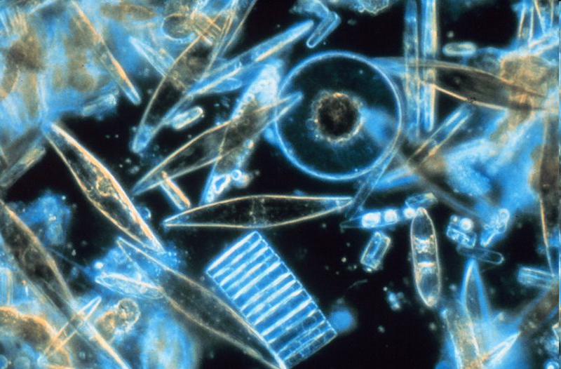
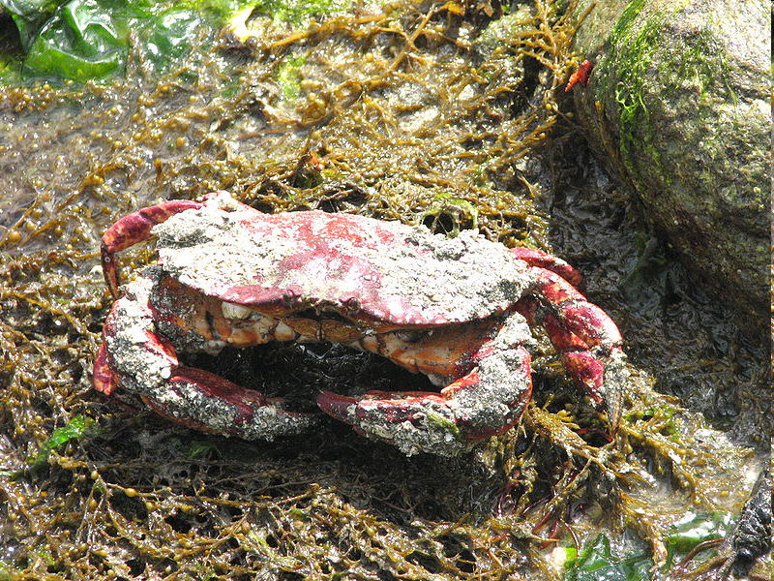
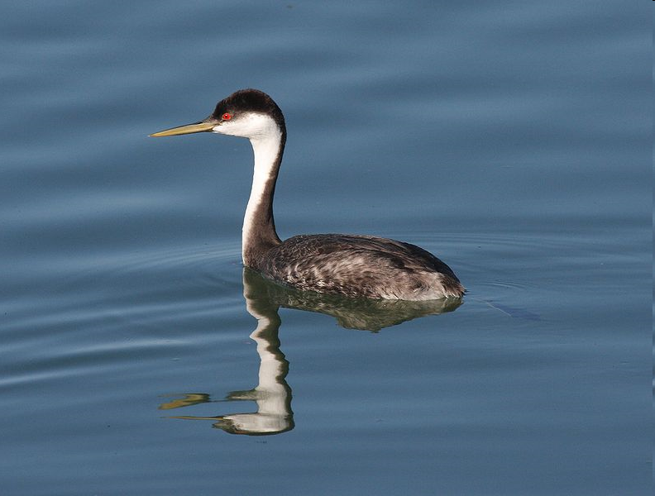
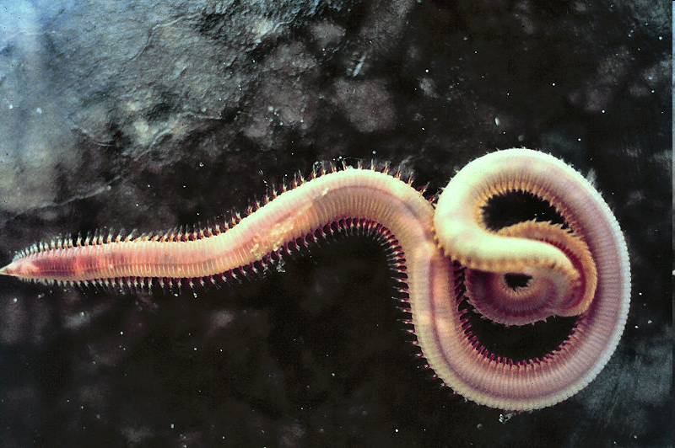
Price List for Santa Barbara Spill, 1969
Grebe
($17.56/each)
Red Rock Crab
($0.75/each)
Bloodworm
($0.25/each)
Phytoplankton
($50.00 per liter)
List of over 850 values for individual species!
NOT HOW NRDA IS DONE TODAY!
Notes:
PICTURES FROM:
Bloodworm: http://en.wikipedia.org/wiki/File:Nerr0328.jpg#file
Western Grebe: http://en.wikipedia.org/wiki/File:Western_Grebe_swimming.jpg
Phytoplankton: http://en.wikipedia.org/wiki/File:Diatoms_through_the_microscope.jpg
Red Rock Crab: http://en.wikipedia.org/wiki/File:Red_Rock_Crab,_Ganges_Harbour.jpg
DATA SOURCE: Submitted statement by Attorney General Edwin J. Dubiel to Senator Muskie’s Subcommittee on Oil Spill Litigation, San Francisco, June 29, 1979 (Exhibit 1)
HAZARDOUS AND TOXIC WASTE DISPOSAL FIELD HEARINGS
JOINT HEARINGS BEFORE THE SUBCOMMITTEES ON ENVIKONMENTAL POLLUTION AND RESOURCE PROTECTION OF THE
COMMITTEE ON ENVIRONMENT AND PUBLIC WORKS UNITED STATES SENATE NINETY-SIXTH CONGRESS FIRST SESSION
MAY 18, 1979— NIAGARA FALLS, N.Y.
JUNE 29, 1979— SAN FRANCISCO, CALIF.
PART 2
SERIAL NO. 96-H9
Also see: http://www.archive.org/stream/hazardoustoxicwa02unit/hazardoustoxicwa02unit_djvu.txt

Slide 25
Restoration Scaling/Damage Quantification
Acre-Years of
Loss Due to Spill
=
Acre-Years Gained
from Restoration Project
Level of Resource
Services
SPILL
Spill
Primary Restoration
Initial
Level
(Baseline)
DATA COLLECTION
INJURY
QUANTIFICATION
Injury
Compensatory
Restoration
Injury
RESTORATION
SCALING/DAMAGE
QUANTIFICATION
(Recovery)
Project
Benefits
SETTLEMENT
RESTORATION
Time
Notes:
Discuss of degree, duration, and area of injury with this slide. Make sure to discuss equivalence of red and green areas.

Slide 26
Damage Quantification for
Human Uses
Human Use Losses
  Beach Activities
  Fishing
  Wildlife Viewing
  Tribal Uses
Damages for Use Losses
  Value of Lost User-Days
  Value of Diminished User- Days
SPILL
DATA COLLECTION
INJURY
QUANTIFICATION
RESTORATION
SCALING/DAMAGE
QUANTIFICATION
SETTLEMENT
RESTORATION

Slide 27
Methodology: Summary
There is a standardized methodology for calculating “damages”
Often uses information gathered during response and investigation, but…
Often requires additional information
  What was injured?
  How much? (# animals, # of acres)
  How badly?
  For how long?

Slide 28
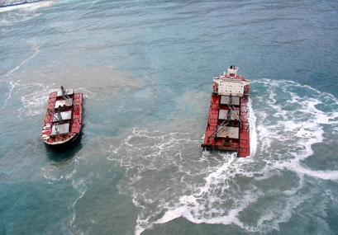
“Large Spills”

Slide 29
Characteristics of a “Large Spill”
Multiple Trustees (e.g. USFWS, NOAA, NPS, State Parks, State Lands, tribes)
Cooperative Assessment with RP
NRDA staff from multiple agencies are present during spill response

Slide 30
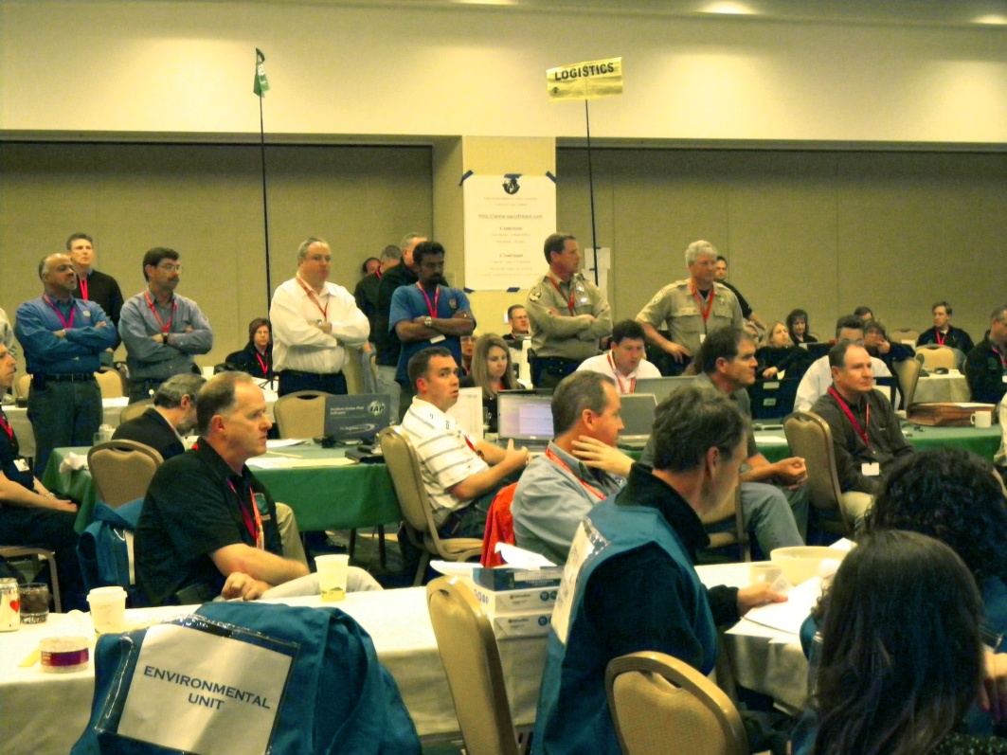
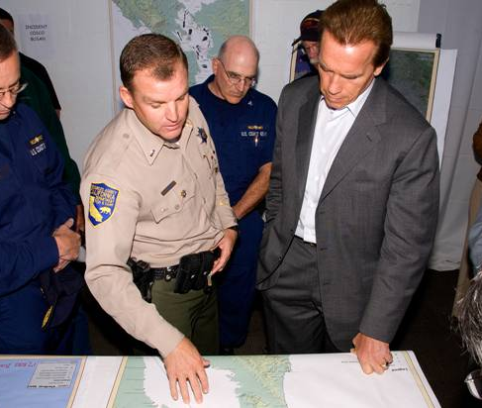
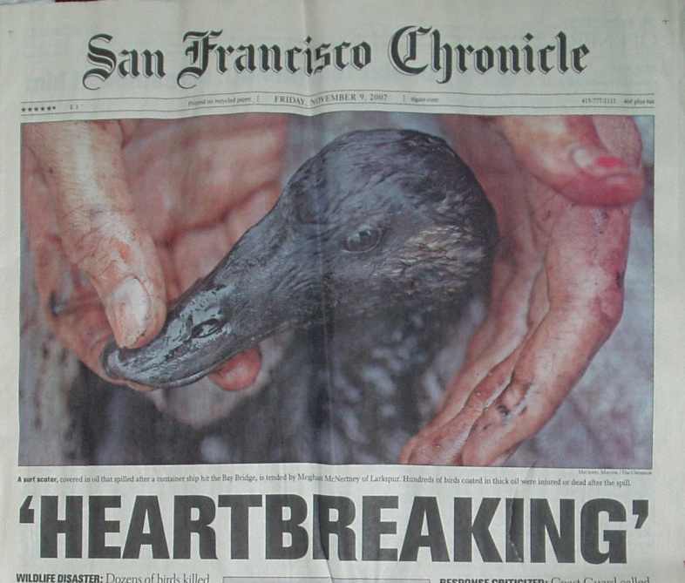
Large Spill Response
Hundreds to thousands of responders
Complicated spill organization
Dedicated NRDA staff activated for spill
Intense public interest

Slide 31
UNIFIED COMMAND
Liaison Officer
Investigations
Safety Officer
Agency
Representatives
Information Officer
NRDA
Representative
OPERATIONS SECTION
PLANNING SECTION
FINANCE/ADMIN SECTION
LOGISTICS SECTION
NRDA
Organization
Staging Area
Situation
Unit
Support Branch
Time Cost
Unit
Recovery and Protection Branch
Emergency Response Branch
Air Operations Branch
Wildlife Branch
Resources
Unit
Service
Branch
Time
Unit
Fed and State
Trustees; RP
Documentation Unit
Procurement Unit
Recovery and Transportation
Demobilization Unit
Compensation/Claims Unit
Wildlife Impacts
Habitat Impacts
Human Use Impacts
Sampling
Coordination with
Trustee Legal and
RP
Care and Processing
Wildlife Recon
Environmental Unit
Widlife Hazing
Scientific Support Coordinator
Sampling
Specialist
Response Technologies Spec.
Trajectory Analysis Specialist
Weather Forecast Specialist
Resources-at-Risk Specialist
Shoreline Cleanup Assessment Spec.
Historical/Cultural Resources Spec.
Disposal
Specialist

Slide 32
NRDA Coordination After Response
NRDA tasks done cooperatively among trustees and possibly RP
NRD settlement coordinated with fines and penalties from multiple agencies for a global settlement
NRD settlement is restoration project-based (maybe be “cash-out” or RP-implemented projects)
Notes:
Under the NOAA NRDA Rules, the Trustees are required to invite the RP to engage in a cooperative assessment.

Slide 33
Trustee Councils
Oversee restoration from large spill settlements
One lead representative from each trustee agency
Consensus decision-making
Restoration Plan with public comment

Slide 34
Large Spill Example:
M/V Stuyvesant
Marine spill in and around Humboldt Bay in 1999
Dredging Vessel
While only ~2000 gallons of bunker fuel released…
  1,251 birds collected dead and dying (including several threatened and endangered species)
  Beach searches spanned 20 days and covered 100 miles of coastline
  Local, State, and Federal agencies responded
  Public outcry

Slide 35
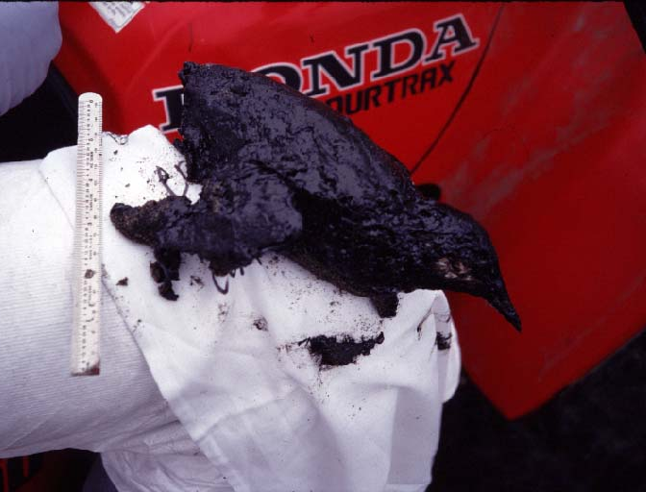
MARBLED MURRELETS
– ESTIMATED 135 KILLED

Slide 36
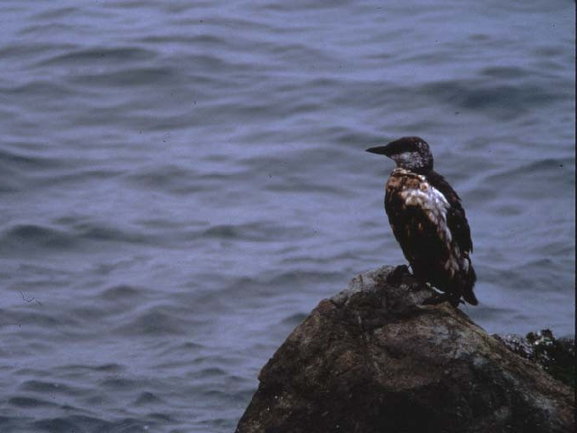
COMMON MURRES
– ESTIMATED 1,600 KILLED

Slide 37
Stuyvesant NRDA
Trustee Agencies worked with the RP in a cooperative assessment
Consent Decree signed in 2006

Slide 38
Stuyvesant Draft Restoration Plan
Injury Categories
1. Grebes and Loons
2. Pelicans, Cormorants,
and Gulls
3. Rocky Seabirds
4. Marbled Murrelets
5. Wetland Birds
6. Water Column
7. Rocky Intertidal Habitat
8. Sandy Beach Habitat
9. Human Recreational Use
Restoration Categories
1. Grebe/Loon Nesting Habitat
Projects
2. Cormorant/Pelican
Nesting/Roosting Projects
3. Rocky Seabird Projects
4. Marbled Murrelet Projects
5. Wetlands Projects
6. Dune Restoration/Snowy
Plover Projects
7. Human Recreational Use
Projects

Slide 39
Restoration Project Examples
Devil’s Slide Common Murre Colony Restoration
Santa Cruz Mtns Old Growth Forest Acquisition
Anacapa Island Rat Eradication
Brown Pelican Roost Site Protection
Santa Clara River Land Acquisition
Santa Clara River Habitat Restoration
Santa Cruz Mtns Campground Corvid Management
Big South Cape Islands, NZ Rat Eradication
Marre Weir Fish Barrier Removal
Filipponi Wetland Restoration
Interpretive Education Center at Guadalupe Dunes
Playground equipment, bike trail, and lifeguard towers at Avila Beach
Santa Maria River Habitat Restoration
Nipomo Creek Habitat Restoration
Guadalupe Endowment for Restoration and Education Projects
Wetland Enhancement and Pt. Edith Wildlife Area (Contra Costa County)
Wetland Enhancement at McNabney Marsh (Contra Costa County)
Pacific Herring Spawning Habitat Enhancement in San Francisco Bay
Steelhead Stream Habitat Enhancement at San Francisquito Creek
Over $200 Million in Restoration Funds Collected So Far

Slide 40
Summary: “Large Spill” NRDA
Coordination challenges during response
Extensive data collection
Long time between spill and settlement
Relatively large settlements (usually)
Not the “common” spill

Slide 41
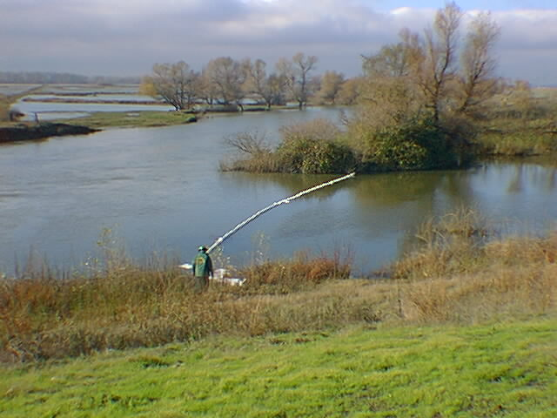
“Small” Spills

Slide 42
What is a “Small Spill”?
All or most of the following apply…
  Natural resource injuries are limited in scope
  DFG is the only Trustee agency involved in the NRDA
  Incident is a one-time event and not a chronic problem
  Impacts on human recreational activities are negligible
Incident must be large enough to warrant NRDA
Notes:
There may be other definitions of ‘small spill’ used by others (eg, wardens, etc.)

Slide 43
Small Spill Process
Same process as large spills
Same methods for calculating damages
Fewer people involved
  Much simpler response structure (fewer coordination problems during the spill response)
Stakes are lower
  Cooperative damage assessment with responsible party is less likely
  Less NRDA data collection
  Faster to settlement
SPILL
SPILL
DATA COLLECTION
DATA COLLECTION
INJURY
QUANTIFICATION
INJURY
QUANTIFICATION
RESTORATION
SCALING/DAMAGE
QUANTIFICATION
RESTORATION
SCALING/DAMAGE
QUANTIFICATION
SETTLEMENT
SETTLEMENT
RESTORATION
RESTORATION

Slide 44
Coordination after Response in Small Spills
Fewer players involved, but coordination still CRITICAL!
  Enforcement
  Local DA/other prosecutor
  OSPR NRDA staff
  OSPR legal
  DFG/OSPR biologist
SPILL
DATA COLLECTION
INJURY
QUANTIFICATION
RESTORATION
SCALING/DAMAGE
QUANTIFICATION
SETTLEMENT
RESTORATION

Slide 45
Where does the money go?
NRDA claims go toward restoration
Small spill claims usually pooled with other settlements/matching funds to make viable projects
SPILL
DATA COLLECTION
INJURY
QUANTIFICATION
RESTORATION
SCALING/DAMAGE
QUANTIFICATION
SETTLEMENT
RESTORATION

Slide 46


Example: Gilsizer Slough
(Sutter County, Central Valley)
1500 gallons gasoline spilled
Road
STEP 1: Biologist
walked the Slough,
finding sheen and
dead fish for 5.7 miles
Investigation Finds Dead
Fish near Storm Drain (bleeding from gills)
STEP 2: Biologist wrote
Supplemental Report/Memo
assessing toxicity of gasoline
to fish at measured levels
(estimating “Degree of Injury”)
Shallow, Narrow, Mud-bottom Slough
STEP 3: Biologist used
“best professional”
Judgment to estimate
recovery time

Slide 47
Example: Gilsizer Slough
What was injured?
  Aquatic Resources (Shallow, Mudbottom Slough)
How much?
  5.7 Miles (Sheen observations in relatively confined stretch)
How badly?
  Near 100% (Biologist assessment of toxicity)
For how long?
  Approximately 3 years (Best professional judgment of responding biologist)

Slide 48
Summary: “Small Spill” NRDA
Smaller settlements (usually)
Limited data collection
Faster to settlement
Coordination challenges after response

Slide 49
Summary
NRDA Process
General Methodology
Process and Challenges in Large Spills
Process and Challenges in Small Spills
The Goal is Restoration!

Slide 50
Contacts
OSPR NRDA Supervisor (primary contact)
  Mike Anderson (916-324-9784 )
OSPR NRDA Toxicologist
  Beckye Stanton (916-327-0916 )
OSPR NRDA Economists
  Steve Hampton (916-323-4724)
  Matt Zafonte (916-323-0635)
OSPR NRDA Attorneys
  Kathy Verrue-Slater (916-324-9813)
  others

Slide 51
Questions?

