Slide 1
How Clean is “Clean”?
Environmental Trade-offs & Cleanup Endpoints
March 27, 2014
Jordan Stout, NOAA
Notes:
Discuss:
Complexities of oil spills (oil as a complex mixture, weathering, shoreline types, critters, sensitivities and seasonalities
Before a spill, answer to “How clean is clean?” is usually: “it depends” - not satisfying
During a spill, we are trying to get from “It depends” to “Yes/No”
We do that by carefully considering the environmental trade-offs & developing operationally-relevant cleanup endpoints

Slide 2
Overview
Why we respond
How we respond
  Environmental trade-offs
  Reaching a balance
When we stop a response
  Cleanup endpoints
  What they are
  Considerations
  Final sign-off

Slide 3
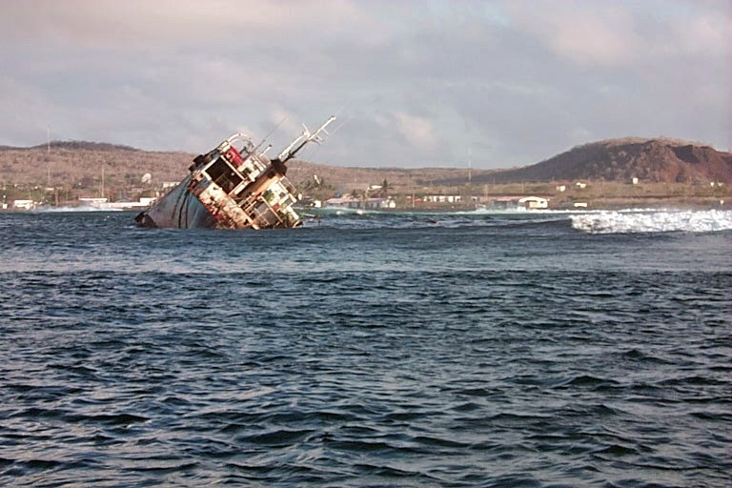
What do we do when this happens…

Slide 4
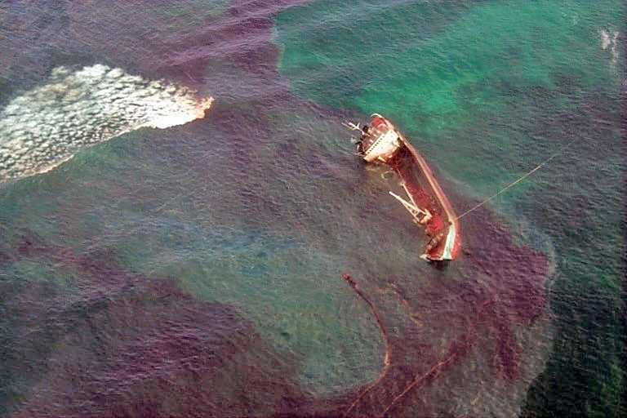
…and the oil gets away?
Notes:
Why we respond of course…

Slide 5
Why we respond
Protect human health & safety
  Responders & public
  On the vessel, on the water & ashore
Minimize overall environmental impacts
  Reduce impacts from oil
  Reduce impacts from response activities
  Accelerate recovery
Minimize economic impacts
Notes:
But since much of this week’s focus in on minimizing environmental impacts, let’s focus there for a little bit…
Consider “minimize overall impacts”… so not just oil but response. We’re trying to look at it as a natural system, that has some ability to recovery, and helping it.
Minimizing environmental impacts ≠ removing every last drop of oil

Slide 6
Why we respond
Protect human health & safety
  Responders & public
  On the vessel, on the water & ashore
Minimize overall environmental impacts
  Reduce impacts from oil
  Reduce impacts from response activities
  Accelerate recovery
Minimize economic impacts
Notes:
But since much of this week’s focus in on minimizing environmental impacts, let’s focus there for a little bit…
Consider “minimize overall impacts”… so not just oil but response. We’re trying to look at it as a natural system, that has some ability to recovery, and helping it.
Minimizing environmental impacts ≠ removing every last drop of oil

Slide 7
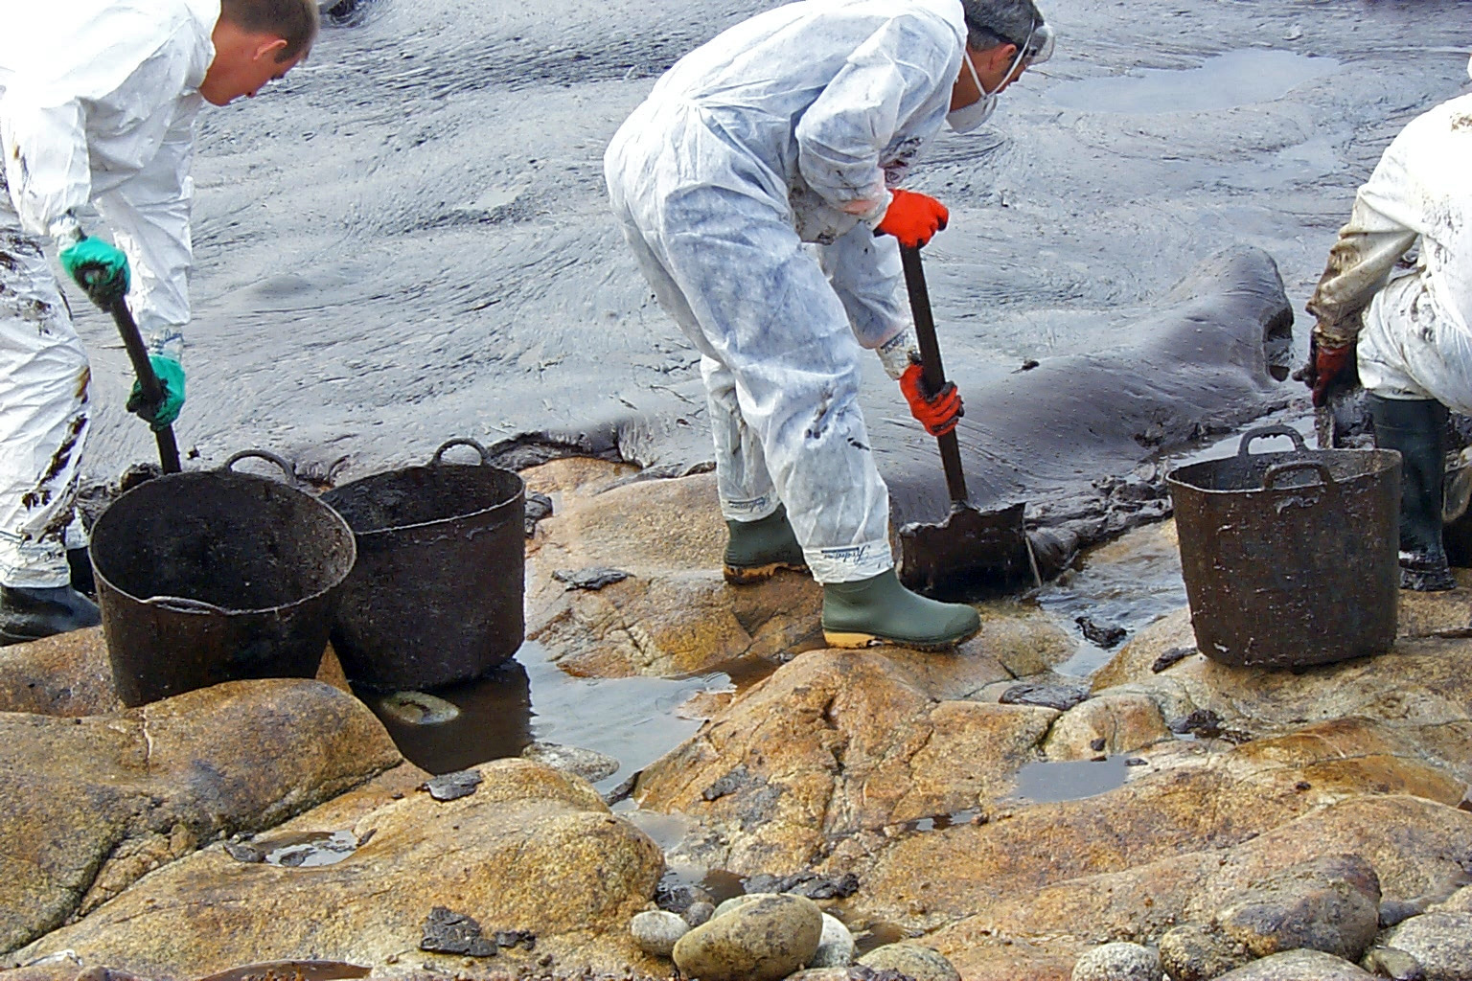
Gross oil removal
T/V Prestige – Spain, 2002
Notes:
General three broad phases of activity… gross oil removal with higher recovery volumes and to reduce remobilization potential.
Oil impact is often far greater than impact from response actions

Slide 8
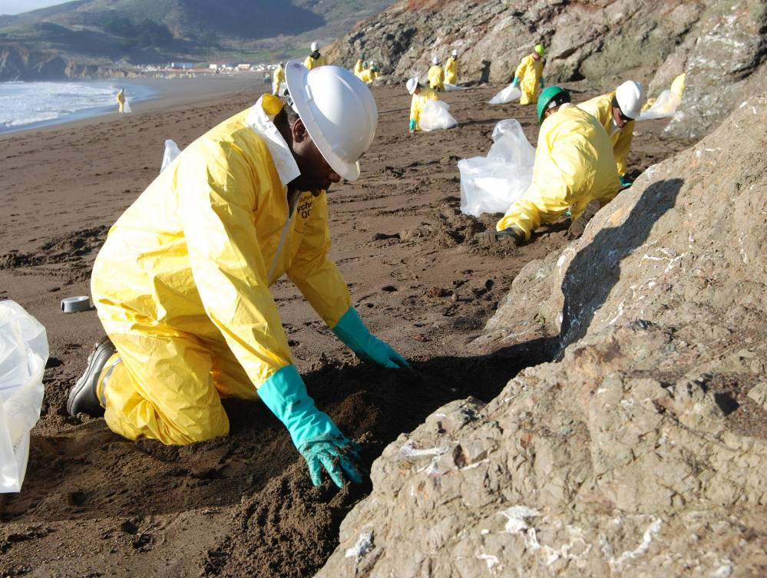
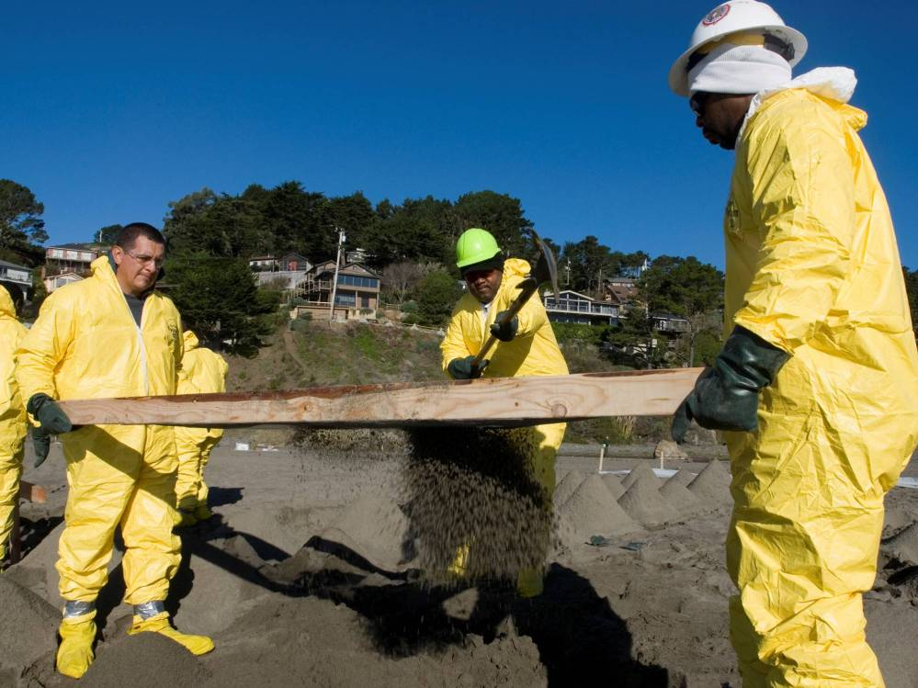
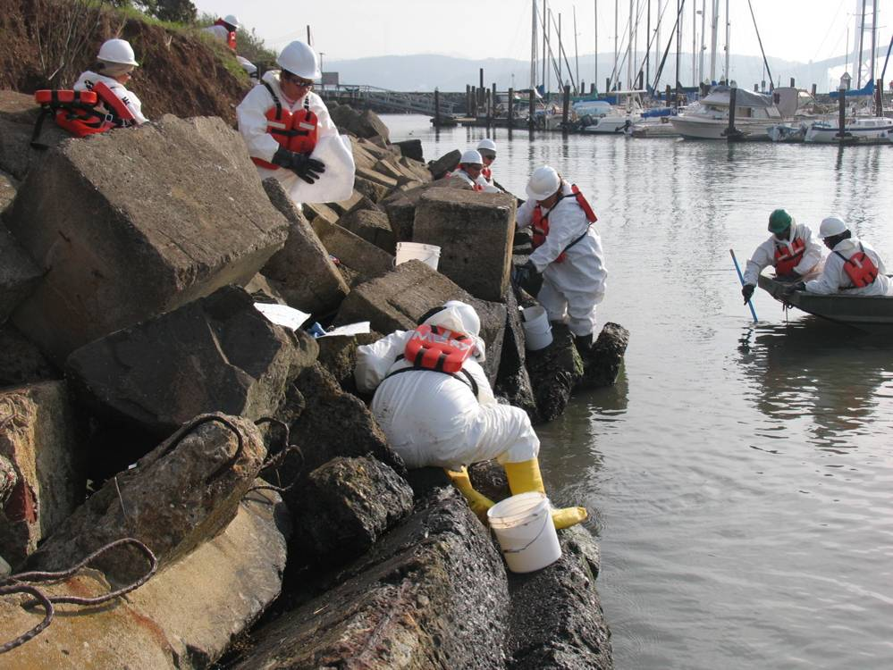
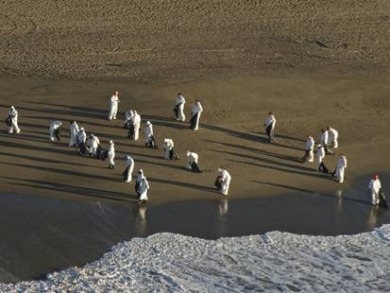
Active cleanup
8
M/V Cosco Busan – San Francisco, 2007
Notes:
Active cleanup that often involves lots of manual labor…
At some point, these cleanup strategies begin to get impractical even though some oil remains.
In many cases, oil impact could be worse than response impacts. To a point…
Strategy becomes inefficient at getting smaller & smaller amounts of residual oil
Sometimes impacts occur with these. 100’s of people causing low impacts can add up to a lot of impacts, right?

Slide 9
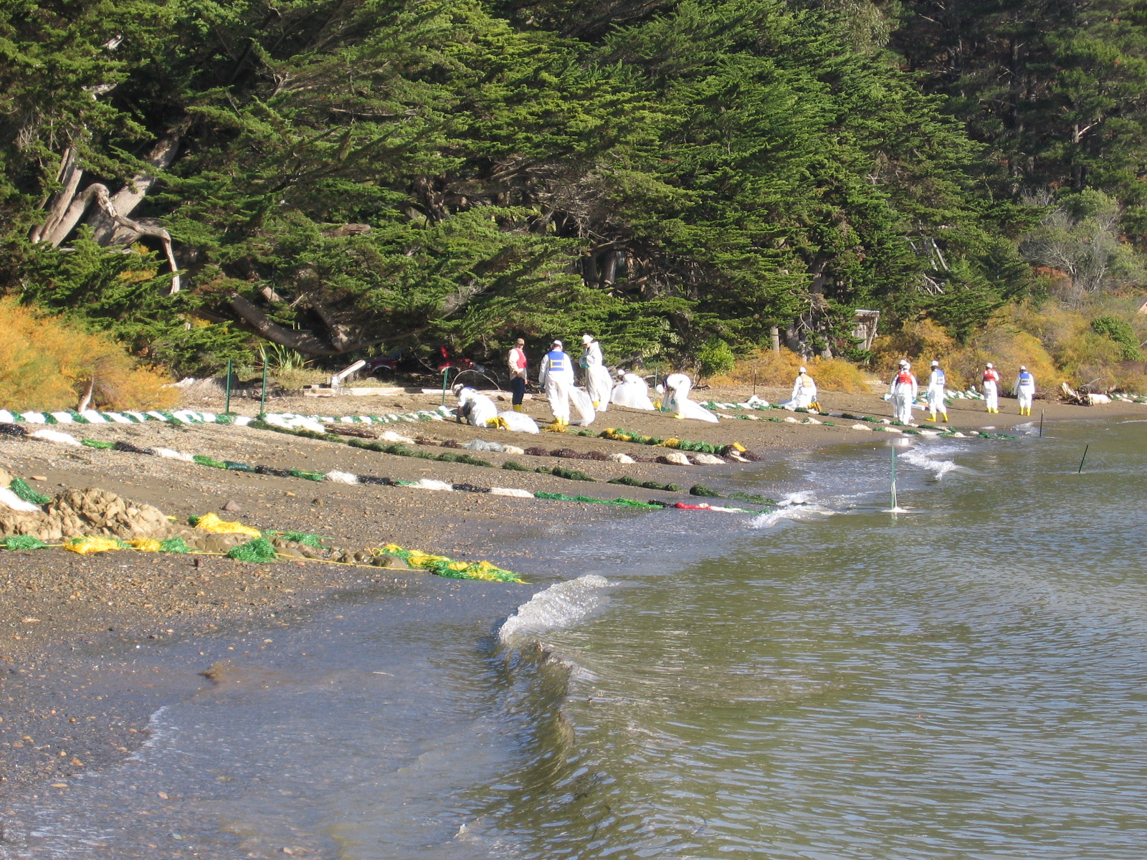
Passive cleanup
M/V Cosco Busan – San Francisco, 2007
Notes:
So there is often an passive cleanup stage where sorbent materials are periodically changed out or other periodic maintenance occurs.
That kind of categorizes how a respond unfolds in general, but thinking about our objective of minimizing impacts needs to be considered in each of these phases, right?
Not much oil left, but it may still be a threat. Trade-offs? At some point, even this could cause more impact than it’s worth.
But we must continually think about our mission to minimize overall environmental impacts at each step in the cleanup. How do we do that?...

Slide 10
How do we minimize overall environmental impacts?
With rapid & effective response
Deploy protection strategies
Provide Operations Section with environmental, cultural & safety constraints
Understand & consider trade-offs
  Resource sensitivity
  Degree & timing of use
  Potential for re-oiling
  Operational safety
  Others
Notes:
So how do we minimize overall impacts?
Mostly spill-specific
Rapid & effective deployment of C-up via Planning (ACP), D&E, Training (ICS, SCAT, others)
Minimize impacts…to the environment using appropriate techniques (e.g. containment, skimming, dispersants (keep oil from reaching wildlife & shoreline), hazing. Reference countermeasures and dispersant talks previously.
Constraints to minimize further injury.
Understanding and evaluate competing issues as trade-offs with the goal of maximizing recovery.
Here’s another way to think about it. Natural system systems fluctuate over time, but in the absence of spill they might look like this…

Slide 11
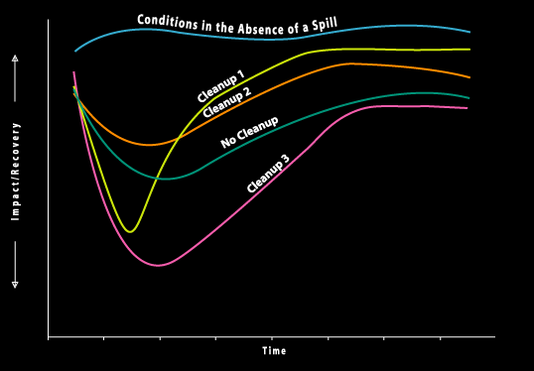
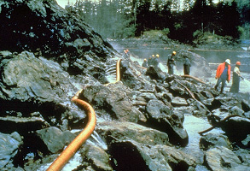
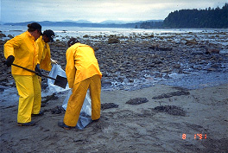
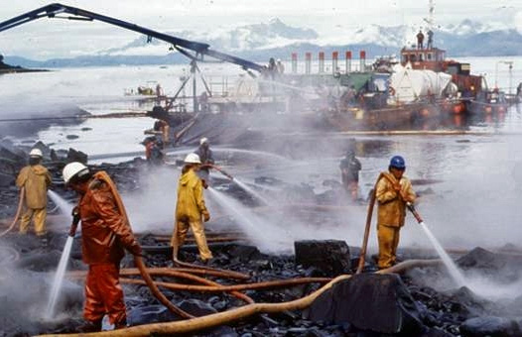
Recovery curve diagram
1
2
3
Notes:
MAXIMIZING RECOVERY - “Recovery” is generally thought of as the condition if the spill had not occurred
May not be the pre-spill condition
Recovery results from a combination of response & restoration activities
Response activities should
Reduce time for impacted wildlife & habitats to recover
Concentrate on “How clean is clean?”
Restoration activities
Reduce time for impacted wildlife & habitats to recover
Concentrate on restoring the injured resources
Recovery curves for a variety of hypothetical responses
W/o spill – Natural variability
No cleanup – Always great uncertainty in predicting natural removal rates
Cleanup 1 – warm water flushing
Cleanup 2 – manual recovery or wiping
Cleanup 3 – hi-pressure steam cleaning
This week is about the environmental response so we’ll concentrate on the “How clean is clean?” question. So…
Illustrates that the most aggressive cleanup strategies are not always the best in terms of environmental recovery. So, not “what’s the quickest way to no oil?” but “what’s the quickest way to recovery?”
We’re focusing on environmental impacts here. Impacts to aesthetic, cultural & recreational resources may require other (possibly more aggressive) strategies.
Steve Hampton will speak on NRDA & Restoration tomorrow
Response and Restoration activities work together to achieve environmental recovery.
Minimizing environmental impacts ≠ removing every last drop of oil

Slide 12
Considering trade-offs
“Often the best cleanup strategy is not one that removes the most oil, but removes the oil that poses a greater threat than the cleanup activity or that allows the oil to be removed by natural processes.”
Michel, J. & B. Benggio, 1999
Notes:
HOW WE RESPOND…
What the least impacting yet effective strategy(ies) might be
What protective guidelines might be needed
When there’s no more oil?
Can we realistically pick up every drop of oil?
If so, then what might the consequences be?
A good endpoint determined early in response will guide the selection of cleanup methods and recommendations.
How we respond to oil in different environments. So, let’s look at some and think about which is worse, the oil or the cleanup?...
Rocky/riprap shorelines
Beaches
Wetlands/marshes

Slide 13
Considering trade-offs
“Often the best cleanup strategy is not one that removes the most oil, but removes the oil that poses a greater threat than the cleanup activity or that allows the oil to be removed by natural processes.”
Michel, J. & B. Benggio, 1999
Notes:
HOW WE RESPOND…
When there’s no more oil?
Can we realistically pick up every drop of oil?
If so, then what might the consequences be?
A good endpoint determined early in response will guide the selection of cleanup methods and recommendations.
How we respond to oil in different environments. So, let’s look at some and think about which is worse, the oil or the cleanup?...
Rocky/riprap shorelines
Beaches
Wetlands/marshes

Slide 14
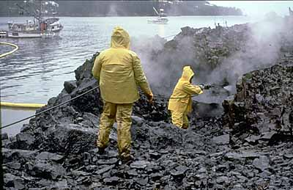
Is this a greater threat than oil?
T/V Exxon Valdez - Alaska, 1989
Notes:
RIPRAP/ROCKY SHORELINES…
What if it does more than just remove oil?
What if it sterilizes the habitat?
How do you even wrap our brains around this stuff? We try and objectively consider the trade-offs…

Slide 15

Or this?
M/V Cosco Busan – San Francisco, 2007
Notes:
RIPRAP/ROCKY SHORELINES…
Seasonal impacts? Herring eggs, nearby nesting birds, etc?
What if someone gets injured, breaks a leg, or drowns?
EU should be providing constraints & guidelines to limit impacts.

Slide 16
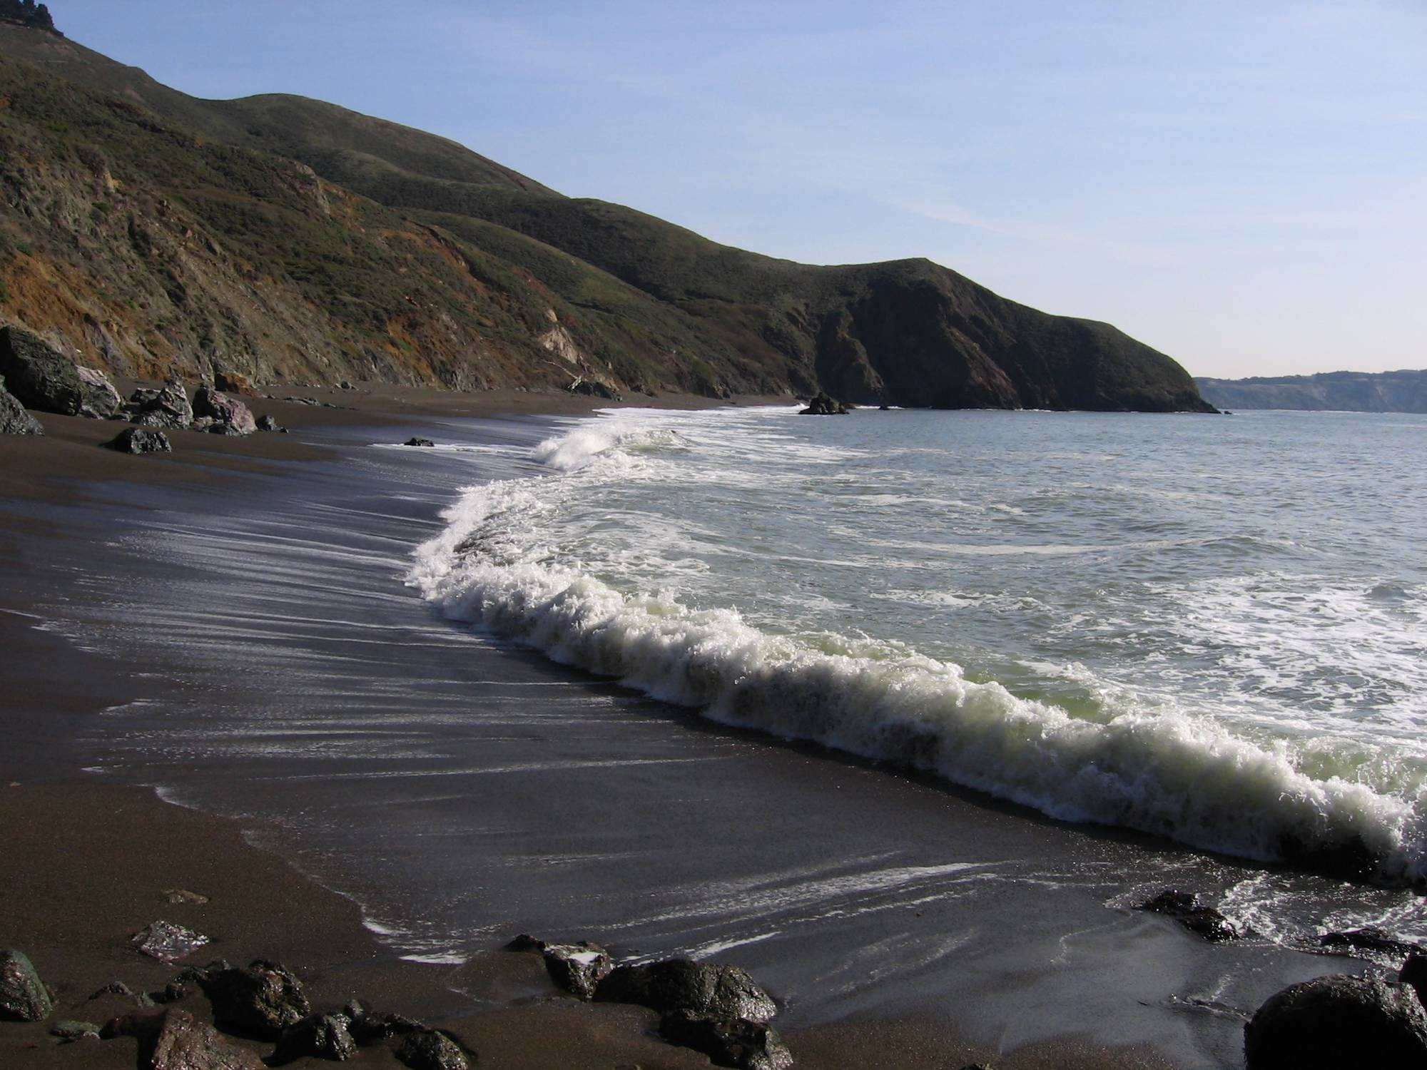

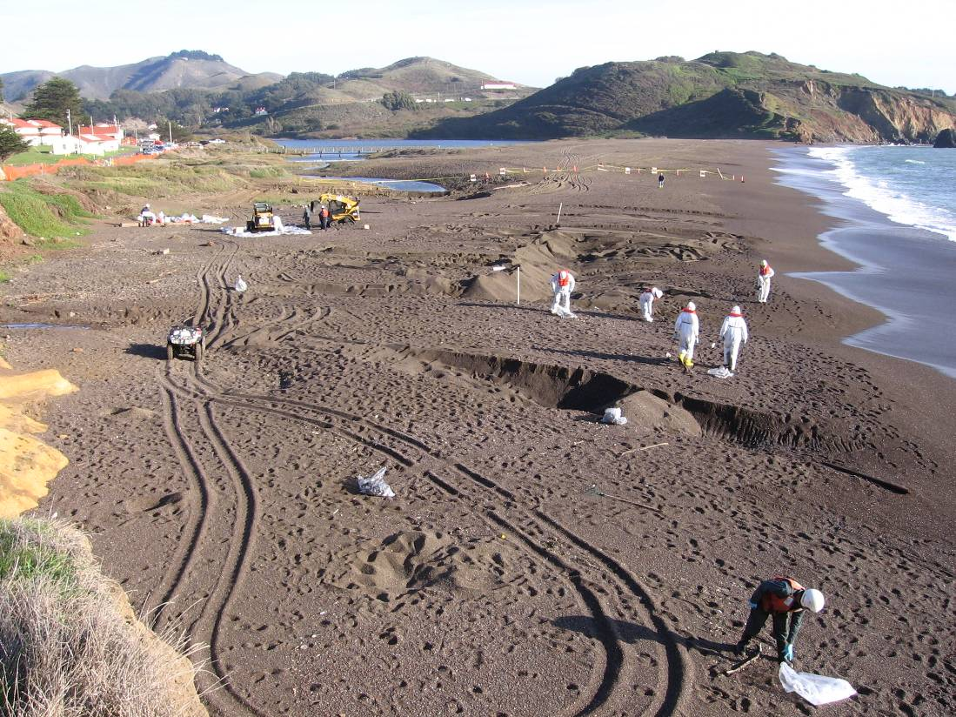
Beaches
Notes:
BEACHES…
# of people – compaction, nesting birds, etc.

Slide 17
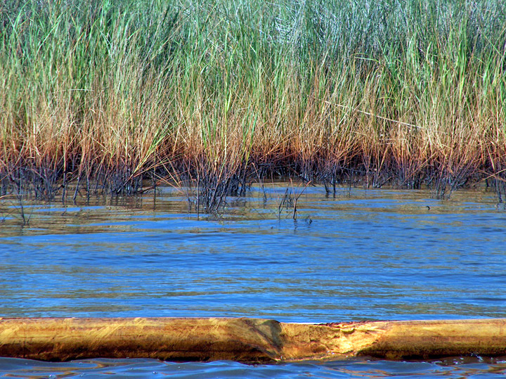
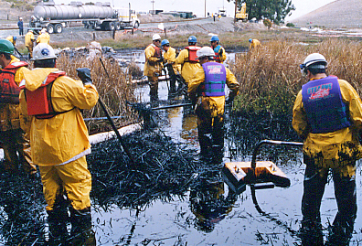
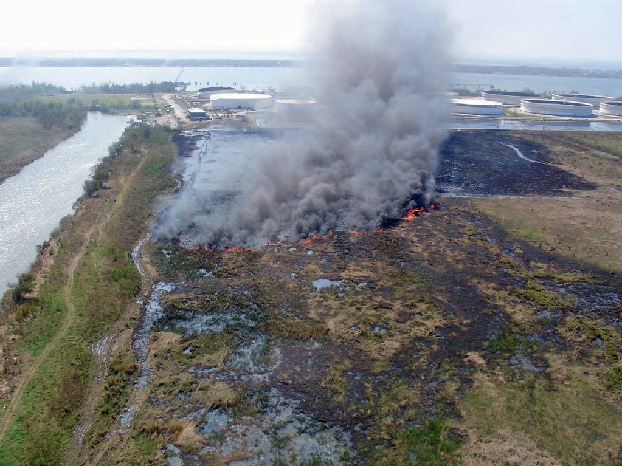
Wetlands & Marshes
Notes:
WETLANDS & MARSHES…

Slide 18
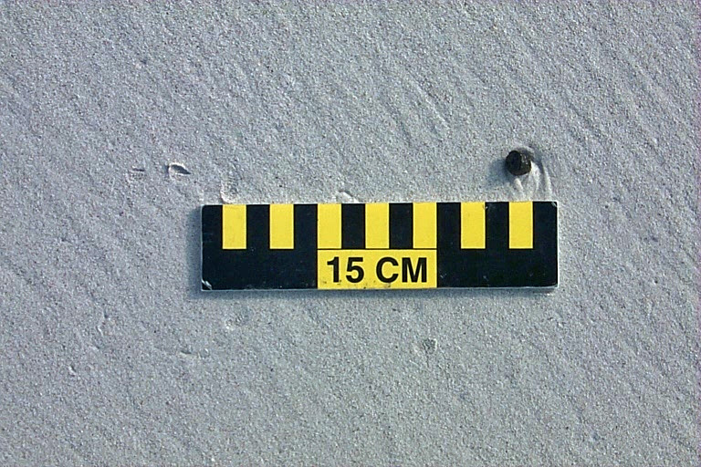
Is this clean enough?
M/V New Carrissa – Oregon, 1999
Notes:
WHEN DO WE STOP?...
When there’s no more oil?
Can we realistically pick up every drop of oil?
If so, then what might the consequences be?
A classic Trade-off situation is: When should you let nature do the work?...
Oil Spill Response – Let’s now look at Response Options.
Some say, you can clean up anything. All you need is time & money, lot’s of it.
Others say, you can’t pick up every last drop.
So, is this clean enough?... What if even small tarballs represent a real threat to an endangered species?
On the other hand…

Slide 19
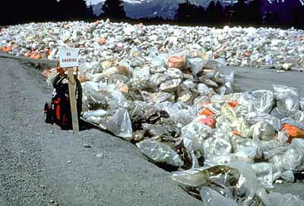
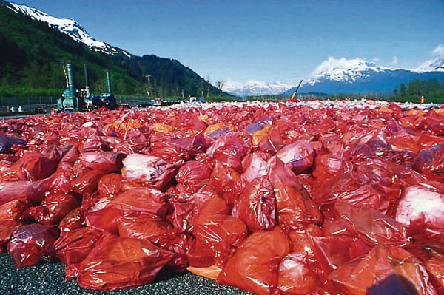
What if more cleaning results in this?
T/V Exxon Valdez - 1989

Slide 20
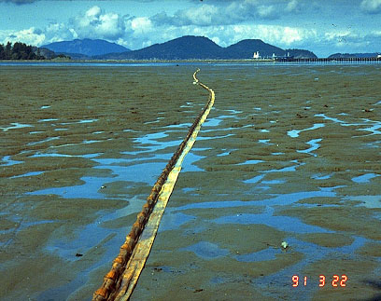
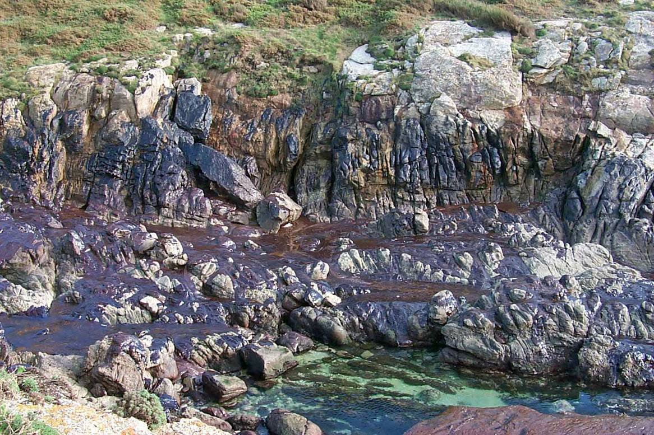
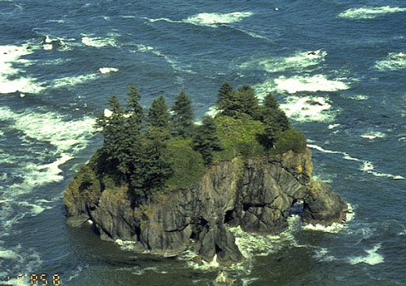
Natural recovery
Sensitive Environments
Worker Safety / Logistics
High Energy Habitat
Notes:
A classic trade-off situation…
When it makes sense:
Highly sensitive habitats
Where cleanup impacts might be worse than the oil
Presence of Threatened/Endangered Species
Easily damaged or especially difficult to restore
Lightly-oiled habitats
Ultimately, natural recovery completes the process
High energy habitats
Dangerous work areas
High wave energy, inaccessibility, or other hazards pose significant threat to safety of workers
1) Highly sensitive habitats where cleanup activities are likely to slow down environmental recovery
2) High energy habitats likely to be scoured by natural forces
3) Lightly oiled habitats – do no more harm – nature will cleanup
4) Areas were worker safety would be at risk
5)
Can you think of some potential down sides?
Oil is left in the environment
Natural recovery may be slower than originally estimated

Slide 21
Three simple questions
Is the remaining oil likely to damage environmentally sensitive resources?
Does it interfere with the aesthetic appeal and amenity use of the shoreline?
Is this oil detrimental to economic resources or disrupting economic activities?
B. Dicks et al., 2002 (ITOPF)
Notes:
Cleanup should proceed as long as it is likely to have a positive effect on the speed of recovery for the affected shoreline.
If the answer to any of the three is “yes”, then cleanup should continue. However, if the answer to all three is “no”, then cleanup should stop.

Slide 22
Cleanup endpoints
Clear, concise & measurable goals
  Incident-specific
  Shoreline type
  Oiling condition
Often qualitative
Allows for systematic way to evaluate & achieve progress
Needs to be done early
Needs to include monitoring
Notes:
Trying to get to “Yes/No”
WHAT ARE THEY?...
This isn’t a long-term remediation situation so we’re not going with strictly quantitative criteria (e.g. ppm)
Operationally-relevant
Often based on qualitative risk
So why not use a standard? Variations in incident, shorelines, oil type, oiling condition, and cleanup strategies
Monitoring to ensure that endpoints are reasonable & achievable
These are goals for Ops and the overall response, so start early!

Slide 23
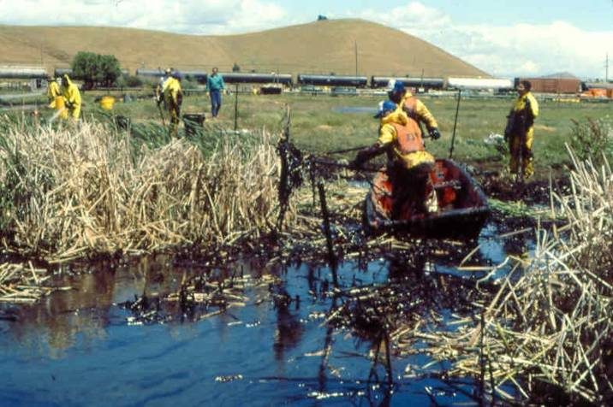
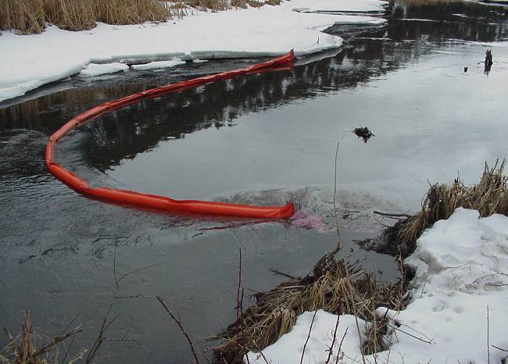


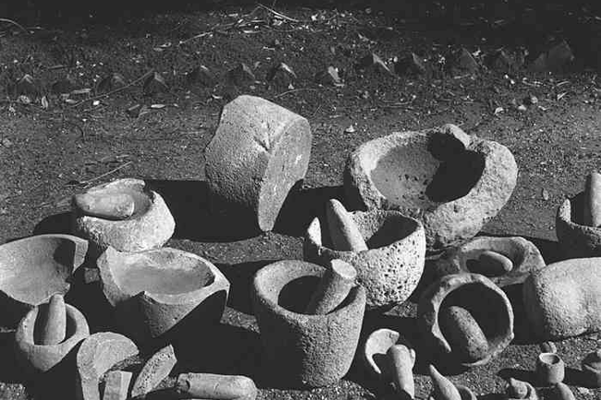
Endpoint considerations
Political & Economic
Habitat
Season/Weather
Cultural / Archeological
Specific Wildlife Issues
Notes:
Environmental
Listed T&E species
Rookeries, colonies, nest sites, spawning areas
Wetlands – “Sensitive Habitats”
Cultural / Archeological
Political
Economic & cost effectiveness(?)
Season / weather
Hunting & fishing seasons
Regional differences
Purpose of ICS is to effectively capture/acknowledge all stakeholder concerns while putting safety & the environment as clear priorities.
On a small spill, it might just be you.
On a bigger spill, it could be a bunch of people and might take a while. So start early

Slide 24
Who’s involved?
Planning Section’s Environmental Unit
SCAT Coordinator, Team Leaders & members
Natural Resource Trustees
Land Managers
Operations Section
Notes:
WHO’S INVOLVED?...
Built among players with the UCS by:
Collaboration
Consensus
Best professional judgement
Frank discussions of incident-specific trade-offs

Slide 25
Helpful references
NOAA Shoreline Assessment Manual (pgs. 22-30)*
NOAA Shoreline Assessment Job Aid*
NOAA / API Response Manuals*
Environmental Sensitivity Index Maps*
Area Contingency Plan*
Facility Response Plan*
Past Experiences / Documents
* Michel, J. & B. Benggio, 1999
Notes:
Resources for help.
Bring these docs to show.

Slide 26
Some examples
“No Visible Oil”
“No more oil than background”
“No longer releases sheens that will affect sensitive areas, wildlife, or human health.”
“No longer rubs off on contact.”
“Oil removal to allow recovery / re-colonization without causing more harm than natural removal of oil residues.”
Notes:
SOME EXAMPLES…
Now we’re getting away from “It depends” to “Yes/No”
The last example tries to get at “do-more-good-than-harm” philosophy but this can be difficult to define in an operational context sometimes and is very incident-specific.
How do you know what’s appropriate? If the Cleanup Endpoint for a given impacted shoreline is clear, concise and measurable and will result in “no’s” for each of the critical questions, then you’re well on your way.
How do we know we’re achieving them? Through an monitoring & sign-off process…

Slide 27
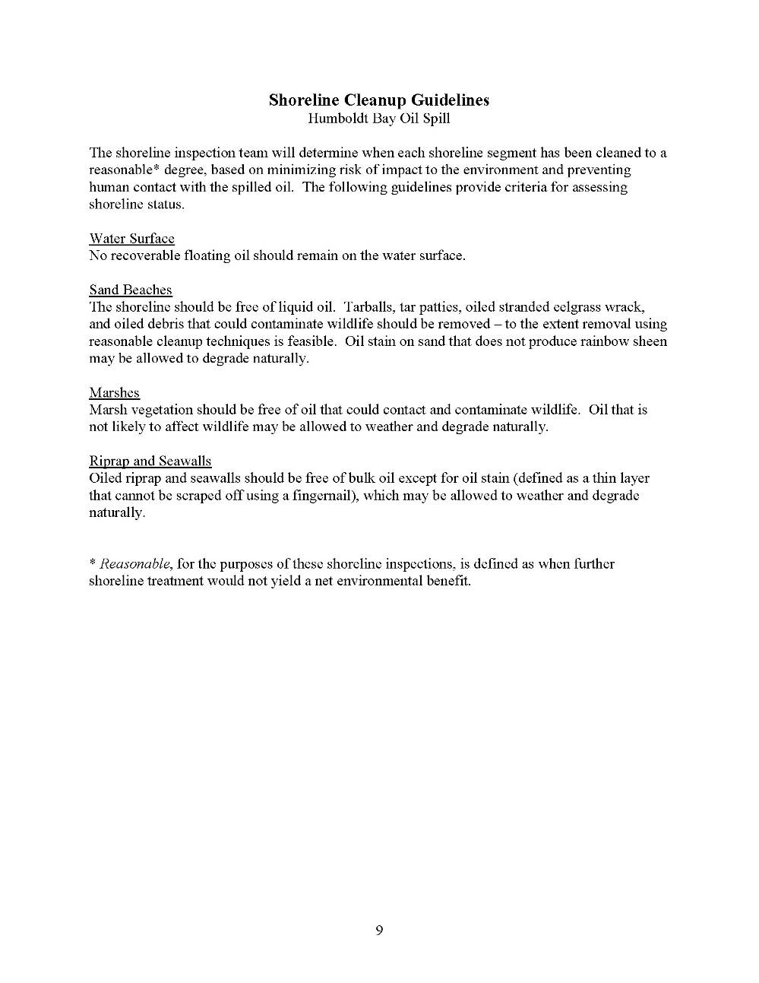
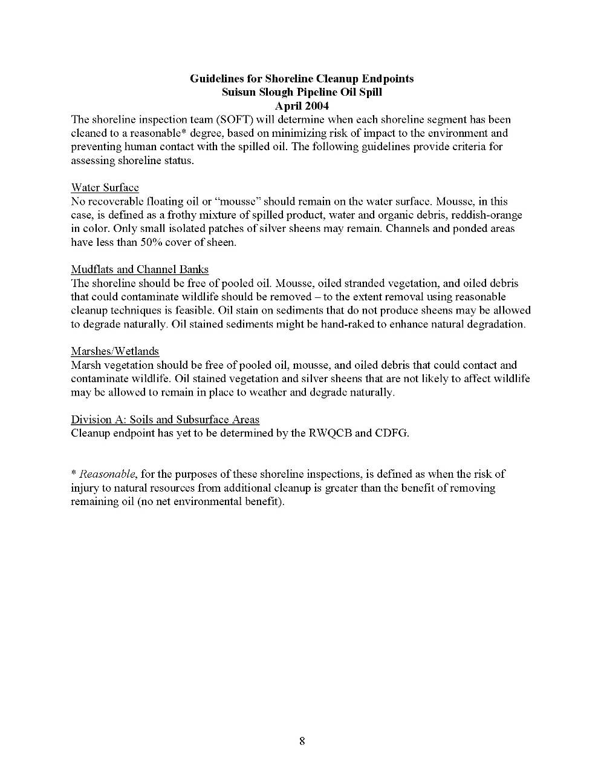
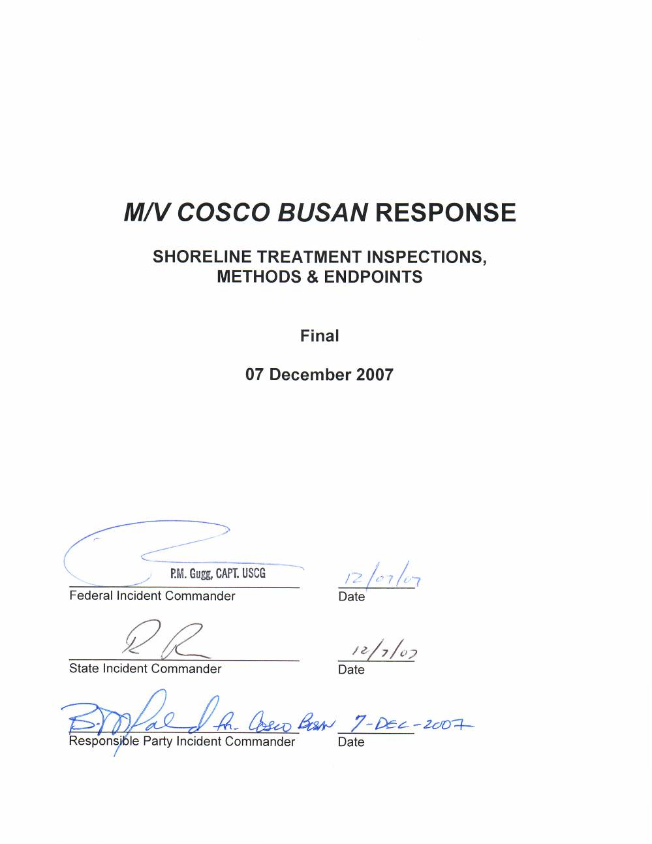

Slide 28
The sign-off process
Iterative process of site inspections & recommendations by SCAT segment
SOFT (Sign-Off Team)
  Closely related to SCAT
  Knowledgeable staff
  Stakeholder involvement
Sign-off procedures
  Incident-specific
  Habitat and species-specific
Notes:
SIGN-OFF PROCESS…
Refer to the previous Shoreline Assessment Presentation for the Process of SCAt (e.g. Reconn Survey, S/L Segmentation, develop spill-specific cleanup guidelines, SCAT surveys, Submit reports, evaluation, monitoring, SOFT).
Like SCAT but with different mission
UC reps, land owner
Consensus decision

Slide 29
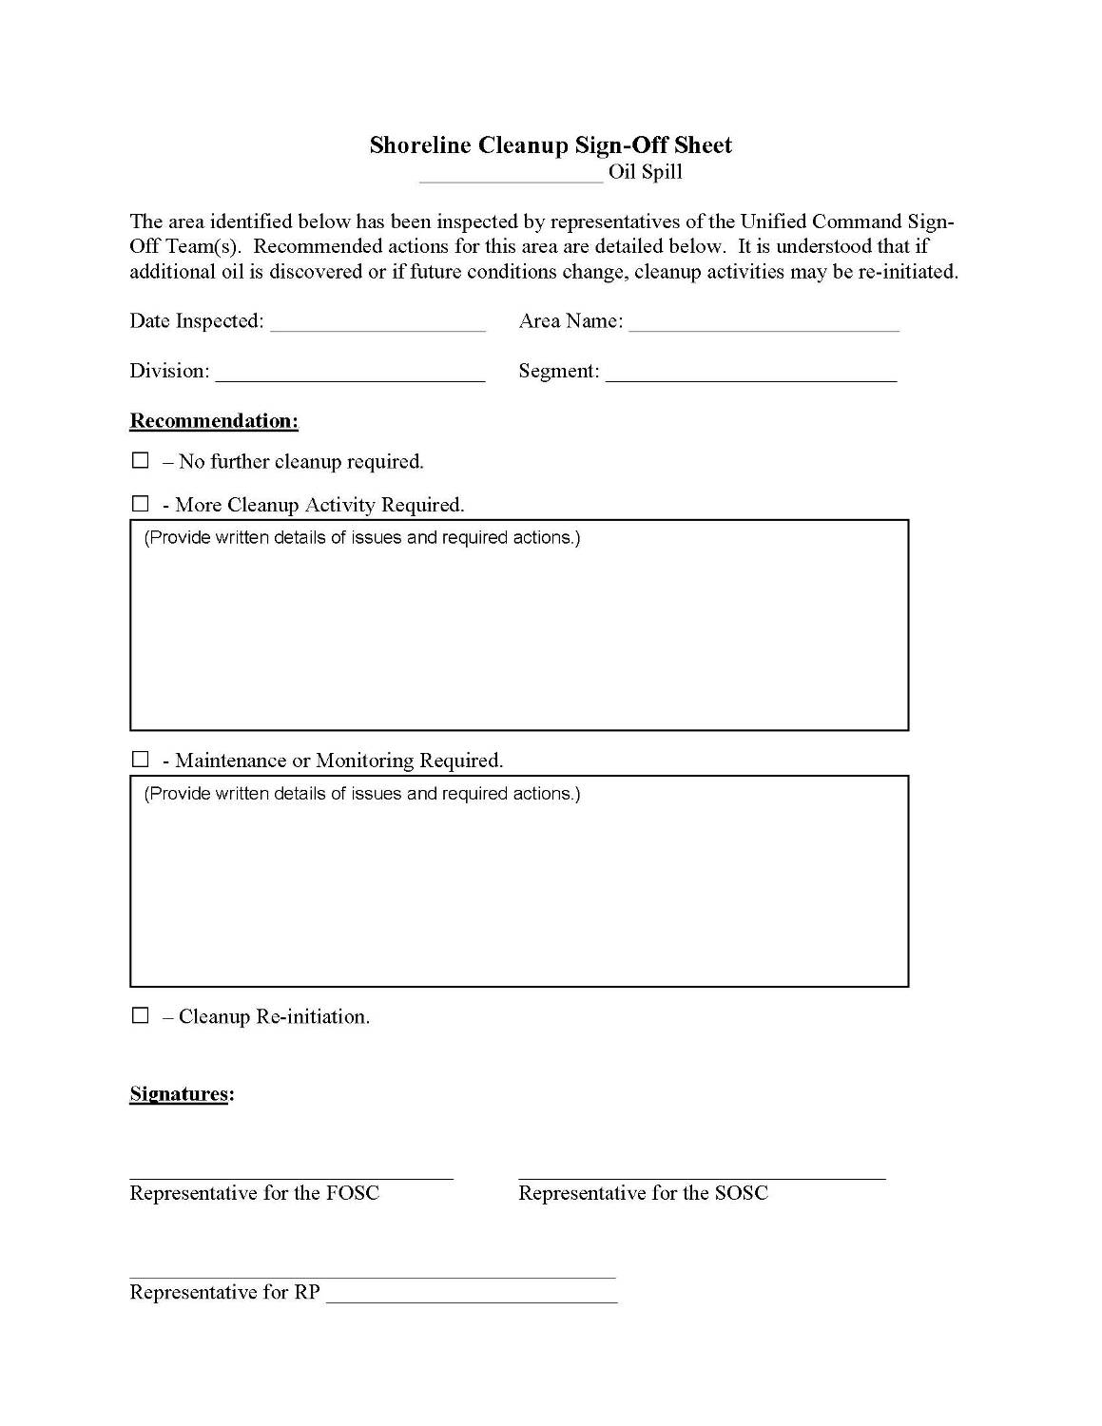
SOFT form
Notes:
Yes/No

Slide 30
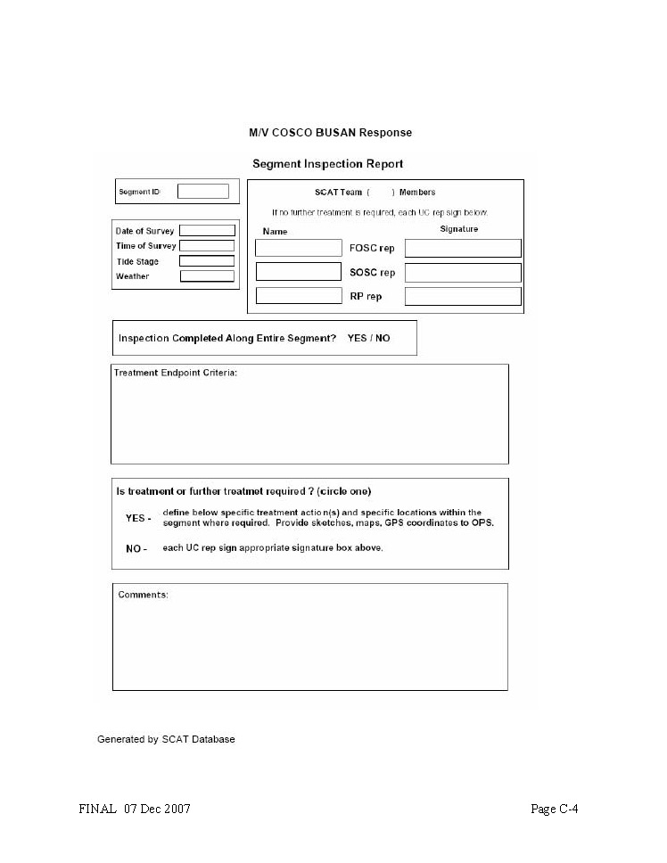
SOFT form
Notes:
Yes/No

Slide 31
Summary
  Consider incident & site-specific factors
  Develop cleanup endpoints early
    Ask the three critical questions
    Use best professional judgment
    Have frank discussion of trade-offs
    Be mindful of speed-to-recovery
    Achieve consensus
  Monitor & re-evaluate endpoints often
  Incorporate endpoints into the SCAT Process
Notes:
Imperfect information requires BPJ, which should include resources & tools from previous spills
Keep the end-goal in mind… a healthy, restored environment

Slide 32
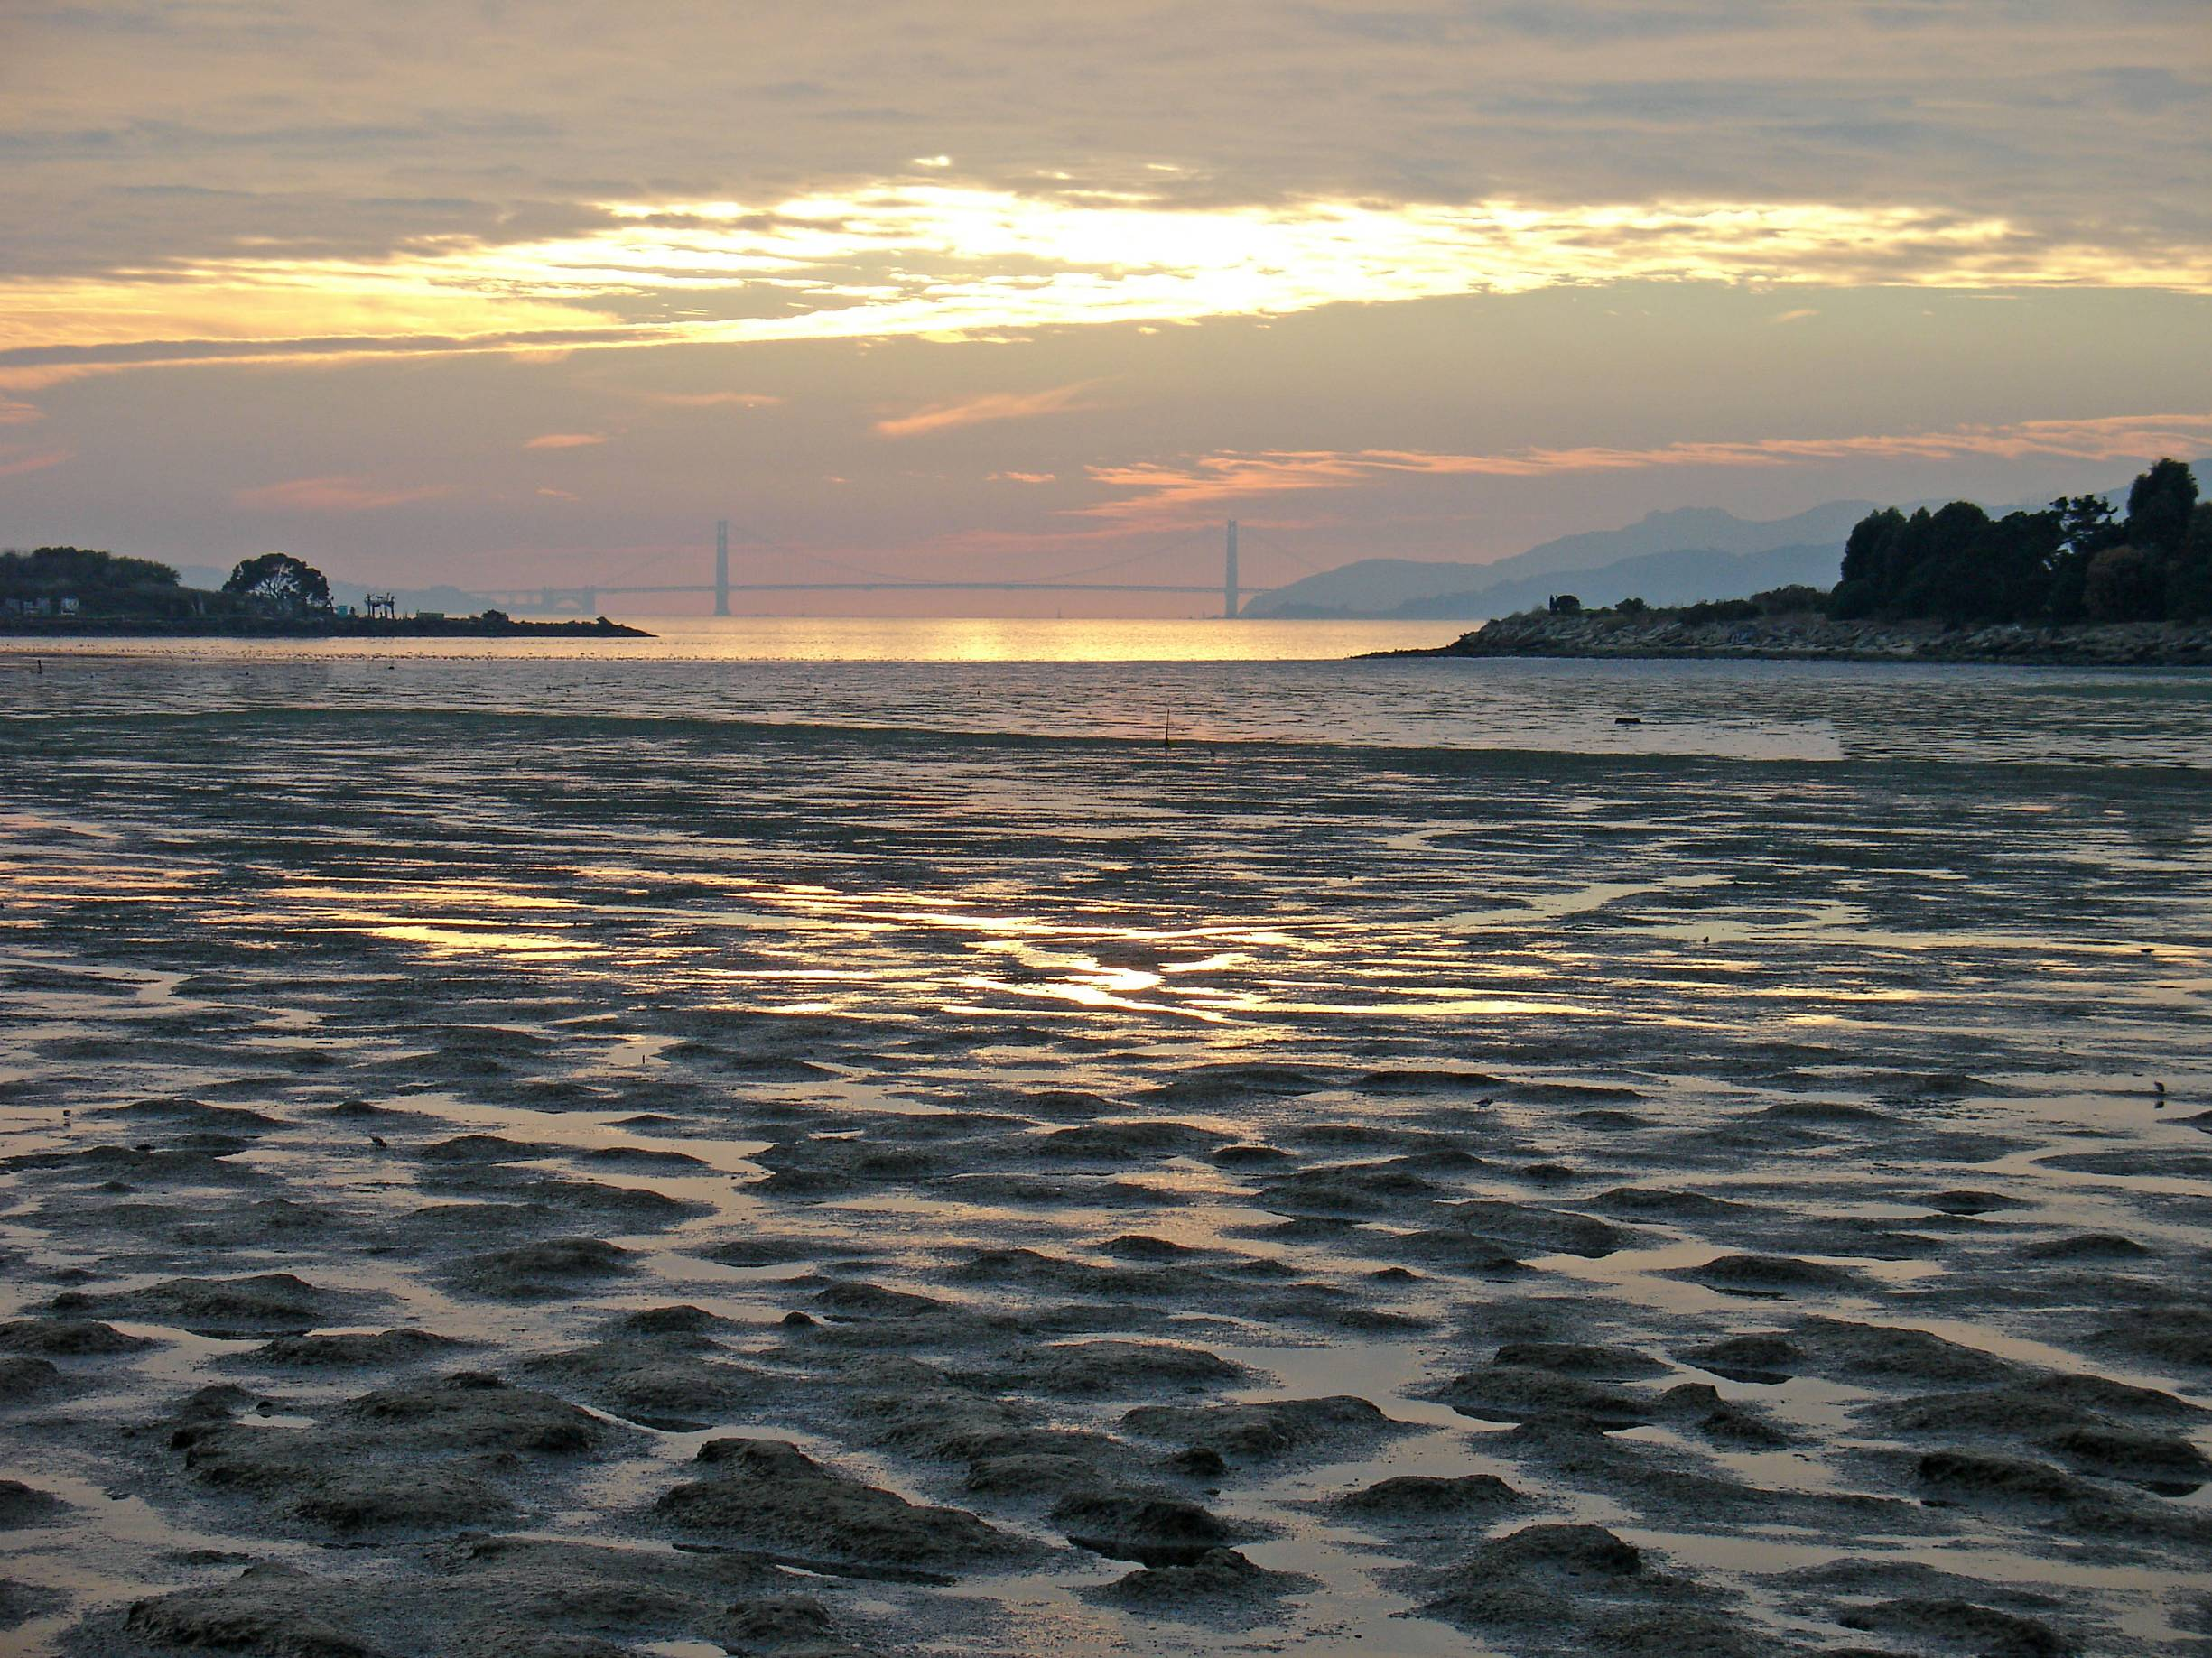
Questions?
Jordan Stout
NOAA Scientific Support Coordinator
Tel: (510) 437-5344
Mobile: (206) 321-3320
24-hour: (206) 526-4911
E-mail: jordan.stout@noaa.gov

