Slide 1
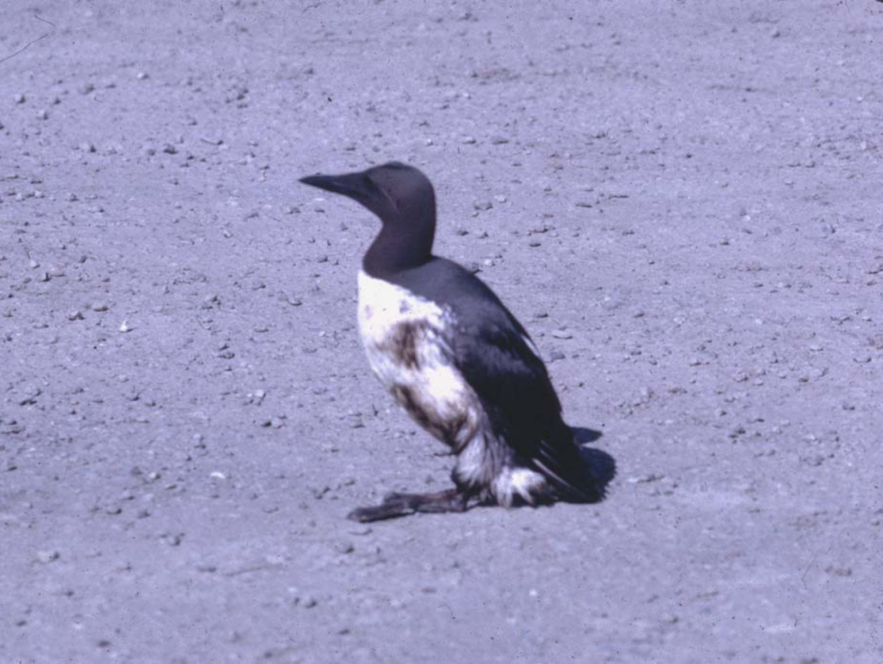


WILDLIFE BRANCH OPERATIONS:
Response to Oiled Wildlife in California
Holly Gellerman - Office of Spill Prevention and Response
California Department of Fish and Wildlife

Slide 2
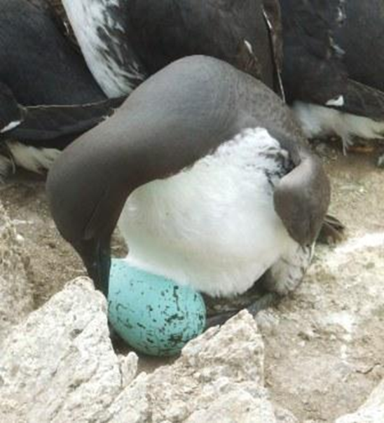
Overview
Development of wildlife response
capacity in California
Wildlife species susceptible to oiling
Organization and responsibilities
of the Wildlife Branch
PRBO

Slide 3
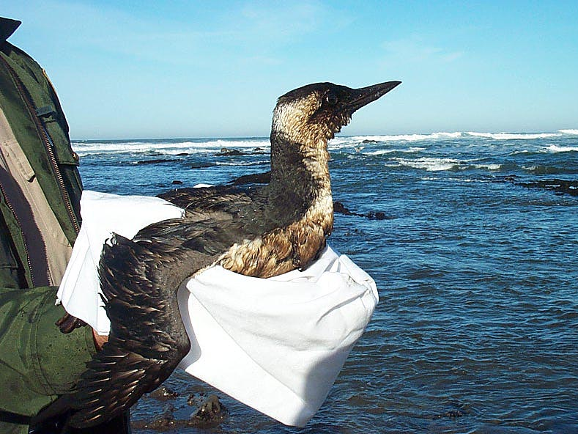
OPA 90: Wildlife Provision
NCP Requirement:
  “…provide for coordinated, immediate and effective protection, rescue, and rehabilitation of, and minimization of risk of injury to, fish and wildlife resources and habitat…”

Slide 4
California Legislation
Lempert-Keene-Seastrand Act (1990)
  Developed CDFW-OSPR
  Required development of rehab stations
Follow-up bills
(1993, 1995, 1997)
  Funds to build and maintain six regional facilities
  Established research program

Slide 5
CA Wildlife Response Plan Development
Originally developed by OSPR in early 90’s
-later, Agencies, NGOs, ACPs, Industry
Previously in ACPs (now in RCP)
Updated in 2011, available on OSPR website
Details WLB purpose, structure, roles, responsibilities

Slide 6
Oiled Wildlife Care Network
(OWCN)
Administration
  1994–1997: OSPR
  1997– : Wildlife Health Center, UC Davis
Mission
  Best achievable capture & care to oiled wildlife

Slide 7
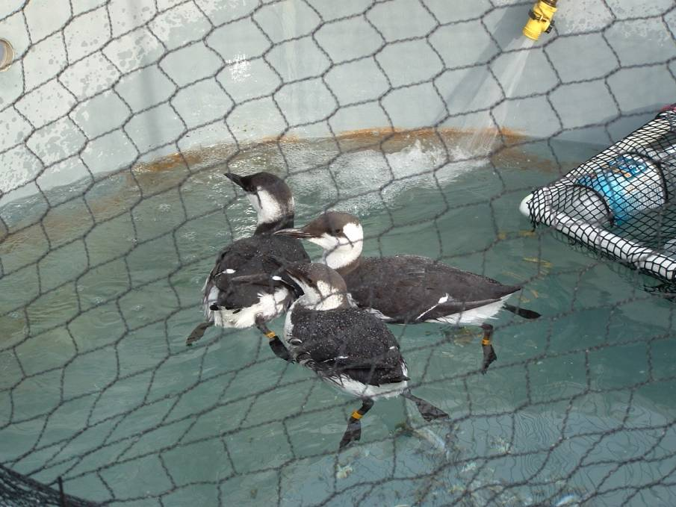
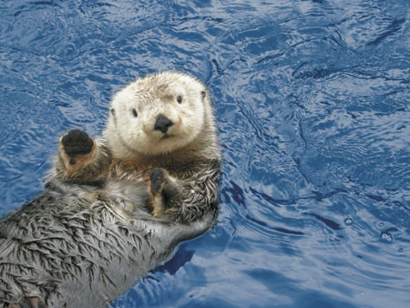
Species susceptible to oiling
Spend a lot of time on the surface of the water
Occur fairly near shore
Have feathers or fur

Slide 8
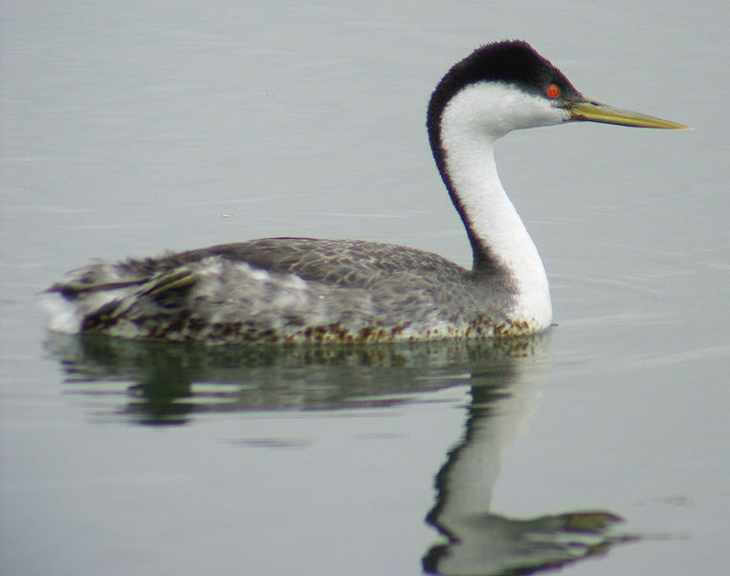
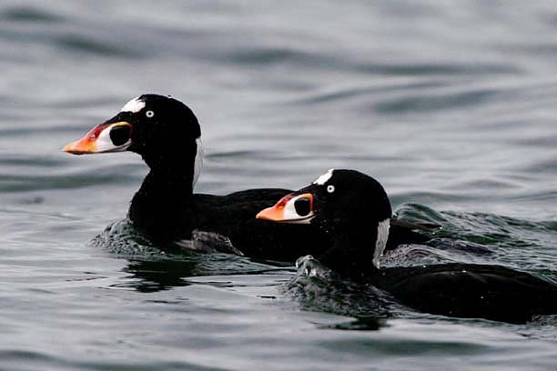
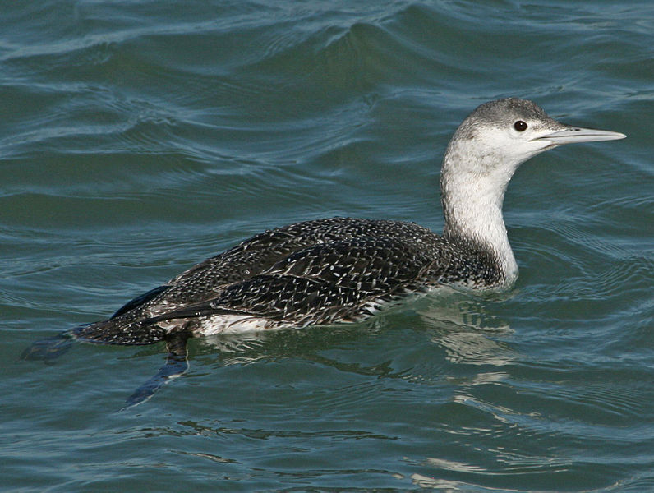
Species typically affected
GREBES
COMMON
MURRES
SCOTERS
LOONS

Slide 9
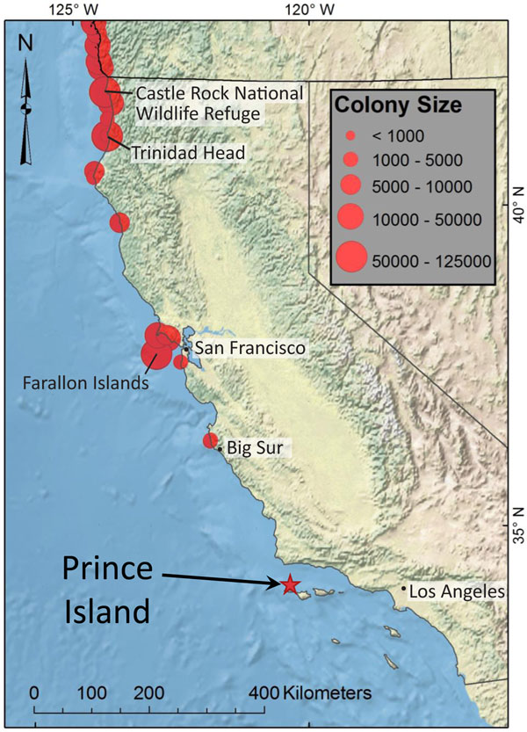
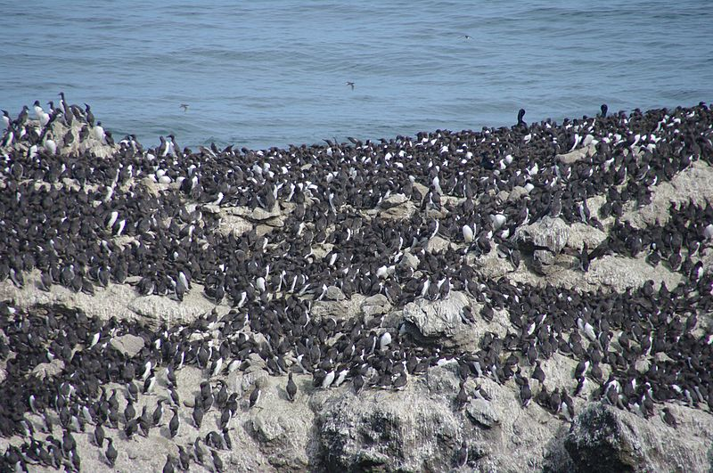
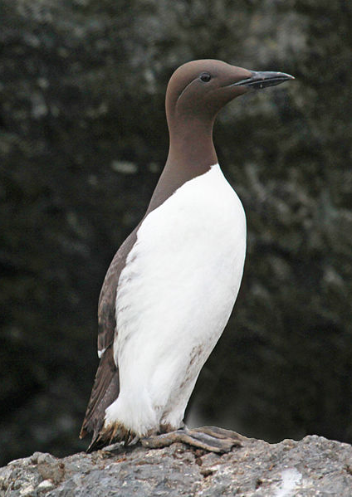
Common Murre
Nest in large colonies on islands & cliffs
>1 million in N.A.; ~350,000 in CA
Dive deep for fish and squid
Move closer to shore and further
south in winter
Adams and Felis, USGS

Slide 10
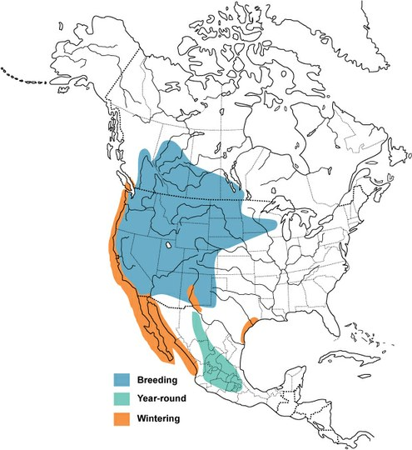
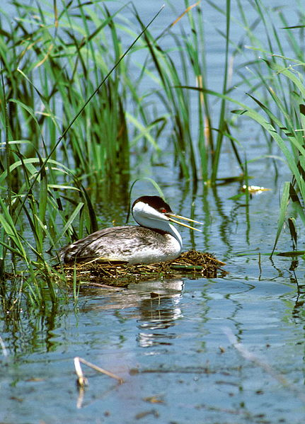
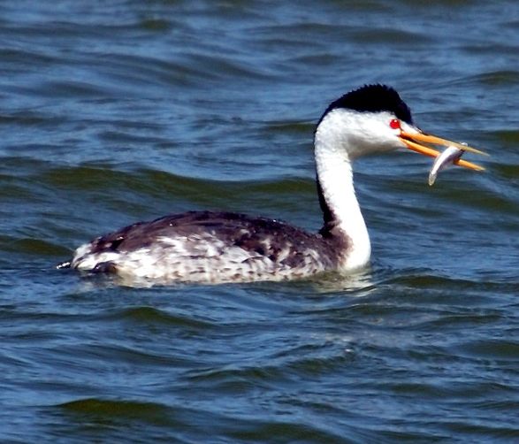
Western/Clark’s Grebe
Build floating nests on lakes
~500,000 in N.A.; ~10,000 in CA
In winter, common in nearshore ocean/bays

Slide 11
Wildlife Branch
In Operations Section
Close coordination with Planning Section
  Resources at Risk
  Minimization of collateral damage
Unified Command
Operations Section
Planning Section
Logistics Section
Finance/ Administration Section
Wildlife Branch

Slide 12
Wildlife Branch
In California, five Groups
Expanded beyond the federal Wildlife Branch structure
Wildlife Branch
Field
Stabilization
Group
Care & Processing Group
Reconnaissance Group
Hazing Group
Recovery Group
Care & Processing Group
Hazing Group

Slide 13
Safety Requirements
24-hr HAZWOPER plus OWCN training
  Conduct wildlife recovery under the direction of the Group Supervisor, after site characterization
4-hr “Hazcom” training plus OWCN training
  Can assist in hot zones, but cannot capture wildlife
  Hazcom can only be used in emergency once
No Hazwoper or Hazcom
  Can assist outside of hot zones

Slide 14
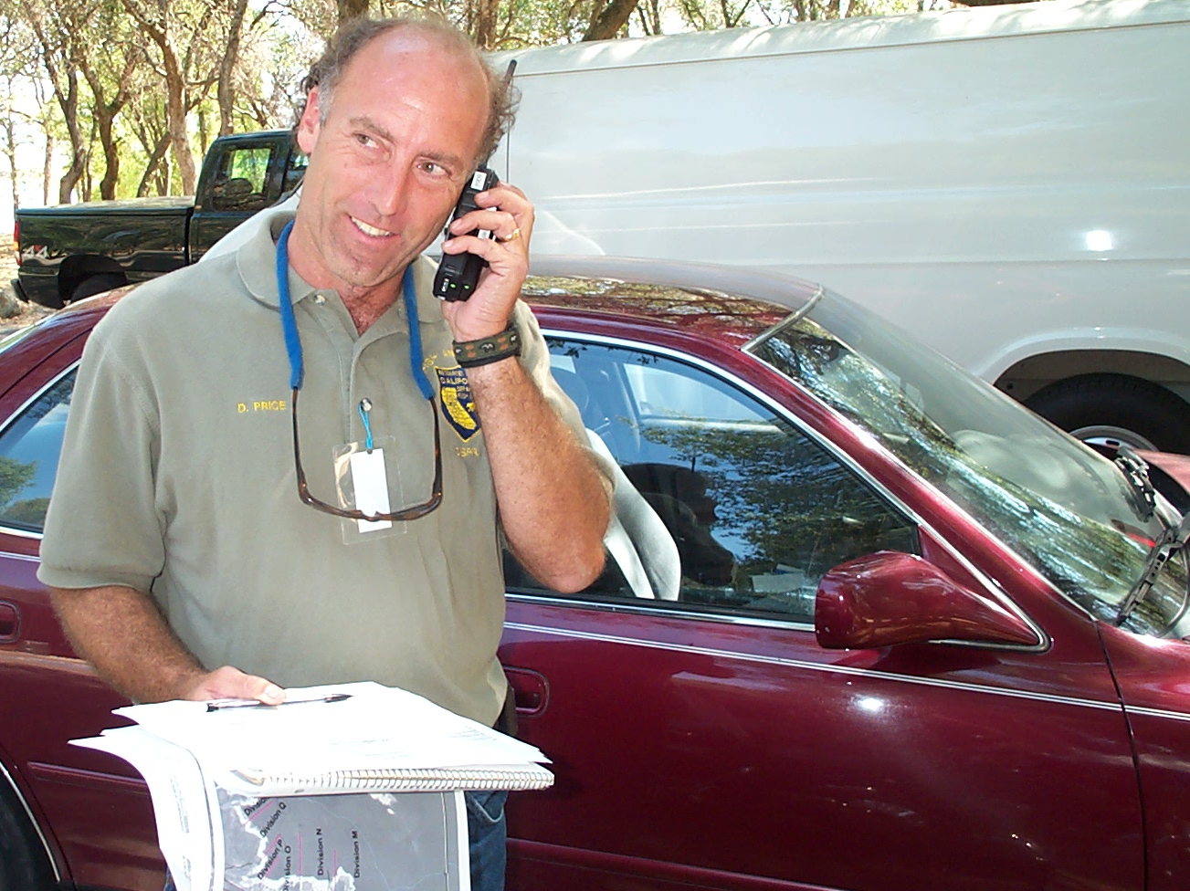
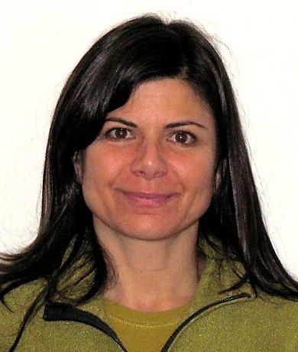
Wildlife Branch Director
Safety, Supervision and Coordination

Slide 15






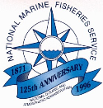



Natural Resource Trustees with Diverse Missions
To protect the public, the environment, and U.S. economic interests…
To manage California's diverse fish, wildlife, plant resources…
To provide for the health, inspiration and education…
To conserve, protect, and enhance fish and wildlife and their habitats…
To preserve unimpaired the natural and cultural resources…
To understand and predict changes in the Earth’s environment…
To teach, research and
public service…
To defend our nation against all foreign and domestic enemies…
To manage the water resources of California in cooperation…

Slide 16
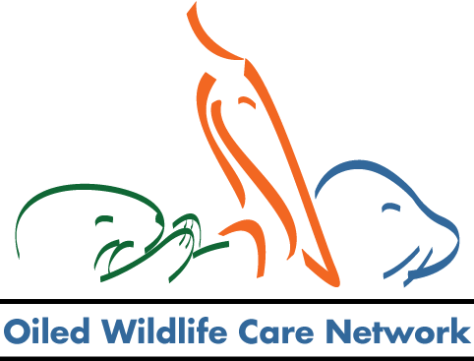





One Team
One Incident
Command Structure
Wildlife Branch
One
Mission
One Unit
One Common Goal

Slide 17
Interaction with other Agencies
What the WB can provide:
Provide cooperating agencies with up-to-date information (as available)
What others can provide for the WB:
Reconnaissance
Provide local knowledge and expertise (e.g. Refuge personnel)
Potentially assist with staffing wildlife reporting hotline
Recovery, Transportation
Assist with beach closures and access
Provide a staging area for the Stabilization Trailer
Assist with transportation of wildlife
If trained, assist with wildlife capture

Slide 18
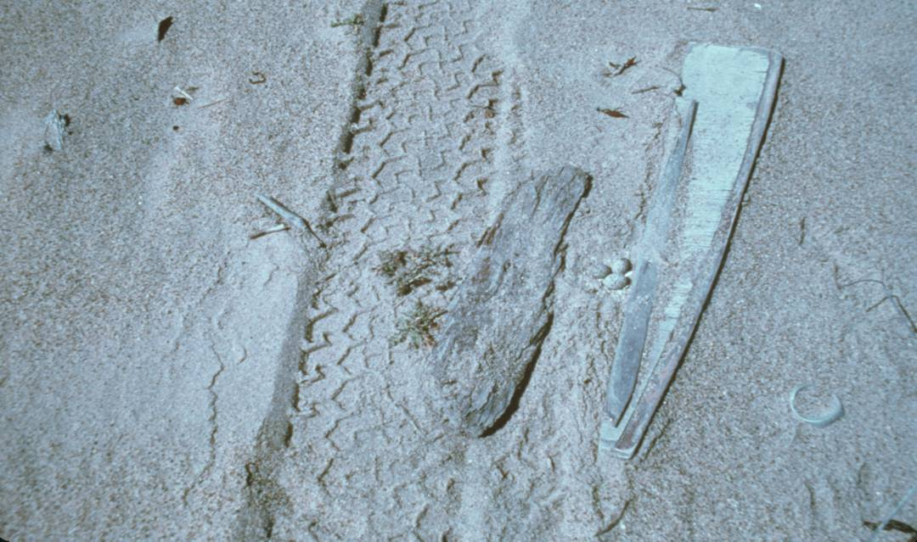
Special Protocols
WILDLIFE RESPONSE PLAN
Guidelines to:
  Minimize incidental impacts to Snowy Plovers, Least Terns, Clapper Rails
  Respond on the Farallon and Channel Islands
  Respond with Sea Otters
Notes:
18

Slide 19
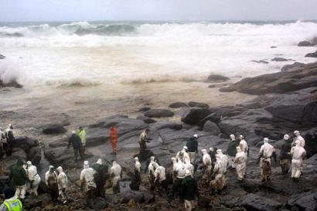
Equipment & Personnel Resources
Tiered Response Levels
Level 1 - Projected impacts for dozens of marine birds or mammals
Level 2 - …for up to low hundreds of marine birds or mammals
Level 3 - …for high hundreds or thousands of marine birds or mammals

Slide 20
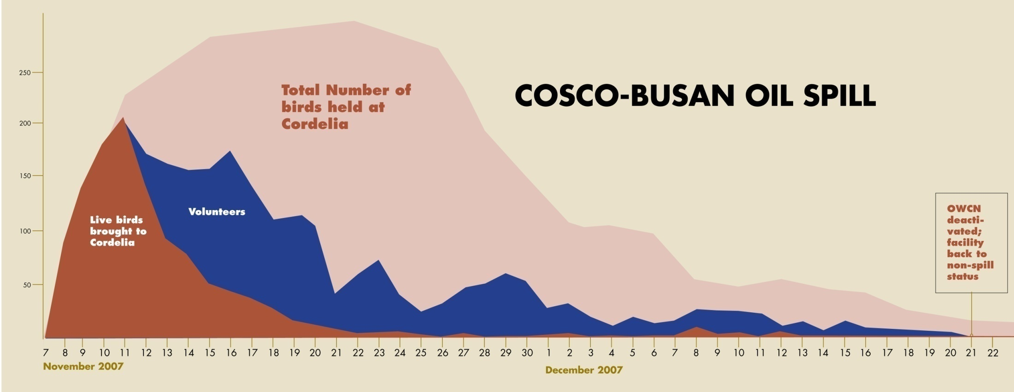
Peak impact usually days 2-10
(Graphics: Alison Kent)

Slide 21
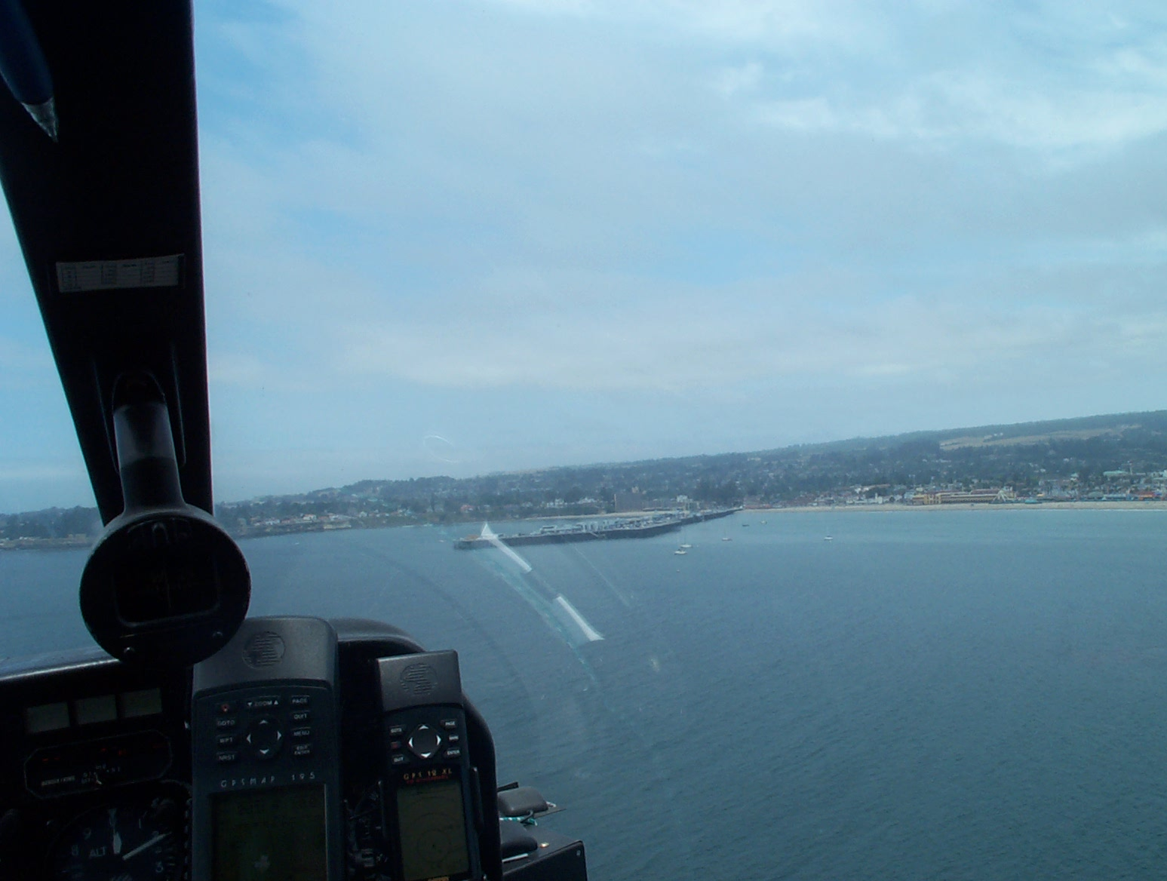
Wildlife Reconnaissance Group
  -Aerial Survey Team
  -Boat Survey Team
  -Shoreline Survey Team
Evaluate numbers, species, and locations of wildlife that could be/are impacted by oil

Slide 22
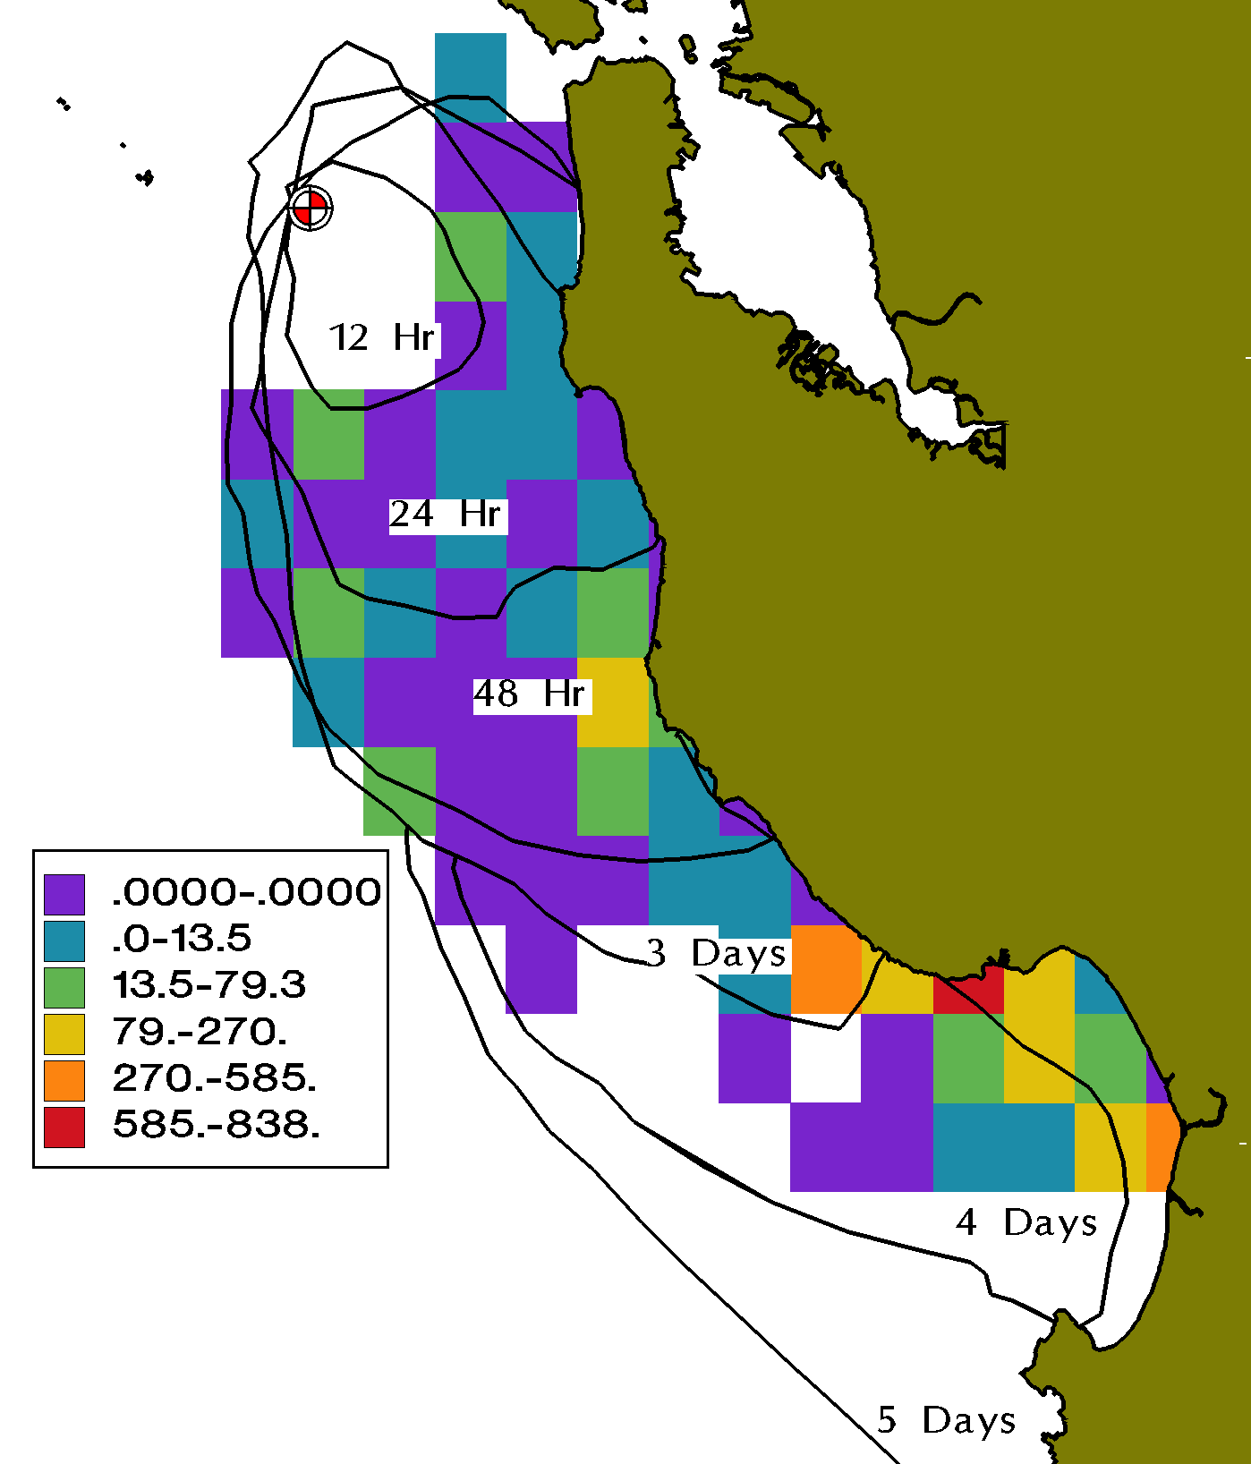
Reconnaissance: Resources-at-Risk Analysis
Resource Impact Potential
 | Common Murre
12 Hours | 665
24 Hours | 4,183
48 Hours | 23,392
3 Days | 25,516
4 Days | 25,762
5 Days | 41,994

Slide 23
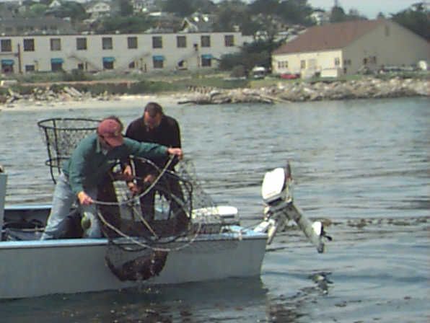
Other Resources:
Wildlife/Technical Experts
Agency Biologists
University Biologists
Private Contractors
GIS Mapping/Database

Slide 24
Wildlife Reconnaissance Group
OILED WILDLIFE HOTLINE
(to report oiled wildlife)
1-877-UCD-OWCN
(1-877-823-6926)

Slide 25
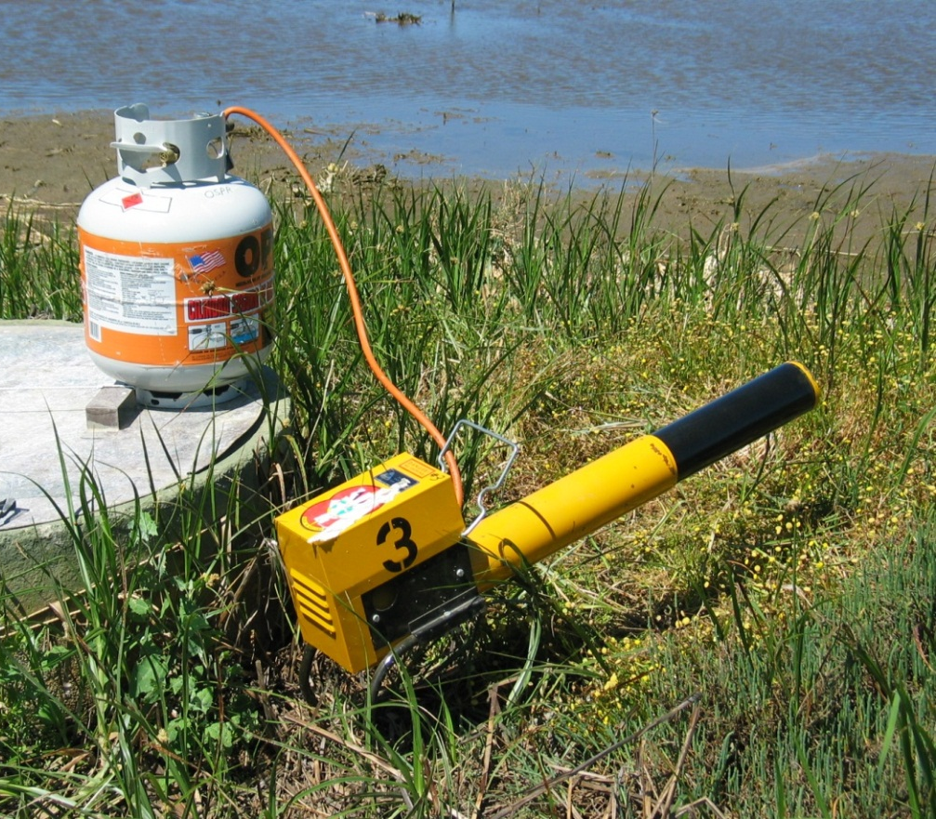
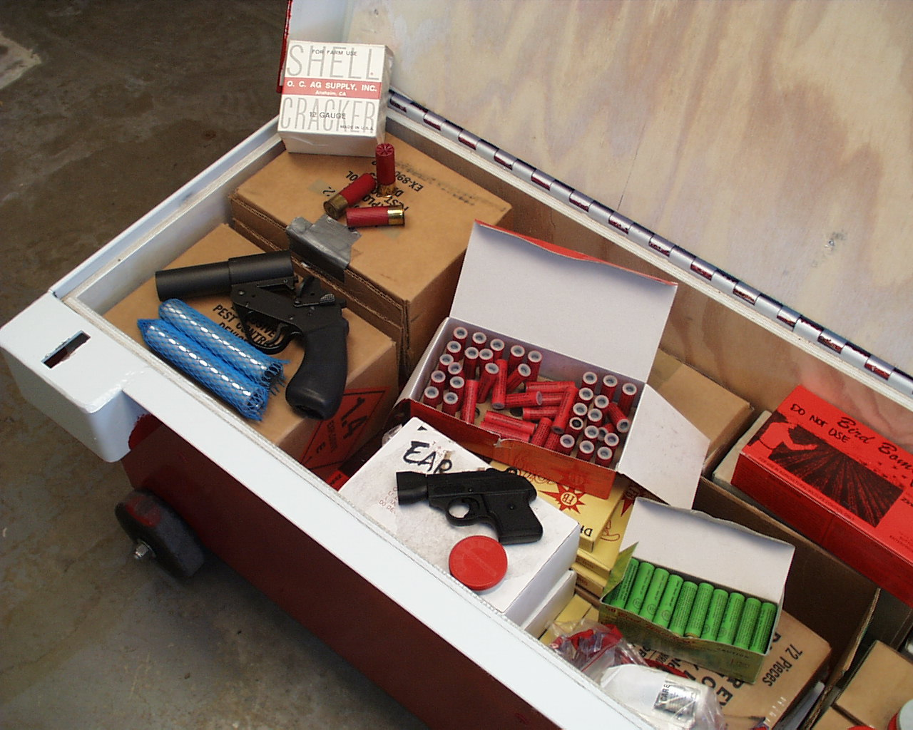
Wildlife Hazing Group
Deter wildlife from entering contaminated areas

Slide 26
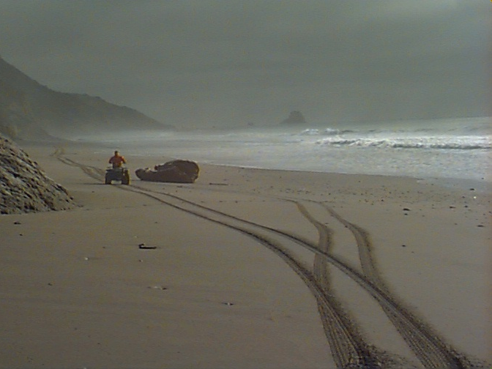
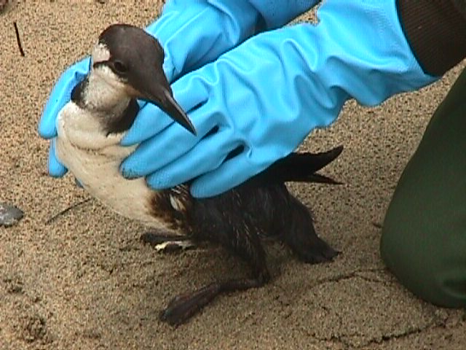
Wildlife Recovery Group
Capture and collection of live and dead animals

Slide 27
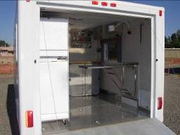
Wildlife Field Stabilization Group

Slide 28
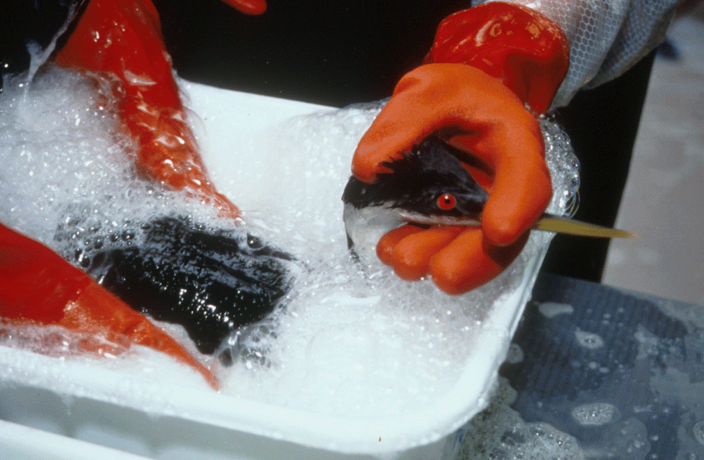
Wildlife Care & Processing Group
Ensures that wildlife exposed to petroleum products receive the best achievable care by providing access to veterinary services
Processes live & dead animals

Slide 29
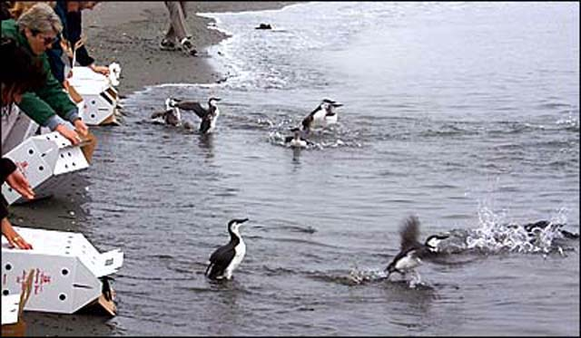
Demobilization
Wildlife Operation activities are typically the last to demobilize

Slide 30
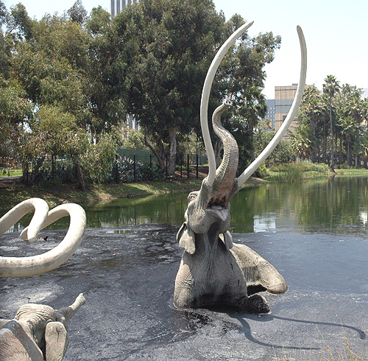
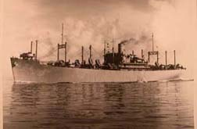
Special Protocols
Mystery Spills
Special Protocols for Response to “Mystery Spills”
  Mystery spills could be
  anthropogenic or natural
  Need to respond appropriately
Notes:
30

Slide 31
Special Protocols
Mystery Spills
OWCN receives 100’s misc. oiled birds per year
Notes:
31

Slide 32
Special Protocols: Mystery Spill Response Guidelines
If known to be anthropogenic:
  Any threat or observed impact to wildlife
If unknown source, notify OWCN & test oil if:
  >3 oiled animals per day, same area
  >1 oiled animal per day, 3 consecutive days
Activate OWCN (pending PCL results) if:
  >5 oiled animals per day, same area
  >2 oiled animals per day, 3 consecutive days
If contamination is not oil (other deleterious):
  OSPR respond at request of CDFW
Notes:
32

Slide 33
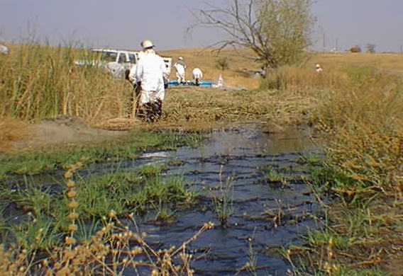
Inland Response
Notes:
33

Slide 34
SUMMARY
The Wildlife Branch is in the Operations Section of the UC
Five groups in the Branch:
  Reconnaissance
  Hazing
  Recovery
  Field Stabilization
  Care and Processing
The OWCN fills most roles other than Reconnaissance
Notes:
34

Slide 35
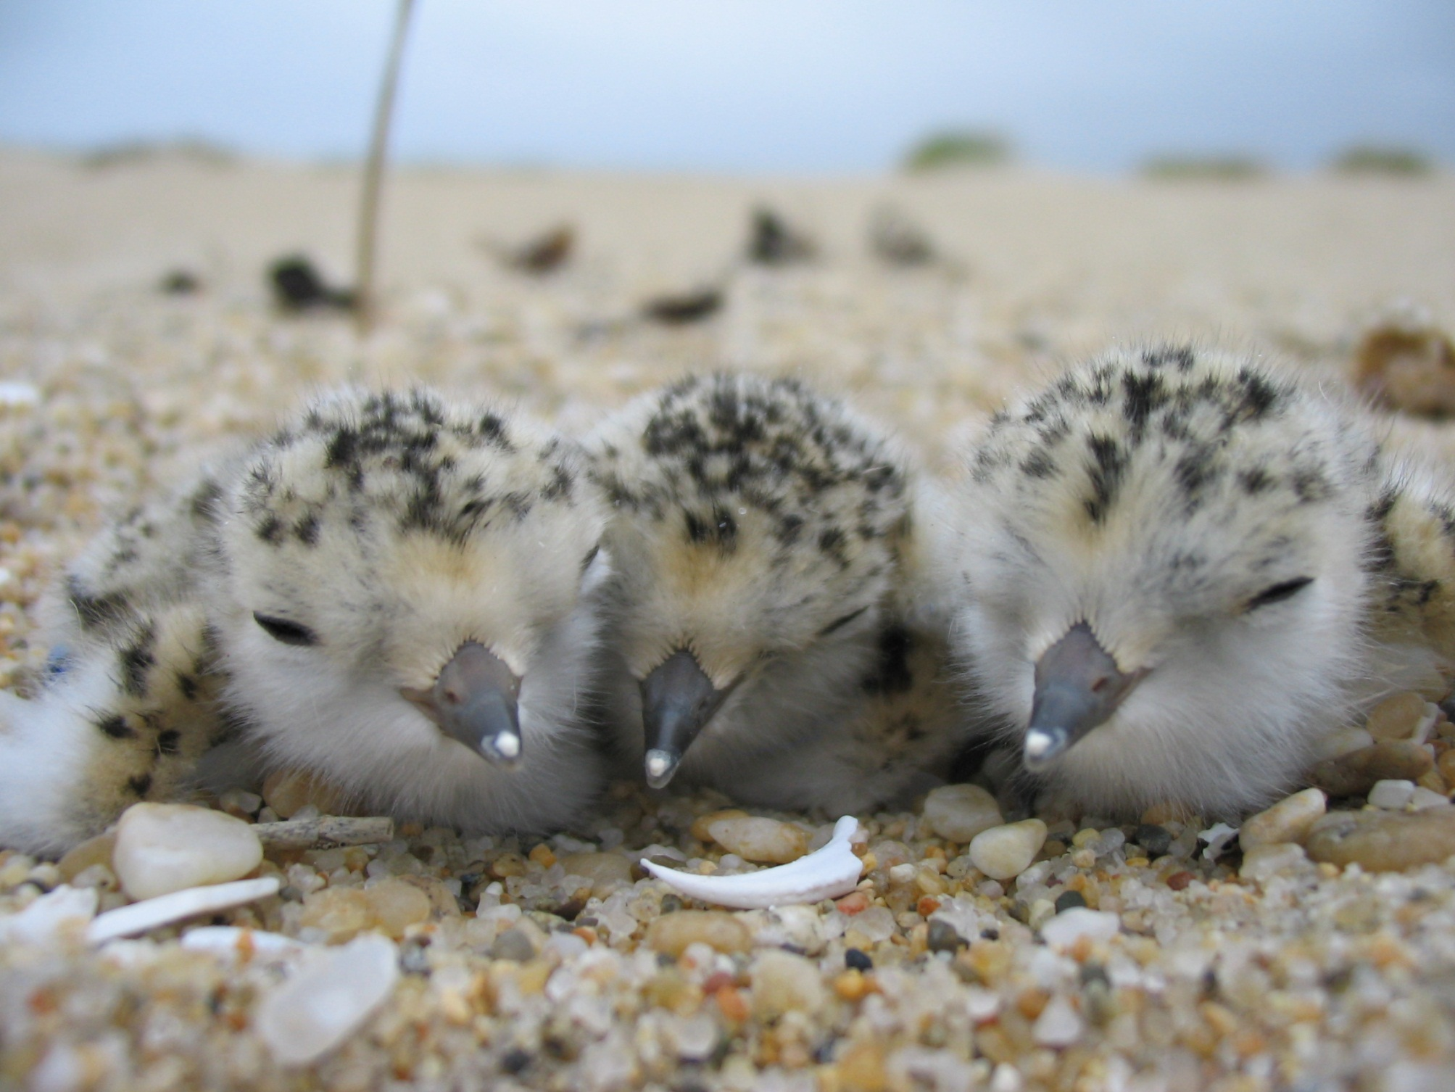

QUESTIONS?
Wildlife Response Coordinator
holly.gellerman@wildlife.ca.gov
o (916)324-6715 c (916)747-0611
www.dfg.ca.gov/ospr/wild-response.aspx

