Slide 1
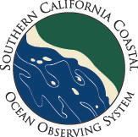
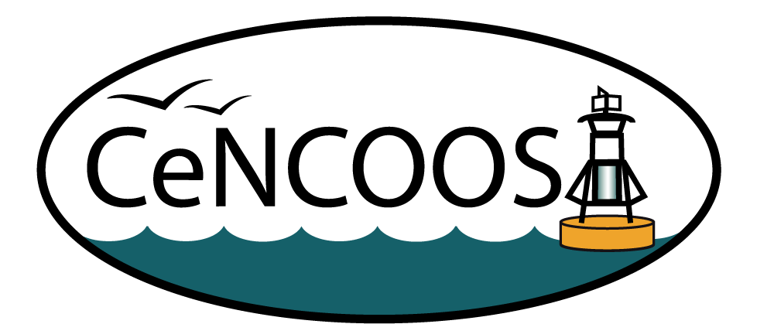
Real Time Ocean Observing for Industry, Government and the Public
Toby Garfield
San Francisco State Universtiy
And
Julie Thomas
University of California, San Diego
OSPR/Chevron Oils Spill Response Technology Workshop
February 27, 2013

Slide 2
This talk is made up of material from many people, not much is “original”
Zdenka Willis: NOAA IOOS Office
Leslie Rosenfeld and Jennifer Patterson: CeNCOOS
Julie Thomas, Lisa Hazard and Eric Terrill: SCCOOS, CDIP and CORDC
My colleagues who built the California HF Radar array with support from the State Coastal Conservancy

Slide 3

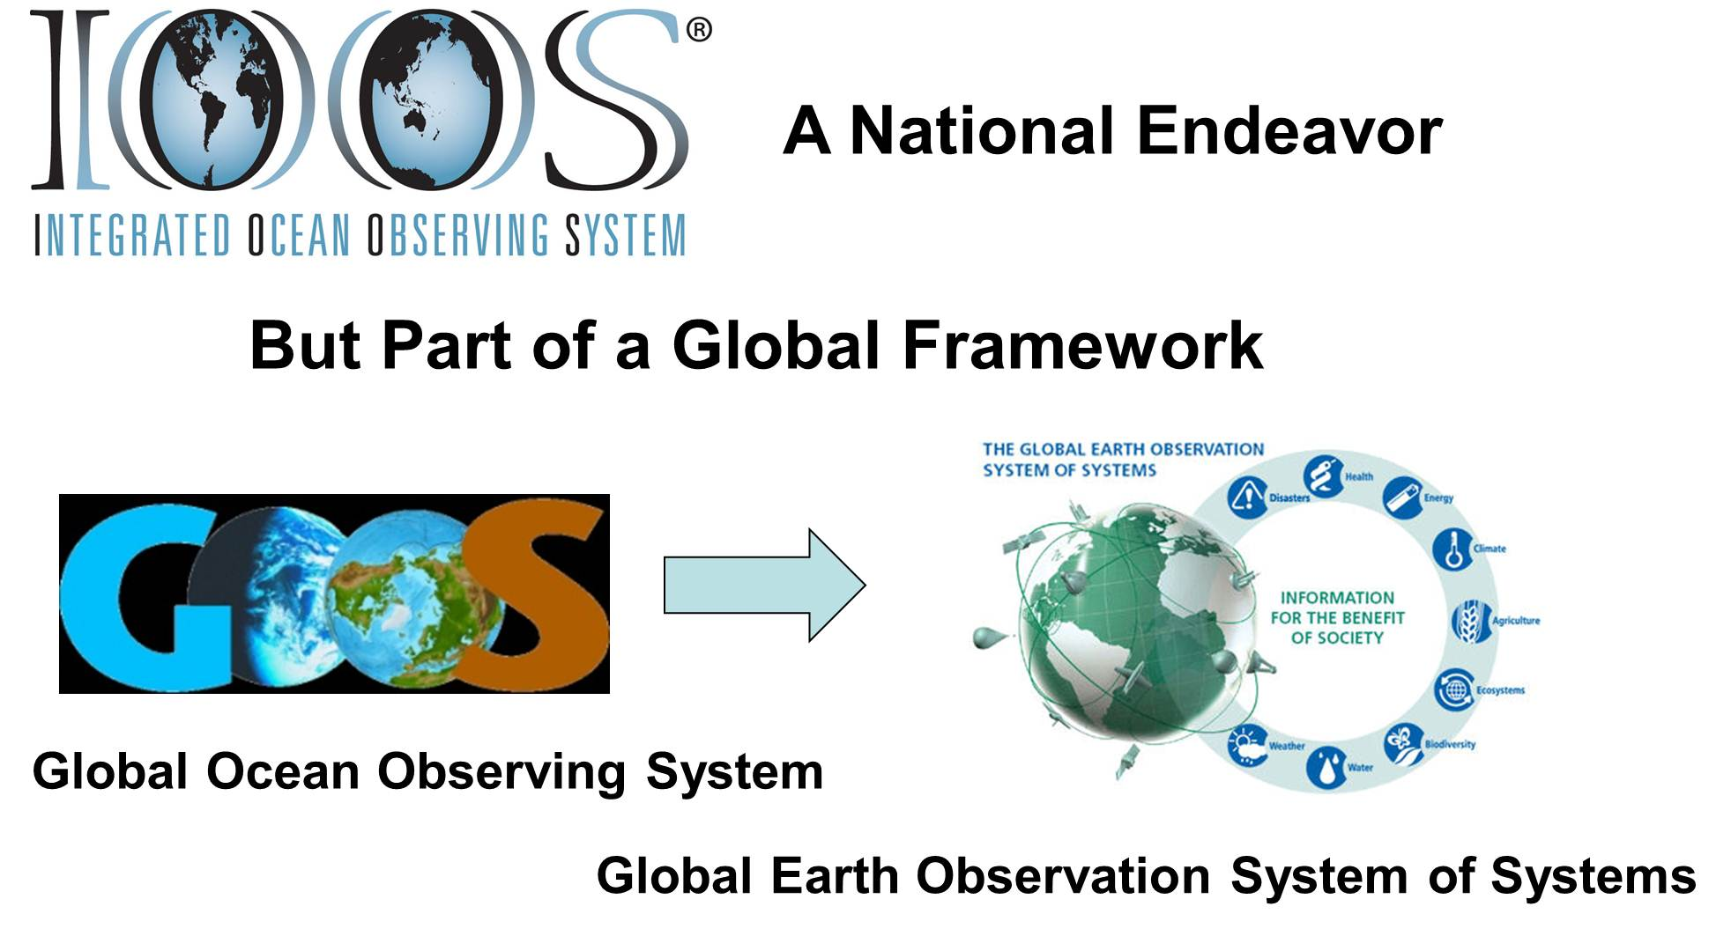
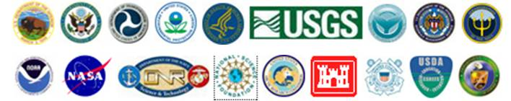
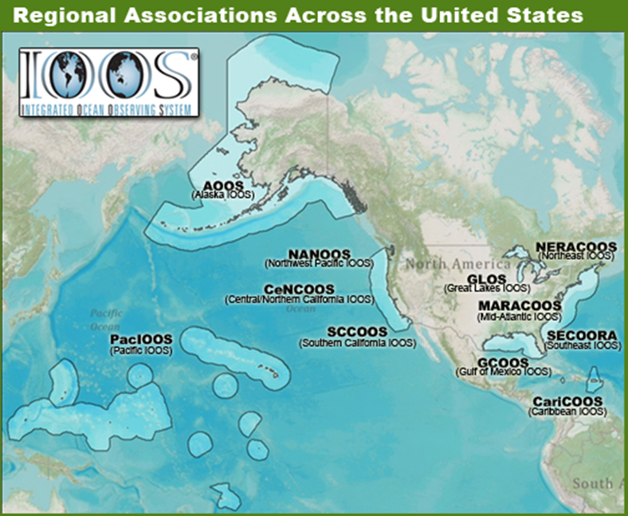
U.S. IOOS: Program Overview
WHO
WHAT
Observation
Data Management
Modeling & Analysis
Research & Development
Education
        WHY: 7 Societal Goals, 1 System
      Predictions of climate change and weather
      Safety and efficiency of maritime operations
      Forecasts of natural hazards
      Improve homeland security
      Minimize public health risks
      Protect and restore healthy coastal ecosystems
      Sustain living marine resources
WHERE
Global
Coastal (EEZ to tidal waters)
Enables Decision making and Science
Notes:
Oceans are critically important to our society and affect the lives of all Americans regardless of whether they reside along the coasts.
IOOS has a Federal and non-Federal footprint. The logos of the Federal Agencies you see hear all contribute to IOOS and have responsibilities in our Oceans, Coasts and Great Lakes. Federal participants oversees the global and national aspects. The 11 IOOS Regional Associations extend our reach to the regional and local stakeholders. Regional Associations are comprised of State, Local, Tribal governments, academia and industry. The Alliance for Coastal Technologies provides for new sensor evaluation.
The strategy allows us to maintain a local connectivity but ensuring a National Consistency.
IOOS® is a solution to increasing observing assets, seamlessly stitched together thought this national data management with models and analysis that extend sparse data both spatial and temporally to provide products that are tailored and driven by the user community
While the program has 7 goals it is really about integrating the information so that the same observing systems can be used to support all 7 goals.
The ocean knows no boundaries therefore US IOOS is not only a national endeavor but it is also part of a global framework, where the United States funds 50% of the global ocean observing system.

Slide 4
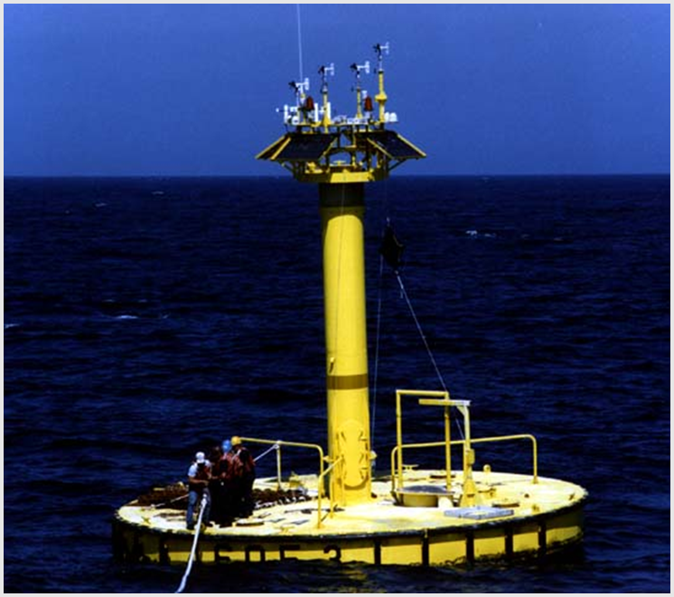
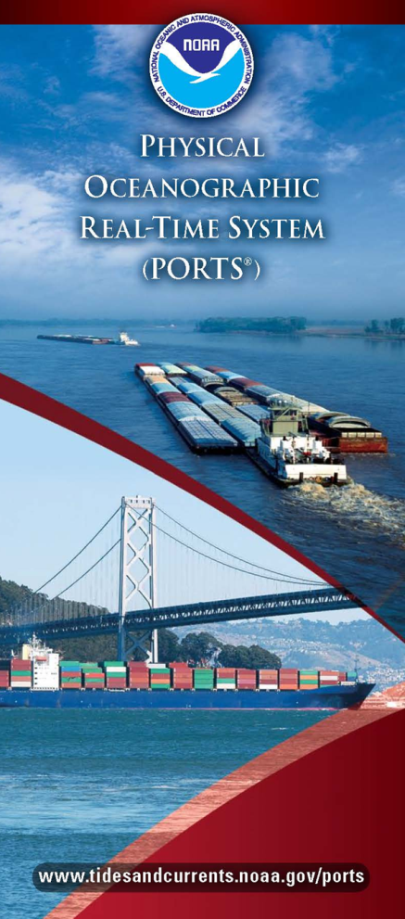
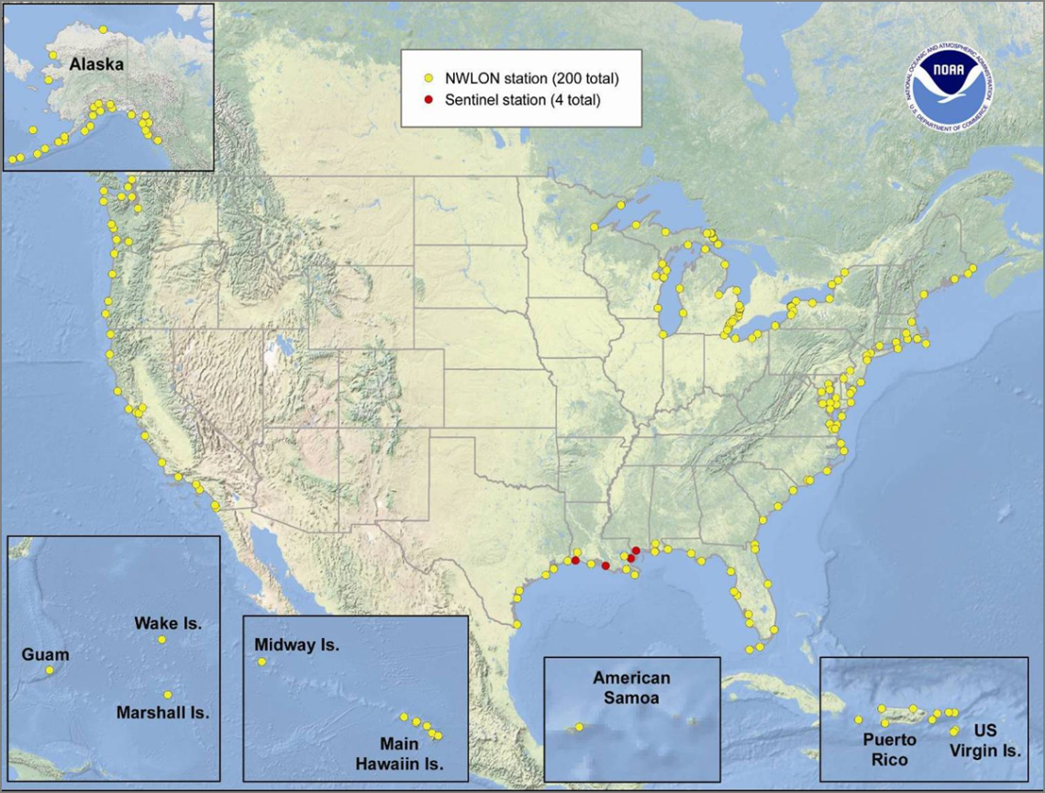
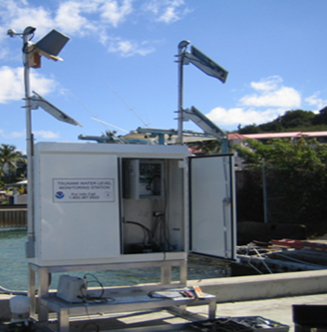
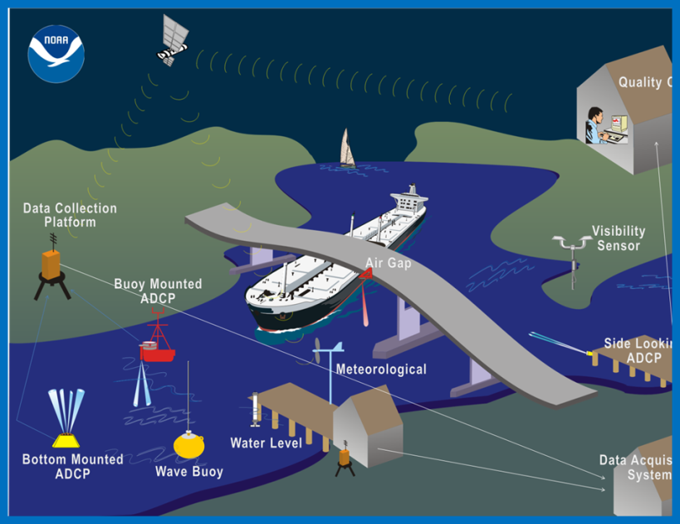
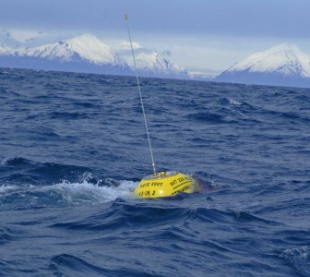
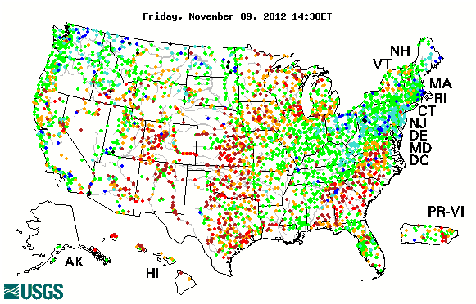
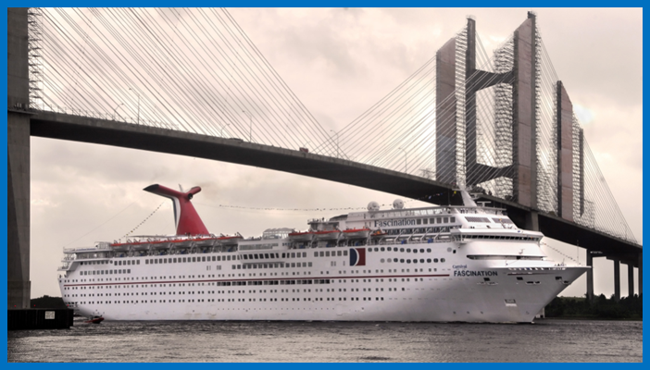
Observing System – Coastal Focus
Buoys: National - 109
Regional - 112
National Water Level Network: 210, 181 with meteorology packages
Wave Buoys: 200 NOAA, US Army Corps, IOOS Regions
National Wave Plan - 2007
Stream Gauges: 8400
PORTS®: 22 systems
Notes:
Taking a quick look at coastal observations across the United States. This shows how the Federal agencies such as NOAA for buoys are augmented by IOOS Regional buoys. Similarly wave buoys are provided by US Army Crops of Engineers, NOAA and the IOOS Regional Associations.
NOAA continues to increase the number and capabilities of its national water level observation network.
NOAA provides support to safe and efficient maritime transportation through the Physical Oceanographic Real-time System in 22 ports.
The United States Geological Survey maintains through a National and Regional partnership 8400 stream gauges
What is not depicted is the many water quality stations at piers, and in estuaries, the amount of human observations and discrete observations that need to be taken to understand the health of the ecosystem

Slide 5
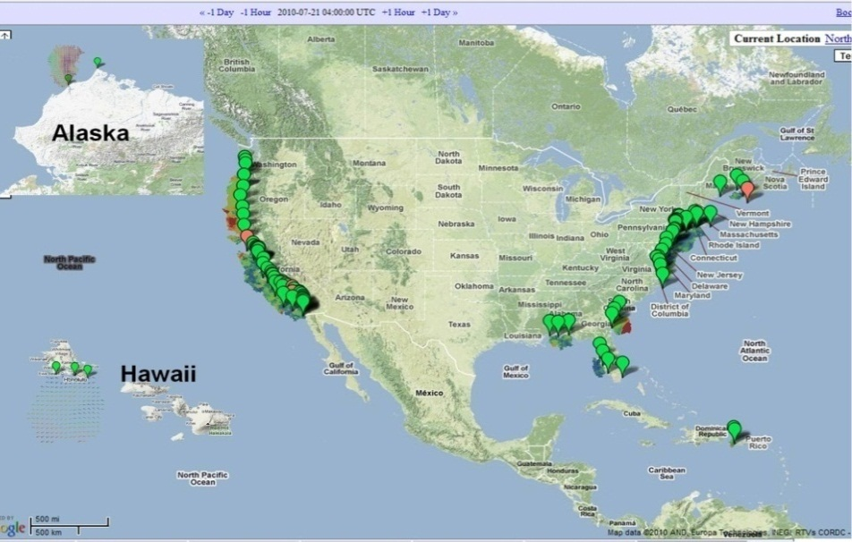
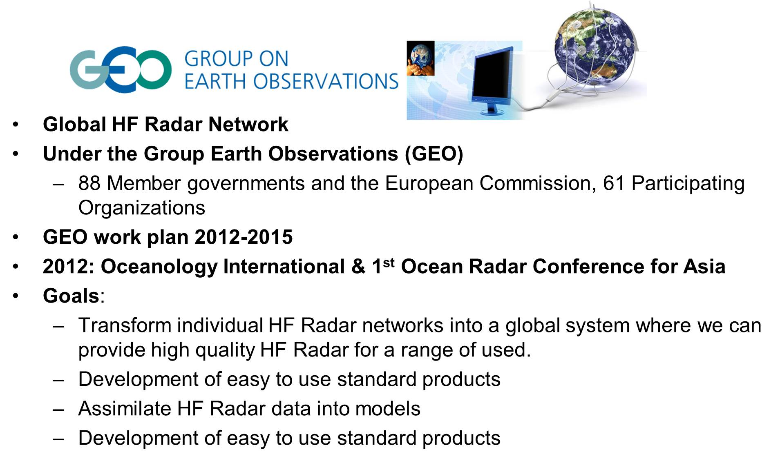
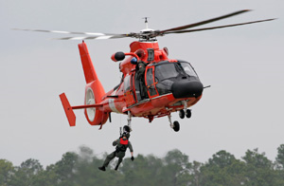
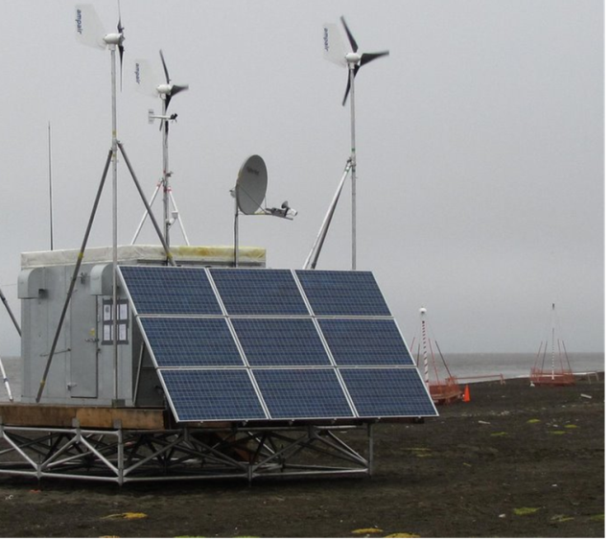
High Frequency Radar Network
Stakeholders
> 30 institutions operate HF Radars; used by >40 government/private entities
Who Depends on it
USCG Search and Rescue: Oil spill response
Water quality; Criminal forensics
Commercial marine navigation
Offshore energy; Harmful algal blooms
Marine fisheries
Emerging - Maritime Domain Awareness
Emerging – Tsunami
Decreases search area by 66% in 96 hours
Notes:
128 HF Radars operating in the network now. Includes 2 HF Radars on the East Coast of Canada operated by the Canadian Coast Guard.
Oil Spill Response: Operationally used for Cosco Busan, 2007; Deepwater Horizon, 2010.
Search and Rescue (SAR): Integrated into the operational US Coast Guard SAR operations (SAROP) program; deployed in the mid-Atlantic in 2009 – Extension Nationwide in 2011-2012.
Emerging Homeland Security needs: The Maritime Security Technology Program (MTP) of DHS S&T includes a project to expand the use of HF Radar to provide increased Maritime Domain Awareness (MDA) and Homeland Security.
As part of the GEO work plan 2012-2015 we have launched the global HF radar task. We have held 2 meetings to date and have 10 countries signed up. See www.ioos.gov for more information

Slide 6
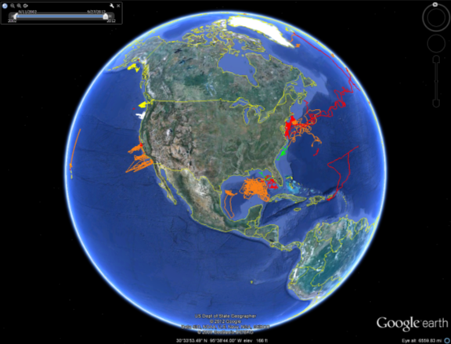
National Glider Network Plan
Asset Map
Workshop 2012
Strategy Website
Plan Development
  Steering Team
  Data Team
Glider DAC
Fig: Developed by D. Rudnick. Display of all glider missions provided since 2000. Shows strong coastal coverage.
Notes:
Significant progress was made developing a National Glider Network Plan.
Glider Asset Map Version 1 is online and displaying SCCOOS gliders. We’re still encouraging others to post their data, so if you have it, share it, and encourage others.
The National Glider Network Plan Workshop to kicked off our efforts at Scripps was held in August 2012.
The results of that workshop and all the presentations can be found on our website. We’ve built a page just to host glider information as we build the Network, http://www.ioos.gov/glider/strategy
Current status: Our current plan is to have the first full draft of the national plan complete by the end of the fiscal year. A final draft is currently in review.
In the Spring, we will circulate the plan to our NOAA partners, IOOS RAs directors (though hopefully most will have heard about its progress through their representatives that attended the workshop and have been helping with the development of the plan), the Observing Council, and the National Ocean Council for their review and input.
The Plan should be finalized by early summer.
In the meantime, our data team has been meeting approx. bi-weekly to determine glider data standards and to finalize the data flow for the Glider Data Assembly Center (GDAC). In the development of a GDAC, we will also be reevaluating the visualization and determining how to develop version 2 of the glider asset map, trying to maximize computer driven updating and populating of the map, provide access to data and tie the map to the rest of the IOOS catalog.

Slide 7
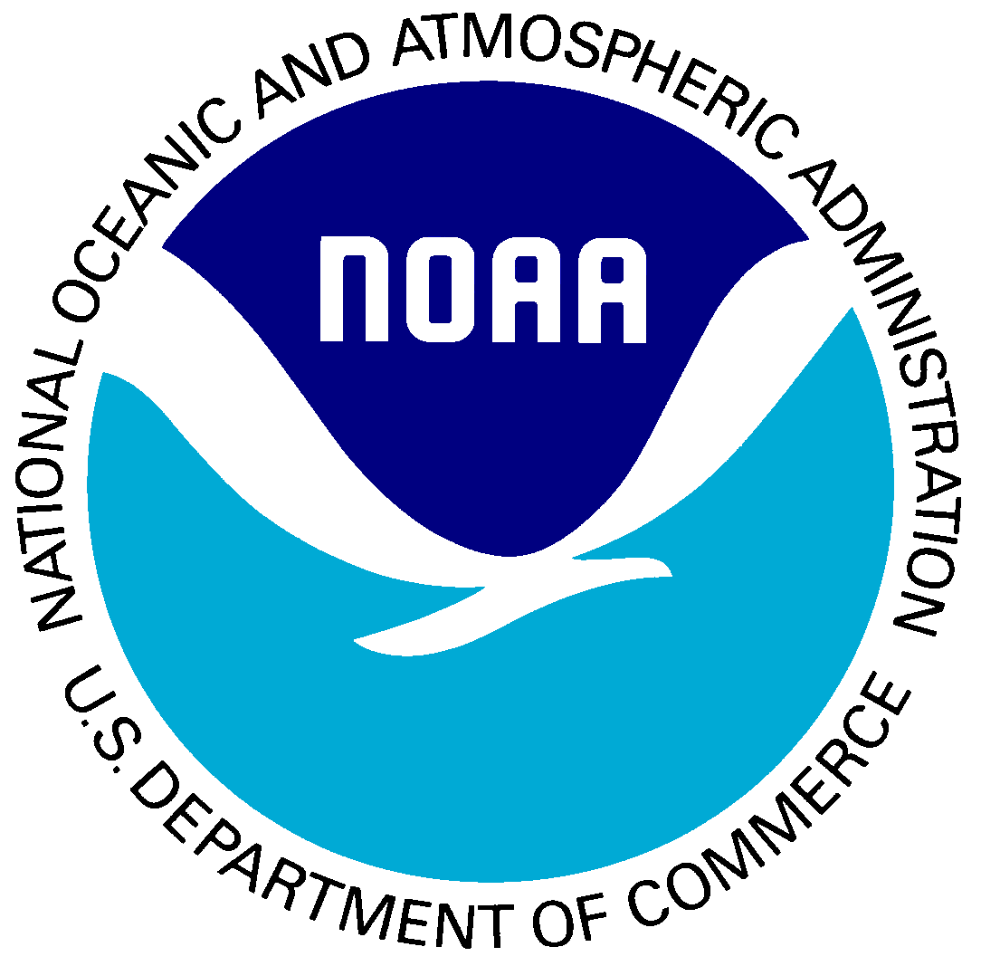
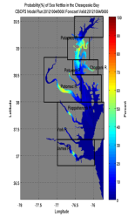
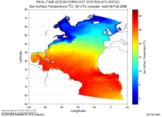
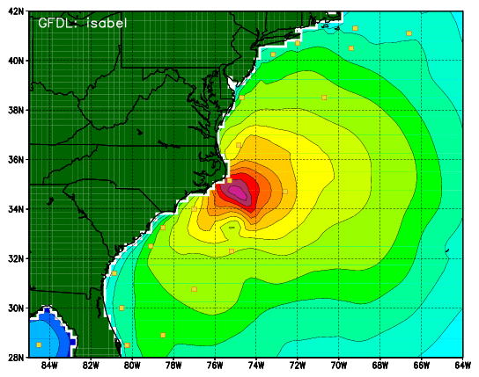
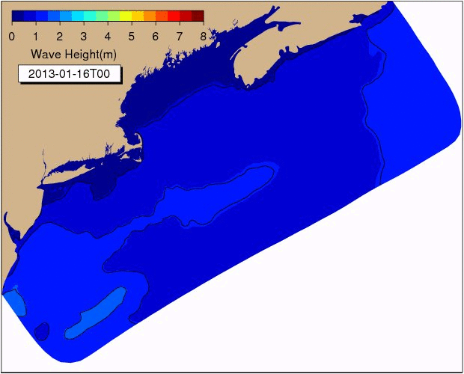
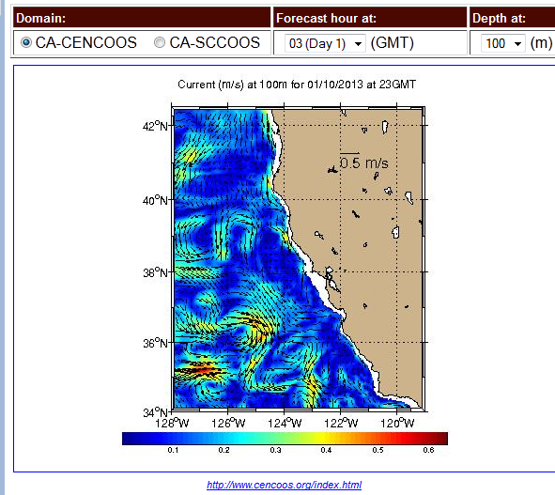
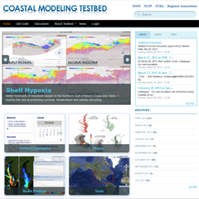
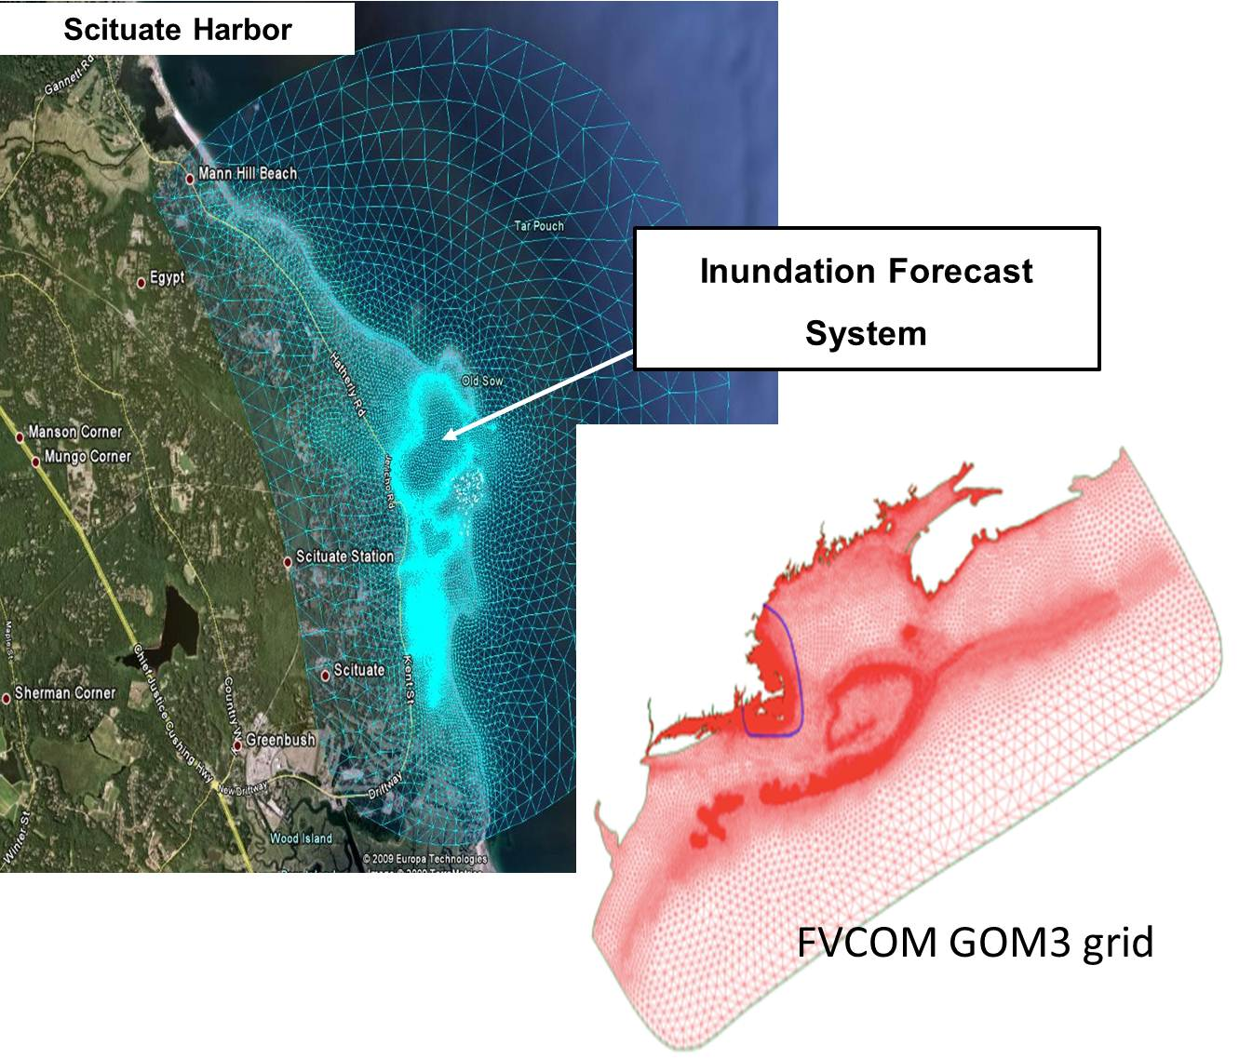
Modeling
NOS – OFS
Great Lakes
Northern Gulf of Mex
Columbia R.
Bays
Chesapeake
Tampa
Delaware
Global
Forecast
System
Oceans
HYCOM
WaveWatch
III
Hurricane GFDL
HWRF
Coupled
Sea Nettle
Forecast
Notes:
Coastal modeling is both at the national and regional level. NOAA has the responsibility for regional and coastal ocean dynamic, surge and wave modeling
This is augmented at the Regional level.
Example left side is from the North East Coastal Ocean Forecast system and is a 3 day waves model which uses the SWAN model adapted to unstructured grids and at high resolution.
In the middle at a higher resolution shows inundation down to the street level, which is done in conjunction with the local weather forecast office. Scituate Inundation Forecast System (Scituate IFS) uses FVCOM with flooding/drying option and driven by NECOFS forecast of surface atmospheric forcing, ocean waves, elevation, and 3D currents, temperature and salinity via one-way nesting. Scituate FVCOM grid developed using latest LIDAR bathymetry/land elevation, USGS bathymetry and state land elevation data. Scituate IFS is in final testing.
Uses unstructured grids
US IOOS also has maintained for the last 2 years a US IOOS modeling test bed that focused on the transition of models to operations with a number of success including the inundation model shown on the slide in the center.
Other regional modeling efforts include:
CariCOOS – validated SWAN and ADCIRC models
SCCOOS, CeNCOOS – developed CA Current Ocean Model webpage
GLOS – completed version 1 of finite volume community ocean model
MARACOOS – ran 3 new models, now total of 8 models with routine data assimilation
PacIOOS – developed 2 new operational Marinas wave models

Slide 8
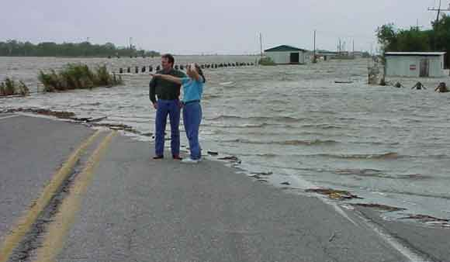
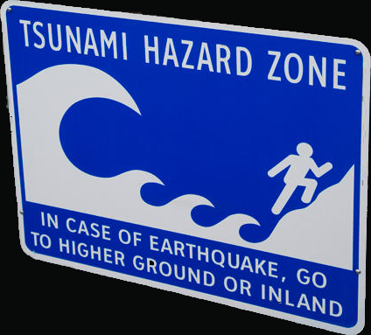
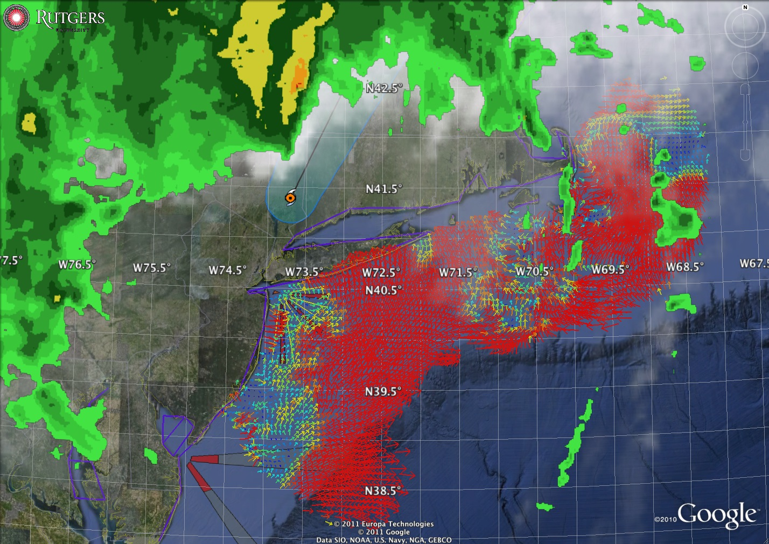
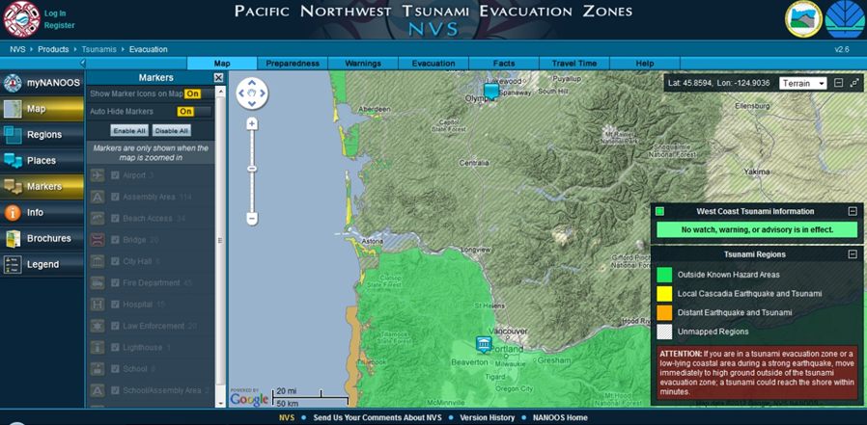
Coastal Hazards
Storm-driven flood predictions accurate to a city block
Tsunami evacuation zone details available online
Around-the-clock data and other information before, during and after hurricanes
U.S. Integrated Ocean Observing System (IOOS)
Notes:
Ocean Observing is critical to Hurricane Forecasting and Tsunamis: Non-Federal of US IOOS augmented NOAA’s observing and forecasting capabilities. NOAA used the buoys from Caribbean, Southeast, Mid Atlantic and Northeastern Regions of IOOS to track the Hurricane, initialize and verify forecasts. USCG, National Hurricane Center, and multiple WFOs used RA models to support local forecasts. As Irene progressed up the East Coast the Mid-Atlantic Regional distributed a dedicated hurricane blog with updates on the storm, especially with regard to high frequency radar data, glider routes and the phytoplankton bloom monitoring. MARACOOS delivered new forecasts to the New Jersey Board of Public Utilities. Underwater glider RU-16 collected an unprecedented 3D dataset from Irene that which will inform forecast model development (particularly intensity) well into the future.
Japanese Tsunami – March 2011: IOOS played a part in the warning and information flow of the tsunami wave’s reach to the United States. Nationally the DART buoys and tide gauges provided vital information for adequate warning. At the Regional level RAs saw five to ten-fold increases in web-traffic proving that the public trusts and look to their IOOS RA for local guidance during national and international distress. Pacific Island Ocean Observing System (PacIOOS) provided real-time water level (tsunami arrival) and turbidity (debris) measurements for Waikiki. The Northwest Association featured their “Tsunami Evacuation Zones for the Oregon Coast,” which has now been expanded to the Pacific Northwest Tsunami Evacuation Zones online portal and free app that provides an at-a-glance view of tsunami hazard zones along the coasts of Oregon and Washington. Southern California Coastal Ocean Observing System (SCCOOS) measured the tsunami signal documented by the NOAA tide gauge on the Scripps Institution of Oceanography pier and by pressure sensors at the four SCCOOS Automated Shore stations: Scripps Pier, Newport Pier, Santa Monica Pier, and Stearns Wharf. Central and Northern California Ocean Observing System (CeNCOOS) captured the tsunami passage using the Monterey Accelerated Research System, Humboldt, San Francisco, and Morro Bays. CODAR SeaSonde HF radars located in Japan and California detected and measured tsunami current flows, representing the first such tsunami observations occurred with any radar, between 10 and 45 minutes prior to its arrival at neighboring tide gauges.

Slide 9
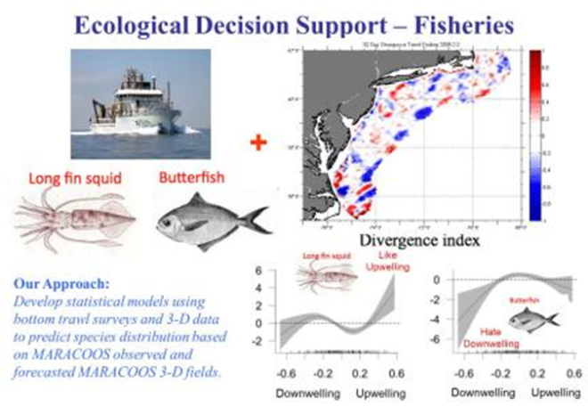
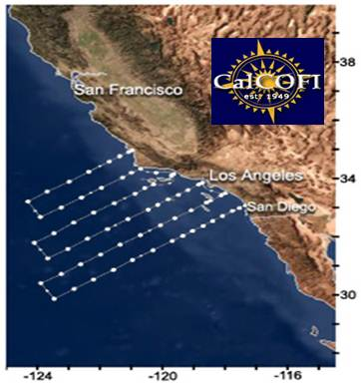
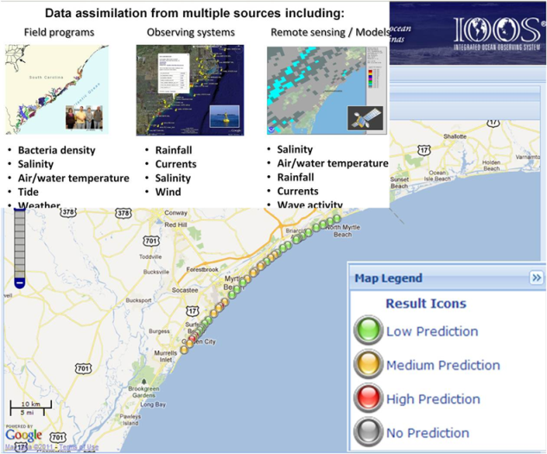
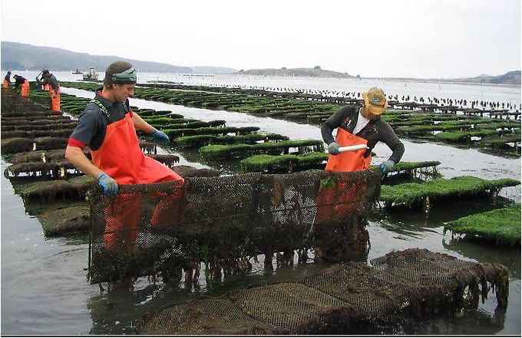
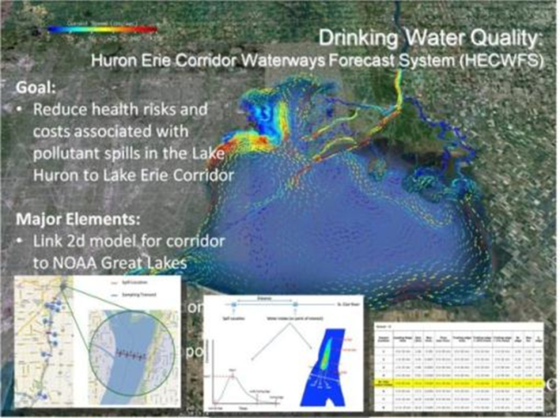
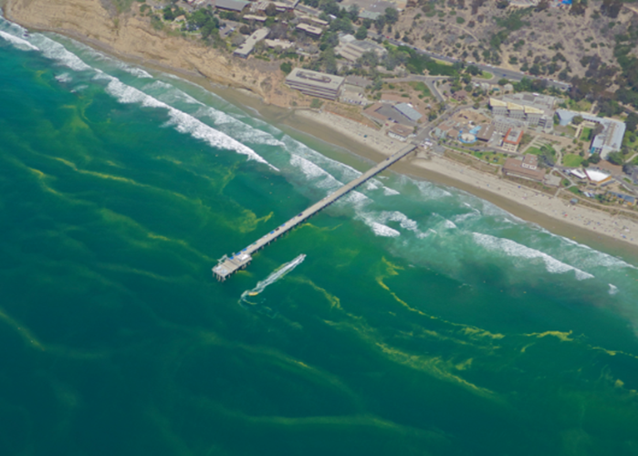
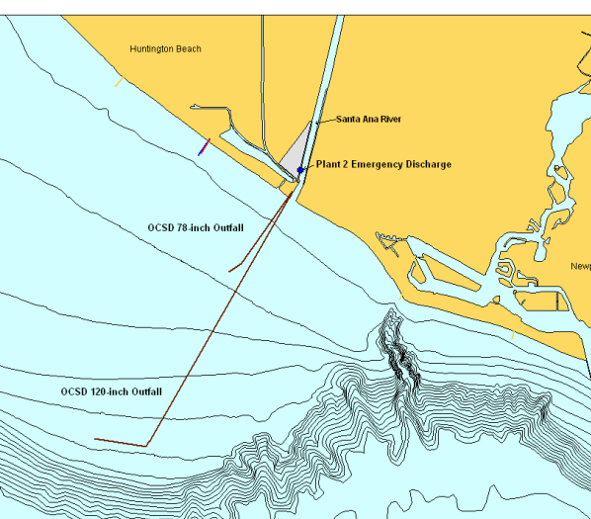
Ecosystem Services
Water Quality/Health Safety
Managing Fisheries/ Changing Climate
Data warn of approaching acidified water or water quality issues
A shellfish hatchery in Oregon had 70% productivity in 2010, up from 20% in 2008
Harmless Phytoplankton
bloom – July 2012
U.S. Integrated Ocean Observing System (IOOS)
Notes:
IOOS and NOAA are supporting the shell fish growers in the Pacific. One of my favorite quotes is from Mark Wiegart co-owner of Whiskey Creek Shellfish Hatchery in Oregon who said “Putting an IOOS buoy in the water is like putting headlights on a car. It lets us see changing water conditions in real-time.” Beginning in 2005, production at some Pacific Northwest oyster hatcheries began declining at an alarming rate, posing severe economic impact and challenging a way of life held by shellfish growers for over 130 years. Oyster production represents 76 percent of the $110 million West Coast shellfish industry, which supports more than 3,000 jobs. By 2008, oyster losses at Whiskey Creek, a supplier to about 75 percent of West Coast oyster farmers, reached 80 percent. At the same time, corrosive acidified seawater was reaching the Pacific Coast. NOAA and IOOS got involved and by 2010 the industry had rebounded 70 percent and now is part of daily business.
Calcofi – gliders, 1949 sardine collapse. Now ecosystem, gliders funded by NOAA climate program, IOOS
Water quality
Beach going
Drinking water
Sewage effluent

Slide 10
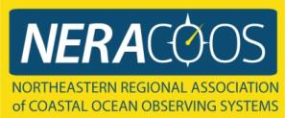
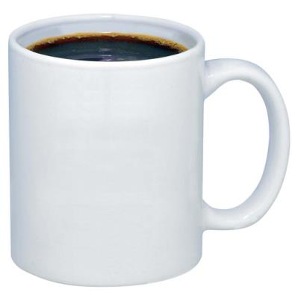
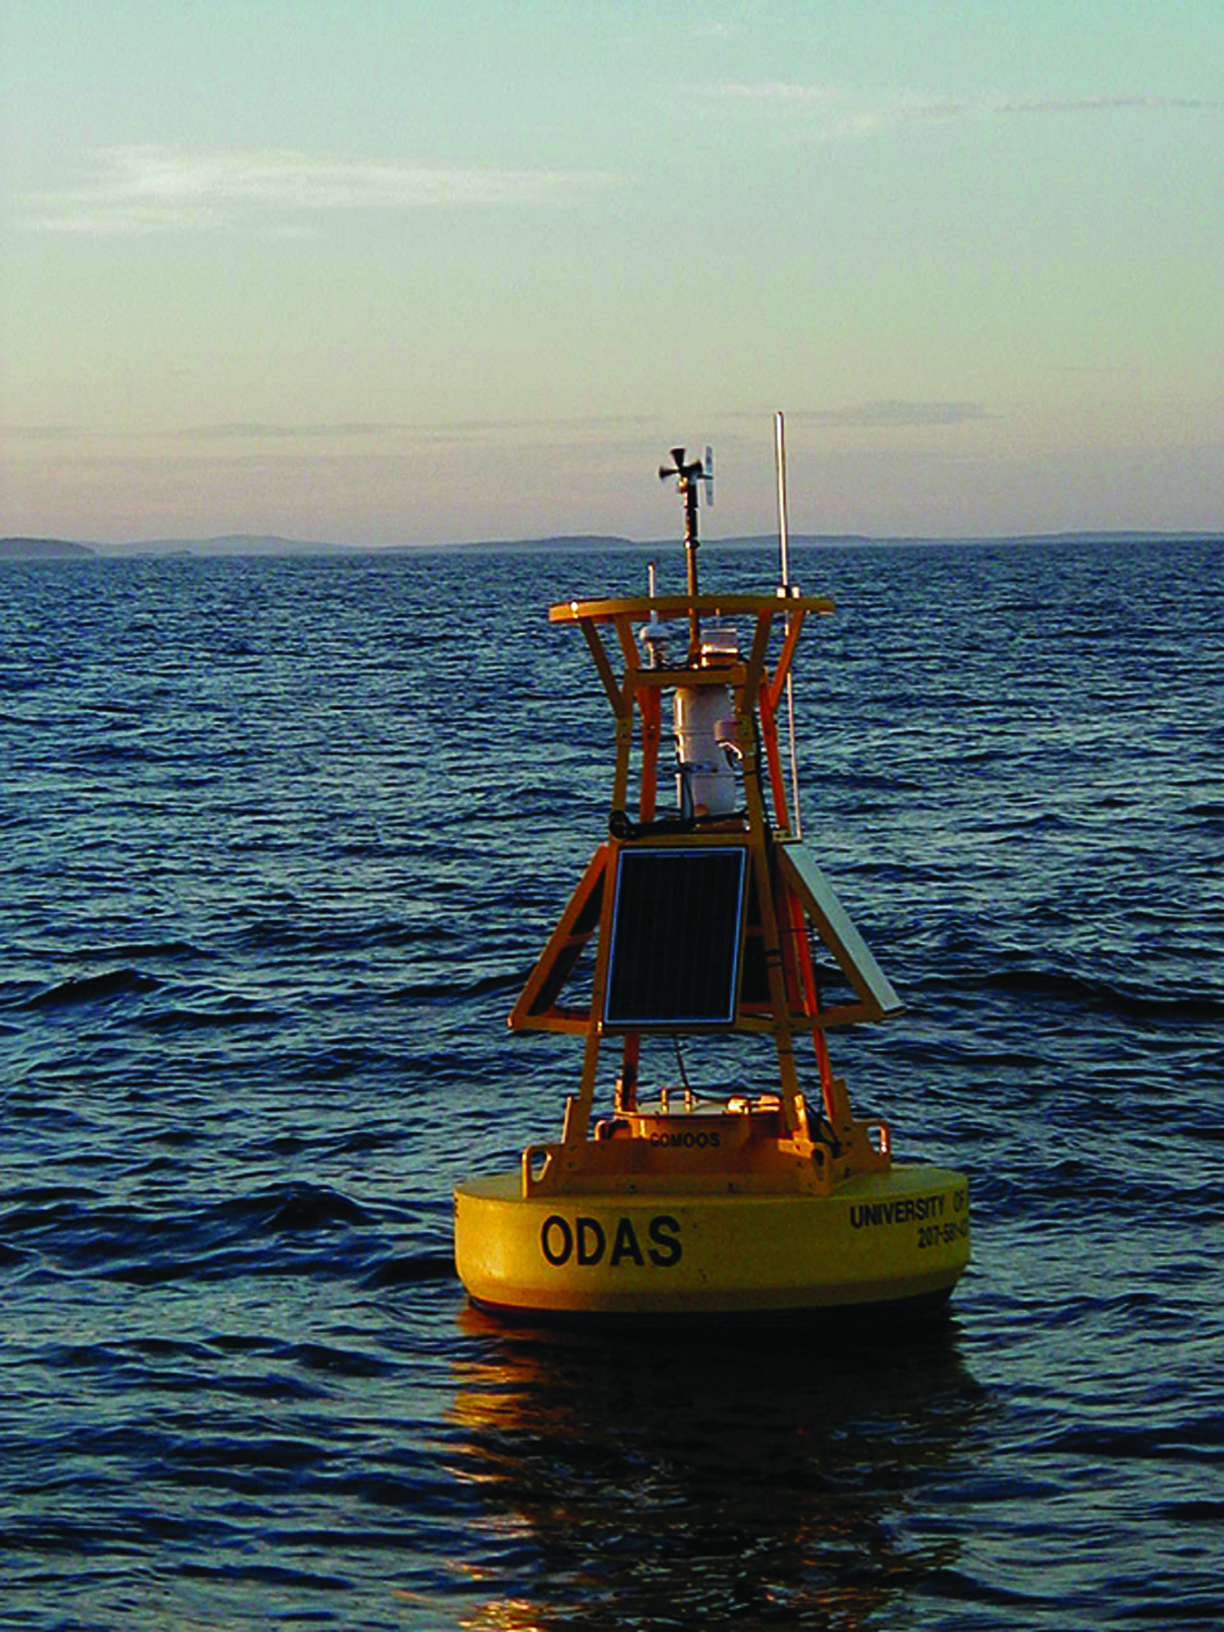
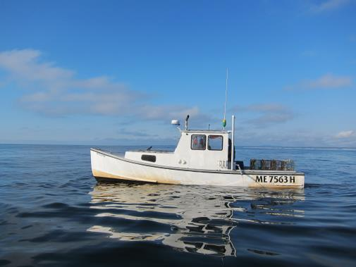
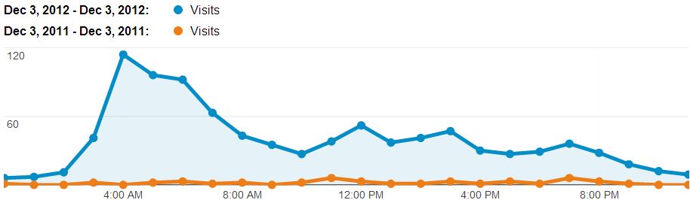
Maritime Operations
+ +
"I trust the weather buoys with my life. Thank you." - Maine Fisherman; "Love your service…I believe your service is a lifesaver. Thanks!" -Dave, Pilot; and "I would like you to know that information you are providing us not only aids us in our work, it almost certainly has saved lives." -Roy Atkinson, Fisherman.
U.S. Integrated Ocean Observing System (IOOS)
Notes:
So you might ask how are a cup of coffee, a buoy and a boat related.
Well when you look at the plot of hits to the NERACOOS website you see that it peaks at 4 am. In talking with fisherman they get up, get a cup of coffee, look at the conditions and determine whether they go out to see.
Both a lives and livelihood issue. Lives in ensuring the safety of lives – see the quotes and livelihoods because if it helps them to run an efficient fishing business.

Slide 11
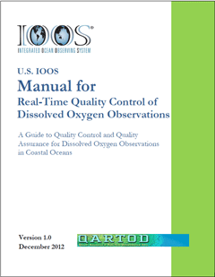
QA/QC efforts
Authoritative QA/QC procedures for the 26 U.S. IOOS core variablesManuals for these QA/QC procedures
Define a baseline set of QA/QC procedures that can be used for certification of RCOOS
Facilitate QA/QC integration with Global Ocean Observing System (GOOS) and other international ocean observation efforts
Work efficiently, without duplication of effort, to facilitate the implementation of common QA/QC procedures amongst US IOOS Partners.
Established in 2012
Notes:
Improving ocean data quality assurance and control will improve the accuracy of tools, models, and forecasts that inform decisions impacting our nation's safety, economy, and environment.
The Nation's ocean observing community now has quality assurance and control standards for real-time dissolved oxygen measurements collected in coastal waters. The U.S. Integrated Ocean Observing System (IOOS) recently released a manual on best practices for quality assurance and quality control tests of dissolved oxygen measurements taken by five commonly used sensors in all coastal regions, including the Great Lakes. The manual, developed in close collaboration with community experts, represents a major step forward for IOOS and includes control steps for the sensors, in addition to those for collected data, which are critical to guaranteeing quality of the data. The manual provides a checklist that the IOOS regions and many others can now use to implement quality assurance and control procedures, factoring in their specific, regionally-unique needs. The dissolved oxygen manual is the first in a series of similar quality control manuals, each focused on a different oceanographic variable. Dissolved oxygen was tackled first because scientists indicated this as a high priority for quality assurance and control standards. Manuals for waves and currents are scheduled for release in March.

Slide 12
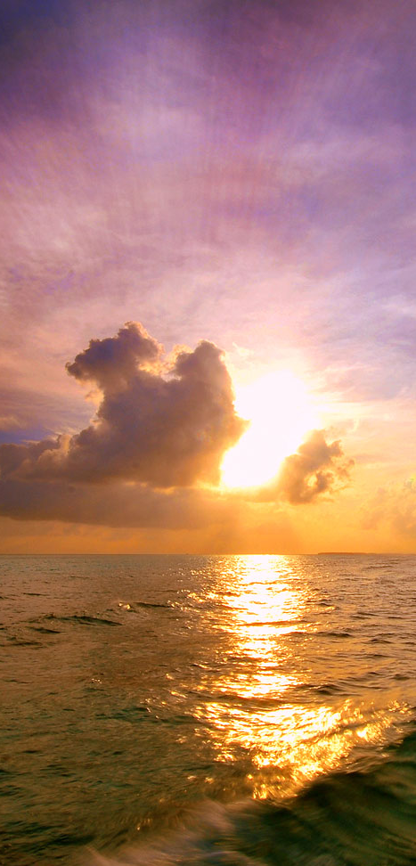

IOOS Summit 2012: A New Vision for IOOS
Major Highlights (ten year perspective)
Enhanced focus on regional/national/global integration
New research and operation models driven by public-private partnerships
Enhanced outreach and communications strategies
Incorporation of biological information
Summit report targeted for release ~ Feb 13, 2013
SUMMIT 2012
A New Decade for an
Integrated and Sustained
Ocean Observing System
November 13-16, 2012
Hyatt Dulles | Herndon, VA
Show your support to sustained ocean observing by signing the Summit Declaration:
http://www.iooc.us/summit/the-us-ioos-summit-declaration/

Slide 13
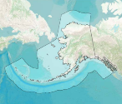
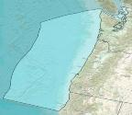
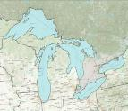
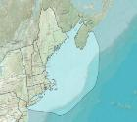
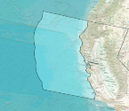
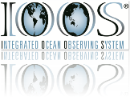







IOOS WORKS IN THE REGIONS
AOOS
NANOOS
GLOS
NERACOOS
CeNCOOS
MARACOOS
PacIOOS
SCCOOS
GCOOS
SECOORA
CariCOOS
Notes:
The IOOS Regional Associations not only built capacity in observations, data management, modeling, and education/outreach, but also developed new tools built across these disciplines. For example:
- ACT developed test protocols for pH sensor validation and verification.
- AOOS built a new oil spill response tool for Cook Inlet, to better manage spill responses; AOOS also created Arctic region webpages which help stakeholders access information such as the Arctic sea ice atlas, glider missions in the Chukchi, HF Radar deployments, ocean acidification monitoring, and where to access other Arctic resources.
AOOS/NOAA collaborated on Salmon Run Timing Prediction project, a joint research project between NOAA’s Auke Bay Lab and Alaska Department of Fish & Game (ADFG). The project has shown a strong correlation over the past 51 years between certain oceanographic conditions and salmon run timing. The team predicted the timing of the salmon runs in the last two seasons to within three days of the actual timing before the start of each run.
- CaRiCOOS developed a ship tracker, which plots near-real-time positions of ships at sea using the Automatic Identification System (AIS).
- CeNCOOS developed an app, Currents on the Bay, which improves safety through real-time and predicted information on surface currents within the San Francisco Bay.
- GLOS supported monitoring activities that provide oxygen levels, water temperature, and wave heights to the Cleveland Division of Water, which allowed for water system shut downs to avoid taking in low quality raw water or adjust treatment appropriately. GLOS also developed new web tool displays, providing information to recreational boaters on the St. Lawrence River, such as nowcasts and 12-hour forecasts of water currents and depth, river condition alerts, details about boat launching locations, and information to aid trip planning.
MARACOOS developed a Rip Current app which helps protect swimmers from coastal rip tides. Rip currents account for 80% of all water rescues and causes over 100 drownings each year in the United States. The app, developed by the Stevens Institute of Technology, helps lifeguards identify and catalog rip current occurrences.
NANOOS developed the Pacific Northwest Tsunami Evacuation Zones online portal and smartphone app, an at-a-glance view of tsunami hazard zones along the coasts of Oregon and Washington.
- NERACOOS developed the Scituate Inundation Forecast System, a new system for forecasting coastal hazards such as Nor'easters, hurricanes and other coastal storms, and provides more detailed coastal forecasts in warning of coastal flooding, and to facilitate evacuation and other emergency measures.
PacIOOS developed a high water level forecasting tool which provides advanced notice of the potential for high sea levels.
SECOORA developed a predictive beach water quality model which was used by the South Carolina Dept of Health and Environmental Control to made a decision to cease support of its rain gauge system that was costly and time consuming to maintain.

Slide 14
What are CeNCOOS and SCCOOS?
www.CeNCOOS.org
CeNCOOS
  Central and Northern California Ocean Observing System
  Extends from Pt Conception to OR border, from the coast out to 200 nm offshore
  Program Office at MBARI, Moss Landing
  48 member organizations
SCCOOS
  Southern California Coastal Ocean Observing System
  Extends from Pt Conception to Mexican border, from the coast out to 200 nm offshore
  Program Office at Scripps Inst. of Oceanography, San Diego
  11 member organizations
www.SCCOOS.org

Slide 15
What do CeNCOOS and SCCOOS do?
Manage an “end-to-end” coastal ocean observing system …
… to benefit USERS in four broad focus areas:
- data collection
- data management
- data dissemination
- numerical model simulations
and forecasts
- product development
- user outreach and facilitation
Water quality
Ecosystems and climate
Marine operations
Coastal hazards

Slide 16







CeNCOOS and SCCOOS Technologies
High Frequency Radar
Gliders
Automated and Manual Shore Stations
Ship-Based Surveys
Harmful Algal Bloom Program
CDIP experimental Sea & Swell Model
Notes:
SCCOOS, is headquarter at Scripps Institute of Oceanography but is comprised of many academic, state/local agencies and industry partners.
The coastal data information program was established in response to a call for the development of a nearshore wave climatology for the US which would allow coastal engineers and planners to make more rational design decisions, USACE program, since 1975. This has been based at SIO since 1975. Funded by: USACE & CDBW it is USACE’s contribution to US IOOS
SIO pier has been sampling since 1916, the oldest data set of Sea Surface Temperature in the world.
Maintains the longest continuous HF Radar network, thanks to both IOOS and CA state funding
1. If 3 day forecast shows >12 seconds waves, then automated message is sent. Important for super tankers as they will start to pitch in long period swell. 2. Deep draft vessels run the risk of hitting the bottom. 3. Cost > $100K -$200K/day to hold a tanker Offshore.

Slide 17





CeNCOOS and SCCOOS Applications
Waves Predictions for Effective Maritime Transportation
Measuring Ocean Acidification as part of California – Current Ocean Acidification Network
Water Quality/Health Safety though observations , data management and modeling
Harmless Phytoplankton
bloom – July 2012
Managing Fisheries/ Changing Climate
U.S. Integrated Ocean Observing System (IOOS)
Notes:
SCCOOS provides science based decision making and advances to science in a number of ways. Here are three examples:
Maritime Safety: Using both the wave information and surface currents coupled with wave models, SCCOOS can provide 3 day forecast that will warn the pilots of LA/Longbeach on conditions that could cause the super tankers to pitch risking groundings by these deep draft vessels. The forecasts have to on the mark because if you need to hold a tanker offshore the cost is between $100K -$200K per day.
Ensuring good water quality to Southern CA: The Orange County Sanitation District (OCSD) routinely reduces flow through and shuts down the 120-inch outfall which is 4.5 miles offshore in order to perform necessary maintenance and repairs and to facilitate construction projects. When this is done they must use the 78 inch outfall pipe that is 1 mile. The OCSD relies on SCCOOS to understand real time oceanographic conditions. SCCOOS has developed a set of products to support both routine ocean outfall operations and in the advent of any unplanned or planned discharges to OCSD's 78-inch ocean outfall or to the Santa Ana River. This information can be used by OCSD operations and environmental monitoring staff, regulators and the public in the advent of any planned or emergency discharge from the OCSD 78-inch ocean outfall or to the Santa Ana River.
Also advances understanding of the ecosystem an climate science
The California Cooperative Oceanic Fisheries Investigations (CalCOFI) are a unique partnership of the California Department of Fish and Game, NOAA Fisheries Service and Scripps Institution of Oceanography. The organization was formed in 1949 to study the ecological aspects of the sardine population collapse off California. Today our focus has shifted to the study of the marine environment off the coast of California, the management of its living resources, and monitoring the indicators of El Nino and climate change. CalCOFI conducts quarterly cruises off southern & central California, collecting a suite of hydrographic and biological data on station and underway.
SCCOOS supports nine nearshore stations of the California Cooperative Oceanic Fisheries Investigations (CalCOFI).
Gliders are being used in understanding fisheries management. The ships go out quarterly, but the gliders are able to occupy the lines continuously therefore we can get a more complete picture of what is going on in the ecosystem
An El Nino event is marked by warm water in the equatorial Pacific. The Spray glider lab, headed by Dan Rudnick, has calculated a "SoCal Niño Index" using glider-measured temperatures at 50 m along CalCOFI line 90 (off of Dana Point), averaged over the inshore 200 km and filtered with a 3-month running mean. The indices are remarkably correlated NOAA’s indicies. NOAA is now predicting El Niño conditions in the next couple of months (temperature anomalies greater then 0.5C). Glider observations are supported by the NOAA Ocean Climate Observation Program through the Consortium on the Ocean's Role in Climate, BP through a cooperative agreement with Scripps Institution of Oceanography, and the Integrated Ocean Observation System (IOOS) through SCCOOS.

Slide 18
Waves http://www.cencoos.org/sections/conditions/waves.shtml
CDIP and NDBC wave buoys linked to CeNCOOS and SCCOOS waves pages
CDIP wave models linked to waves and models pages
CeNCOOS-generated wave climatology product
Wave ht only available thru CeNCOOS data portal

Slide 19





Coastal Data Information Program cdip.ucsd.edu
Mission: Monitor and predict near shore waves and shoreline change.
Based at SIO since 1975
35 Wave Stations, LIDAR & In-Situ Beach Surveys
17 People
$3.5M+ / yr budget
Funded by:
USACE
CDBW
Investigators:
Richard Seymour
Robert Guza
Bill O’Reilly
Storm and El Niño enhanced sea levels during an extreme tide
Ocean Beach Feb 1983

Slide 20



CDIP Swell Model
CDIP measures, analyzes, archives, and disseminates coastal environment data for use by coastal engineers, planners, and managers, as well as scientists and mariners.

Slide 21


Wave Climatology: CDIP Buoy Pt. Reyes Past/Present Wave Heights
http://www.cencoos.org/sections/products/wave_climatology.shtml
Notes:
A dynamic graph of significant wave heights averaged and updated each day. This product is generated using data from CDIP buoy (located 22 NM west of Pt. Reyes, CA), measuring the 1/3 highest waves every 30 minutes. Plots of daily wave heights for each year since 1997 are represented on the graph, with the current year data highlighted. A long-term mean line, created by averaging wave heights from all previous years (updated every year), is also included on the graph for comparing with the current year wave heights. The maximum daily averaged wave height measured since 1997 is also displayed (23.2 ft on Jan 19th 2010).

Slide 22

http://cdip.ucsd.edu/

Slide 23


Slide 24
Notes:
In Situ Observations: began over 10 year ago when RTC built its present research pier. This has been supported first by CICORE funds and now CeNCOOS. All our data goes through the appropriate QA/QC and then is posted to the CeNCOOS data server. There are 15 RTC assets that feed into the CeNCOOS data server

Slide 25





Notes:
Three of SFSU assets are the meteorological station at our pier and our in situ sondes both at our pier and at the Cal Maritime wharf in Carquinez Strait.
25

Slide 26

Notes:
26

Slide 27
Notes:
And we also use the site to provide for specific requests. I’m not sure how many people realize that tankers use oz/ft³ to determine water density and then the draft to which they can load the vessels!

Slide 28

Capturing events as well as trends
Notes:
In addition to the longer term trends that must have long time series to capture, the array is excellent for episodic events. Here is the Japan tsunami moving up through SF Central Bay and San Pablo Bay and into Carquinez Strait. Fred also did a nice diagram of the rate of change of the ocean surface along the outer coast.

Slide 29
Why is surface current mapping with HF radar important?
Provides continuous, high resolution mapping of currents for:
Tracking point source pollution or discharges
Oil spill preparedness and response
Search and Rescue
Marine operations
Connectivity analyses: e.g. MPAs, coastal discharges, larval retention areas
Assimilation into numerical models
Analysis of long-term trends

Slide 30

HF radar is a land based system that uses the reflection of radio frequency transmissions off of ocean surface waves to calculate the surface current speeds.

Slide 31


Radial currents from multiple sites are combined to derive the full current vector field.

Slide 32
February 11, 2013

Slide 33
February 11, 2013

Slide 34
February 11, 2013
IOOS HF radar antennas along the continental US: http://www.cordc.ucsd.edu/projects/mapping/

Slide 35



April 20, 2010 – no systems operating
April 24, 2010 – USF systems online
HF Radar National Network (HFRNet) – Coastal Observing Research and Development Center at Scripps Institution of Oceanography – PI Dr. Eric Terrill eterrill@ucsd.edu
British Petroleum (BP) Incident Command Center (ICC)
NOAA IOOS liason: Dr. Jack Harlan jack.harlan@noaa.gov
Office of Response and Restoration (OR&R) Emergency Response Division (ERD)
(formerly Hazardous Materials Response Division (HAZMAT))
Official NOAA forecasts for oil spill trajectories General NOAA Operational Modeling Environment (GNOME)
Office of Response and Restoration (OR&R) Assessment and Restoration Division (ARD)
GIS shape files of HFR products and a data feed to the Environmental Response Management Application (ERMA)
Near real-time currents available in various formats (NetCDF, GNOME NetCDF, Shapefile, kml): http://cordc.ucsd.edu/projects/mapping/
Near real-time currents available via THREDDS at NDBC: http://sdf.ndbc.noaa.gov:8080/thredds/catalog.html
Ocean Observing assets and data availability: http://rucool.marine.rutgers.edu/deepwater/
May 1, 2010 – USM systems online

Slide 36


Mapping Surface Currents in Gulf of Mexico with HF Radar
Scripps Point of Contact: Eric Terrill (eterrill@ucsd.edu) www.cordc.ucsd.edu/projects/mapping
Scripps HF Radar Activities in Gulf Of Mexico
Developers of realtime data management and distribution system for national network (120+ radars). Leverages State of CA network.
Processing of data for NOAA OR&R for official trajectories.
Realtime Google products for data overlays.
BP funded project to develop capability for HF radar on oil platforms
SAR imagery from CSTARS/UMIAMI. OI mapped HF Radar surface currents from CORDC/SIO. Radars operated by USM.
Notes:
2005 – COCMP establishes California HFR array and web access through CORDC,
2005 - IOOS office supports CORDC to develop architecture for HFR national network distribution,
2006 – SafeSeas06 was the first collaborative effort between CeNCOOS and OR&R Hazmat: netCDF format standardized,
2007 – CoscoBusanincident used HFR in spill predictions, development of GIS format,
2008 – NPREP netCDF and GIS formats standardized.

Slide 37


Integrated observations and model forecasts http://rucool.marine.rutgers.edu/deepwater

Slide 38


Case Study 3: Tar Balls
Late January 2008, oil and tarballs washed up on beaches from Monterey to San Francisco
They were determined to be from a natural seep, not from the Cosco Busan or other spil

Slide 39


Surface current measurements showed that the tarballs’ appearance followed a period of exceptionally strong flow from the south
Jan. 26, 2008

Slide 40

2012 Orange County Sanitation District (OCSD)
Ocean Outfall Diversion
The Orange County Sanitation District (OCSD) discharges its treated effluent from a 120-inch ocean outfall that terminates in 200 feet of water, approximately 4.5 miles offshore Newport Beach and Huntington Beach.
On September 14, 2012 OCSD diverted the flow from the 120-inch outfall to the 78-inch outfall as part of a project to inspect, assess, and rehabilitate the Outfall Land Section and Ocean Outfall Booster Pump Station Piping.
The District has a secondary, 78-inch outfall located in about 60 feet of water, 1 mile off the coast. Periodically, OCSD request special permits to divert effluent from the 120-inch pipe to the 78-inch pipe for emergency purposes and planned maintenance projects.

Slide 41
SF Sewage District Ocean Beach Outfall Discharge
October, 2007
http://norcalcurrents.org/COCMP/outfall_tracking.html
Notes:
Colors denote hours after particles released (red = 6, green = 12, blue = 24) for ensemble of trajectories calculated over Oct. 1-10, 2007. Gray arrows are sample surface current vector map from 10/06/07 at 0600 GMT.
The end gate to the Southwest Ocean Outfall offshore of Ocean Beach in SF was lost in Oct. 2007. Buoyant fw mixture was released from the pip 6.5 km offshore. These results were produced in response to a request from the SF Public Utilities Commission.

Slide 42


The iPhone/iPad App is back, I think!

Slide 43




Tsunami detection with HF radar
Time series of velocity components from the radar at Bodega Bay and simultaneous water level observations from the Point Reyes tide gauge. Radial velocities were resolved perpendicular to the shore, and averaged over bands 2-km wide parallel to the shore.
Lipa, et al 2011, Remote Sensing

Slide 44

Determining the areas for a higher possibilities of debris stranding on the shore. This was done using a two-year data set of HF radar daily surface currents.

Slide 45

"Drop-a-Drifter" tool
http://ourocean.jpl.nasa.gov/MB/mbmangen.jsp
Get to this under Data Products menu
For multiple drifters,
Click to see push pin;
Drag mouse to get box
Click again
Choose compute & plot
45

Slide 46




"Drop-a-Drifter" Surface Water Trajectories
http://www.cencoos.org/sections/products/drop_a_drifter.shtml
http://ourocean.jpl.nasa.gov/SCB/scbmangen.jsp
If you wish to determine the origin of something found floating or on the beach, please use the multiple drop mode and: select an end time of whenever it was found and a start time previous to the end time, then drop multiple drifters over a large area to see the most likely origin.
Parameters
CeNCOOS 3 day est. Trajectory
SCCOOS 3 day est. Trajectory
Notes:
This Google Map based tool at the website for NASA's Jet Propulsion Lab (JPL) where the product was created. The movement of a particle of surface water (the trajectory) can be computed during the past (since Oct. 4th, 2010), present and future (48-hrs ahead). This can be used to indicate where any floating substance (oil etc.) or object (buoy etc.) came from or will go. Choose a starting point for a trajectory by "dropping" a virtual drifter marker on the map. The drifter path will be indicated by a colored line based on the dates selected. If you wish to determine the origin of something found floating or on the beach, please use the multiple drop mode and: select an end time of whenever it was found and a start time previous to the end time, then drop multiple drifters over a large area to see the most likely origin. Trajectories are determined using the Regional Ocean Modeling System (ROMS). Note: although several data sources are incorporated in ROMS, the drifter tool has not yet been validated with actual data.
46

Slide 47


Thank you,
any questions?

