Slide 1
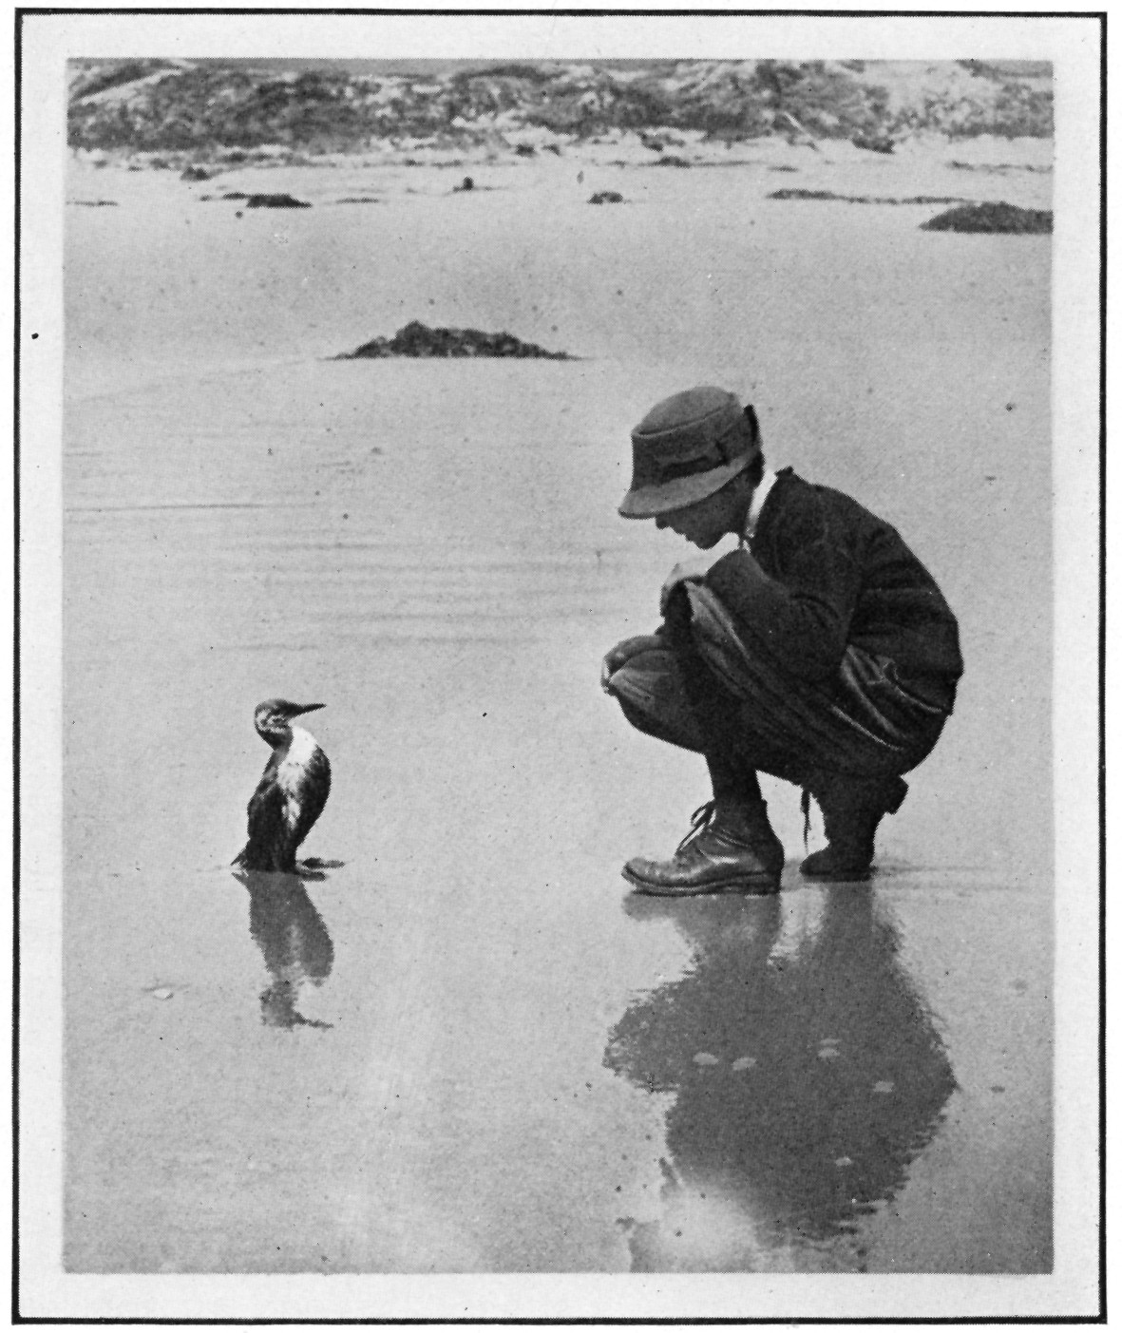
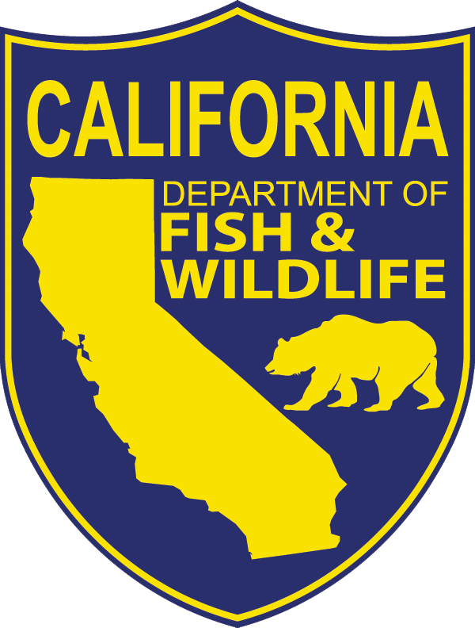
Natural Resource Damage Assessment (NRDA)
Local Gov’t Training
Riverside, April 2016
Steve Hampton
Santa Barbara, 1923
Notes:
Introduce myself and background

Slide 2
Overview
What is Natural Resource Damage Assessment (NRDA)?
Methodology
Questions and Answers
Notes:
Note: mention that this is california’s take on the NRDA process. The methods are consistent with what is being done by noaa at the federal level, we do many smaller cases and often utilize state law.
???Ask how many people have been involved in case with NRDA before? If not, how many people have seen a NRDA presentation before?

Slide 3
Potential Components of a Pollution Settlement
FINES, PENALTIES
COST RECOVERY
(Response & NRDA)
NATURAL RESOURCE DAMAGES
THIRD PARTY CLAIMS
Notes:
Fines and Penalties
Punishment for criminal or negligent conduct (although some statutes are “strict liability”)
Ranges in fine/penalty size are typically determined in statute (at least for those penalties pursued by DFG)
Specific amount generally depends on conduct/behavior of the RP
Natural Resource damages based on amount of compensatory restoration needed to address natural resource injury independent of RP behaviour

Slide 4
What are Natural Resource Damages?
Compensation for natural resource injuries
“Injuries” versus “Damages”
Damages based upon amount of restoration needed to “make the environment and public whole” (OPA 90 Rule, CERCLA)
Notes:
Compensation = Civil Damages, Projects, Restitution (criminal proceeding)
OPA 90 = Oil Pollution Act of 1990
CERCLA = Comprehensive Environmental Response, Compensation, and Liability Act

Slide 5
Coordination during Response
State and
Fed Trustees
FOSC
UC
NRDA Representative
NRDA
Branch
SOSC
RP
RP
Wildlife Impacts
Habitat Impacts
Human Use
Impacts
Coordination with
Trustee Legal and
RP
Operations
Planning
Logistics
Finance
Environmental Unit
Notes:
NRDA During Response: NRDA Liaison with Unified Command and coordination with Environmental Unit in Planning
Why Dotted Line? NRDA has a different function than spill response. NRDA studies the spill; our mission is not to clean-up the spill.
Lessons learned – more coordination on field activities and health and safety issues; greater outreach by NRDA liaison

Slide 6



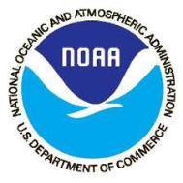


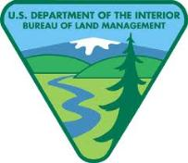
Potential Trustees
CA
  CDFW*
  State Parks
  State Lands
Federal
  NOAA*
  USFWS*
  NPS
  BLM
Tribes
* Primary agencies typically involved in NRDA
Notes:
Define “Trustee”: An agency responsible for protecting or managing a resource for the people of the state or the nation as whole.

Slide 7
NRDA Myths
NRDA is a black box of smoke and mirrors and there is no standard method for calculating damages
Natural resource damages are usually much larger than response costs
NRDA is punitive
Trustees are only interested in “cash out” settlements
Settlement money goes into the general fund
Notes:
RP can implement restoration project directly
NRDA money goes to restoration projects
Response costs dwarf NRDA claims in most cases
Use standard method (HEA/REA) and inputs

Slide 8
The NRDA Process
SPILL
DATA COLLECTION
INJURY
QUANTIFICATION
NEXUS
RESTORATION
SCALING/DAMAGE
QUANTIFICATION
SETTLEMENT
RESTORATION
Notes:
Injury Quantification = Quantification + Determination
After “Restoration Scaling/Damage Quantification”, it is worthwhile noting that the OPA Rule/Federal process contemplates Selecting Restoration Alternatives and Developing a Restoration Plan which goes out to public review. Then you present a demand to the RP. And if the RP does not agree to the demand in 90 days, the Trustees may file a claim with the fund center or file suit. Of course, we can settle at any time and we usually do prior to developing a Restoration Plan.

Slide 9
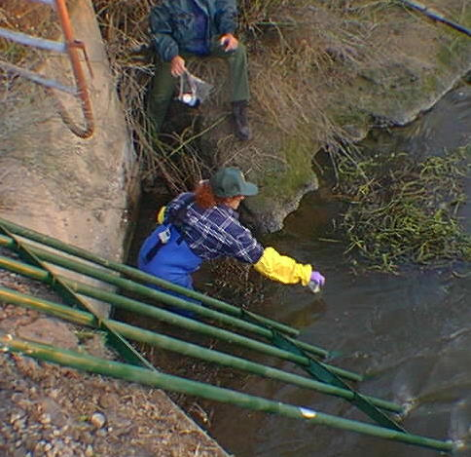
Natural Resource Damage Assessment: Methodology
Level of Resource
Services
Initial
Level
Injury
Project
Benefits
Time

Slide 10
Data Collection and Injury Determination
Central Questions
  What was injured?
  How much? (# animals, # of acres)
  How badly?
  For how long?
  Use Reports & Study Data
SPILL
DATA COLLECTION
INJURY
QUANTIFICATION
RESTORATION
SCALING/DAMAGE
QUANTIFICATION
SETTLEMENT
RESTORATION

Slide 11
Data Collection and Injury Determination
Later activities: “Putting it all together”
  Modeling
  Subsequent NRDA studies
SPILL
DATA COLLECTION
INJURY
QUANTIFICATION
RESTORATION
SCALING/DAMAGE
QUANTIFICATION
SETTLEMENT
RESTORATION
Notes:
Bird mortality models
Bird scavenging & searcher efficiency
Tissue chemistry
Laboratory toxicity tests

Slide 12
Restoration Scaling/Damage Quantification
Acre-Years of
Loss Due to Spill
=
Acre-Years Gained
from Restoration Project
Level of Resource
Services
SPILL
Spill
Primary Restoration
Initial
Level
(Baseline)
DATA COLLECTION
INJURY
QUANTIFICATION
Injury
Compensatory
Restoration
Injury
RESTORATION
SCALING/DAMAGE
QUANTIFICATION
(Recovery)
Project
Benefits
SETTLEMENT
RESTORATION
Time
Notes:
Discuss of degree, duration, and area of injury with this slide. Make sure to discuss equivalence of red and green areas.

Slide 13
Damage Quantification for
Human Rec Uses
Human Recreational Uses
  Beach Activities
  Fishing
  Wildlife Viewing
  Tribal Uses
Use surveys, car counters, input from land managers
Damages for Use Losses
  Value of Lost and Diminished User-Days
SPILL
DATA COLLECTION
INJURY
QUANTIFICATION
RESTORATION
SCALING/DAMAGE
QUANTIFICATION
SETTLEMENT
RESTORATION

Slide 14
Methodology: Summary
Standardized method that uses degree and spatial/temporal extent of injuries to calculate damages
Often uses information gathered during response and investigation, but additional field work may be needed
Bottom Line: Damage Assessment “studies the spill”

Slide 15
NRDA Coordination After Response
NRDA tasks done cooperatively among trustees and possibly RP
NRD settlement coordinated with fines and penalties from multiple agencies for a global settlement
NRD settlement is based on one or more compensatory restoration projects
Notes:
Under the NOAA NRDA Rules, the Trustees are required to invite the RP to engage in a cooperative assessment.

Slide 16
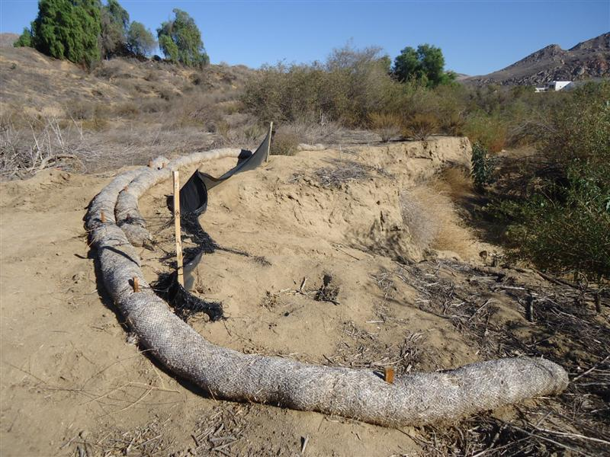
Local Example: Carbon Lite/Springbrook Wash
Sodium hydroxide (pH=12) onto 0.82 acre of habitat.
Clean-up included excavation, ramp/road construction, and removal of some riparian habitat.
Impacts to western spadefoot toad and riparian habitat.
Restoration requirement = 0.38 acres.
Nearby restoration project cost $145K/acre; using that rate (plus some adjustments), damages = $42K.

Slide 17
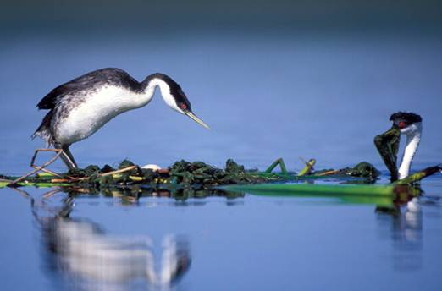
NRDA Stats (Dec. 2015)
Large Cases: 29
  Settled: 25 (Total = $203 million)
  Active: 3
Small Cases: 190
  Settled: 113 (Total = $7.7 million)
  Terminated: 29
  Active: 51
Restoration Projects: 400(approx.)
  Completed: 249
  On-going: 74
  Planned: 77

Slide 18
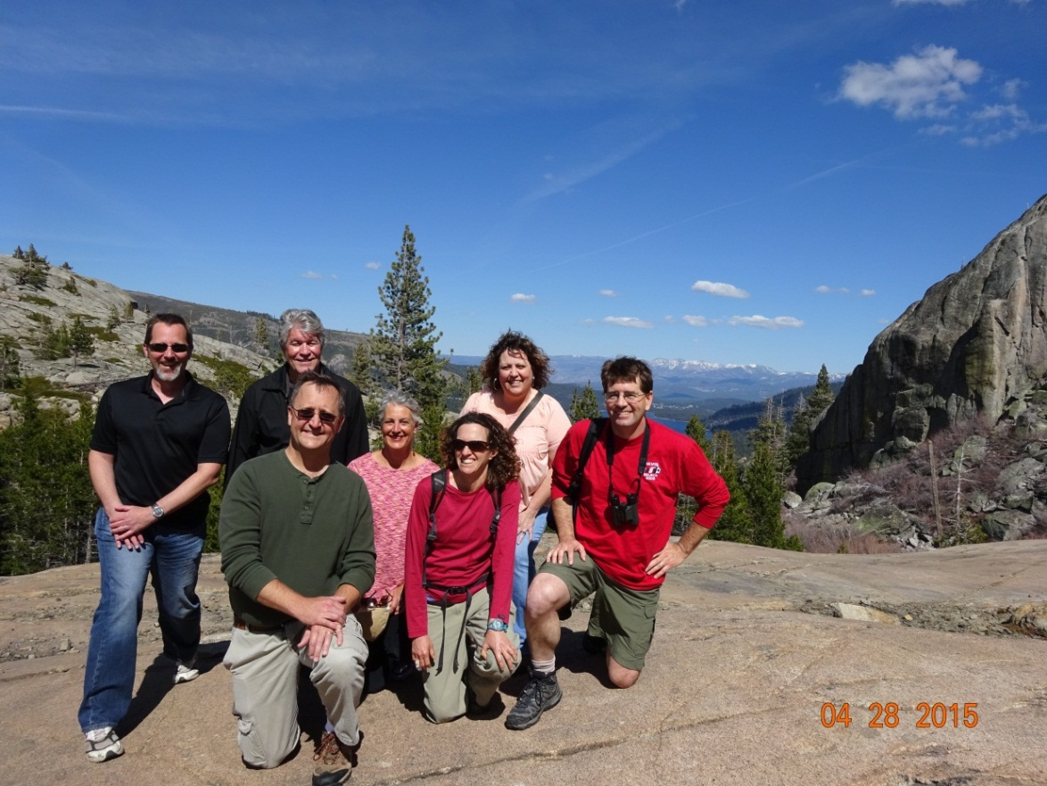
Contacts
OSPR NRDA
Primary Contact, Supervisor
  Michael Anderson
  916-324-9784
Toxicology and Field Sampling
  Beckye Stanton
  Regina Donohoe
  Bruce Joab
Economics, Birds, and Recreational Use
  Matt Zafonte
  Steve Hampton
Restoration & Response
  Bryand Duke
OSPR Legal
Primary Contact, Supervisor
  Eric Milstein
  916-324-9812
Large spills
  Kathy Verrue-Slater
Small Spills [including inland pollution]
  Wendy Johnson
  Lisa Wolfe
  Ryan Todd
http://www.dfg.ca.gov/ospr/NRDA/

