Slide 1
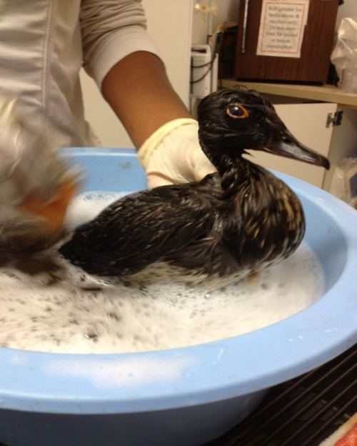


Response to Oiled Wildlife in California
Holly Gellerman - Office of Spill Prevention and Response
California Department of Fish and Wildlife

Slide 2
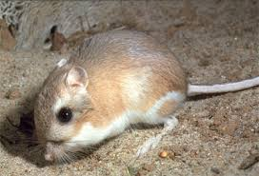
Overview
-Wildlife susceptible to oiling
-Wildlife Response Plan for Oiled Wildlife in CA
-Oiled Wildlife Care Network
-Wildlife Branch at the Command Post
-Wildlife Branch in the field
-What we can provide & how you can help

Slide 3
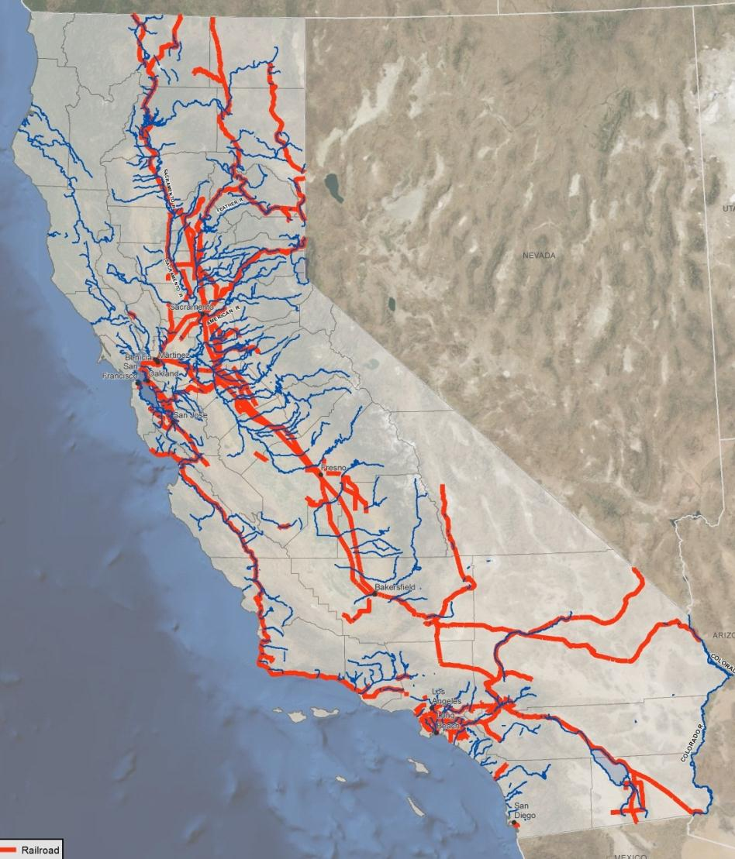
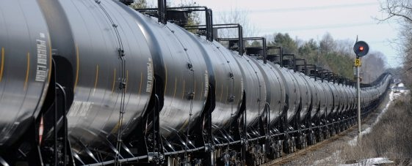
Possible Routes for Crude-by-Rail

Slide 4
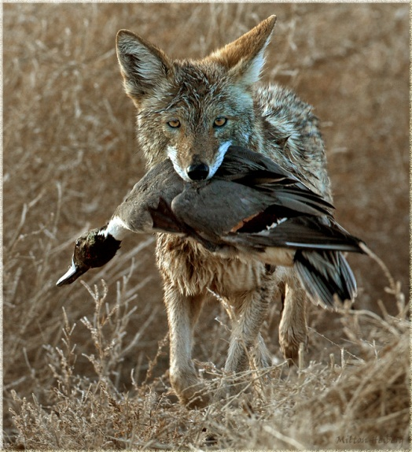

Wildlife species susceptible to oiling
Spend time on the surface of the water

Slide 5
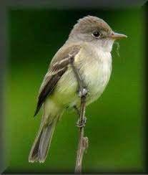
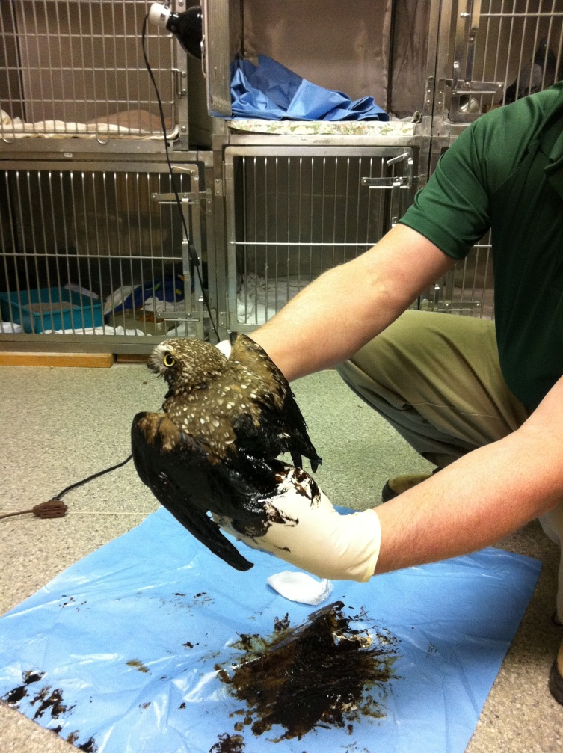
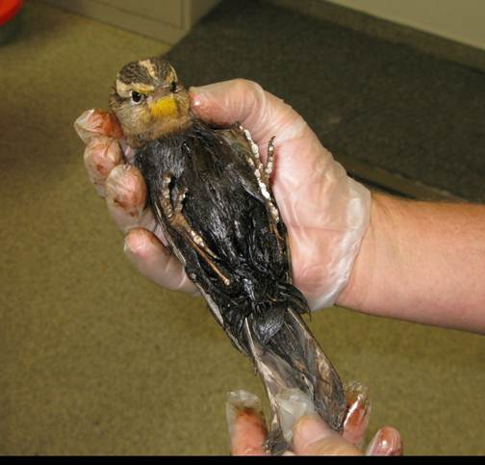
Birds affected by oil
SW Willow Flycatcher
Burrowing Owl
Western Meadowlark

Slide 6
CA Wildlife Response Plan
Originally developed by OSPR in early 90’s
-later input, Agencies, NGOs, Industry
Updated 2011/2016, available on OSPR website:
www.wildlife.ca.gov/OSPR/Preparedness/ Wildlife-Response
Details WLB purpose, structure, roles, responsibilities & special protocols

Slide 7
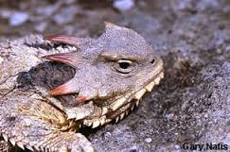
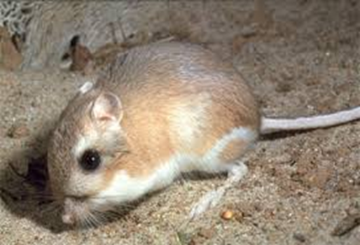
Special Protocols
WILDLIFE RESPONSE PLAN
Guidelines to:
  Minimize incidental impacts to Threatened and Endangered Species
  We are developing guidelines to address inland species
Notes:
7

Slide 8
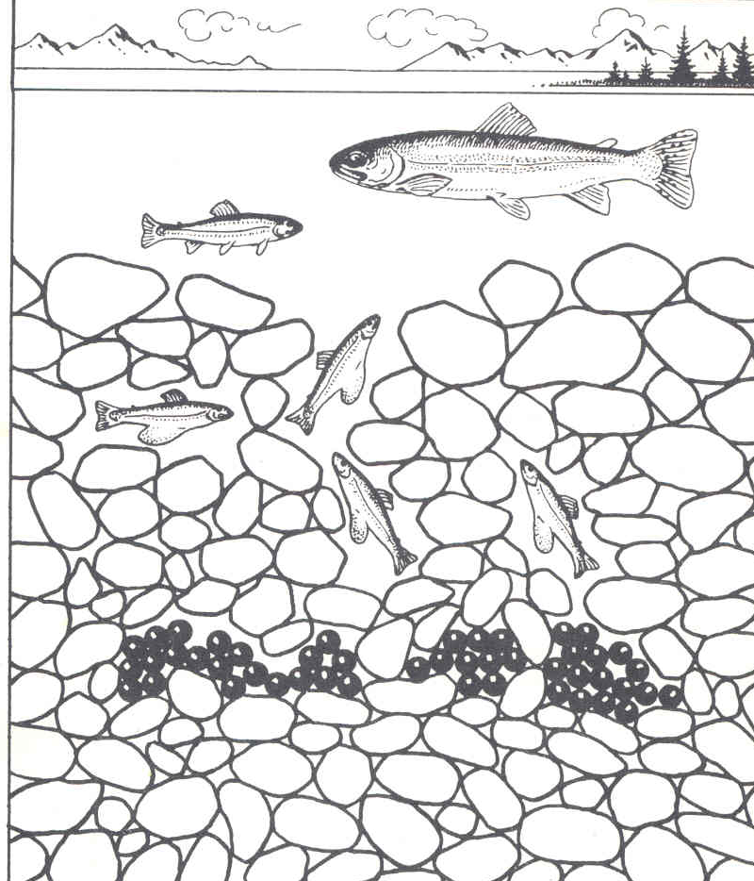
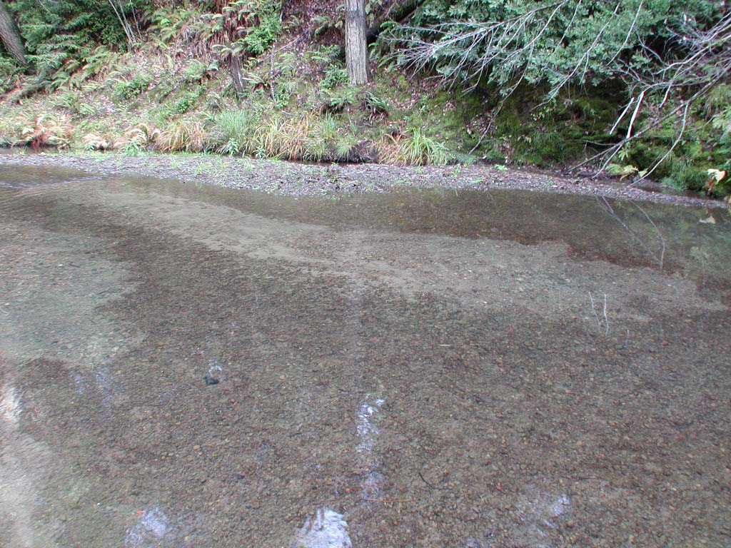
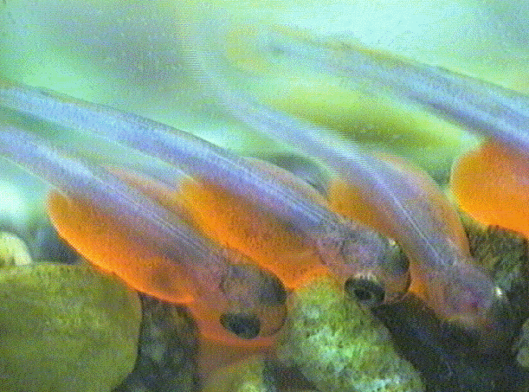
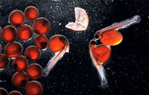
Potential risks to fish
Adult Migration
Spawning
Egg Incubation
Emergence/Fry
Juvenile Rearing
Out-migration (smolt)

Slide 9
Oiled Wildlife Care Network
(OWCN)
Administration
  1994–1997: OSPR
  1997– : Wildlife Health Center, UC Davis
Mission
  Best achievable capture & care to oiled wildlife

Slide 10
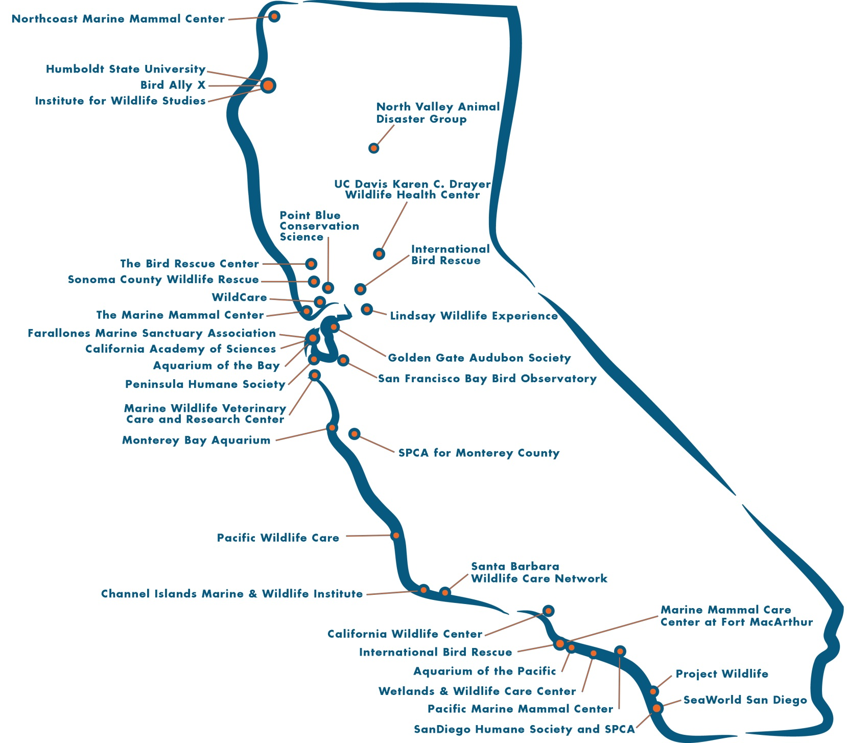

Slide 11
Wildlife Branch
In Operations Section
Close coordination with Planning Section
  Resources at Risk
  Minimization of collateral damage
Unified Command
Operations Section
Planning Section
Logistics Section
Finance/ Administration Section
Wildlife Branch

Slide 12




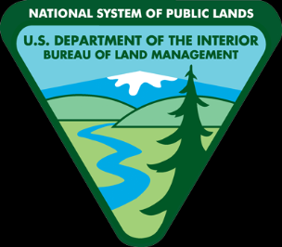



Natural Resource Trustees with Diverse Missions
To protect human health and the environment…
To manage California's diverse fish, wildlife, plant resources…
To conserve, protect, and enhance fish and wildlife and their habitats…
To provide for the health, inspiration and education…
To preserve unimpaired the natural and cultural resources…
To manage and conserve public lands for the use and enjoyment of present and future generations under our mandate of multiple-use and sustained yield…
To teach, research and
public service…
To sustain the health, diversity, and productivity of the Nation’s forests and grasslands to meet the needs of present and future generations...
To manage the water resources of California in cooperation…

Slide 13

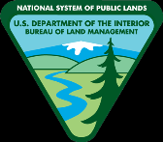




One Team
One Incident
Command Structure
Wildlife Branch
One
Mission
One Unit
One Common Goal

Slide 14
Wildlife Branch
In California, five Groups
Wildlife Branch
Field
Stabilization
Group
Care & Processing Group
Reconnaissance Group
Hazing Group
Recovery Group
Care & Processing Group
Hazing Group

Slide 15
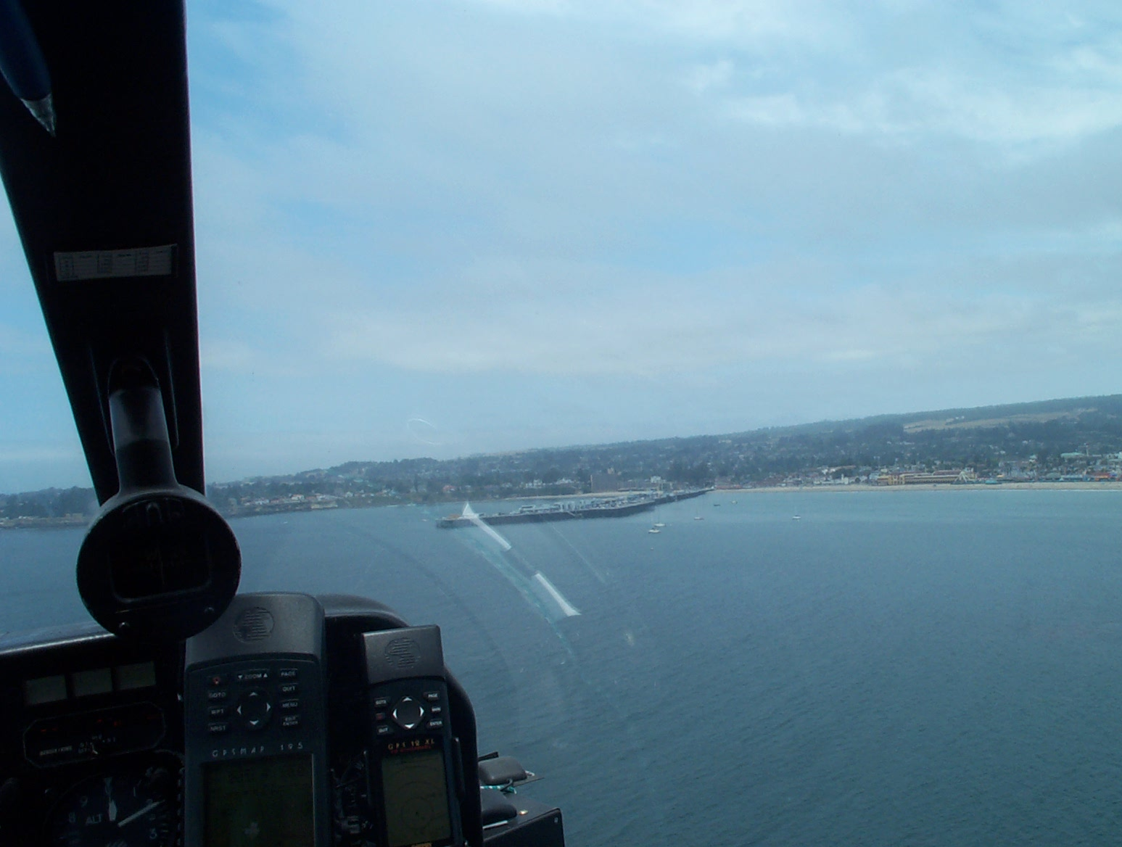
Wildlife Reconnaissance Group
  -Aerial Survey Team
  -Boat Survey Team
  -Land Survey Team
Evaluate numbers, species, and locations of wildlife that could be/are impacted by oil

Slide 16
Wildlife Reconnaissance Group
OILED WILDLIFE HOTLINE
(to report oiled wildlife)
1-877-UCD-OWCN
(1-877-823-6926)

Slide 17
Other Resources:
Wildlife/Technical Experts
Agency Biologists
University Biologists
Private Contractors
GIS Mapping/Database

Slide 18
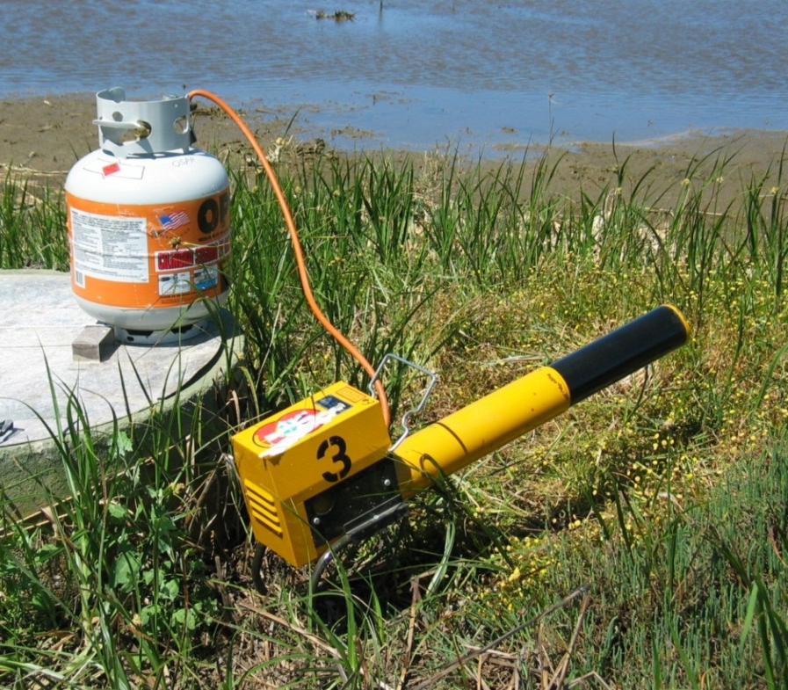
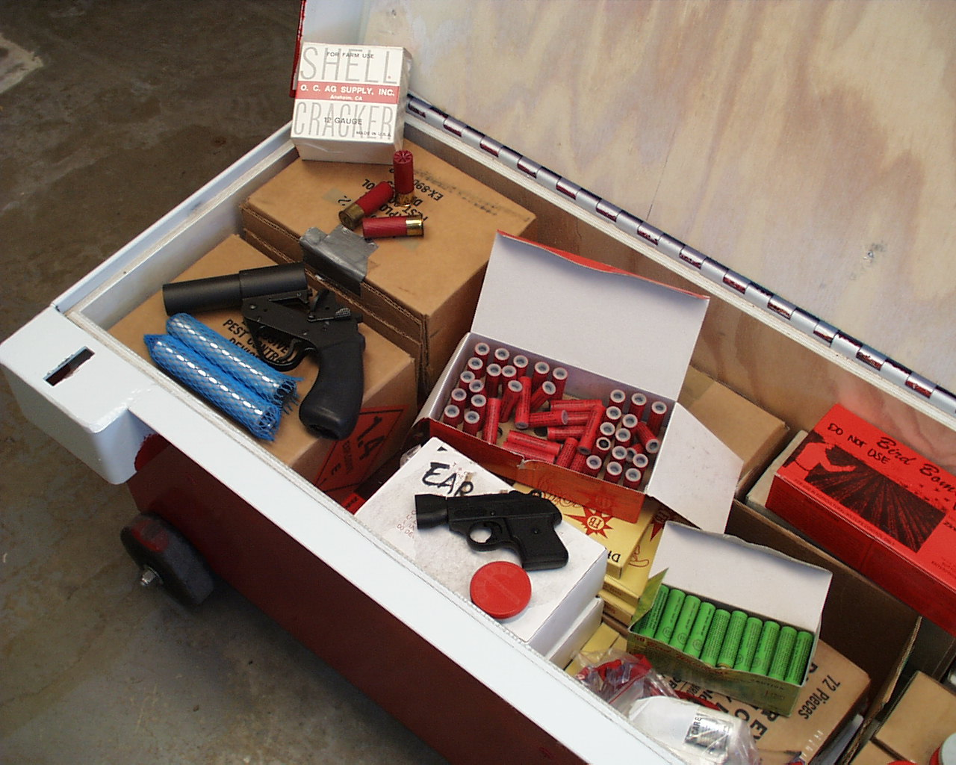
Wildlife Hazing Group
Deter wildlife from entering contaminated areas

Slide 19
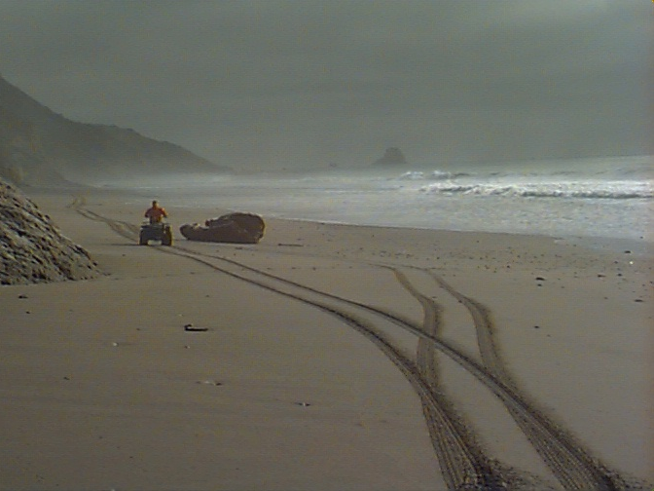
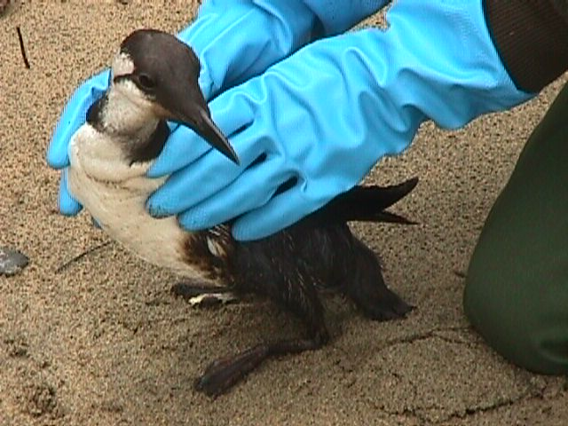
Wildlife Recovery Group
Capture and collection of live and dead animals

Slide 20
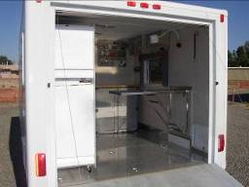
Wildlife Field Stabilization Group

Slide 21
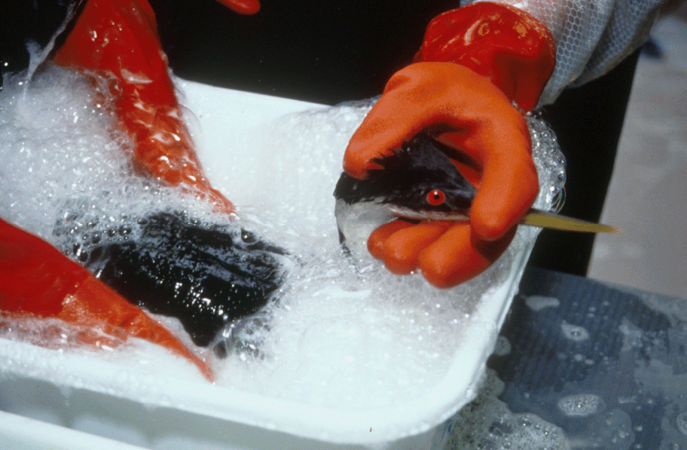
Wildlife Care & Processing Group
Ensures that wildlife exposed to petroleum products receive the best achievable care by providing access to veterinary services
Processes live & dead animals

Slide 22
Hazwoper Requirements
24-hr HAZWOPER plus OWCN training (+ 8 hr annually)
  Conduct Wildlife Operations under the direction a Group Supervisor, after site characterization

Slide 23
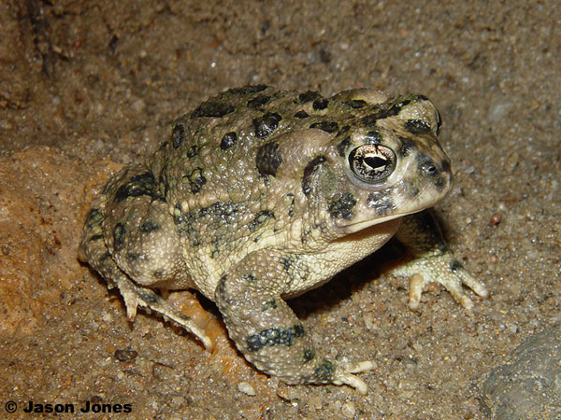
Demobilization
Wildlife Operation activities are typically the last to demobilize

Slide 24
Interaction with Local Agencies
What the WB can provide:
Provide cooperating agencies with up-to-date information (as available)
What others can provide for the WB:
Reconnaissance
Provide local knowledge and expertise (e.g. USFS biologists)
Recovery, Transportation
Assist with closures and access
Provide a staging area for wildlife field ops
Assist with transportation of wildlife
If OWCN trained, assist with wildlife capture

Slide 25
Transporting a bird
Box
- bird can stand
small ventilation holes
kept in shade
Vehicle
enclosed truck front cab, van, SUV
(NO truck beds or truck shells)
wet bird 80f
dry bird requires cooler temp
Chain of Custody
in a declared spill, it begins at the primary care facility

Slide 26
SUMMARY
--Wildlife Response Plan for Oiled Wildlife in CA
-Oiled Wildlife Care Network 1-877-823-6926
-The Wildlife Branch is in the Operations Section of the UC
-The OWCN fills most roles other than Reconnaissance,
if interested, get training
Notes:
26

Slide 27

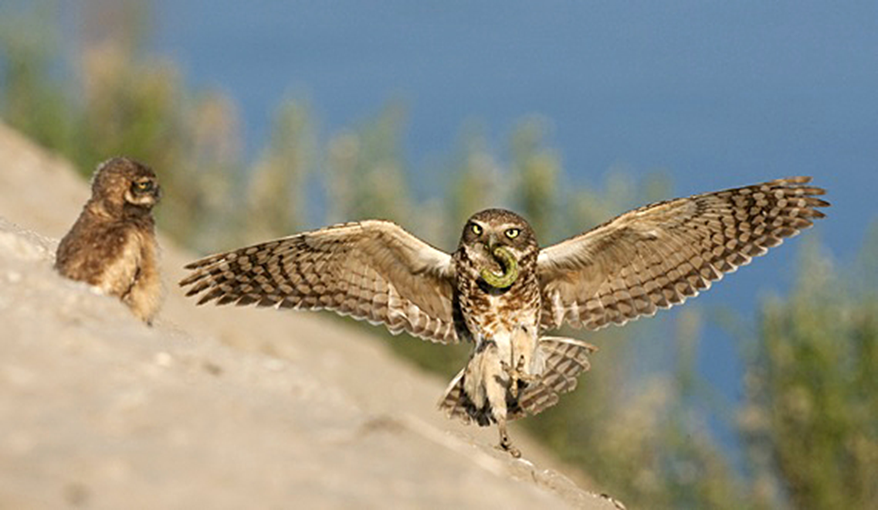
QUESTIONS?
Wildlife Response Coordinator
holly.gellerman@wildlife.ca.gov
office (916)324-6715
cell (916)747-0611
www.wildlife.ca.gov/OSPR/Preparedness/
Wildlife-Response

