Slide 1
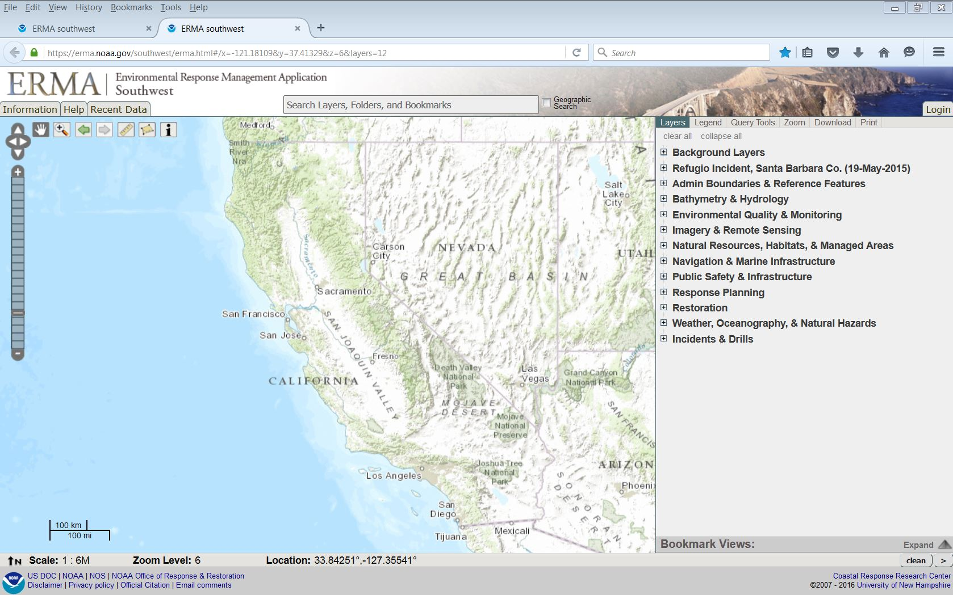
The Environmental Response Management Application®
ERMA Southwest
https://erma.noaa.gov/southwest/

Slide 2
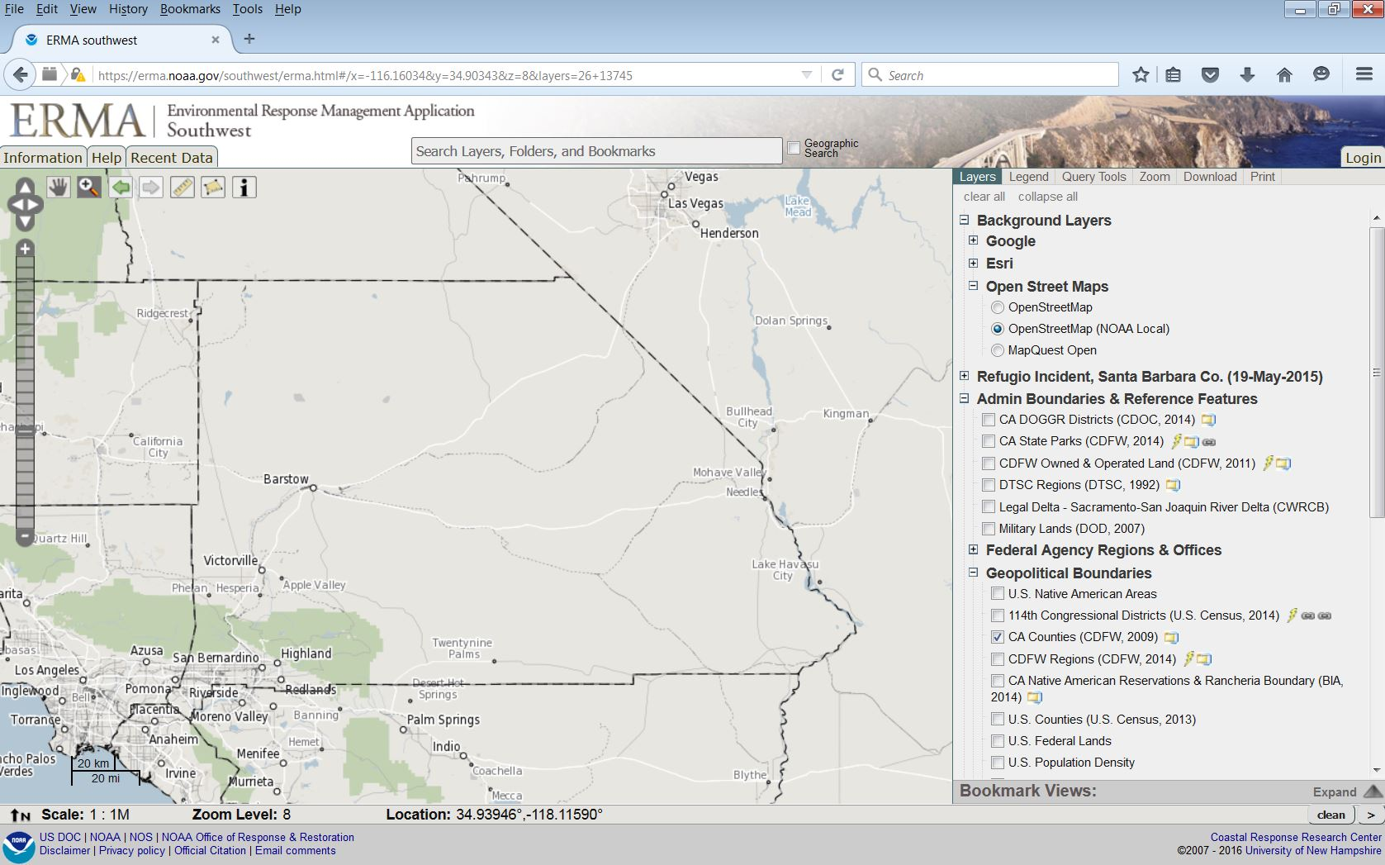
San Bernardino County

Slide 3
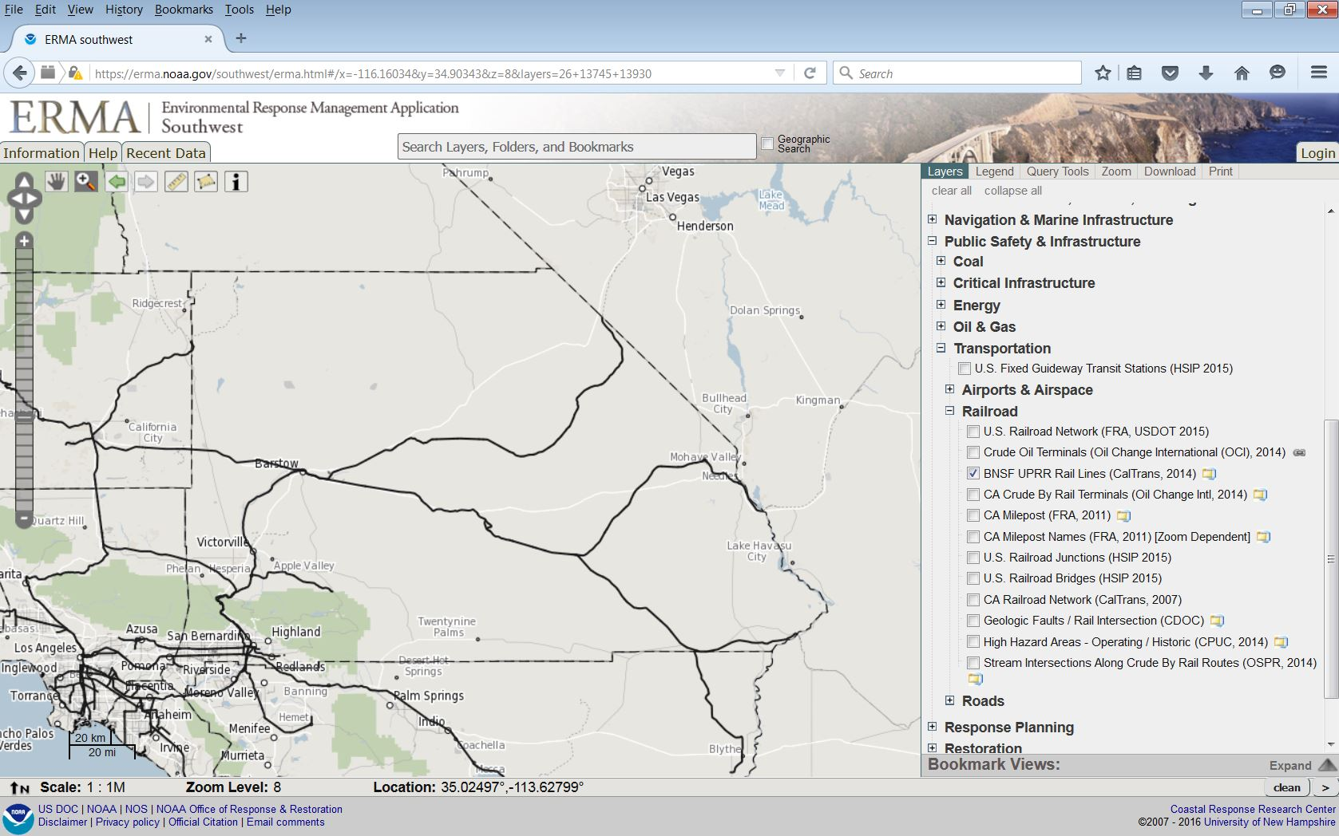
San Bernardino County
Crude by Rail Routes

Slide 4
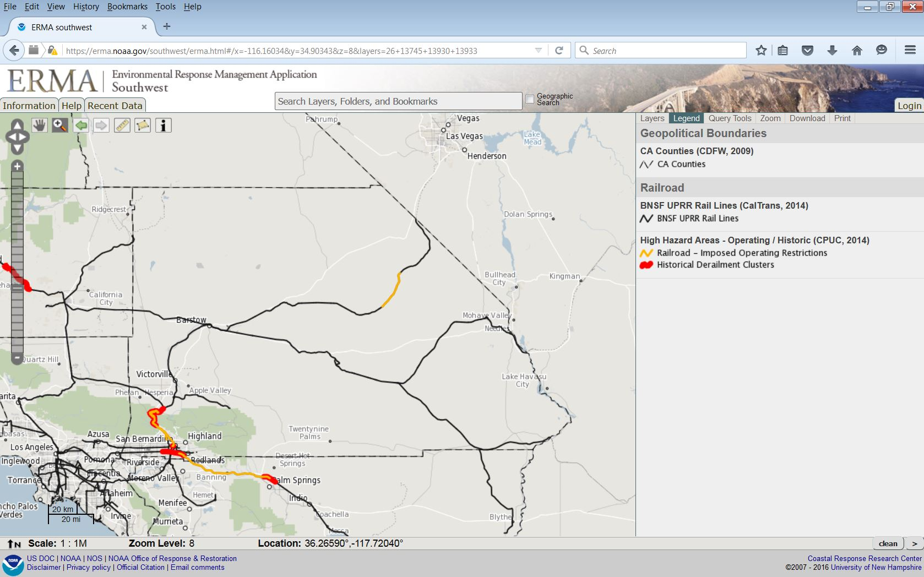
San Bernardino County
High Hazard Areas

Slide 5
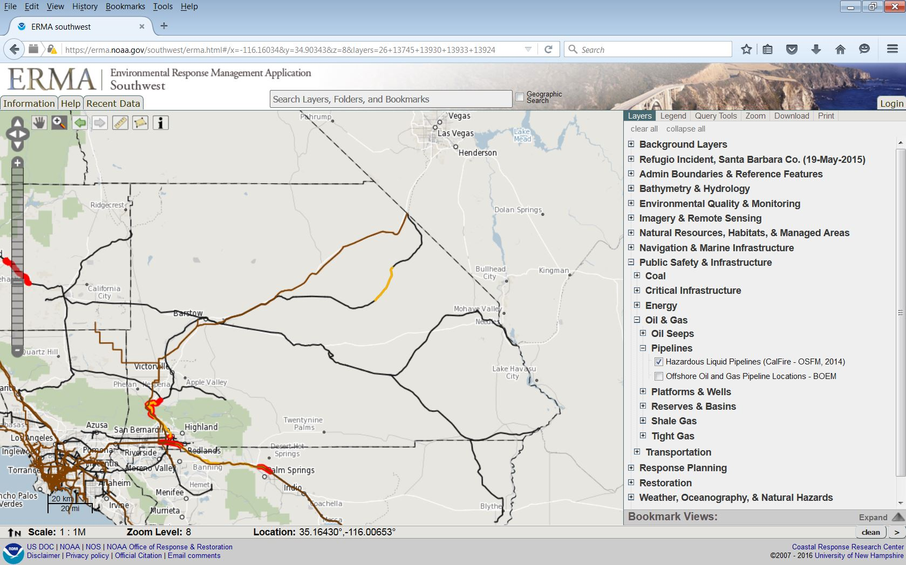
San Bernardino County
Hazardous Liquid Pipelines

Slide 6
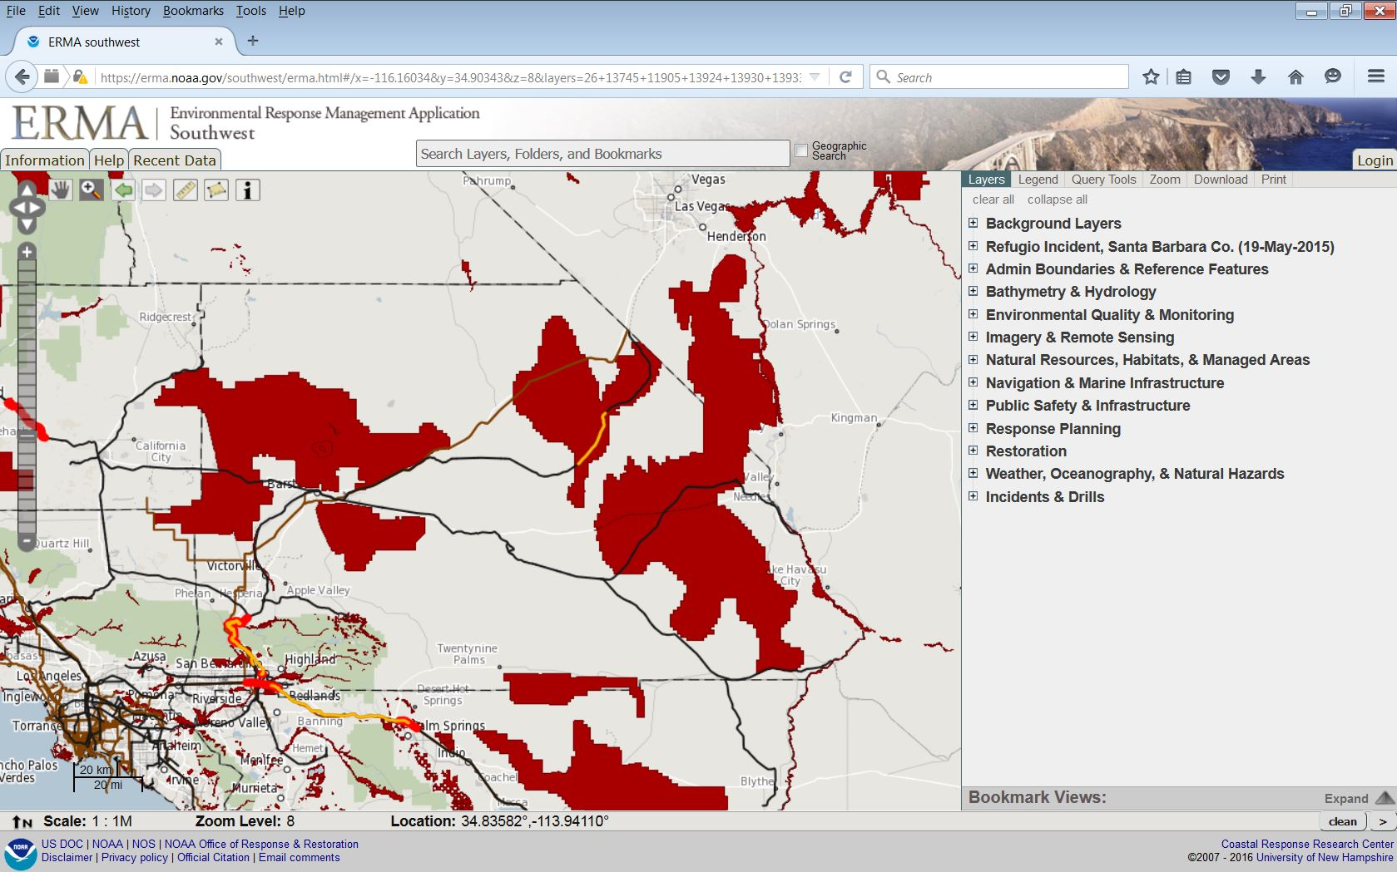
San Bernardino County
Critical Habitat (USFWS)

Slide 7
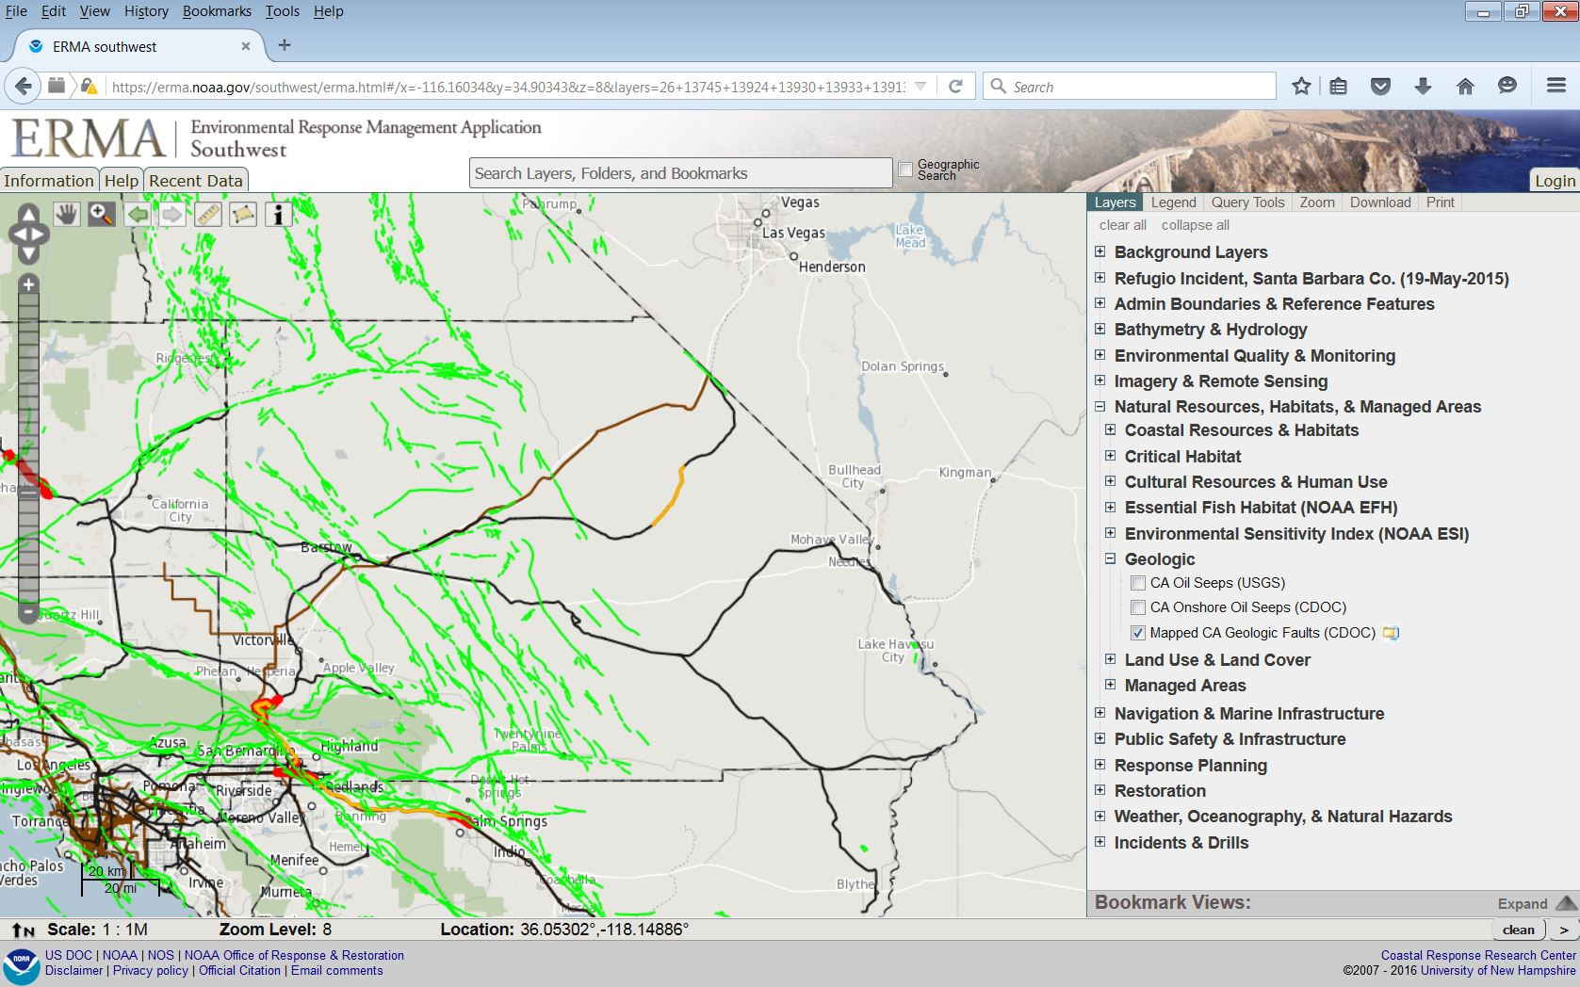
San Bernardino County
Mapped Geologic Faults (CDOC)

Slide 8
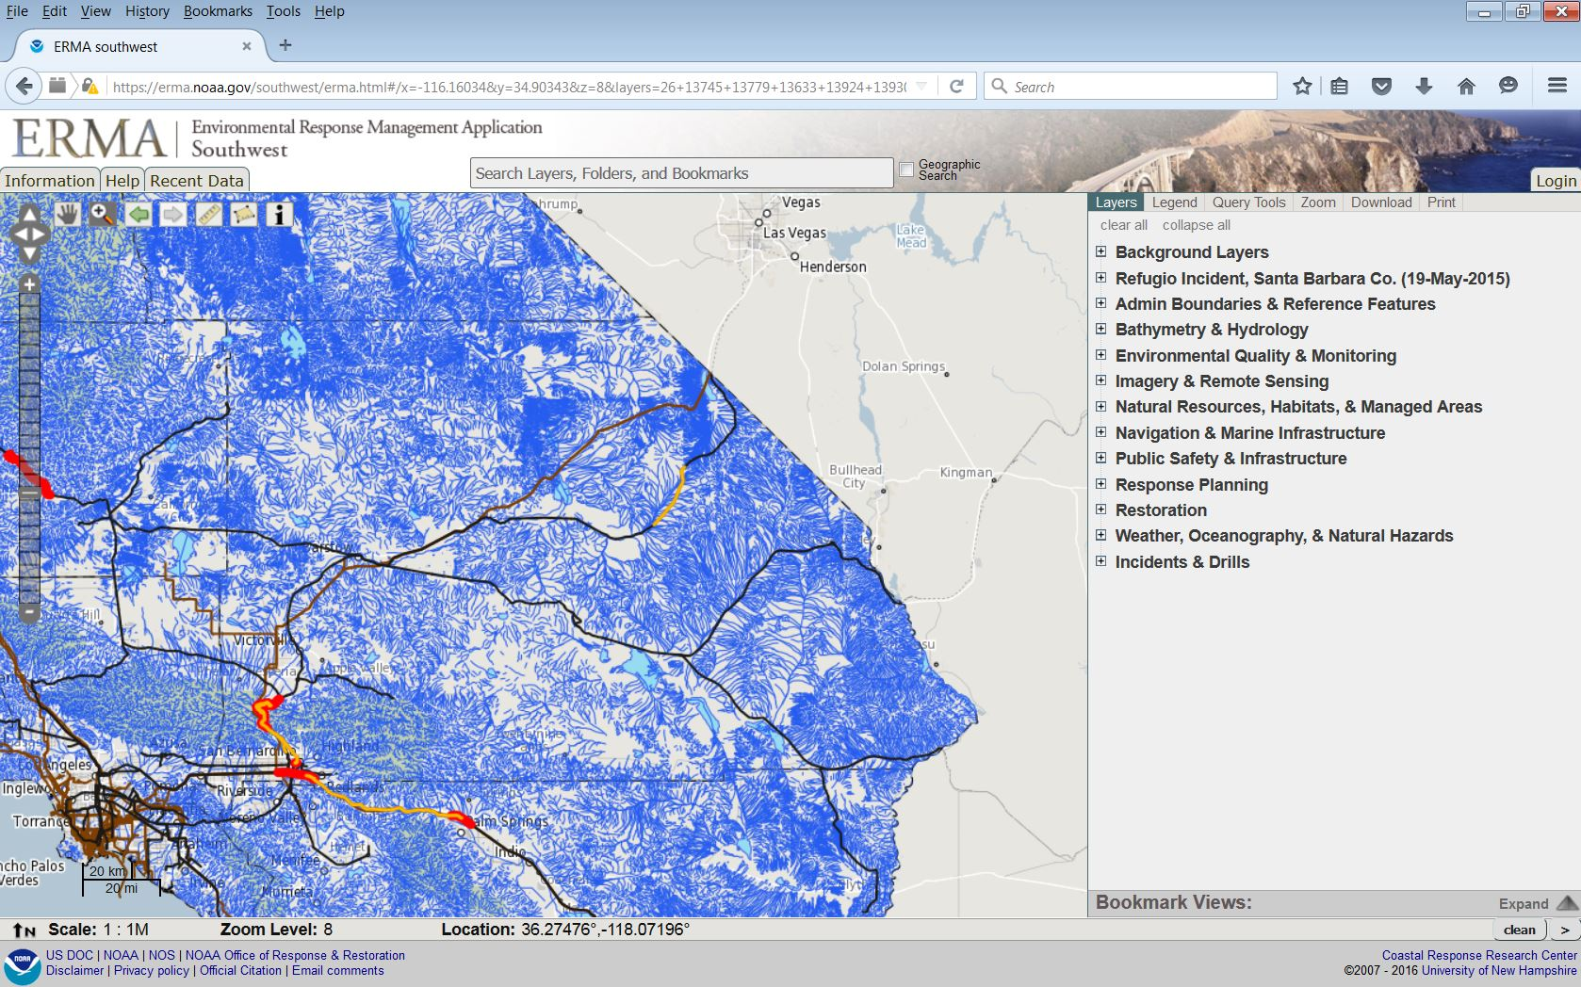
San Bernardino County
Surface Waters* of the State of California
*USGS National Hydrographic Data Set, Modified by CDFW Staff.
Includes Permanent, Intermittent and Ephemeral Streams

Slide 9
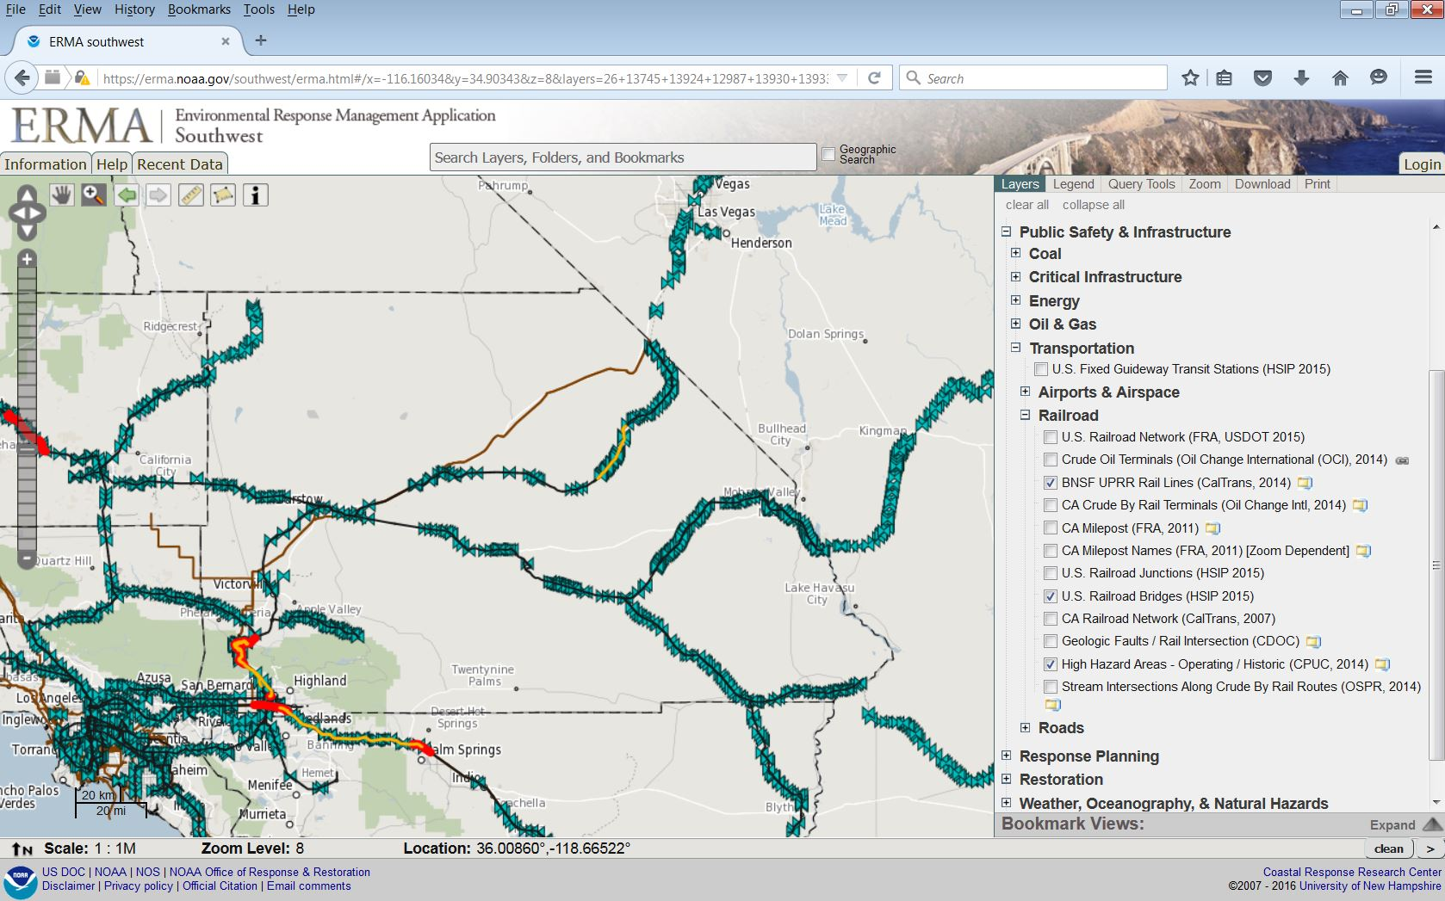
San Bernardino County
Rail Road Bridges

Slide 10
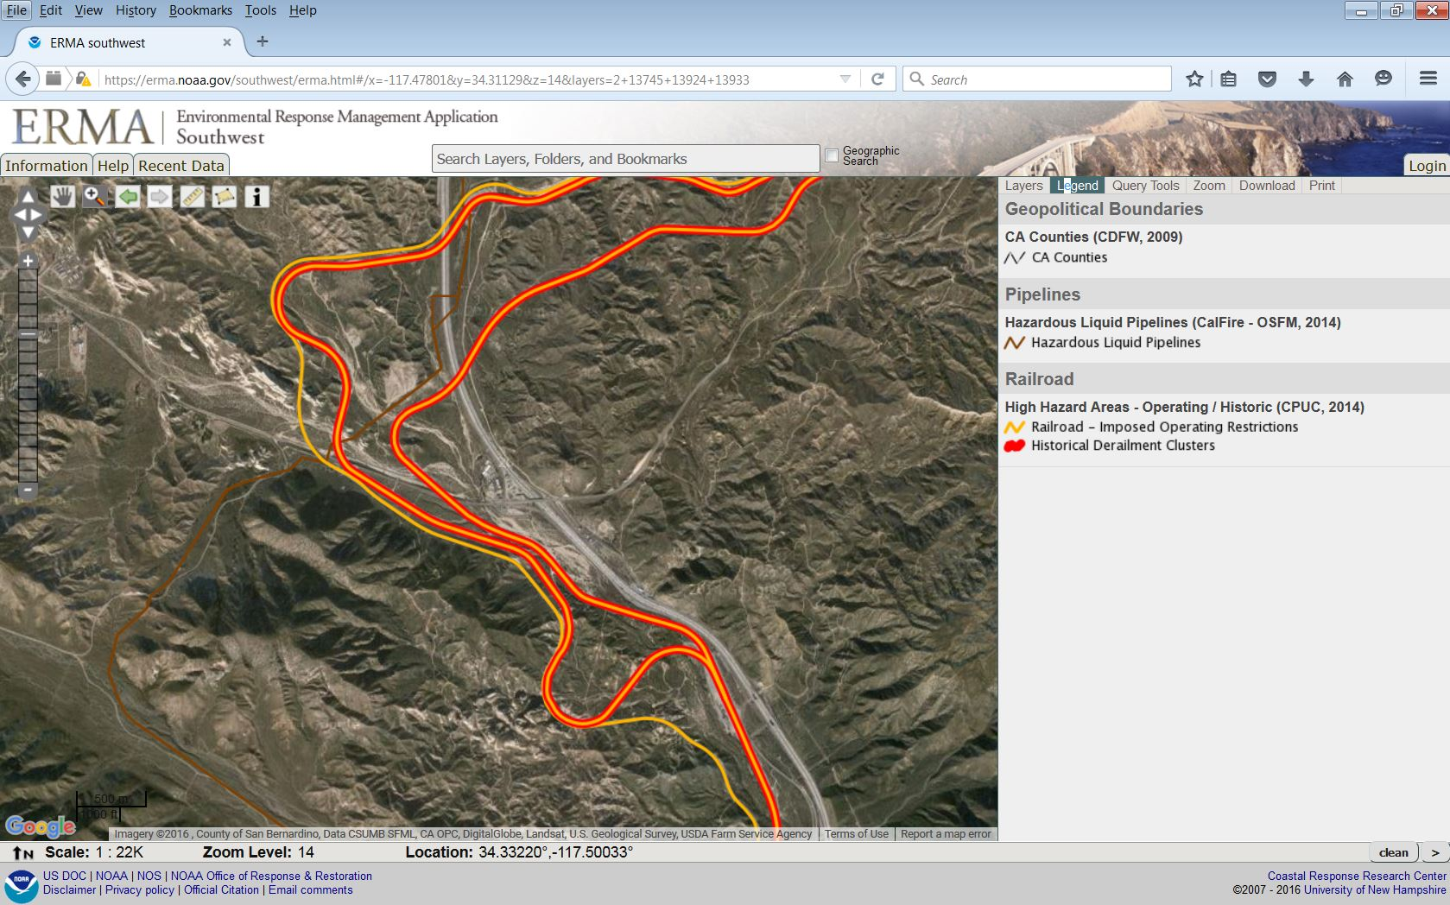
San Bernardino County
High Resolution Imagery

