Slide 1
CDFW, VegCAMP Vegetation Projects
Collaborators Meeting
Rachelle Boul, Senior Vegetation Ecologist and Program Lead
June 14, 2023

Slide 2
BDB and VegCAMP
Biogeographic Data Branch (BDB)
Sacramento, California
Vegetation Classification and Mapping (VegCAMP) Staff
The mission of CDFW’s Biogeographic Data Branch is to collaborate with others to collect, manage, analyze, and distribute biogeographic data for effective conservation and management of California’s natural resources.
Acting Branch Chief: Carie Battistone
Other BDB Programs:
BIOS
CNDDB
CAU
Rachelle Boul, Senior Vegetation Ecologist and Program Lead
Jaime Ratchford, Vegetation Ecologist
Betsy Bultema, Vegetation Ecologist
Rosie Yacoub, GIS Specialist
Melanie Gogol-Prokurat, Lead Ecologist/Supervisor
Limited Term Staff:
Torrance Haynes, Vegetation Ecologist
Annie Allen, Vegetation Ecologist
Monica Tydlaska, GIS Specialist
Scientific Aids: Diandra Graber, Jared Hom, Ashley Bendit
Contract Staff: Catherine Curley, Nani Teves, Sabrina Bento, Sarah Nasif, William O’Brien, Heather MacRoberts, Song Hunter

Slide 3
CDFW, VegCAMP Vegetation Projects
Collaborators Meeting
VegCAMP overview
A few things to consider
Introduction to current VegCAMP Projects
Where. Who. What.
Cross-agency collaboration
Cross-project collaboration

Slide 4
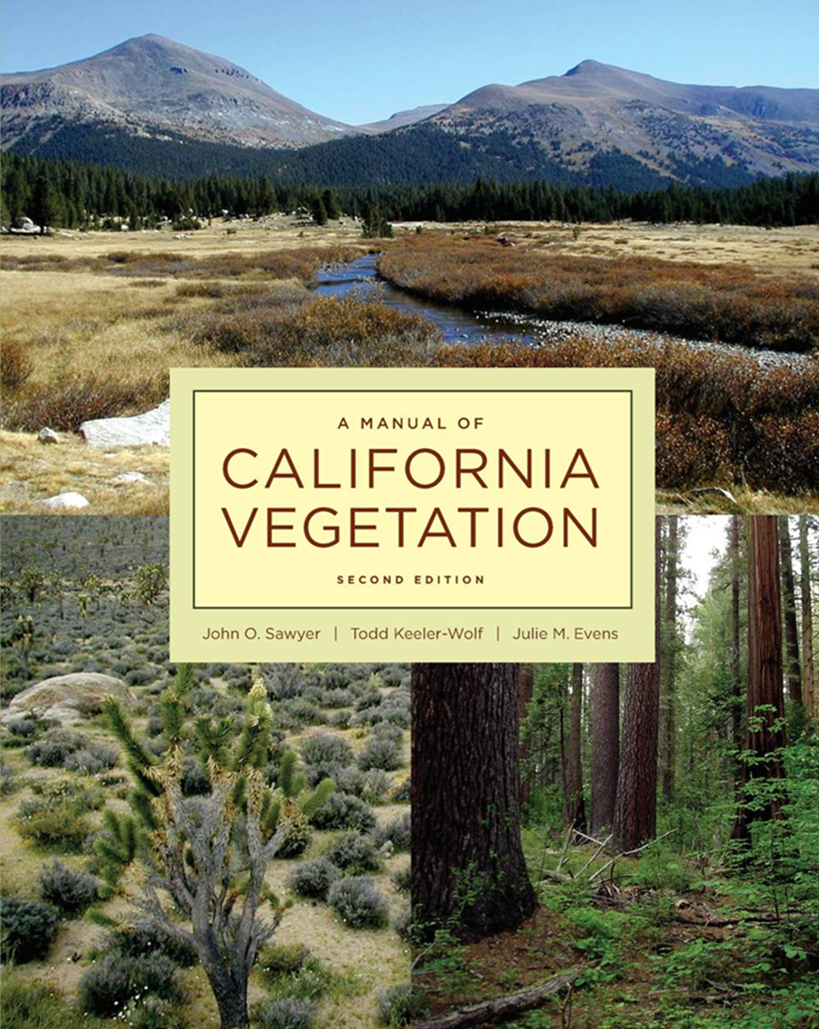
Vegetation Classification and Mapping Program
What is VegCAMP?
Develops state standards for vegetation data (sampling, analysis, mapping, reporting)
Develop CA’s vegetation classification system
Identify sensitive natural communities
Our goal: Complete a fine-scale, state-wide vegetation classification and map.
Notes:
VegCAMP sets standards for vegetation classification and fine-scale vegetation mapping in the state under FGC section 1940.
We work with the Vegetation Program staff of the California Native Plant Society to create and maintain California’s expression of the National Vegetation Classification System, in a partnership that began almost 30 years ago.
VegCAMP also provides training and support in creation and use of vegetation maps to ensure maps meet our standards and contribute to a consistent state-wide map.
Why do we do this? Vegetation is often considered to be the best single surrogate for habitat and ecosystems. Vegetation maps are now among the principal tools involved in wildlands management and planning.

Slide 5
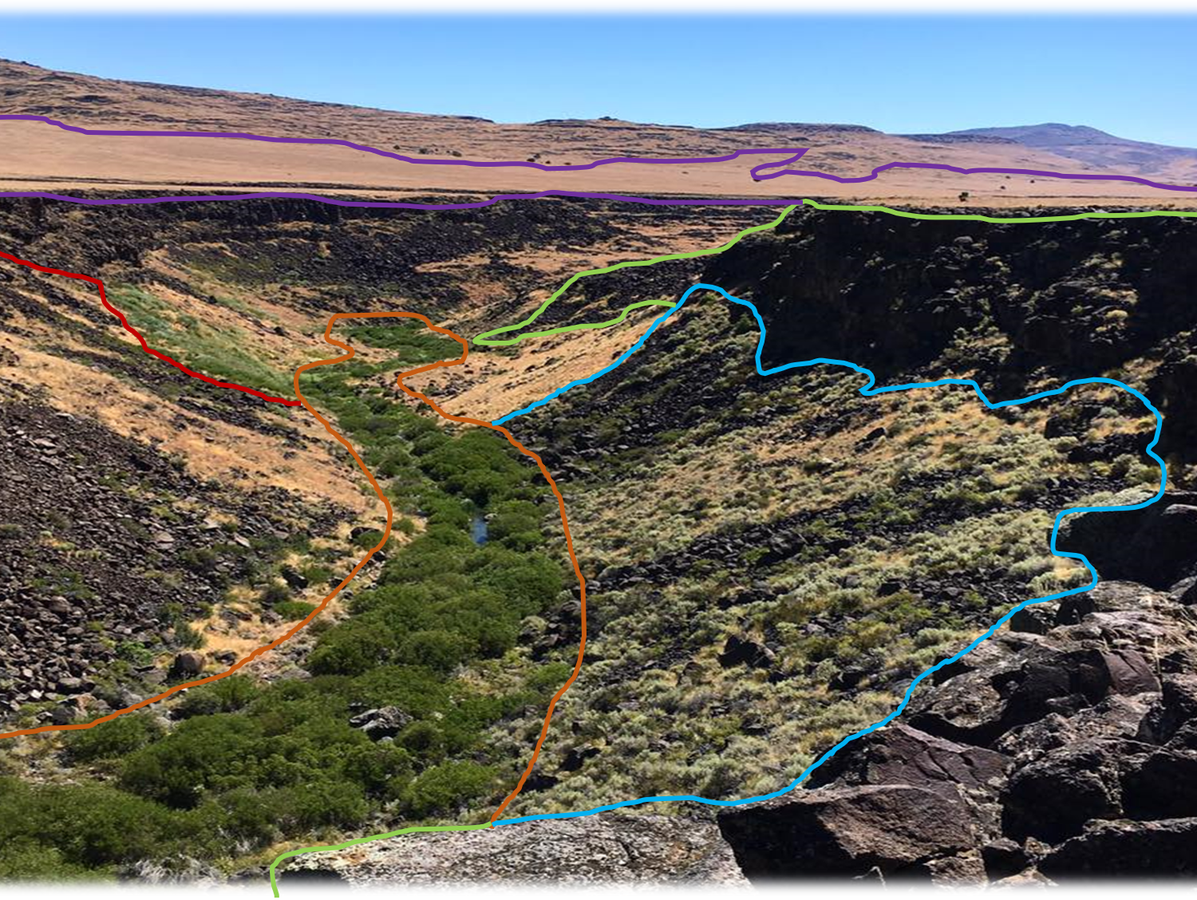
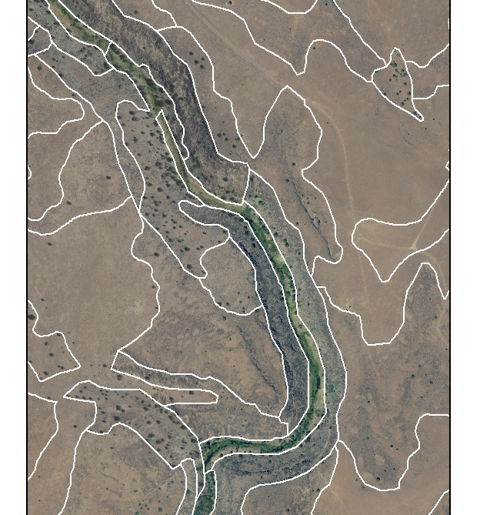
Vegetation Classification and Mapping Program
What Is Vegetation?
Cheatgrass – medusahead grassland
Columbia Plateau cliff, scree and rock
Bitter brush scrub
Arroyo willow thickets

Slide 6
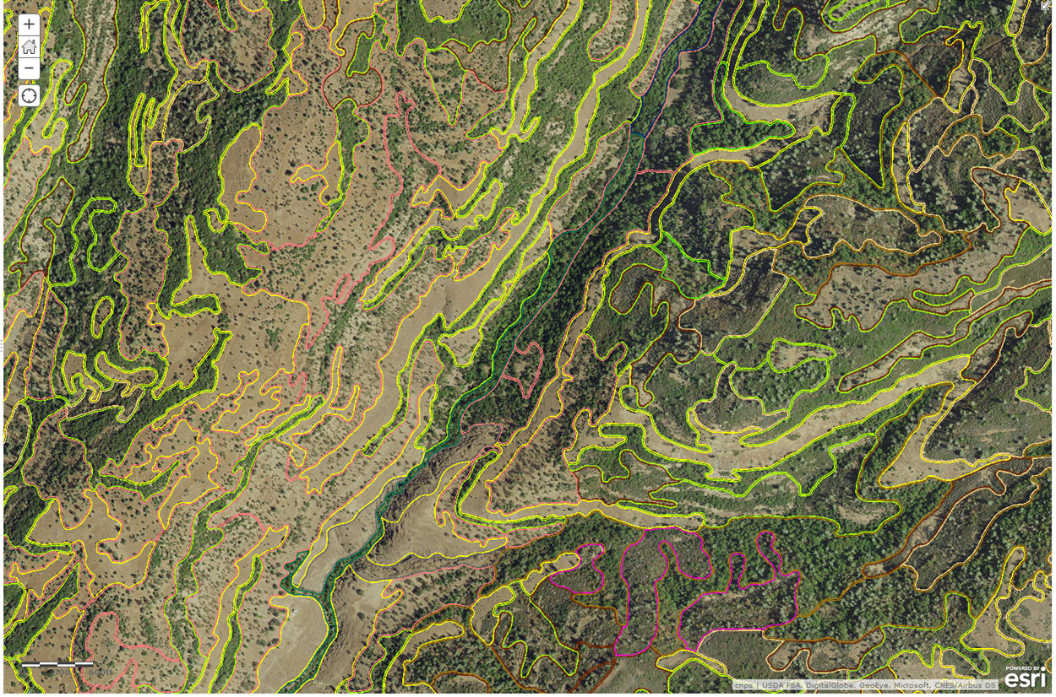
Vegetation Classification and Mapping Program
State-standard vegetation maps are fine-resolution and richly attributed to serve multiple uses
Veg alliance: Quercus douglasii
Tree cover (conifer) 1%
Tree cover (hardwood) 24%
Shrub cover 2%
Herbaceous cover 10-20%
Exotic cover < 10%
Modal tree size 6-12”dbh
Modal tree height 5-10 m
Polygon size 5.22 acres
Human disturbance 0
Identify sensitive natural communities
Conservation and wildlife corridor planning
Wildlife habitat modeling
Fire and fuels management
Impact and invasive species assessment
Land management planning
Notes:
Each vegetation map polygon has many attributes including vegetation type, conifer cover, hardwood cover, tree height, shrub cover, disturbances such as roadedness and development, and the upper levels of the hierarchy. This allows display of the map at any level of the hierarchy, say, all riparian types or all conifer vs. hardwood types. The map can also be used to display polygons based on other attributes, such as Ponderosa pine stands with no roads or other disturbances, or Ponderosa pine stands of a certain tree height. Recent uses of the maps include wildfire risk assessment, climate change and sea level rise planning and illegal cannabis grow locations and modeling. VegCAMP is looking forward to completing classification and mapping of the entire state.

Slide 7
Vegetation Classification and Mapping Program
Classification
Maps
Standards
CNPS: Manual of California Vegetation Online & CNPS Website
CDFW: Biogeographic Information and Observation System
CDFW: VegCAMP Website
*Links on images above

Slide 8
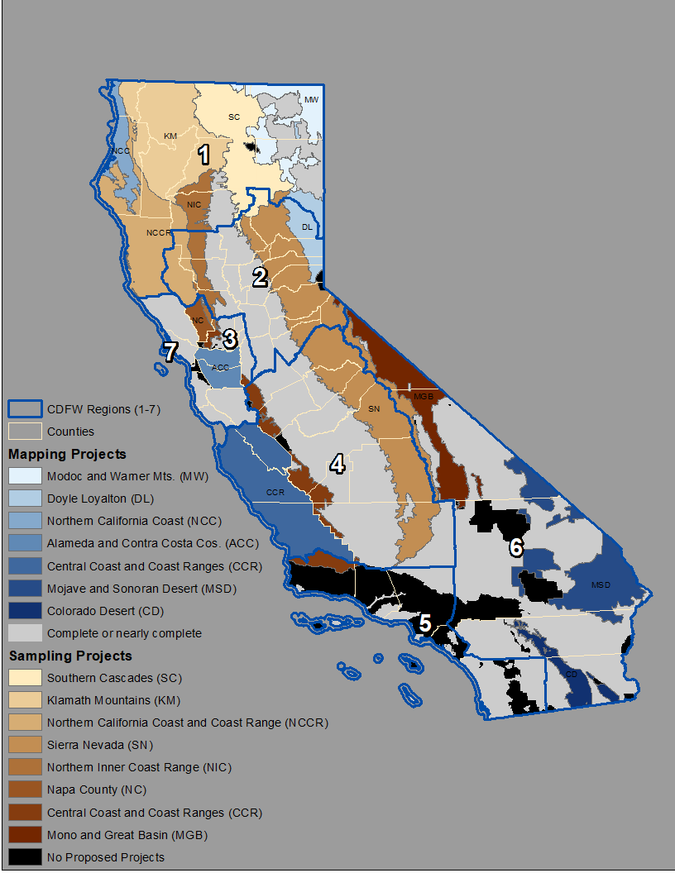
2023 Vegetation Sampling and Mapping Projects

Slide 9
Cross-project Collaboration
Data collection, storage, and flow
Tracking count and distribution of community types sampled
Land access and collection permits
Other?

Slide 10
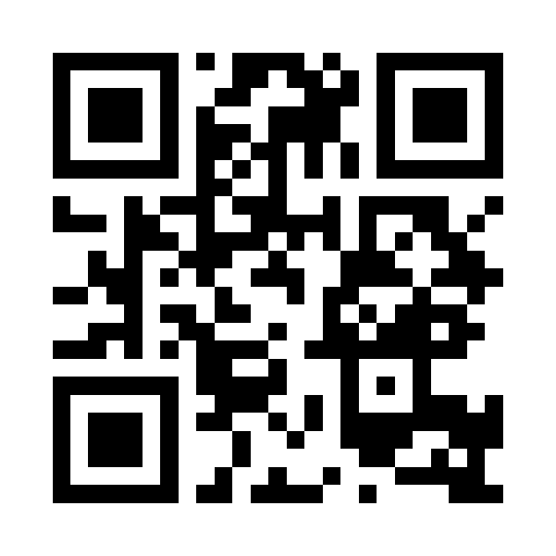
Cross-agency Collaboration
How might you use vegetation data in your work?
Is there a particular project or region that you are most interested in?
Are you able to provide land access information and be a point of contact to discuss this further?
Do you know of any existing vegetation data that we might not know about?
Is there anything else you’d like to ask or share with us?
Complete the online survey here:
https://arcg.is/11bbP90

Slide 11
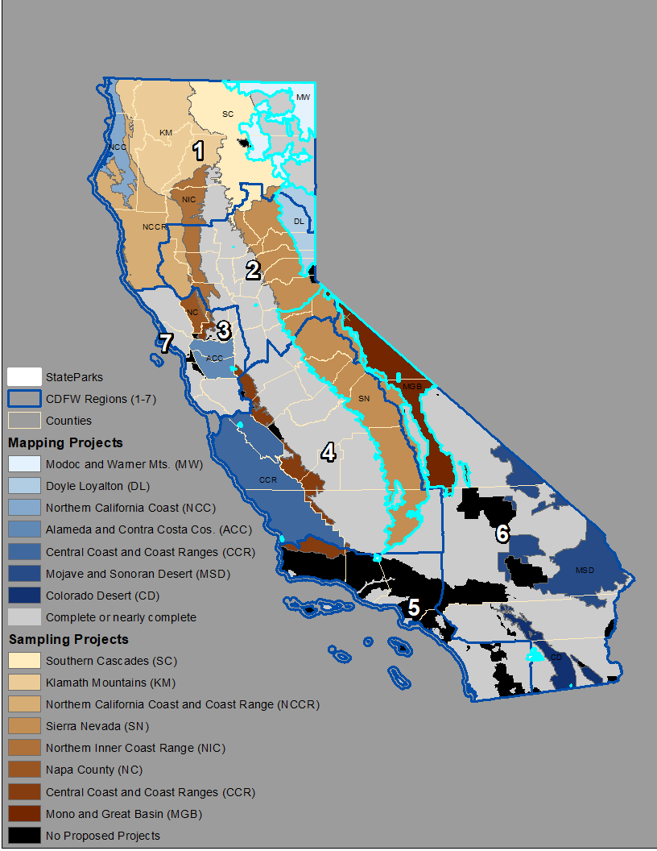
GIC Vegetation Sampling and Mapping Projects
VegCAMP
Project Managers –
Jaime Ratchford, Jaime.Ratchford@wildlife.ca.gov
Nani Teves, Nani.Teves@Wildlife.ca.gov
Data Coordinator –
Monica Tydlaska, Monica.Tydlaska@Wildlife.ca.gov
Geographical Information Center
Project Manager - Jason Schwenkler, jschwenkler@csuchico.edu
Doyle Loyalton sampling and mapping
Modoc Plateau and Warner mountains sampling and mapping
Southern Sierra Nevada sampling
Mono and Great Basin sampling
State Parks sampling and mapping

Slide 12
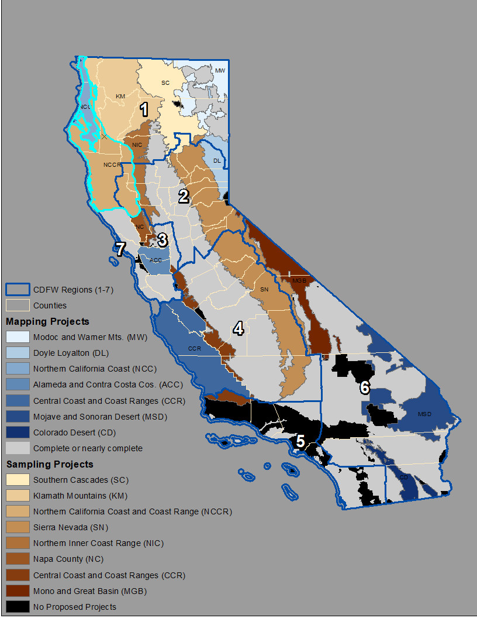
Northern CA Coast Vegetation Sampling and Mapping
VegCAMP
Project Managers –
Betsy Harbert, Betsy.Bultema@Wildlife.ca.gov
Nani Teves, Nani.Teves@Wildlife.ca.gov
Data Coordinator –
Rosie Yacoub, Rosalie.Yacoub@wildlife.ca.gov
Tukman Geospatial
Project Manager – Mark Tukman, mark@tukmangeospatial.net
Aerial Information Systems
Project Manager – Debbie Johnson
California Native Plant Society
Project Manager - Julie Evens, jevens@cnps.org
Field and Data Coordinator - Jennifer Buck-Diaz jbuckdiaz@cnps.org
Notes:
Betsy is also completing the classification analysis

Slide 13
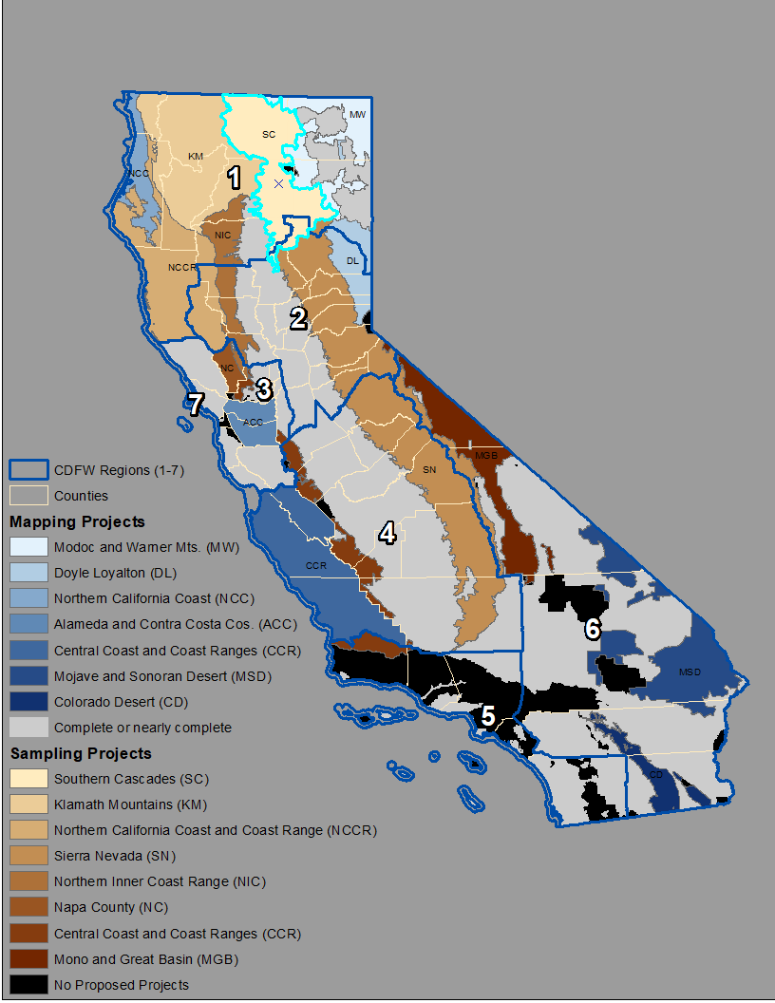
Southern Cascades Vegetation Sampling
VegCAMP
Project Managers –
Jaime Ratchford, Jaime.Ratchford@wildlife.ca.gov
Nani Teves, Nani.Teves@Wildlife.ca.gov
Data Coordinator –
Monica Tydlaska, Monica.Tydlaska@Wildlife.ca.gov
Vollmar Natural Lands Consulting
Project Manager – Jake Schweitzer, jake@vollmarconsulting.com
Siskiyou BioSurvey
Assistant Project Manager - Gretchen Vos, oregongretchen@yahoo.com

Slide 14
Klamath Mountains Vegetation Sampling
VegCAMP
Project Managers –
Betsy Harbert, Betsy.Bultema@Wildlife.ca.gov
Nani Teves, Nani.Teves@Wildlife.ca.gov
Data Coordinator –
Rosie Yacoub, Rosalie.Yacoub@wildlife.ca.gov
California Native Plant Society
Project Manager - Julie Evens, jevens@cnps.org
Field and Data Coordinator - Jennifer Buck-Diaz jbuckdiaz@cnps.org
Cal Poly Humboldt
Project Manager/ Field and Data Coordinator - Erik Jules, esj4@humboldt.edu
Bigfoot Trail
Field and Data Coordinator - Michael Kauffmann, michaelekauffmann@gmail.com

Slide 15
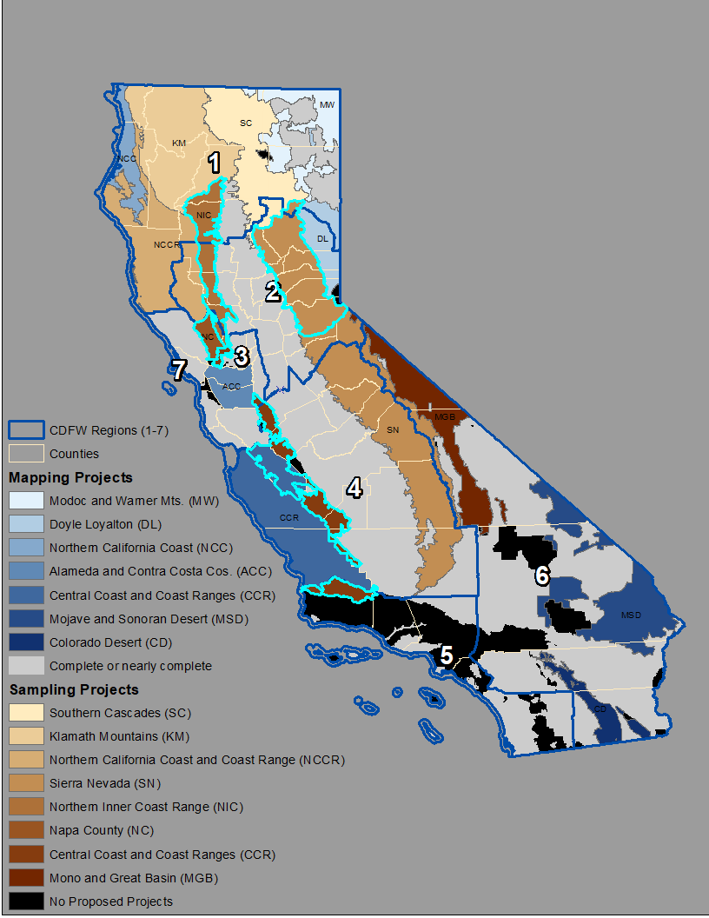
UC Santa Cruz Arboretum Vegetation Sampling
VegCAMP
Project Managers –
Rachelle Boul, Rachelle.Boul@wildlife.ca.gov
Nani Teves, Nani.Teves@Wildlife.ca.gov
Field Liaison –
Todd Keeler-Wolf, Todd.Keeler-Wolf@wildlife.ca.gov
Data Coordinator –
Rosie Yacoub, Rosalie.Yacoub@wildlife.ca.gov
UC Santa Cruz
Project Manager - Brett Hall, brett@ucsc.edu
Field and Data Coordinators –
Lucy Ferneyhough, lferneyh@ucsc.edu
Alex Hubner, ahubner@ucsc.edu
Northern Sierra Nevada sampling
Northern Inner Coast Range and Napa County sampling
Central Coast and Coast Ranges Sampling

Slide 16
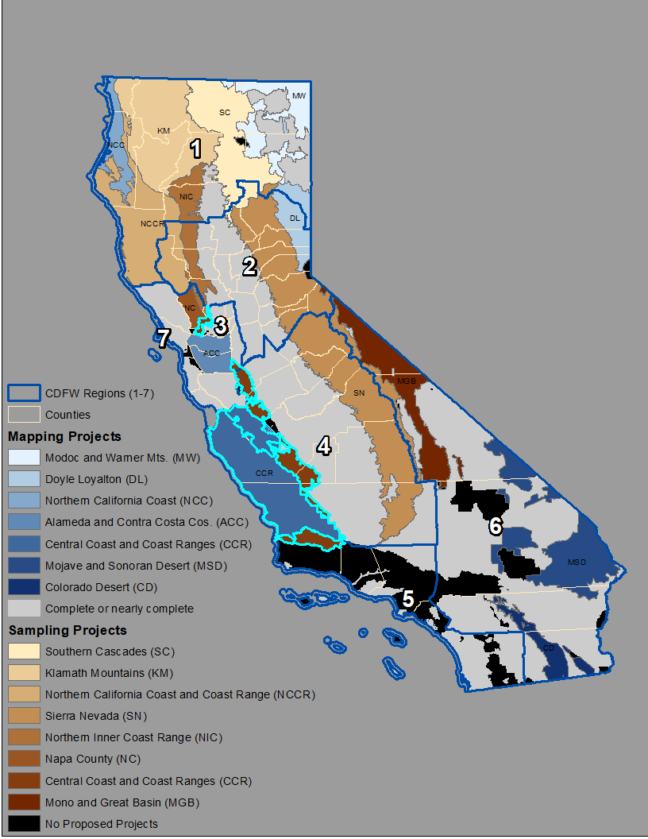
Central CA Coast Vegetation Sampling and Mapping
VegCAMP
Project Managers –
Rachelle Boul, Rachelle.Boul@wildlife.ca.gov
Nani Teves, Nani.Teves@Wildlife.ca.gov
Data Coordinator –
Rosie Yacoub, Rosalie.Yacoub@wildlife.ca.gov
Coastal San Luis Resource Conservation District
Project Manager – Maurica Anderson, manderson@coastalrcd.org
Resource Conservation District of Monterey Co.
Tukman Geospatial
Project Manager – Mark Tukman, mark@tukmangeospatial.net
California Native Plant Society
Project Manager - Julie Evens, jevens@cnps.org
Field and Data Coordinator – Mark Bibbo, mbibbo@cnps.org

Slide 17
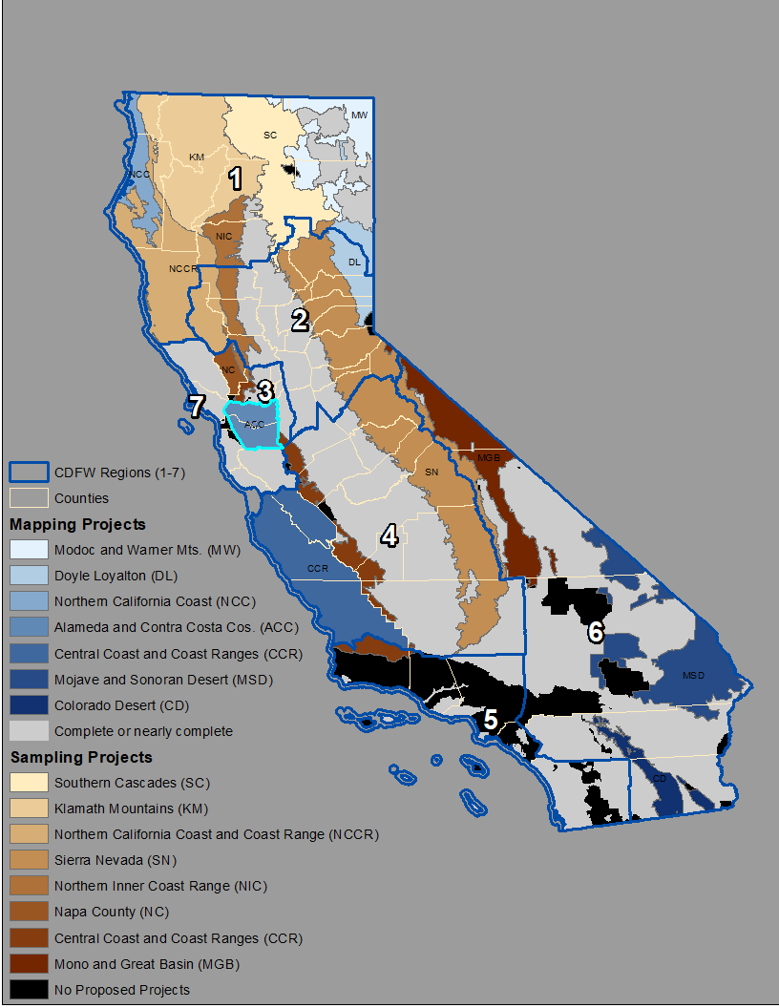
Alameda and Contra Costa Co. Sampling and Mapping
VegCAMP
Project Managers –
Rachelle Boul, Rachelle.Boul@wildlife.ca.gov
Nani Teves, Nani.Teves@Wildlife.ca.gov
East Bay Regional Park District
Project Manager – Dina Robertson, DRobertson@ebparks.org
Tukman Geospatial
Project Manager – Mark Tukman, mark@tukmangeospatial.net
California Native Plant Society
Project Manager - Julie Evens, jevens@cnps.org
Field and Data Coordinator – Mark Bibbo, mbibbo@cnps.org
Nomad Ecology
Project Manager - Erin McDermott, emcdermott@nomadecology.com
Benson Bio Consulting
Shelly Benson, shelly@bensonbioconsulting.com

Slide 18
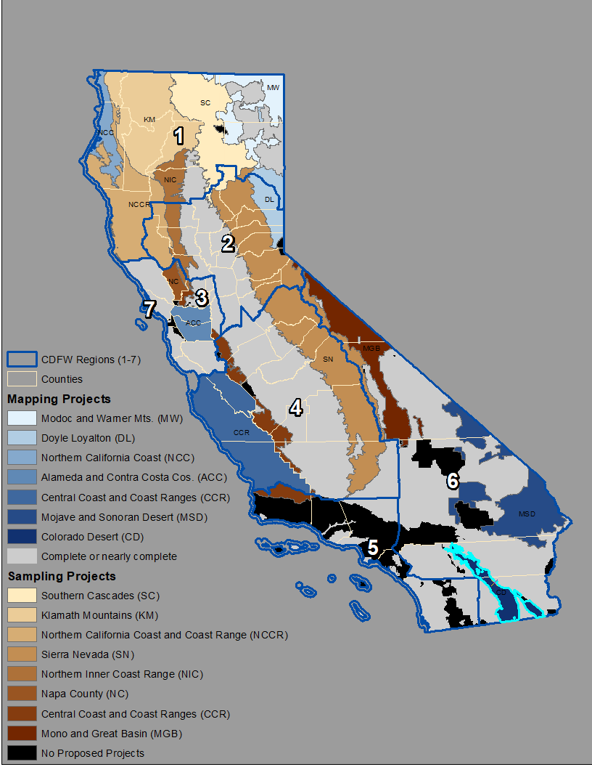
Colorado Desert Vegetation Mapping Project
VegCAMP
Project Managers –
Rachelle Boul, Rachelle.Boul@wildlife.ca.gov
Nani Teves, Nani.Teves@Wildlife.ca.gov
Data Coordinator –
Rosie Yacoub, Rosalie.Yacoub@wildlife.ca.gov
UC Riverside
Project Manager – Lynn Sweet, lynn.sweet@ucr.edu

Slide 19
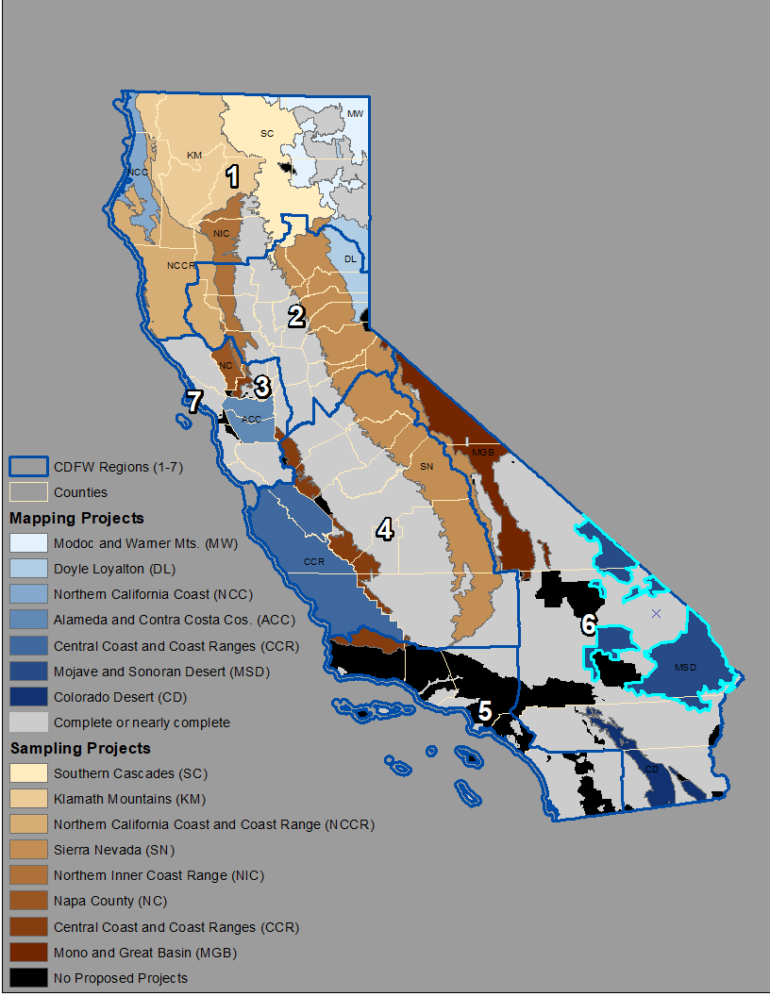
Mojave and Sonoran Desert Vegetation Mapping
VegCAMP
Project Managers –
Rachelle Boul, Rachelle.Boul@wildlife.ca.gov
Nani Teves, Nani.Teves@Wildlife.ca.gov
Data Coordinator –
Rosie Yacoub, Rosalie.Yacoub@wildlife.ca.gov
Aerial Information Systems
Project Manager – Debbie Johnson
California Native Plant Society
Project Manager - Julie Evens, jevens@cnps.org
Field and Data Coordinator - Jennifer Buck-Diaz jbuckdiaz@cnps.org
Ironwood Consultants
Project Manager – Dave Kesonie, dave@ironwoodbio.com

Slide 20
2023 Vegetation Sampling and Mapping Projects

Slide 21
Cross-agency Collaboration
How might you use vegetation data in your work?
Is there a particular project or region that you are most interested in?
Are you able to provide land access information and be a point of contact to discuss this further?
Do you know of any existing vegetation data that we might not know about?
Is there anything else you’d like to ask or share with us?
Complete the online survey here:
https://arcg.is/11bbP90

Slide 22
Cross-project Collaboration
Data collection, storage, and flow
Tracking count and distribution of community types sampled
Land access and collection permits
Others?

Slide 23
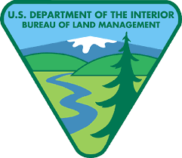
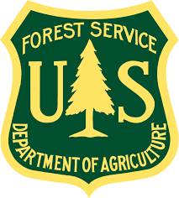
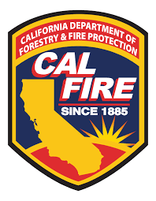
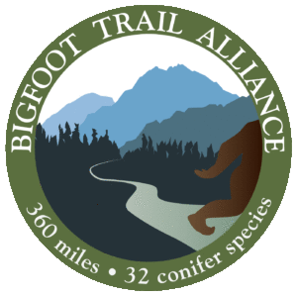
Collaboration is key!

