Slide 1
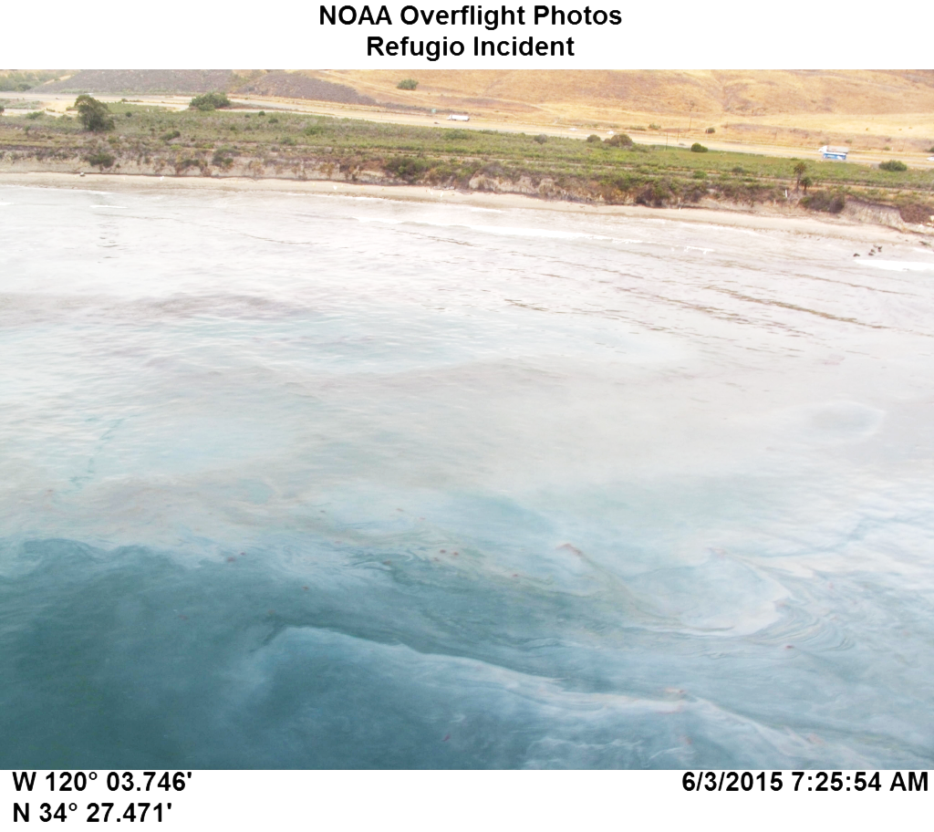
Refugio Oil Spill Response & Recovery
Regional Response Team
July 14, 2015

Slide 2
Incident Summary
On 19 May 2015 at 1243, a Hazardous Materials Spill Report was submitted to the Governor’s Office of Emergency Services
The report indicated a 24-inch pipeline rupture that occurred near Refugio State Beach in Santa Barbara County, CA
The responsible party (Plains All American Pipeline) estimated the total release at 500 barrels (21,000 gallons) of crude oil on the shoreside of Hwy 101 which then flowed into the Pacific Ocean
Initial reports estimated a sheen to be 3.5 NM along the beach and 50-100 yards into the water

Slide 3
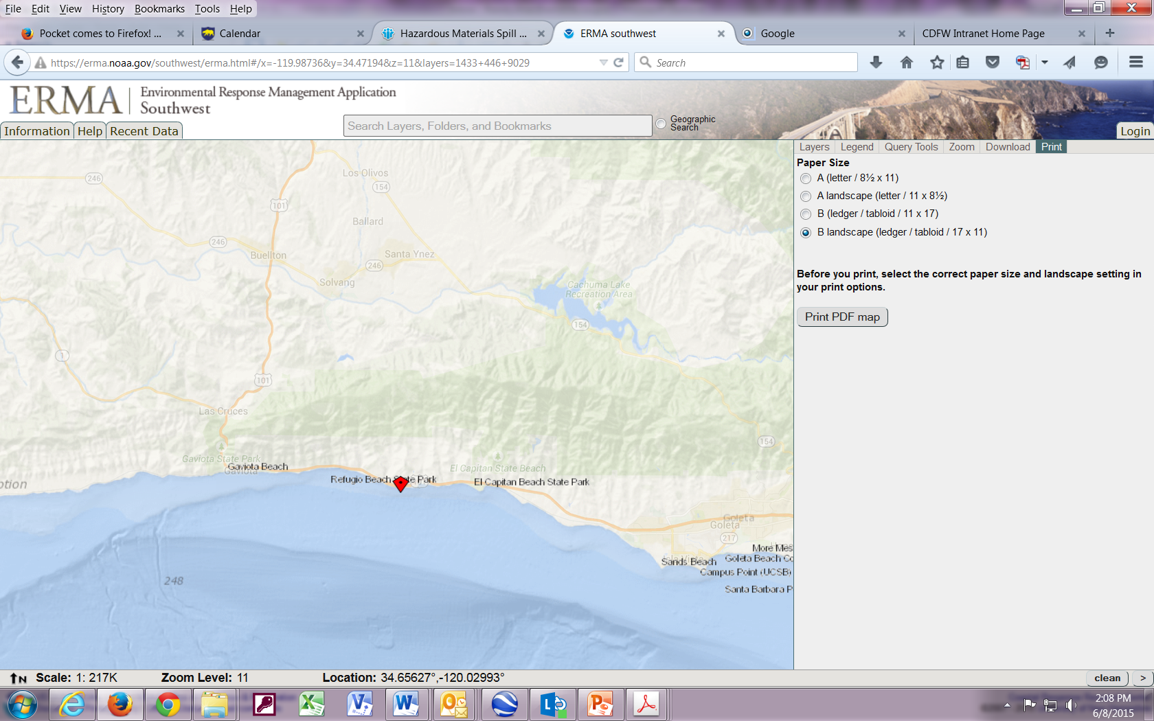
Location of Incident
(Approximately 25 miles west of Santa Barbara)

Slide 4
Incident Command Post (ICP) Initially Housed at Santa Barbara OEM Currently Housed at Private Building Near the SB Airport
Notes:
Initial ICP was located at the Santa Barbara County Fire Department Emergency Response Center. The ICP was later moved to a leased building by the Santa Barbara Airport

Slide 5
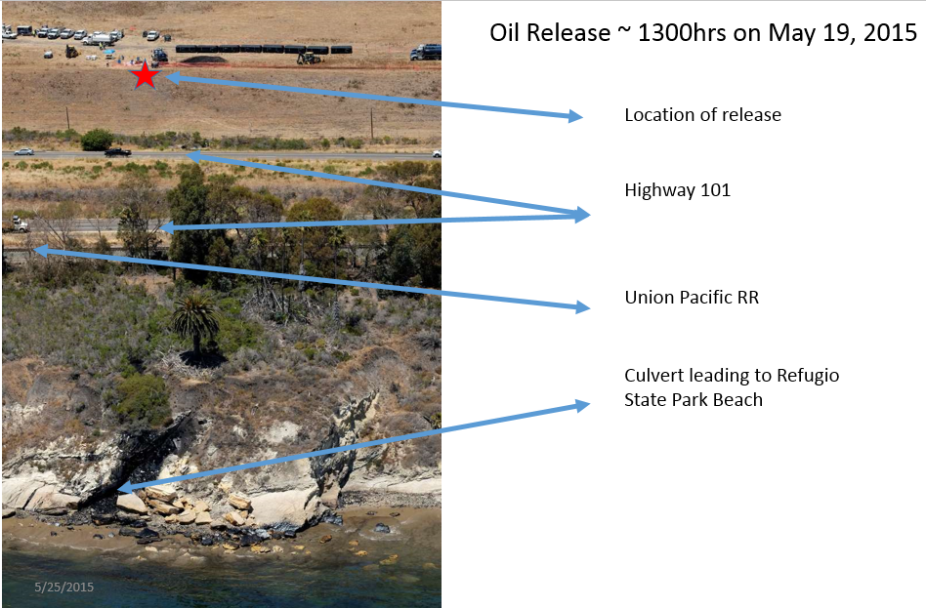

Slide 6
Release Site
(Replaced pipeline above Hwy 1 / 101)
Photo Courtesy of NOAA

Slide 7
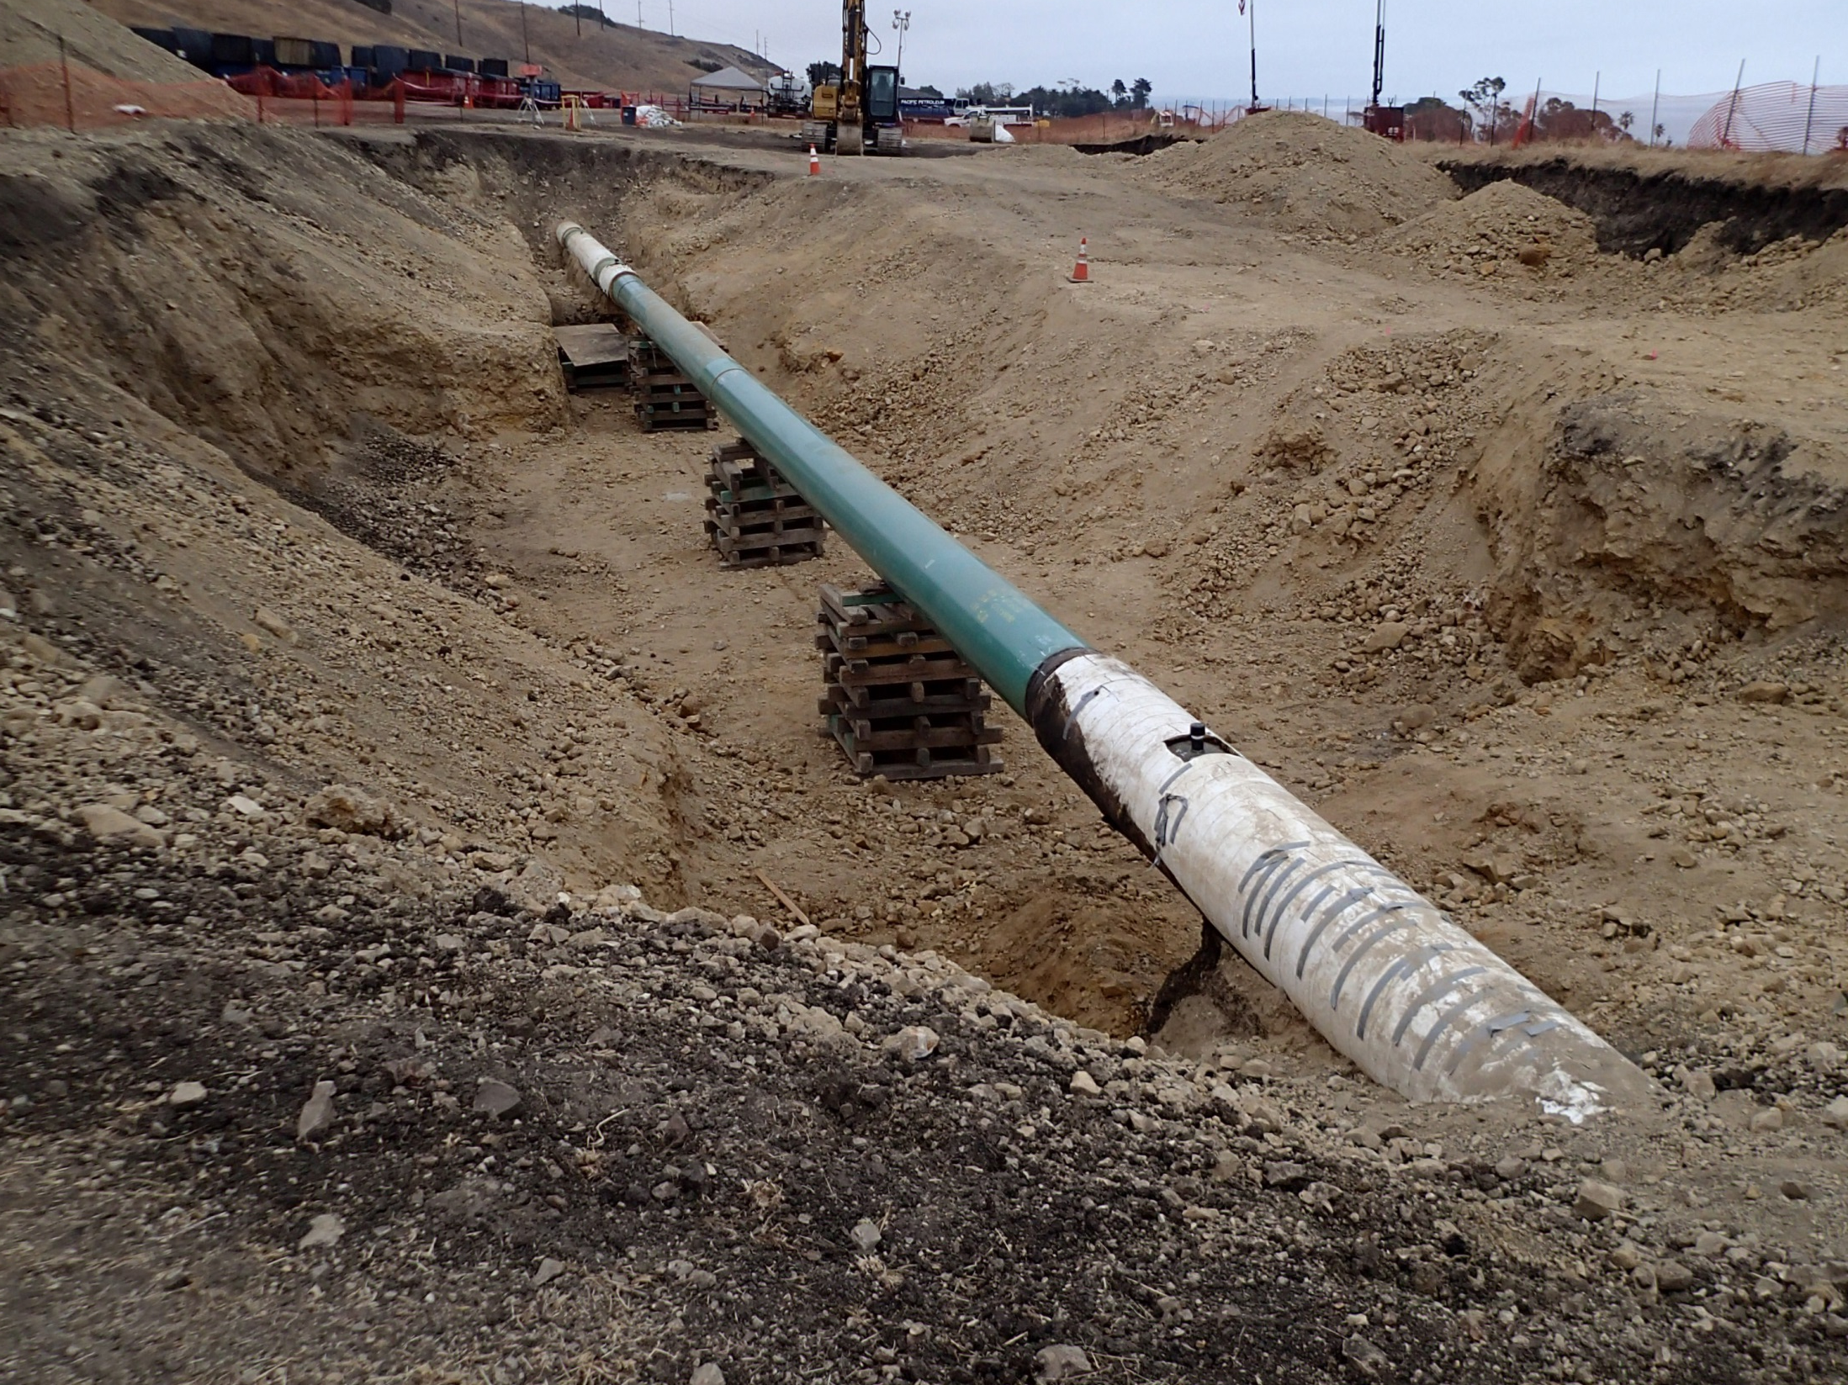
Pipeline Replacement
Photo Courtesy of CDFW-OSPR

Slide 8
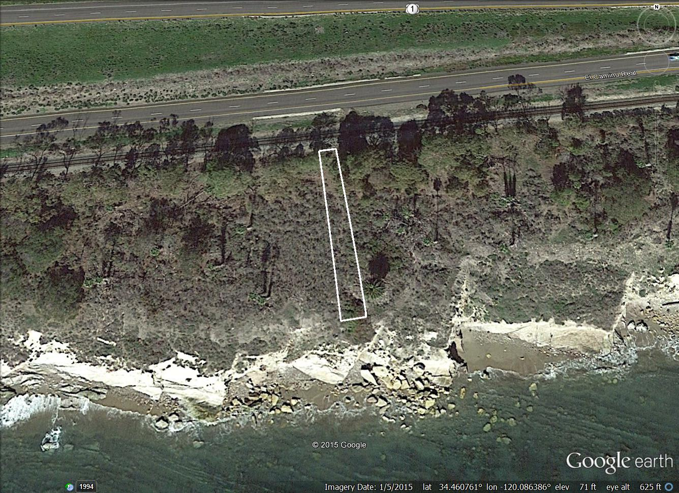
Contaminated Soil Removal
(Estimated dimensions: 250’ x 10’-50’ x 2’)

Slide 9
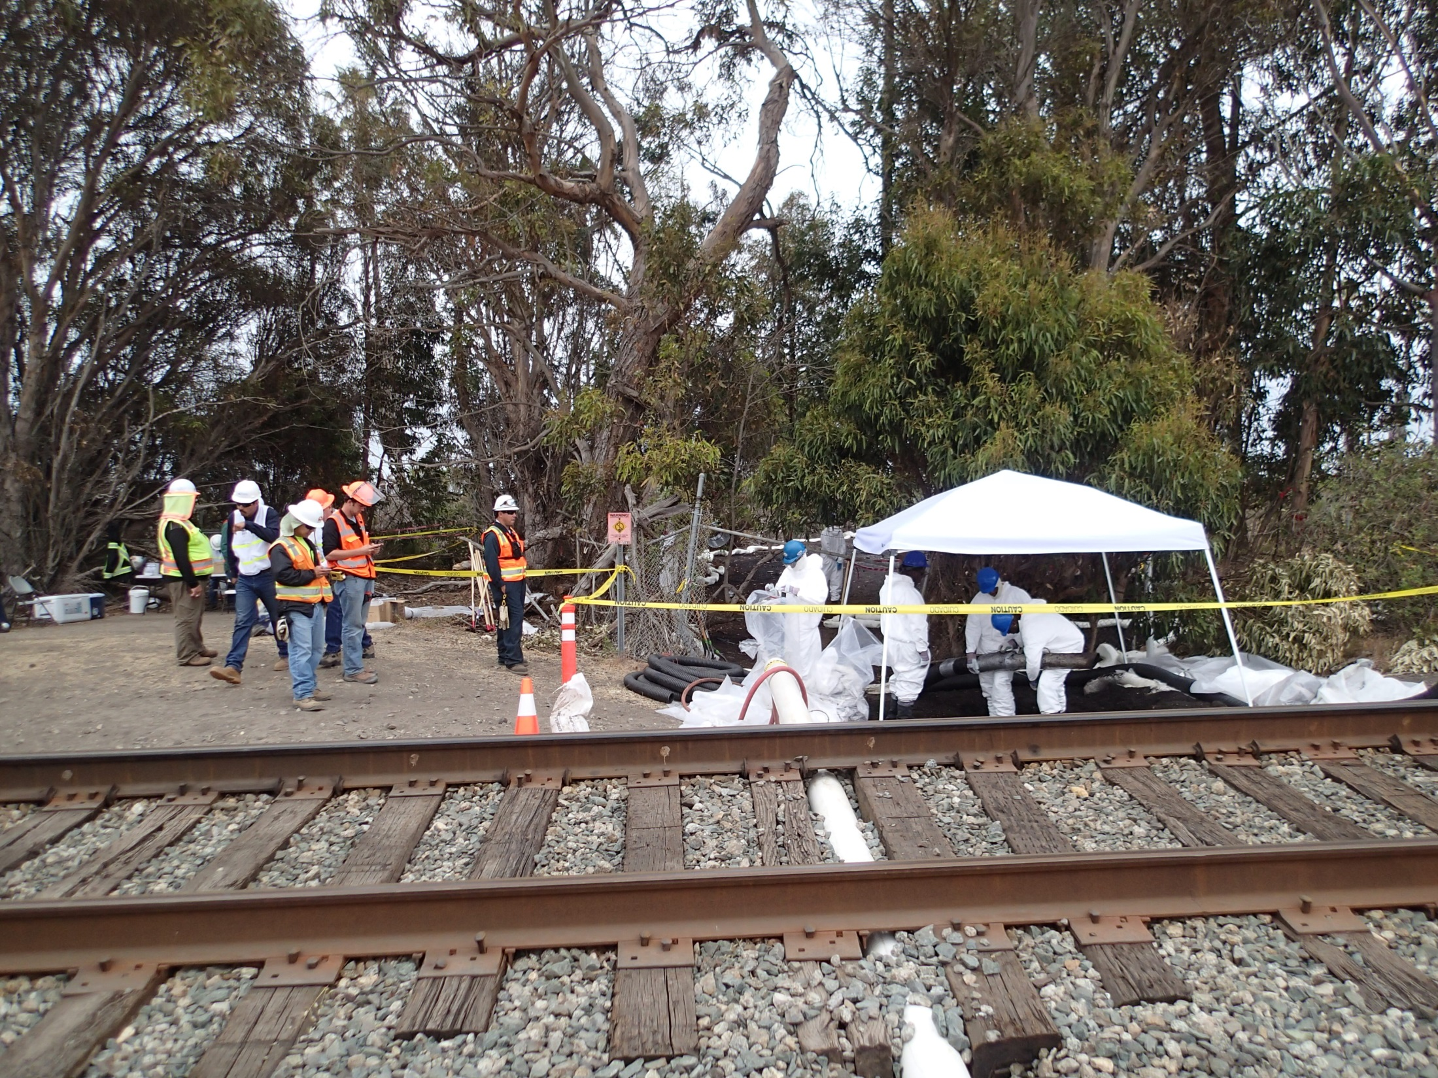
Location of Release
(below RxR line)
Photo Courtesy of CDFW-OSPR

Slide 10
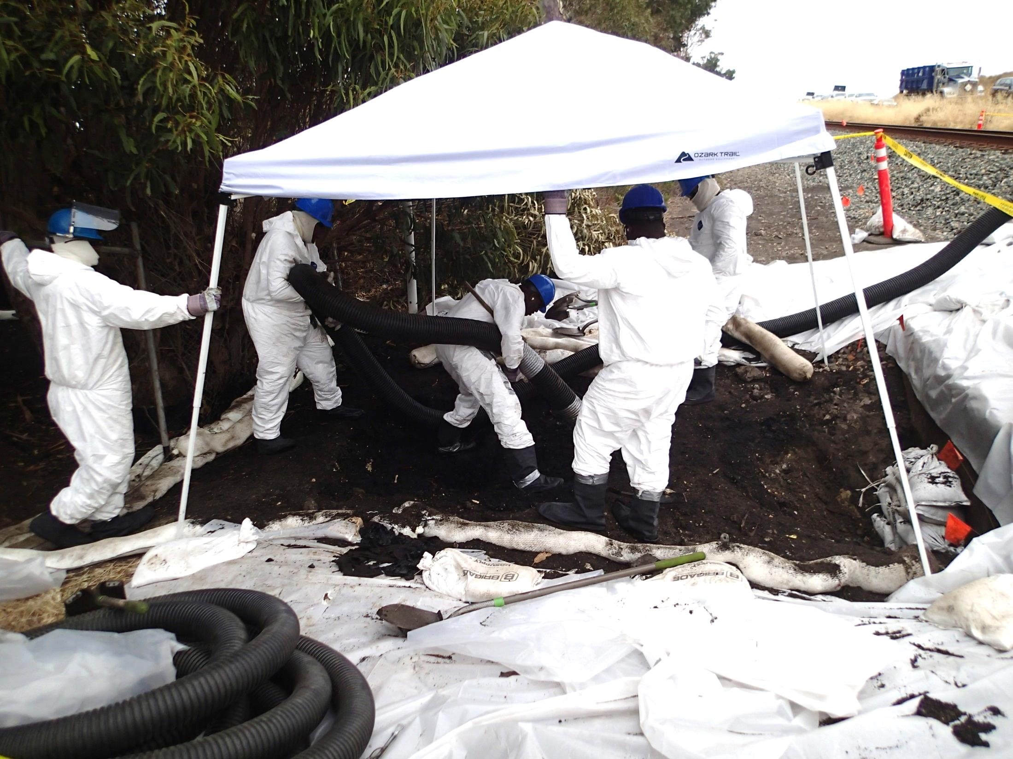
Contaminated
Soil Removal
Photo Courtesy of CDFW-OSPR

Slide 11
Current Coastal Terrace Operations:
Continued concentrated effort to clean up Coastal Terrace Sections 4 & 5
Operations involve using a spyder back hoe to excavate contaminated soil and helicopter to lift and transport loads
The operations are being monitored by US EPA, State Parks, Central Coast RWQCB, Santa Barbara County and cultural/tribal monitors

Slide 12
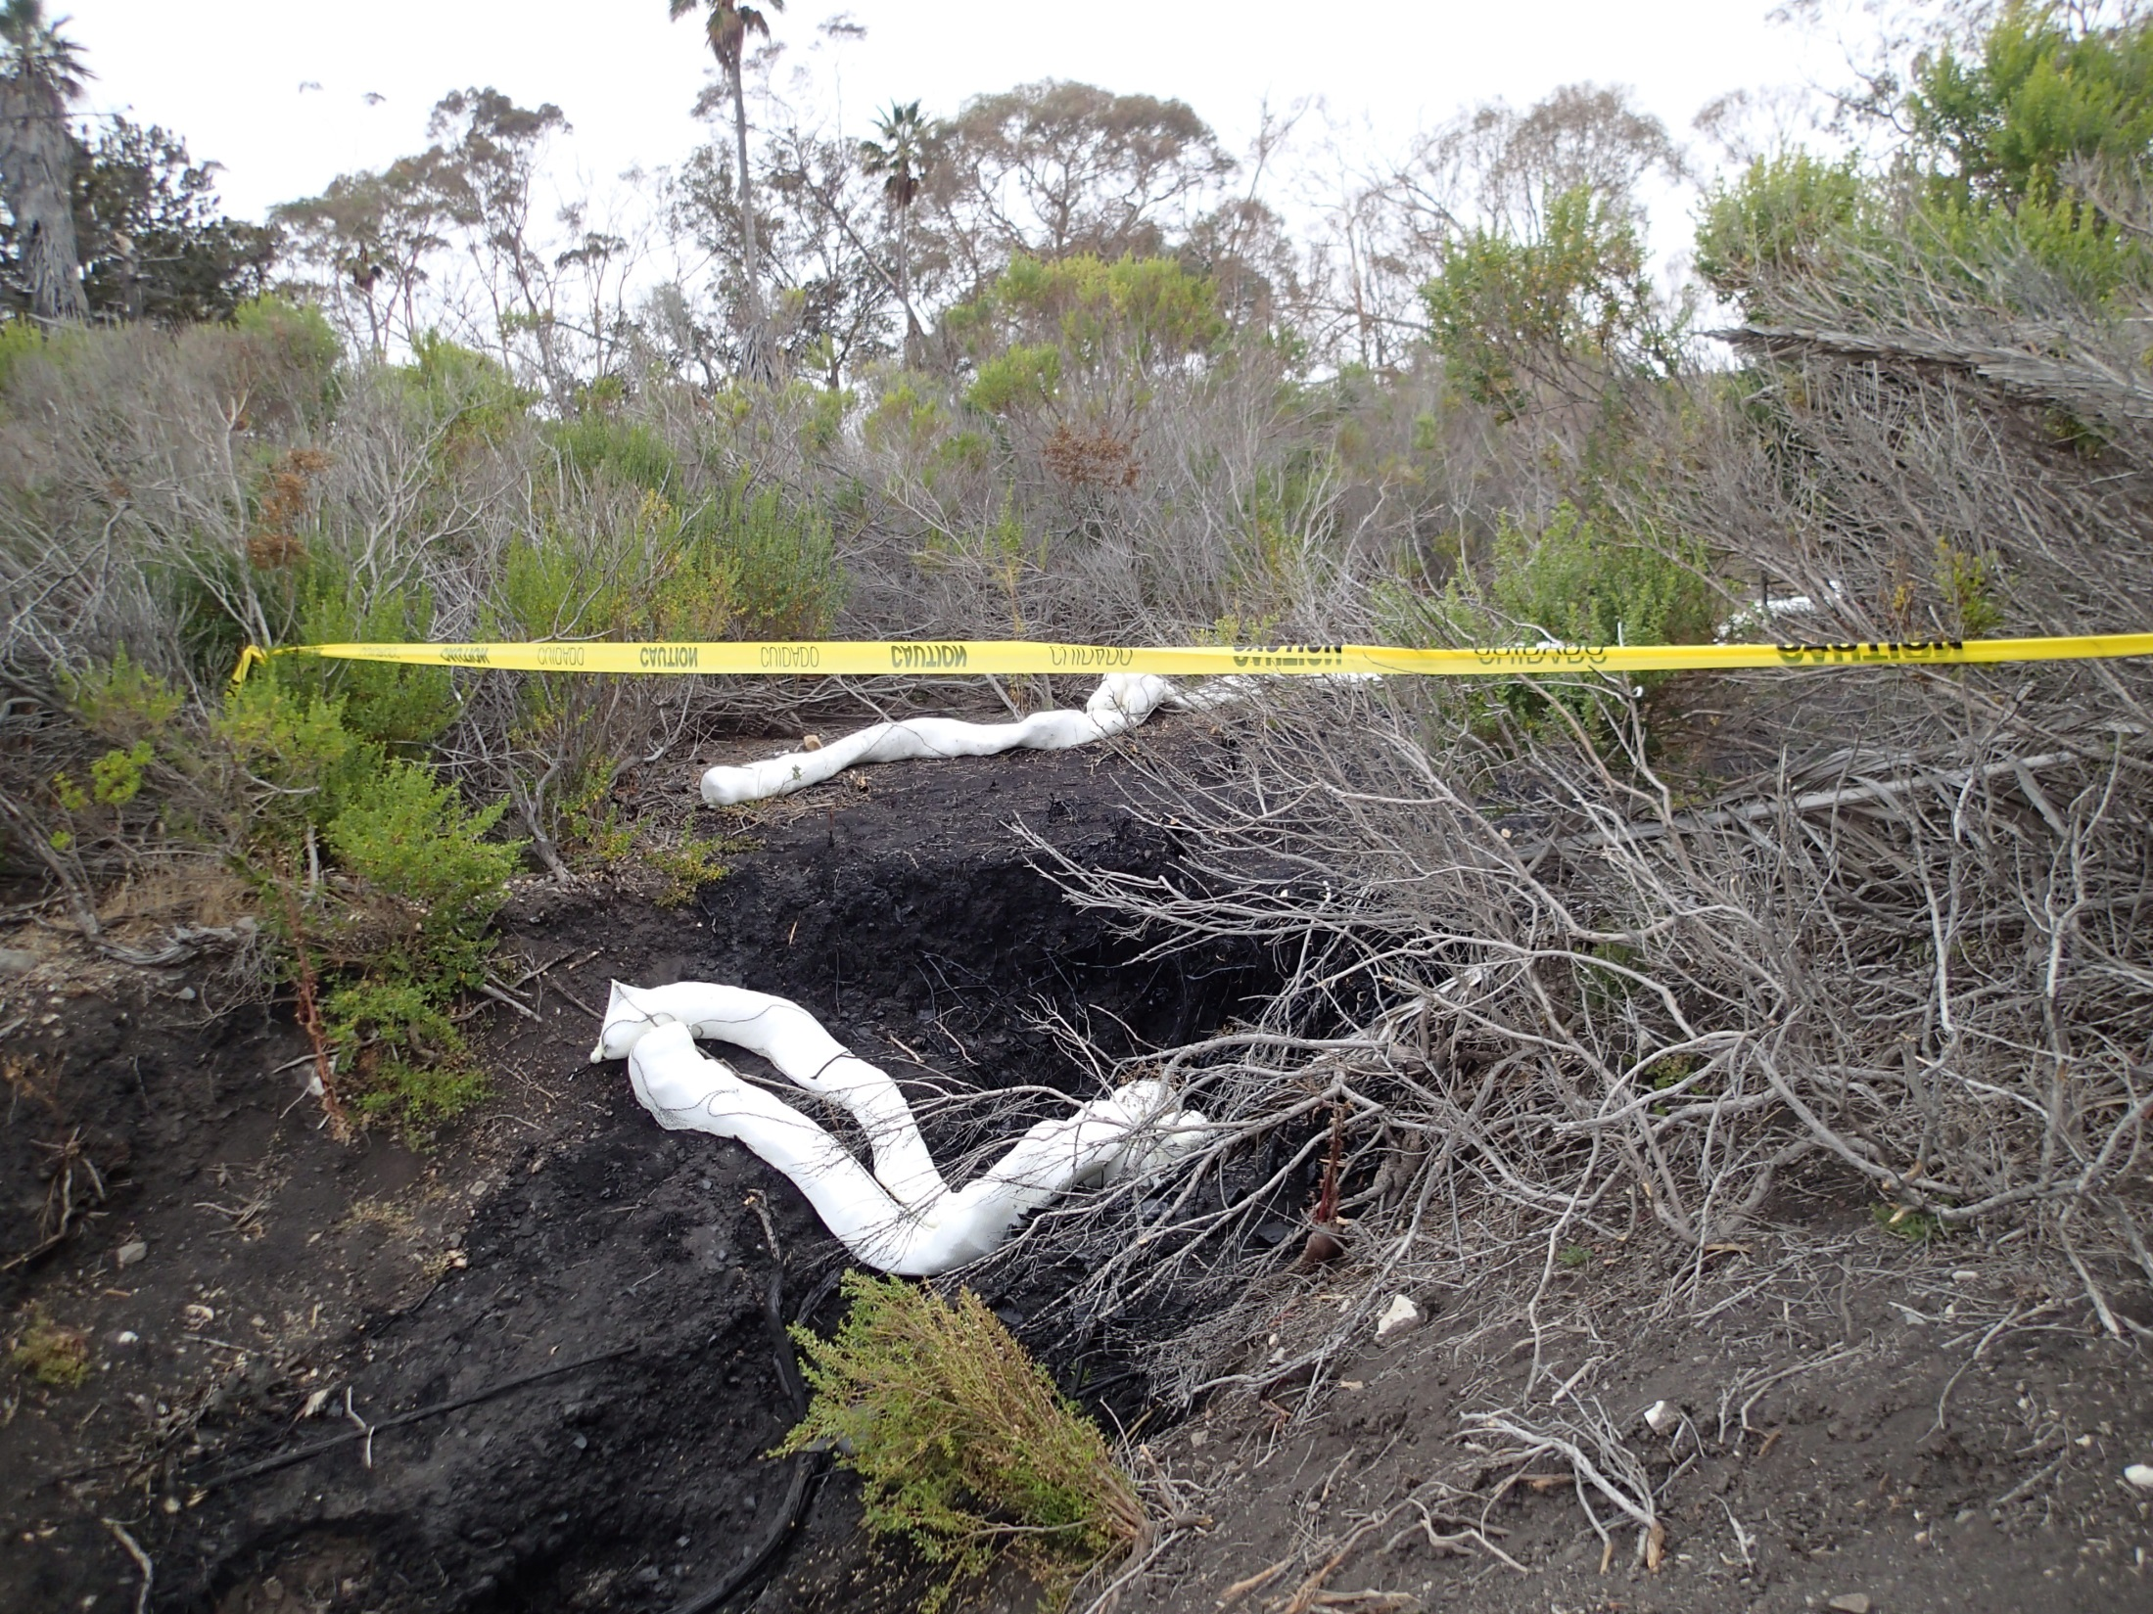
Slough area below the terrace
Photo Courtesy of CDFW-OSPR

Slide 13
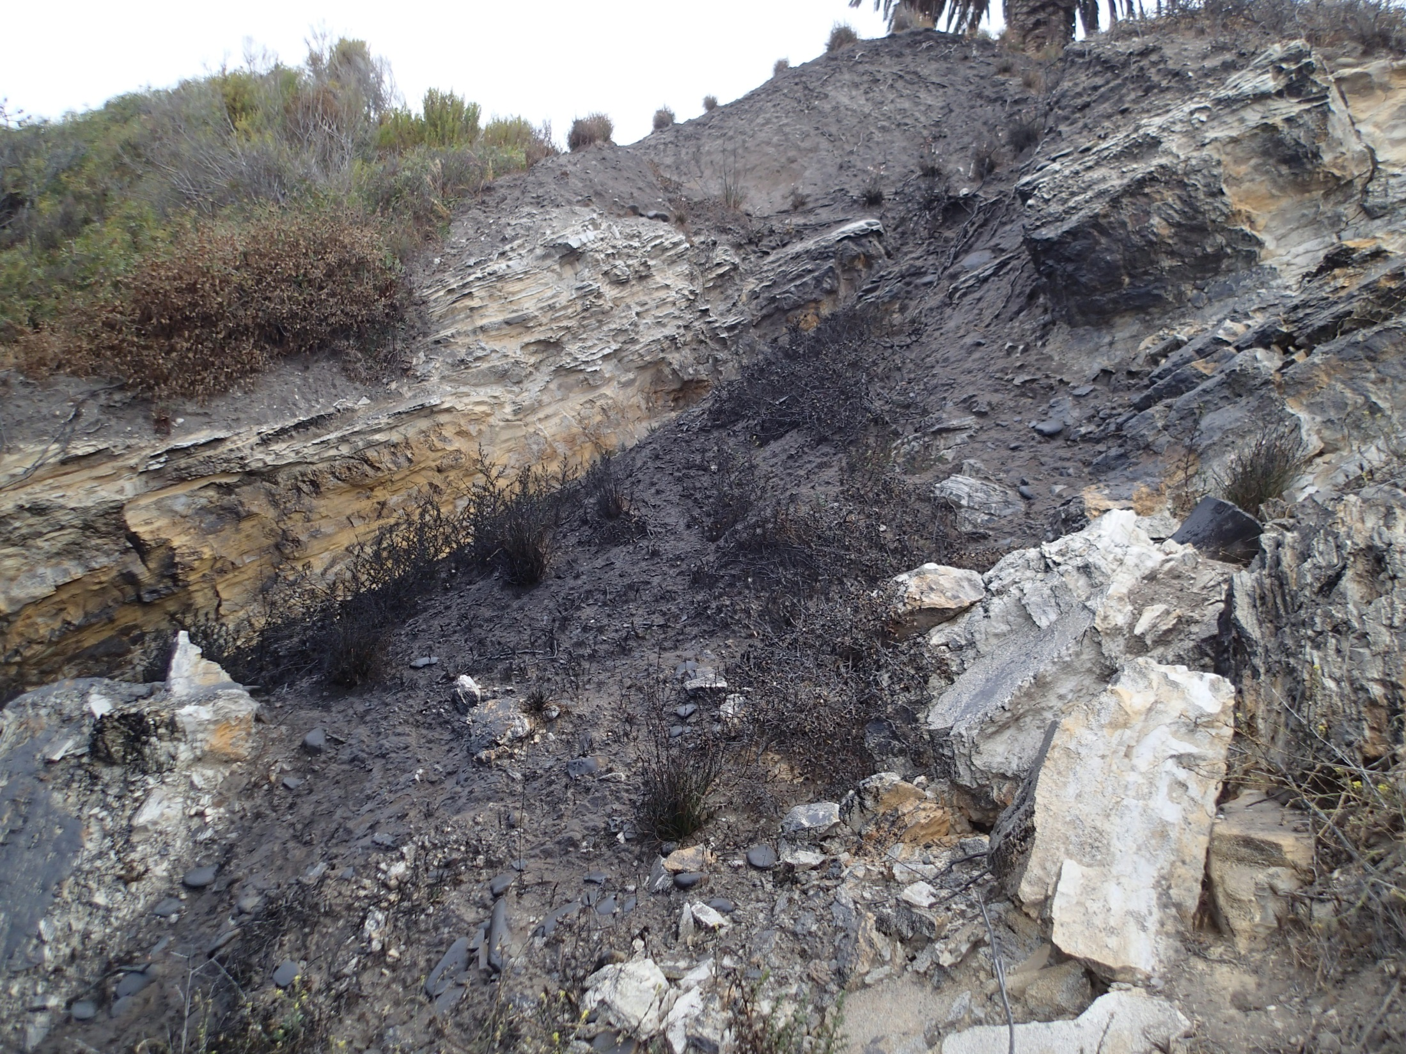
Cliff area below the terrace
Photo Courtesy of CDFW-OSPR

Slide 14
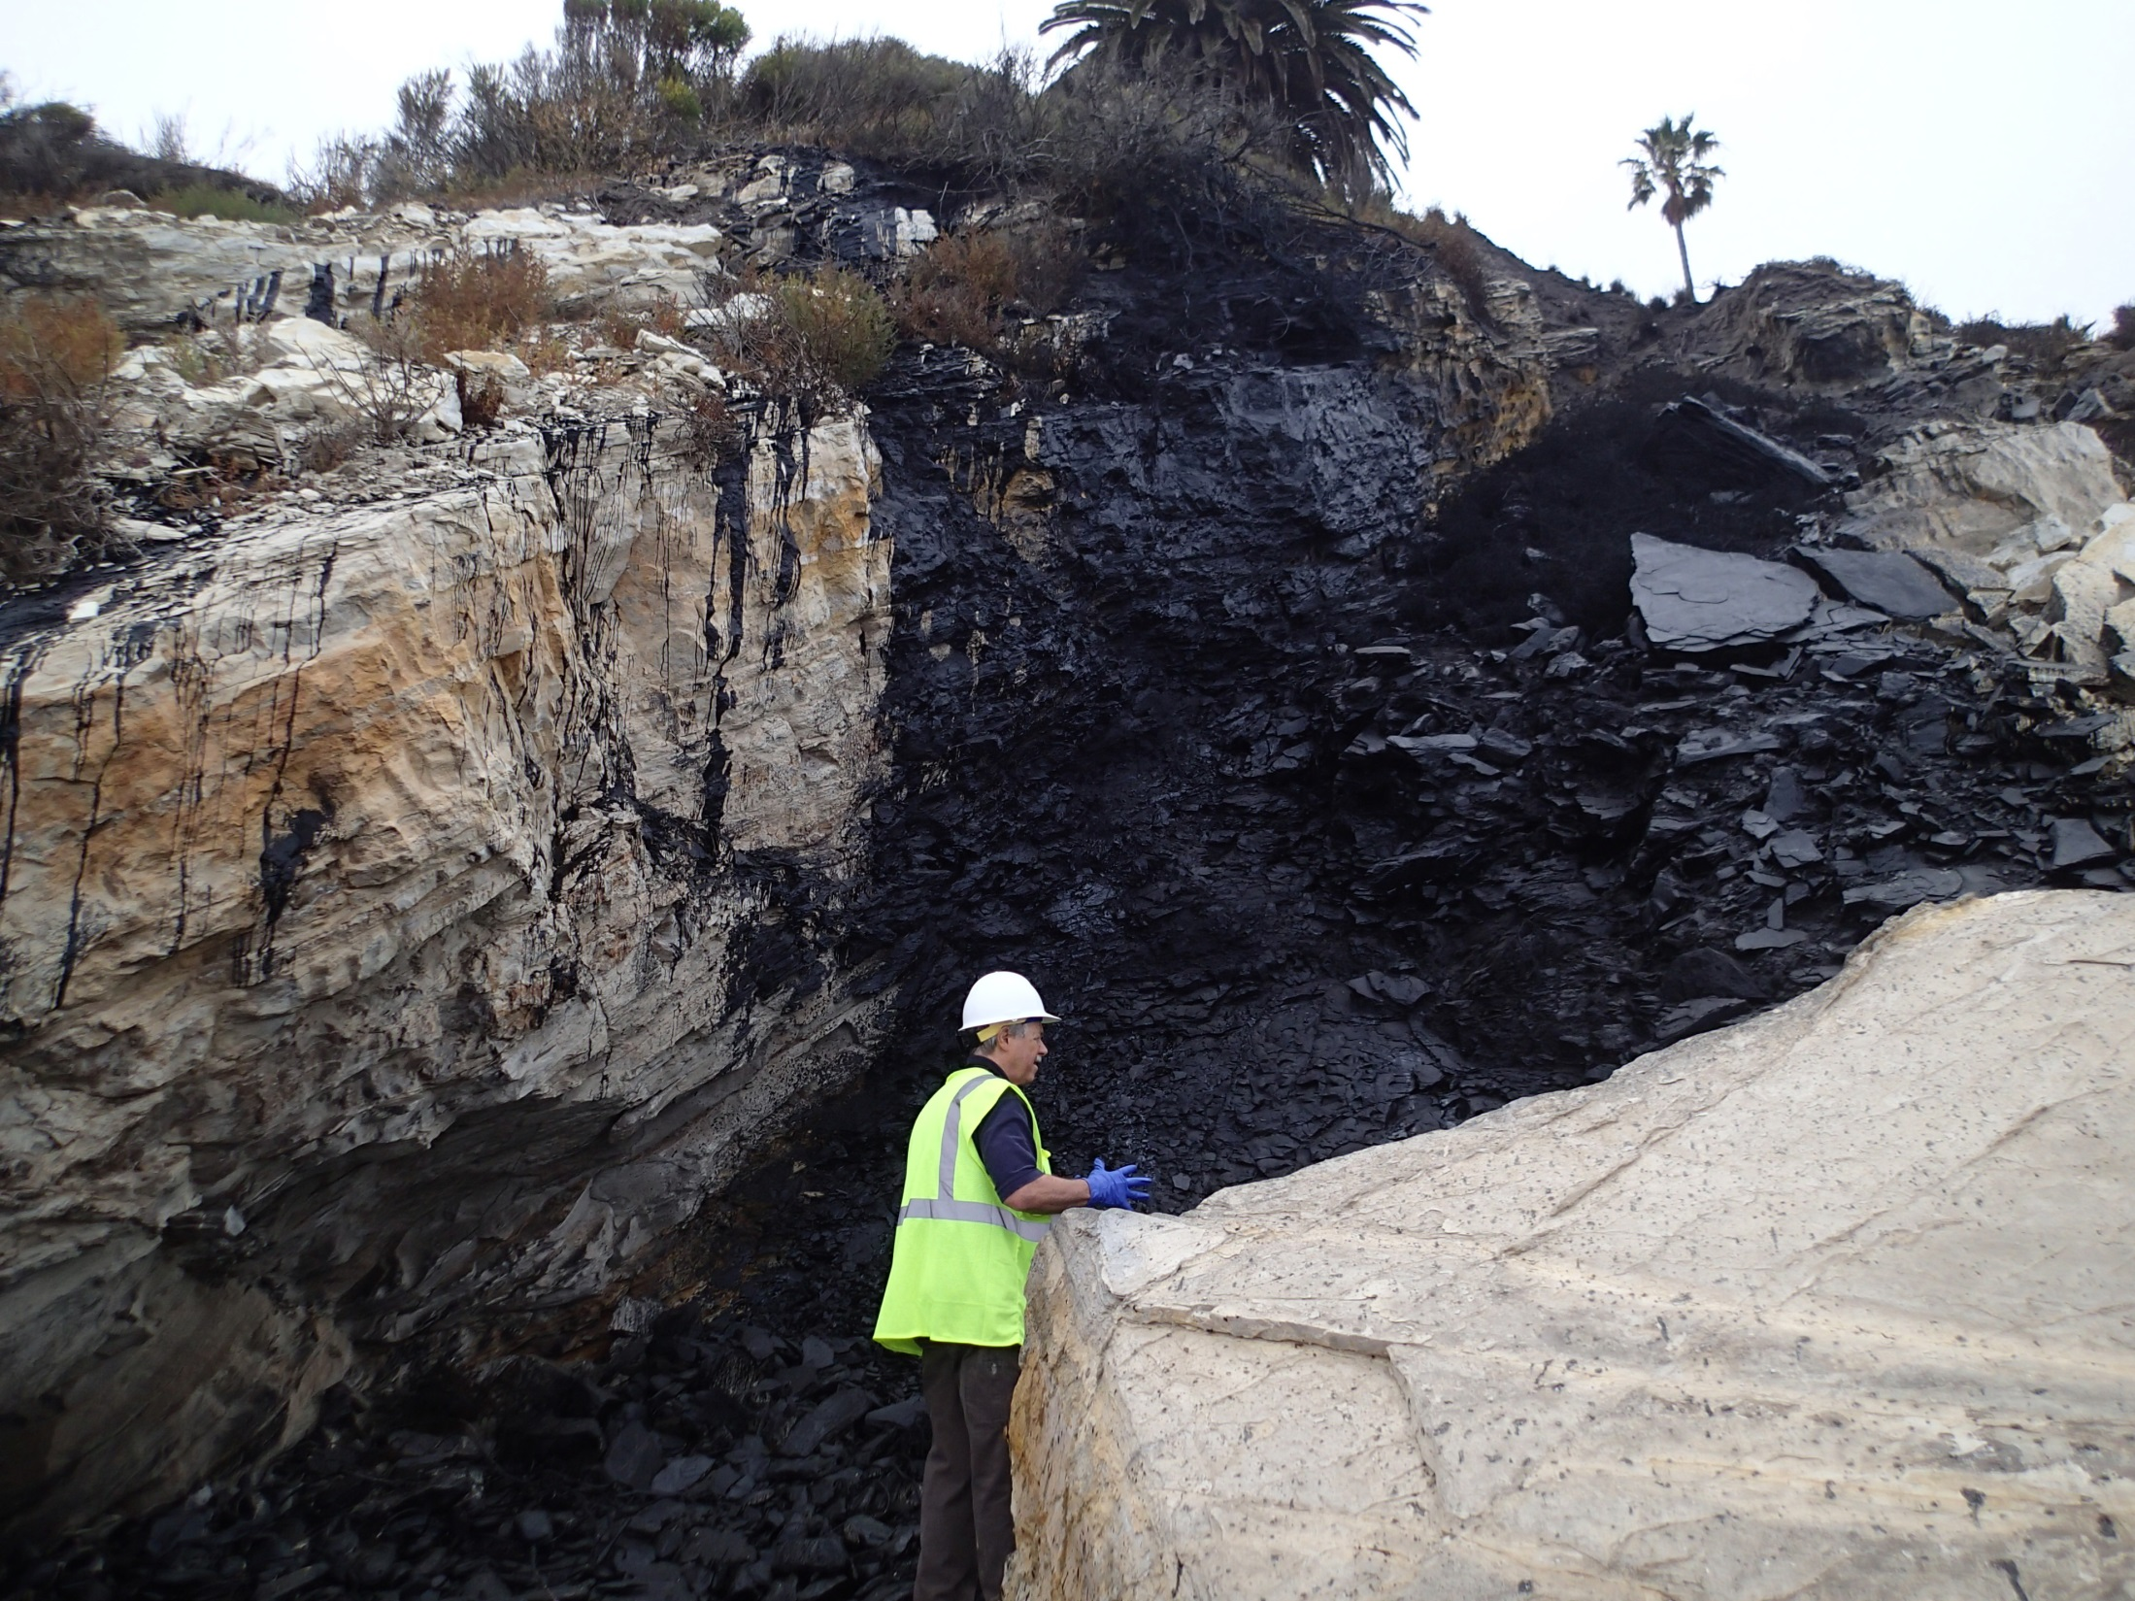
Cliff face and
upper intertidal area
Photo Courtesy of CDFW-OSPR

Slide 15
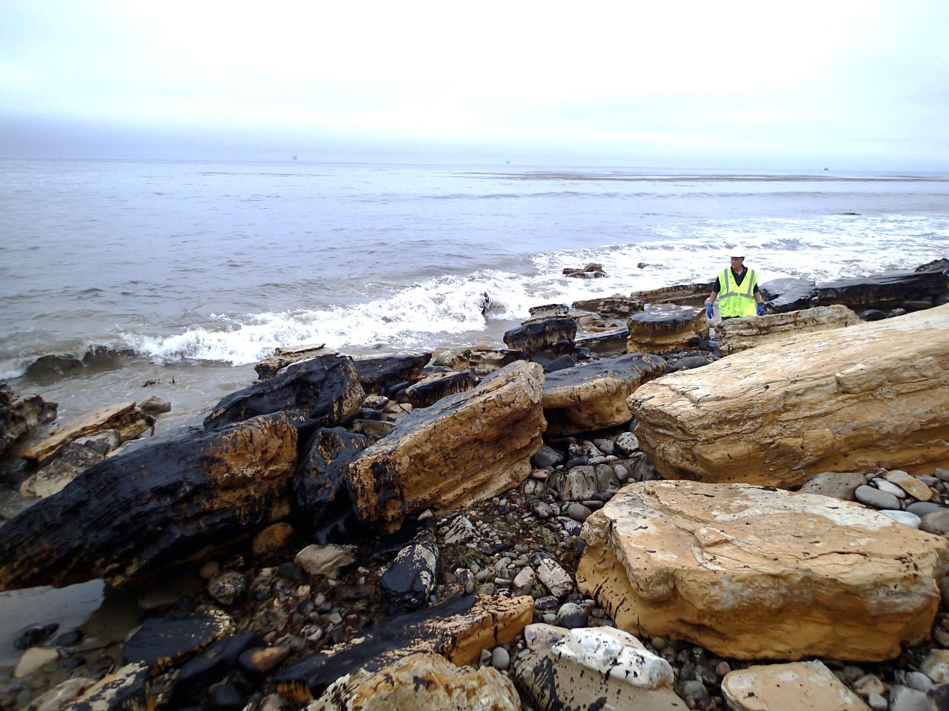
Shoreline below the cliff
Photo Courtesy of CDFW-OSPR

Slide 16
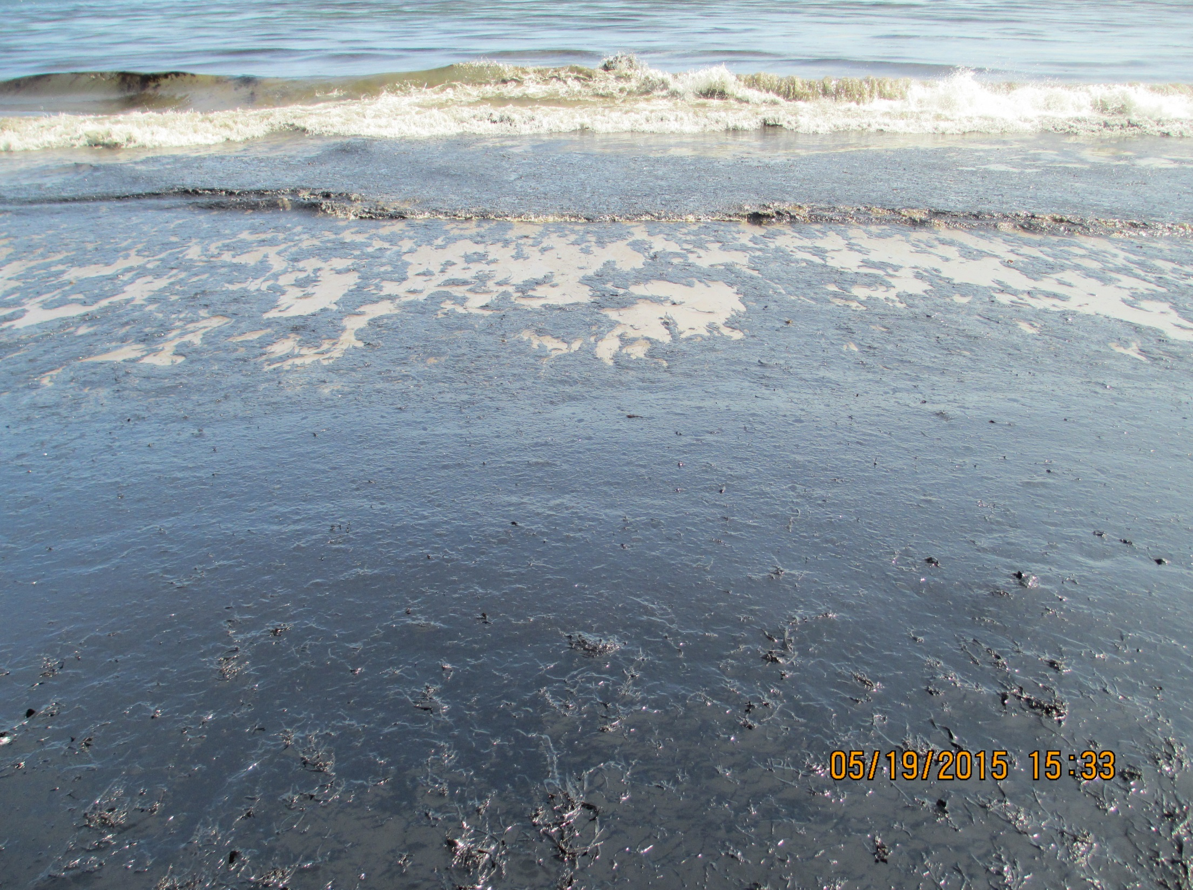
Other Shoreline Impacts
Photo Courtesy of NOAA

Slide 17
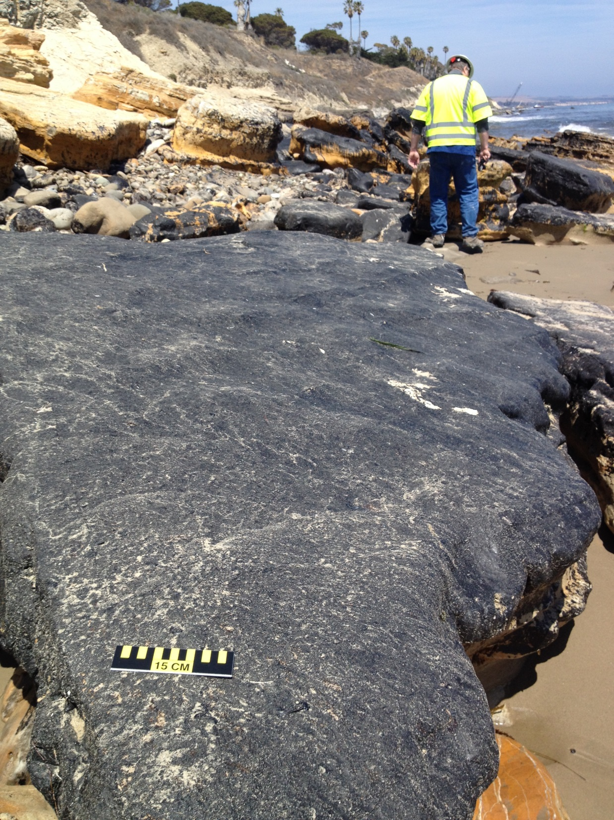
Photo Courtesy of NOAA

Slide 18
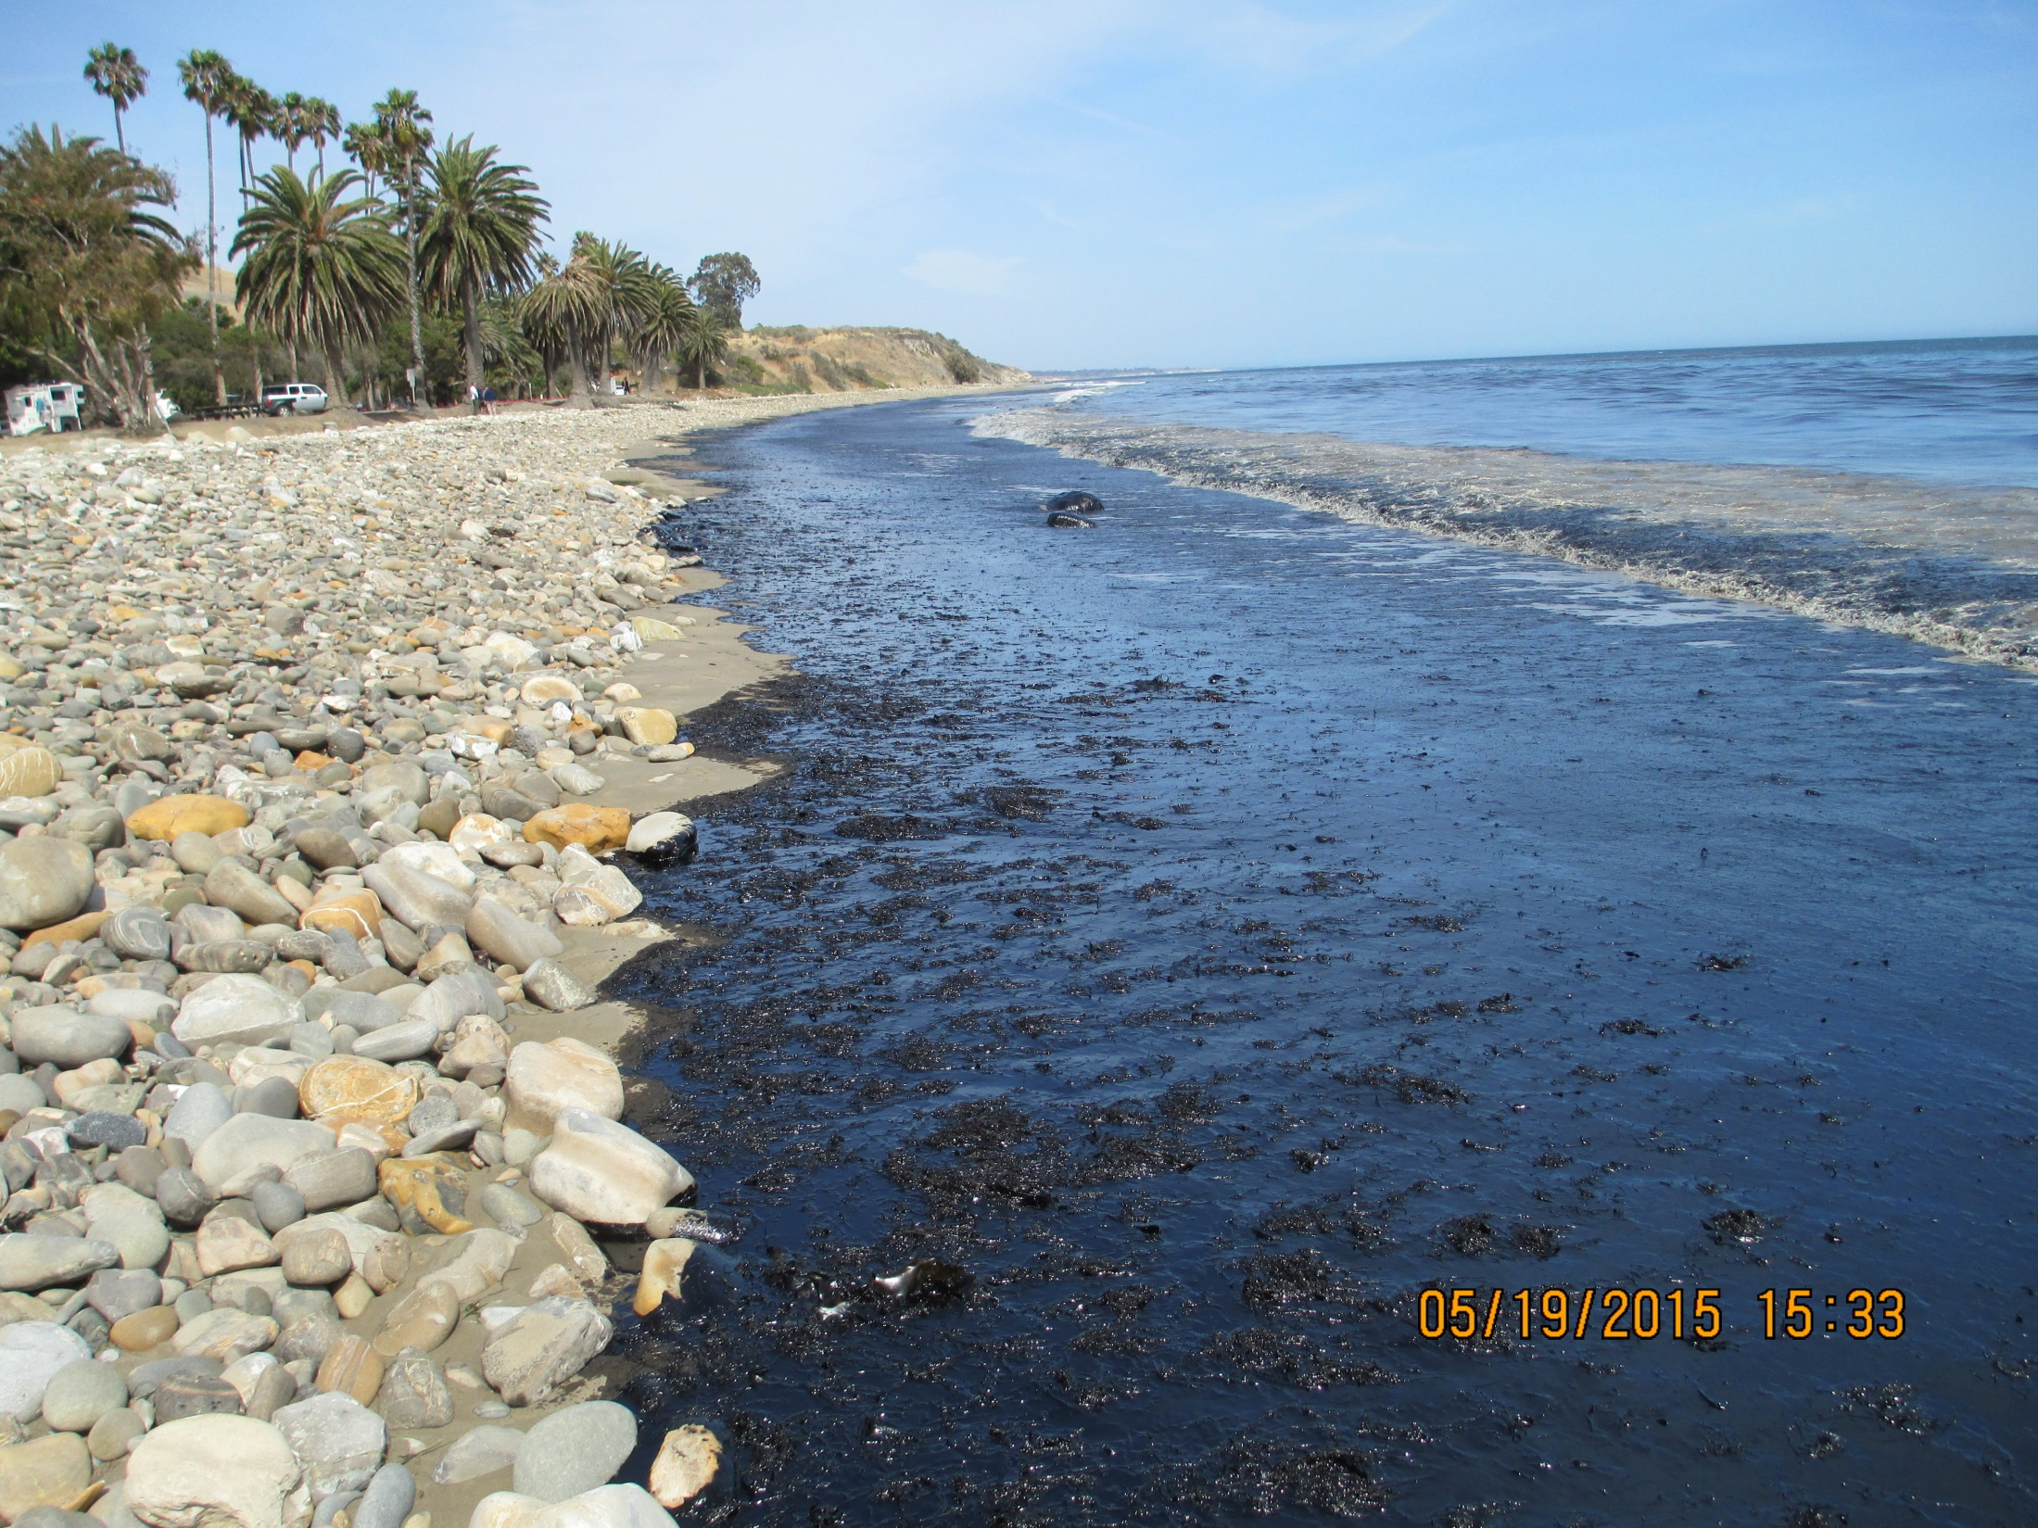
Refugio State Beach
Photo Courtesy of NOAA

Slide 19
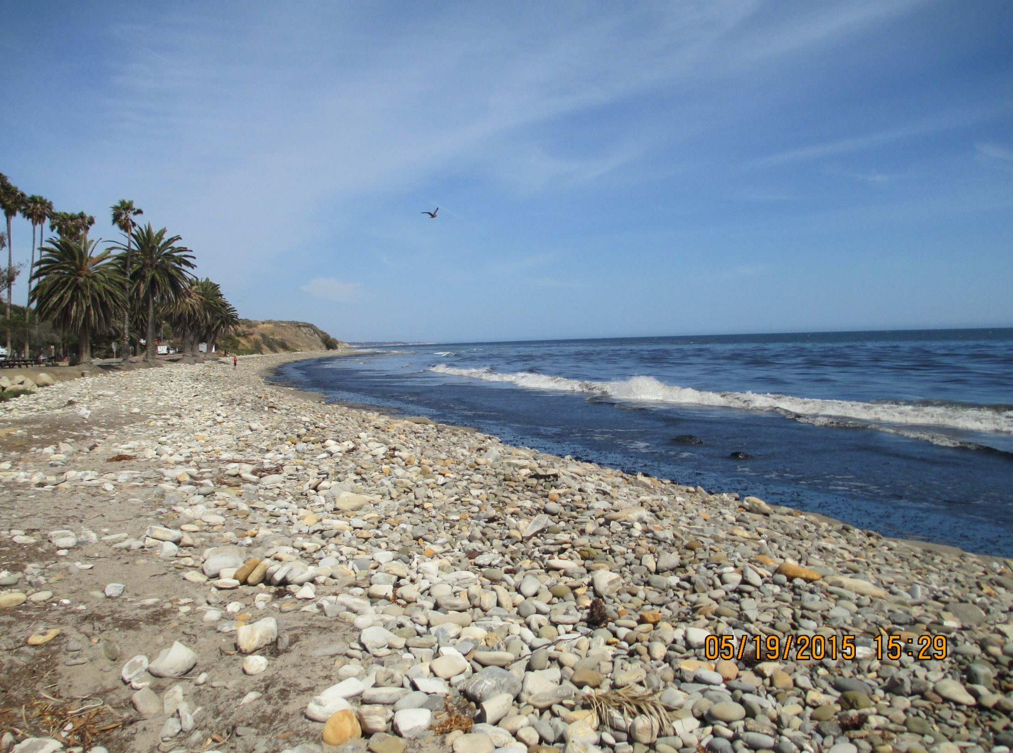
Refugio State Beach
Photo Courtesy of NOAA

Slide 20
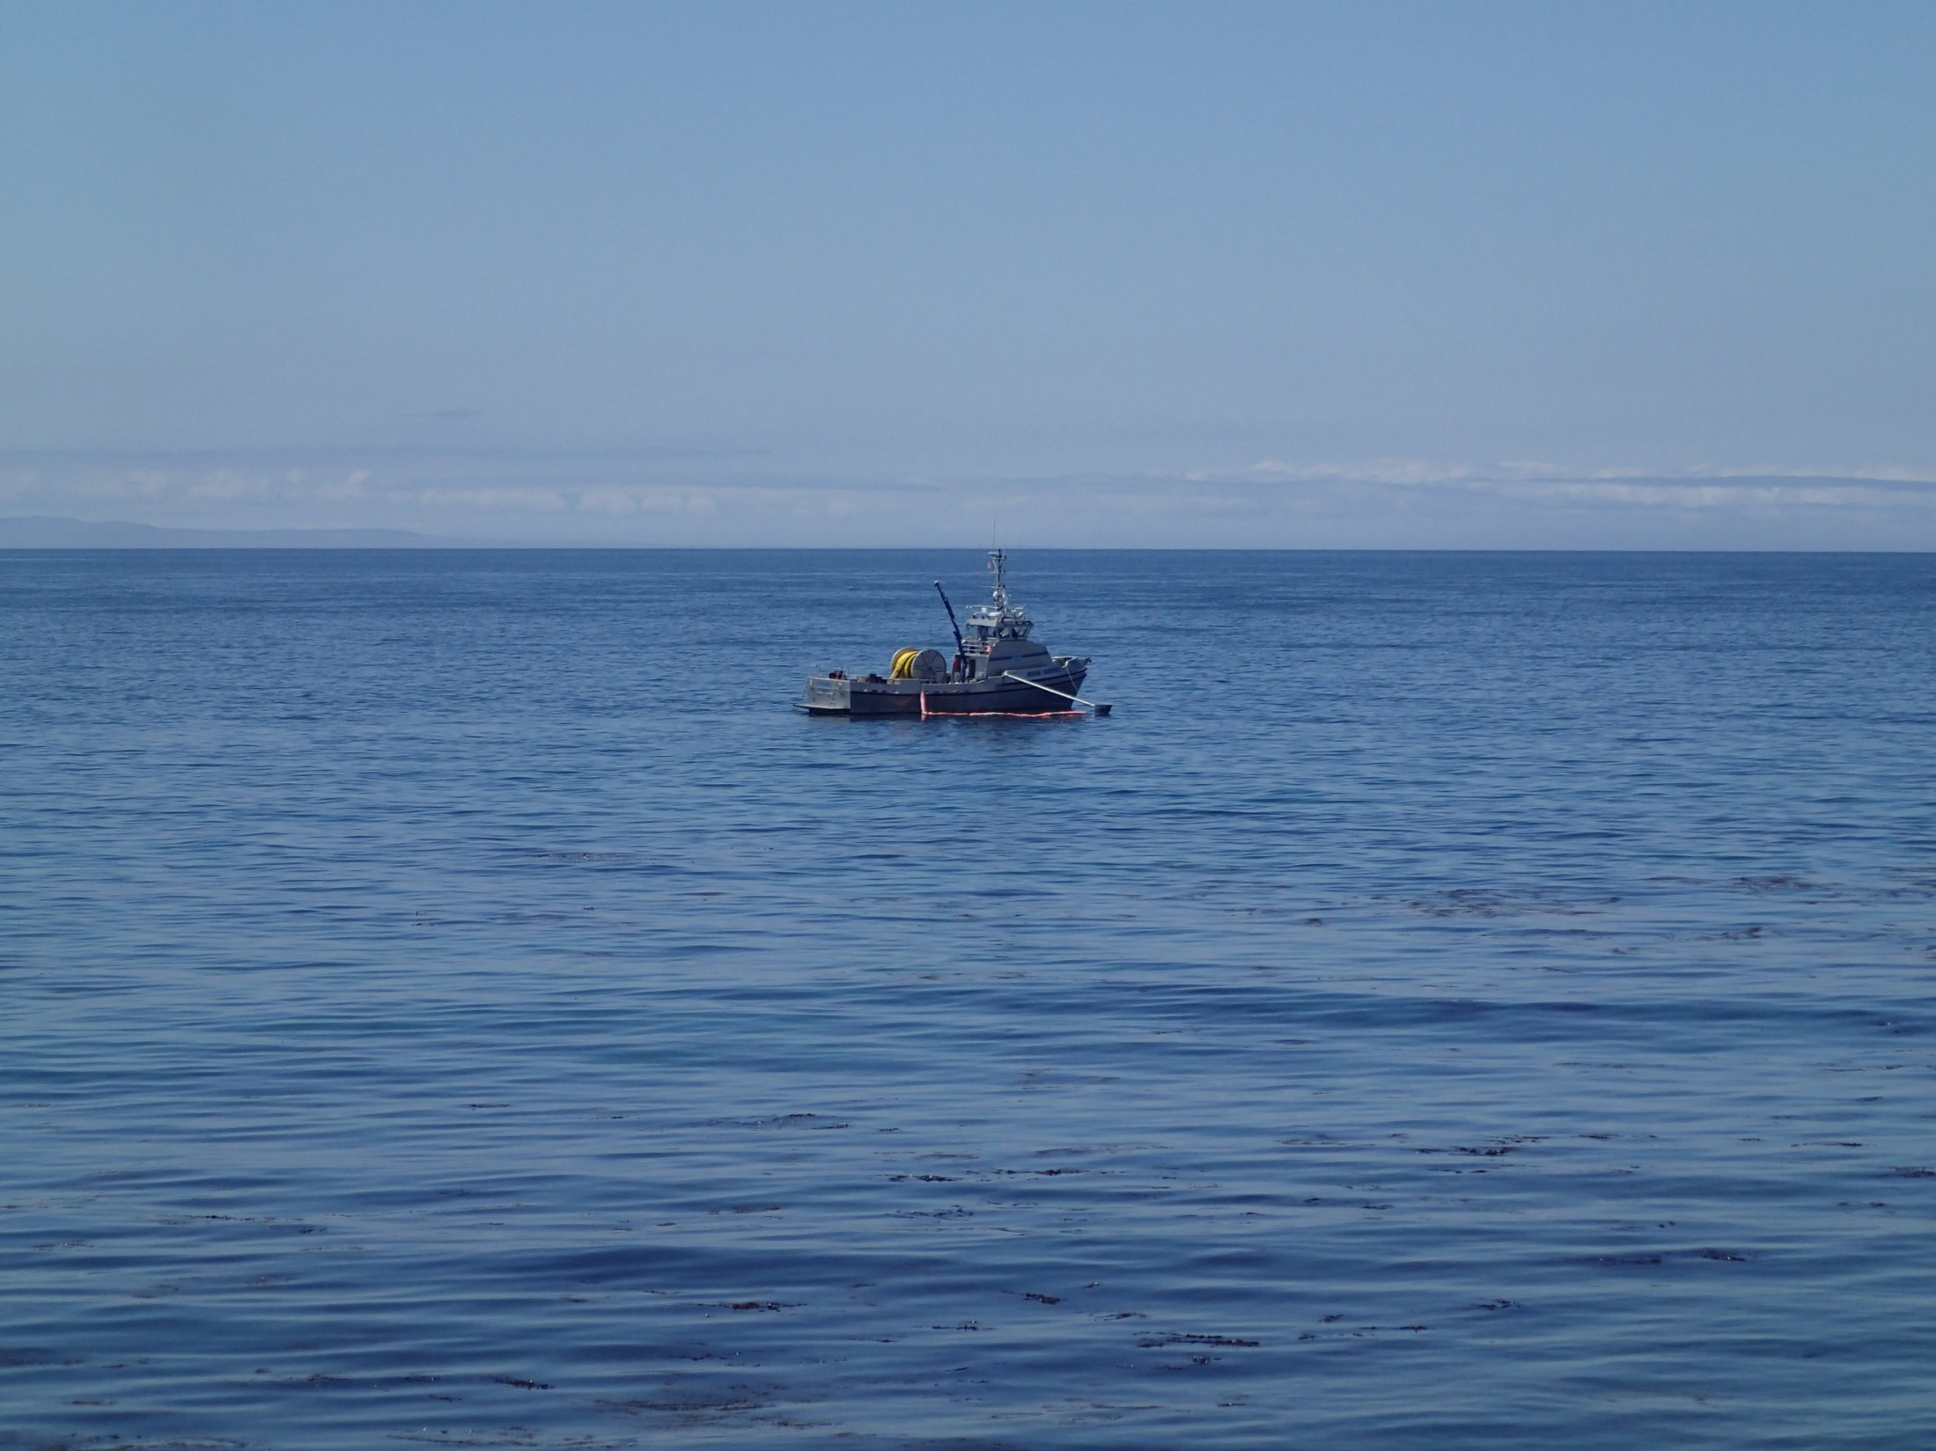
On-Water Operations
The on-water vessel response concluded approximately June 18th with the last vessel responsible for removing all remaining snare boom.
The cumulative total of oily water mixture removed the on-water recovery was approximately 14,267 gallons
Photo Courtesy of CDFW-OSPR

Slide 21
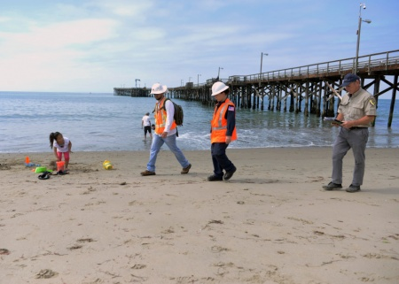
Shoreline Cleanup Assessment Techniques (SCAT) Team
Scat Teams are responsible for documenting the extent and degree of oiling

Slide 22
Current SCAT Activities
Phase II Cleanup Endpoints have been achieved for 98% of the overall impacted shoreline
The remaining 2% is confined to Division I, J and K
Div. I
Div. J
Div. K

Slide 23
“Sampling Blitz”
The UC conducted a one reconnaissance-level oiling assessment survey
A minimum of one sample of fresh oil or tarballs will be collected from each division.
Results of analysis is pending but will be shared with the UC and stakeholders

Slide 24
Three Teams Established
Team composition:
UC representatives (CDFW-OSPR, USCG, & RP)
Local stakeholders (Non-Governmental Organizations and City/County representatives)
Geographic Extent Covered by Teams:
Team 1 surveyed Santa Barbara County
Team 2 covered Ventura County
Team 3 covered Los Angeles / Orange County

Slide 25
The sample sites were determined based on:
Natural depositional shoreline locations
Publically reported heavy oiling shorelines
High recreational use areas, and/or
Areas where natural oil seepage tends to collect based on local knowledge.

Slide 26
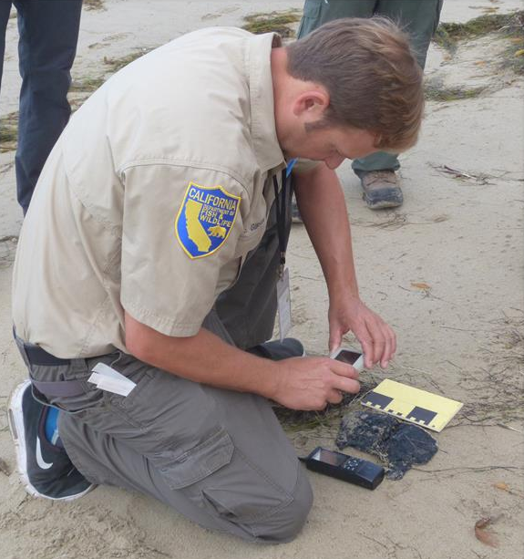
Once a candidate tarball was identified, pertinent information was documented prior to sampling

Slide 27
Tarball sample was split 3-ways and were given to :
CDFW-OSPR
USCG
RP

Slide 28
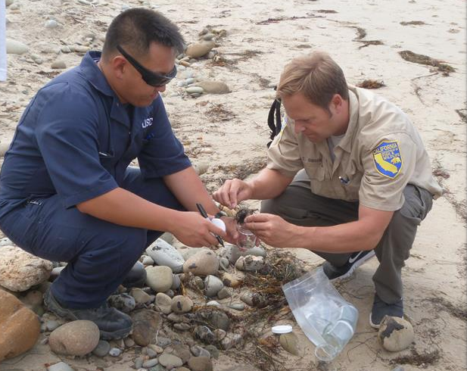
The UC agreed for the purpose of this sampling event CDFW-OSPR Petroleum Chemistry Laboratory would run the samples for analysis and conduct interpretation for the UC
Samples were taken following the methodology practiced throughout the event
Care was taken to not contaminate the samples or exposures to the samplers

Slide 29
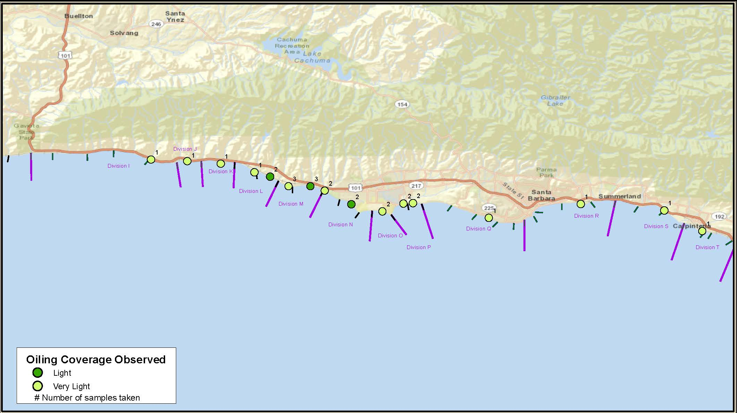
North Team #1
Santa Barbara County

Slide 30
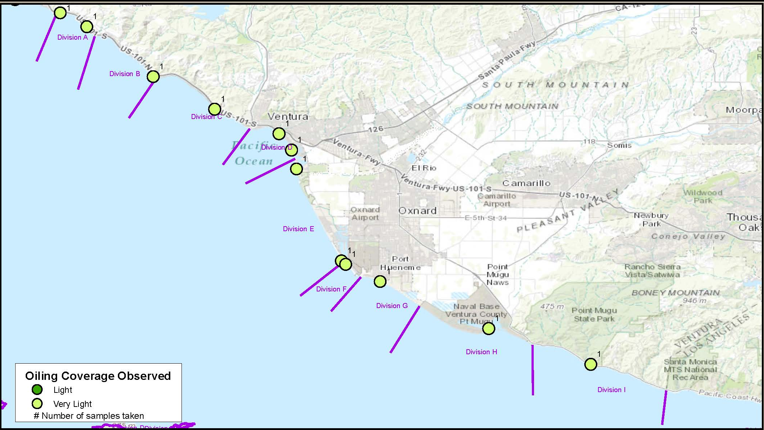
North Team #2
Ventura County

Slide 31
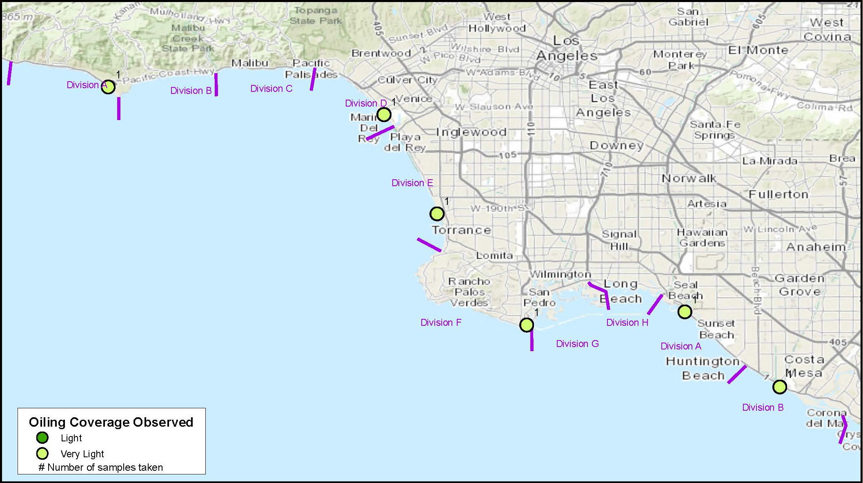
South Team #1
Los Angeles / Orange Counties

Slide 32
Volunteers
Number of Volunteers Applications Submitted: 1000
Number of Volunteers Trained: 263
Number of Volunteers Deployed: 159

Slide 33
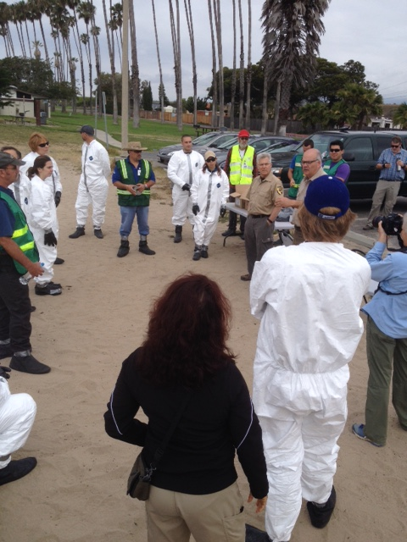
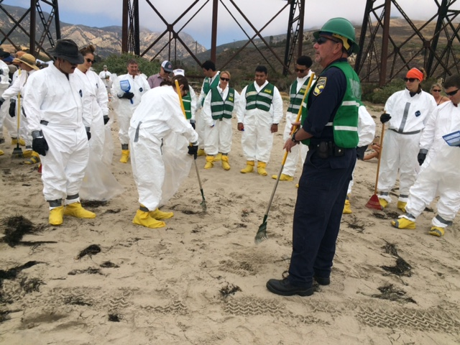
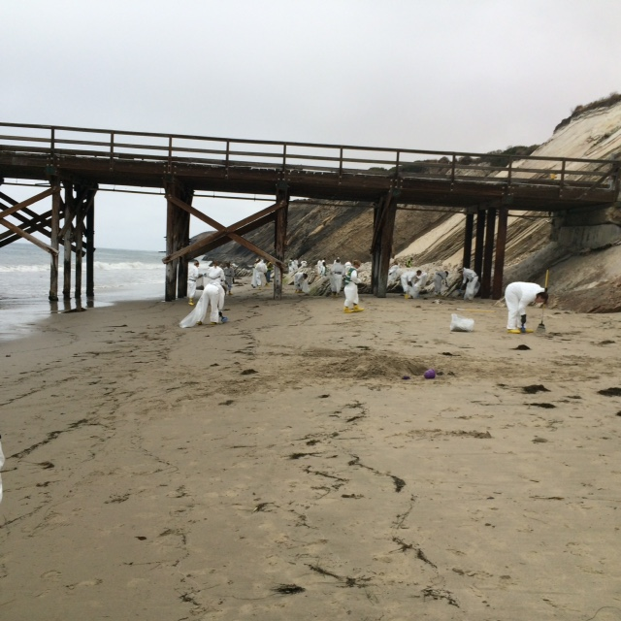
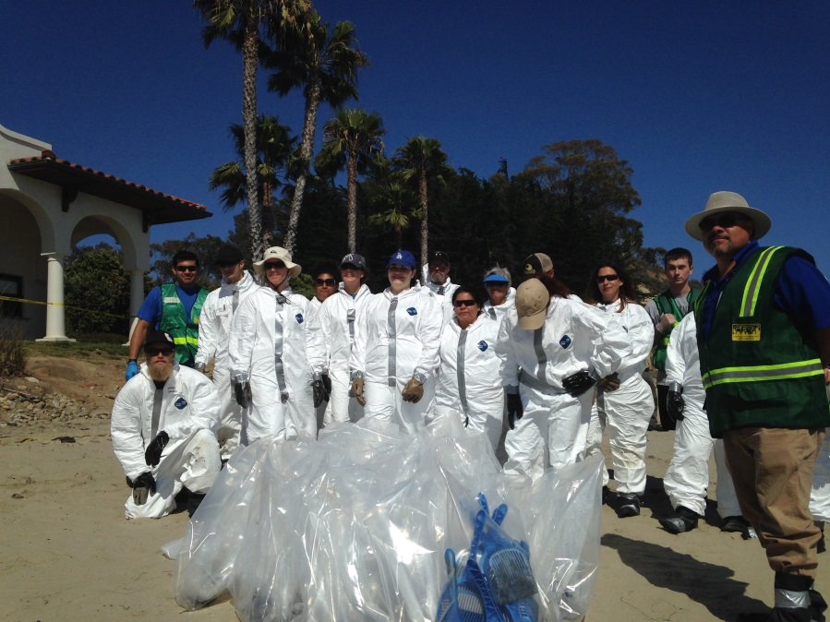
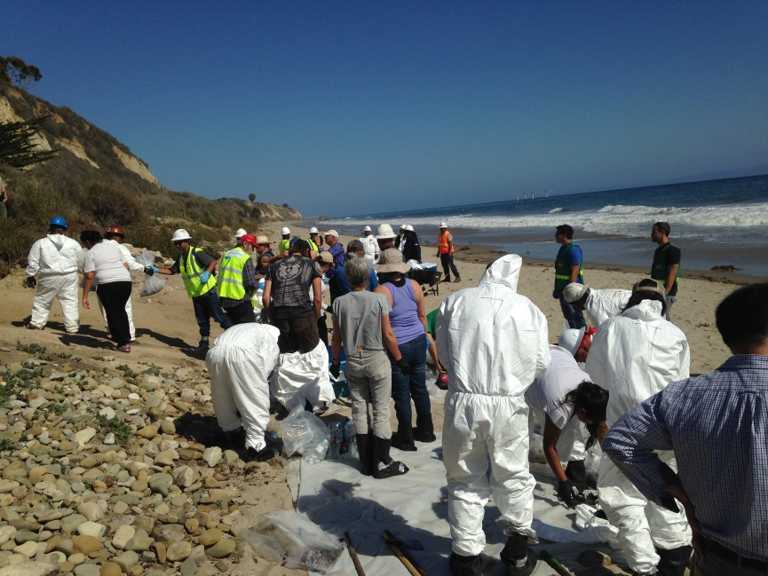

Slide 34
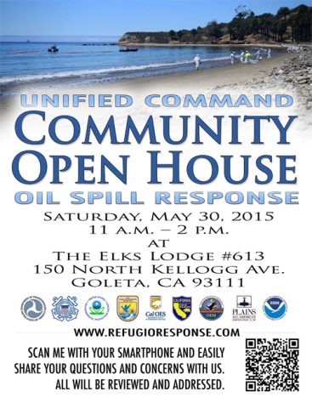
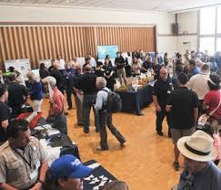
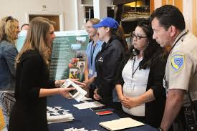
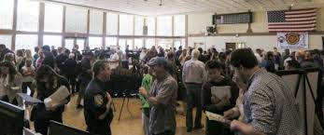

Slide 35
Wildlife Activites
Well meaning public place themselves at risk by attempting to rescue oil-covered wildlife

Slide 36
Current Wildlife Branch Activities
Wildlife Branch field recovery operations and Command Post presence have been demobilized
Care for oiled wildlife continues off-site with oversight by the Wildlife Branch Director also working remotely
Wildlife numbers will be updated in the future only to add to numbers of animals released, or if corrections to previous numbers are required based on continuing review of records.

Slide 37
Other Activities:
Over 40 separate response plans have been approved by the Unified Command for the Refugio Incident
Submerged oil surveys in geographic areas with the highest probability of encountering Refugio Incident oil were conducted using multi-beam sonar, side scan sonar, ROV deployment and finally ground-truthing by divers. For all the surveys, no sunken or suspended oil was observed with the exception of the possibility of pea-sized tarballs rolling in the surf 4-6’ of water offshore of El Capitan

Slide 38
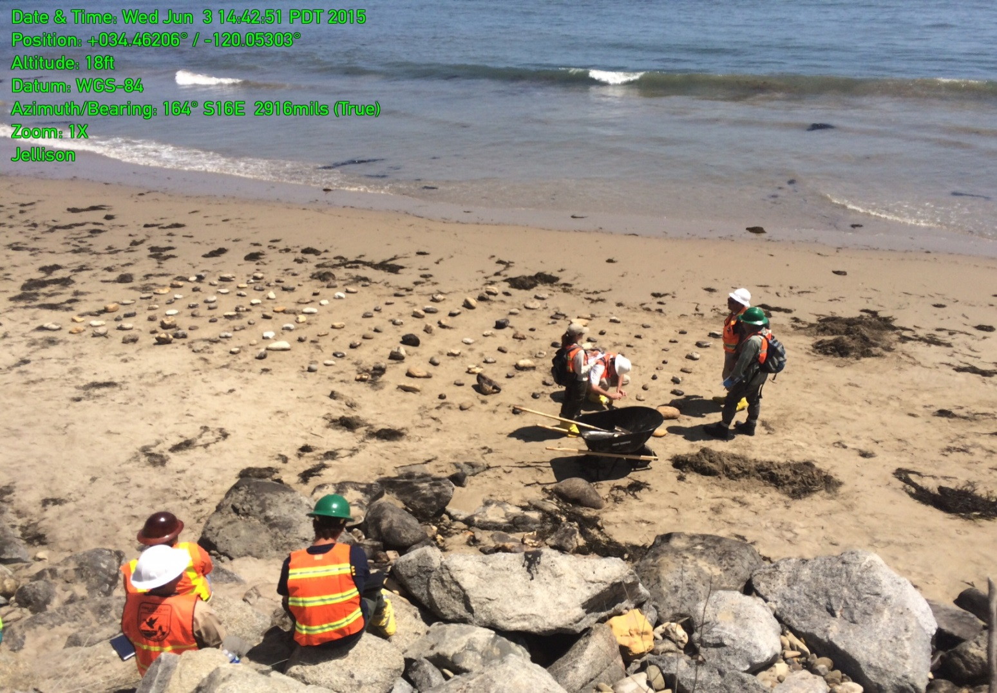
Other Activities (continued):
Cobble relocation treatment test – Cobbles of varying sizes were placed in the surf zone to test for mobility and natural cleaning (results pending)

Slide 39
Other Activities (continued):
Sediment washing using a cement mixer - Oiled cobble from Refugio Beach State Park was tumbled in a small electric cement mixer with course sand in a test to see if this was a viable option. Approximately 15-20 cobbles from 3 to 6 inches in diameter with up to 30% oil coat were tumbled in the mixer with sand and examined at 5 minute intervals for a 30 minute treatment period. After the first 5 minutes, the soft oil coat was much reduced to oil stain with some small patches of oil coat remaining, however there was little further improvement after the 30 minute treatment. The consensus was that the cobble tumbling test did not produce an acceptable level of oil removal from the cobble and use of this technique to treat the oiled cobble at Refugio Beach State Park was rejected.

Slide 40
Other Activities (continued):
Wire brushing test - Boulders and bedrock surfaces were first scraped with a shovel to remove as much of the thick oil coat as possible. This was followed by the use of a wire brush to remove remaining oil from these solid surfaces. The observer reported that wire brush treatment scattered bits of removed oil over a wide area making containment and collection difficult. Furthermore, wire brushing actually spread the oil onto un-oiled areas of the rock surface making a small patch of oil into a much larger stain. For these reasons, use of wire brushes to remove oil from the surfaces of bedrock and boulders was rejected.

Slide 41
Questions?
Yvonne Addassi
Deputy Administrator
Department of Fish & wildlife - OSPR
(916) 324-7626
yvonne.addassi@wildlife.ca.gov
Photo Courtesy NBC Los Angeles

