Slide 1
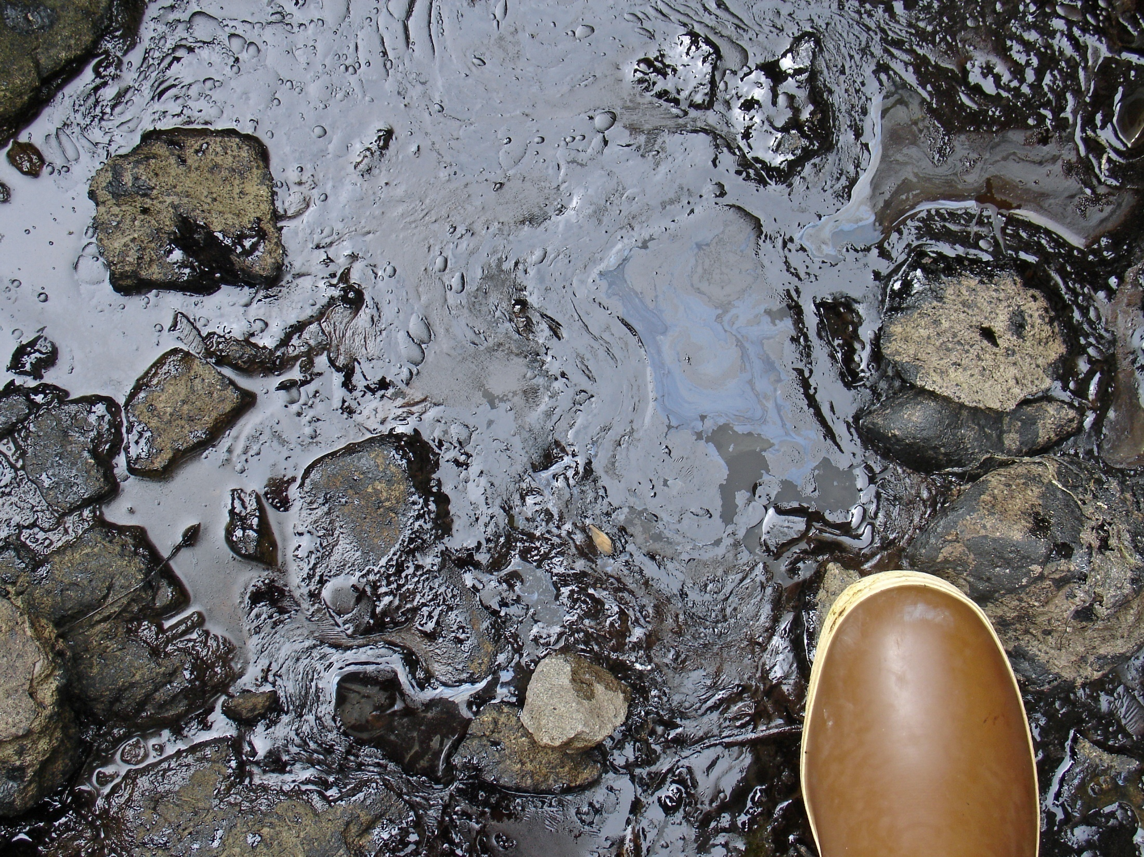

Oil Composition & Weathering
Jordan Stout
NOAA Scientific Support Coordinator
Tel: (510) 437-5344
Mobile: (206) 321-3320
24-hour: (206) 526-4911
E-mail: jordan.stout@noaa.gov
NOAA
Emergency Response Division
www.response.restoration.noaa.gov
Notes:
Oils & their properties

Slide 2

Overview
  What is oil?
  Differences between crude & refined oils
  Basics of oil composition
  Concepts of oil properties
  What happens when oil spills?
    Spreading
    Weathering mechanisms
  (there will be quizzes)

Slide 3
National Academy of Sciences, 2002
Millions of Gallons
Source

Slide 4
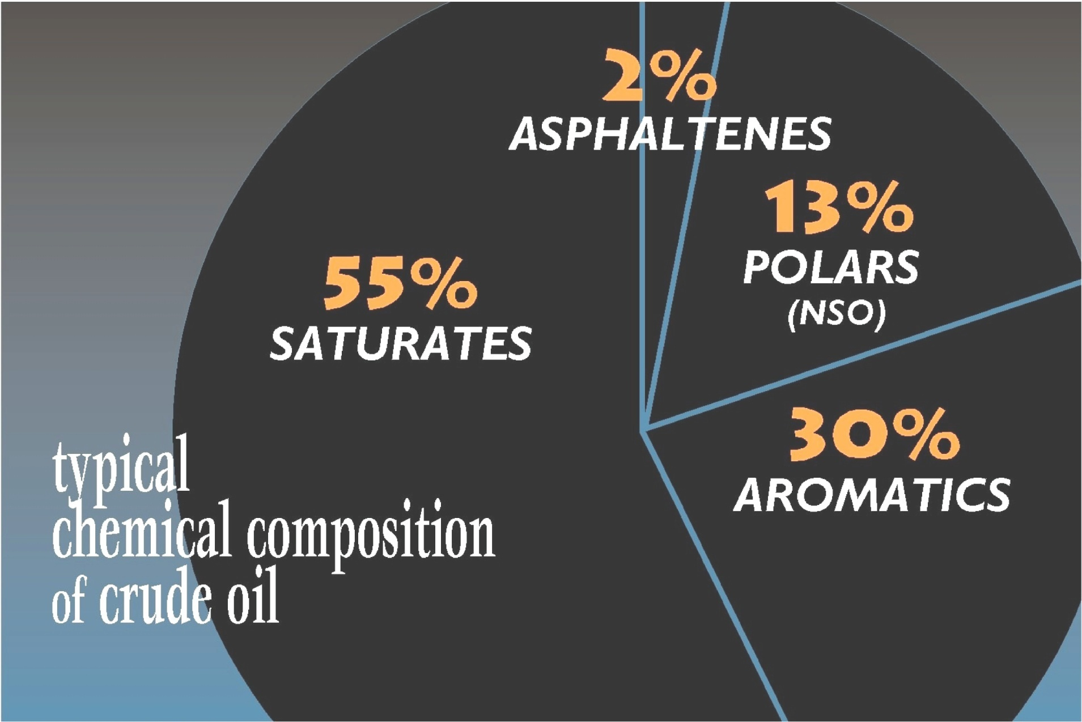
What is Oil?

Slide 5
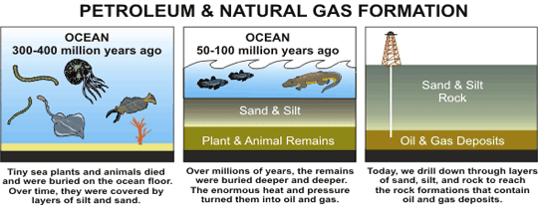
Petroleum Oil is…
…naturally occurring
…a gas (natural gas), liquid (crude oil), or solid (bitumen)
…a mixture of thousand(s) of types of hydrocarbons and other compounds
…the basic building block for millions of different chemicals & compounds
Picture from U.S. Energy Information Administration

Slide 6
Petroleum Oil is…
Complex mixture of
  1,000’s of compounds
  Chemical structures (i.e. straight-chain, cyclic & aromatic hydrocarbons)
  Molecular weights
  Proportions
Two general categories
  Crude oils
  Refined oils (“products”)
Crudes vary by field, across the same field and over time
Notes:
Oil contains 50 to 98% hydrocarbons
Kuwait Crude is considered “sour” - it has 10 times more sulfur than Louisiana crude, which is “sweet”.
Crudes extracted from the same oil field can vary in chemistry over time.
This mixture varies with the production field and within areas of the same field (e.g., between wells and between different depths in the same well). Transported products are typically a blend or mix of oils from different areas and often contain additives (Simecek-Beatty, 1995).

Slide 7
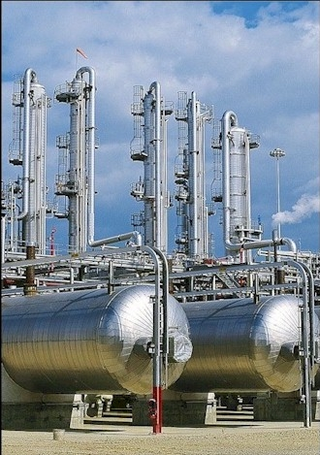
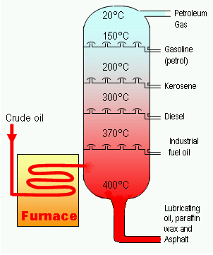
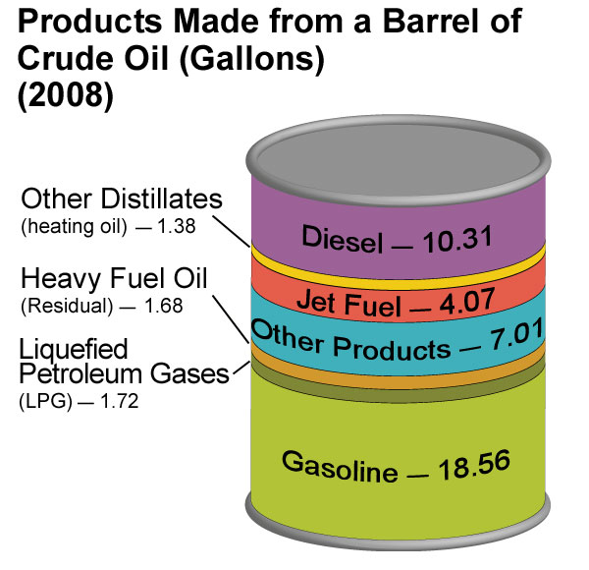
Notes:
Refineries “boil oil” to generate different boiling point fractions. But also use other methods to increase the amount of gasoline from a barrel of oil so the residuum is getting heavier
→”Oil” spills may be crude and refined products
Crude oil are made up of..
Crude oils are refined into a variety of consumer products which are composed of…
One barrel of crude oil, when refined, produces about 19 gallons of gasoline, and 10 gallons of diesel, as well as other petroleum products.
oils are made up of a wide range of compounds from volatile, light materials to more complex heavy compounds
Refined into a variety of consumer products composed of smaller and more specific ranges

Slide 8
Distillation & Cracking
  Refineries use fractional distillation to separate various components
  The distillate fractions are characterized by their boiling points
  Boiling temperature & viscosity of residuum increase as distillates are removed
  Various refined products look & behave differently in the environment

Slide 9
What Is All That Oil Used For?
  hair spray, hair gel, balloons, cosmetics, toiletries, pet toys, sandals/flip flops, ballpoint pens, vertical blinds, plastic hangers, phones, picture frames, polyester clothing, trash bags, photo albums, children's toys, document binders, freezer bags, shopping bags, Teflon products, storage containers, band-aids, candles, egg cartons, disposable plates, garden hose, marking pens, office equipment, kitchen utensils, faux fur, pantyhose, spray paint, and many, many more!

Slide 10
Oil “Fingerprinting”
Alaska North Slope Crude
SS Jacob Luckenbach
(bunker fuel)

Slide 11
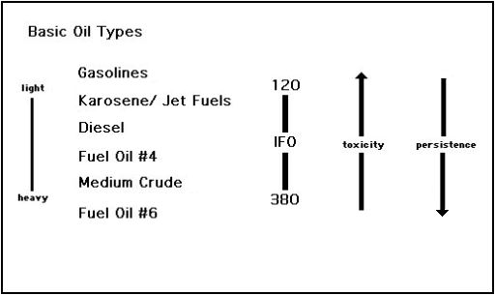
Products Behave Differently

Slide 12
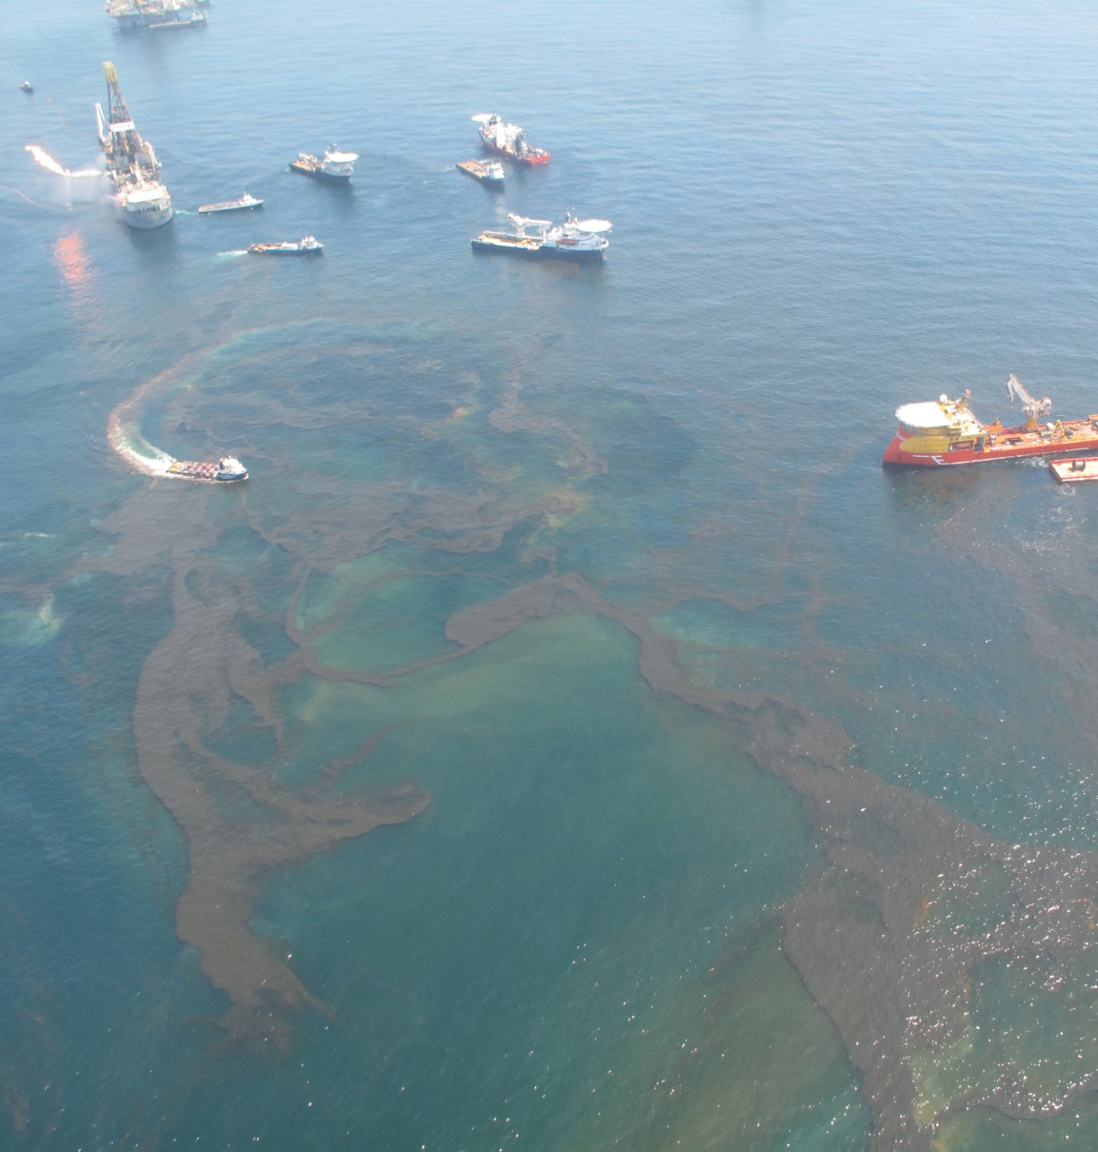
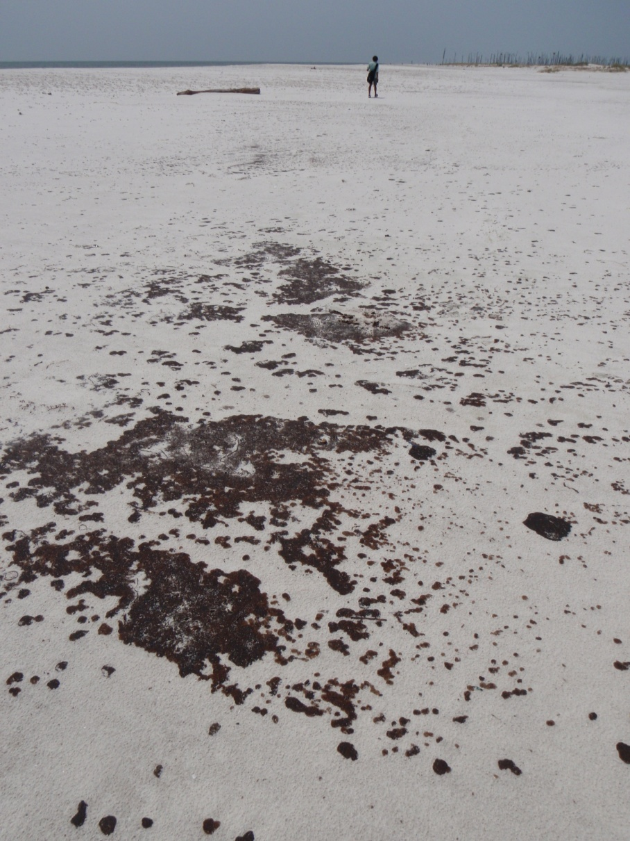
Photos from Deepwater Horizon Oil Spill 2010
Notes:
→Why is oil chemistry important?
Oil chemistry will effect behavior, toxicity, and persistence
Photos are from DWH oil spill – fresh oil near source, tarballs on a MS beach
Predicting trajectories of oil need to consider not only where the oil goes and what happens to it along the way (transport and fate)

Slide 13
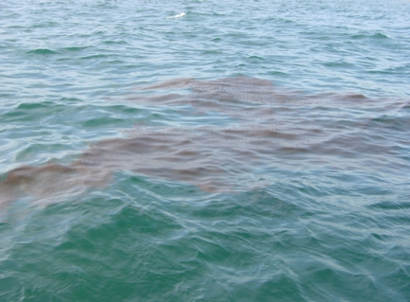
Notes:
It’s the oil’s chemistry that can tell you how it might interact with the water & winds

Slide 14
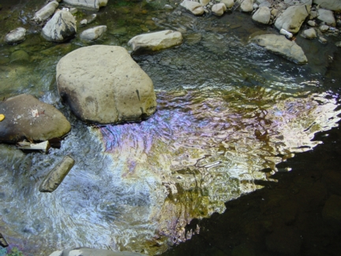
Notes:
Or with shorelines

Slide 15
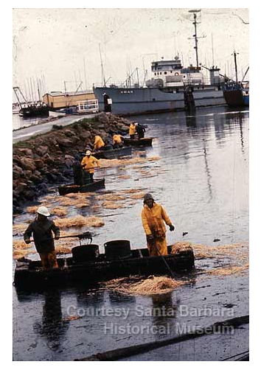
Elemental Analysis
Element | Crude Oil | Freezed-dried Turkey
C | 83-87% | 68%
H | 10-14% | 8%
N | 0.1-2% | 11%
O | 0.05-6% | 4%
S | 0.05-6% | <<1%
Santa Barbara Spill ‘69
Turkey
Notes:
→Now starting to look in more detail into the chemical composition
A joke from Robert Jones: How can you tell a freeze-dried turkey from a crude oil?
Not sure what the punchline is…
Oil is composed principally of hydrocarbons (cmpds containing only hydrogen and carbon) – hydrocarbons constitute ~97% of most petroleum and remaining elements (nitrogen, sulfur, and oxygen make up remaining 3%

Slide 16
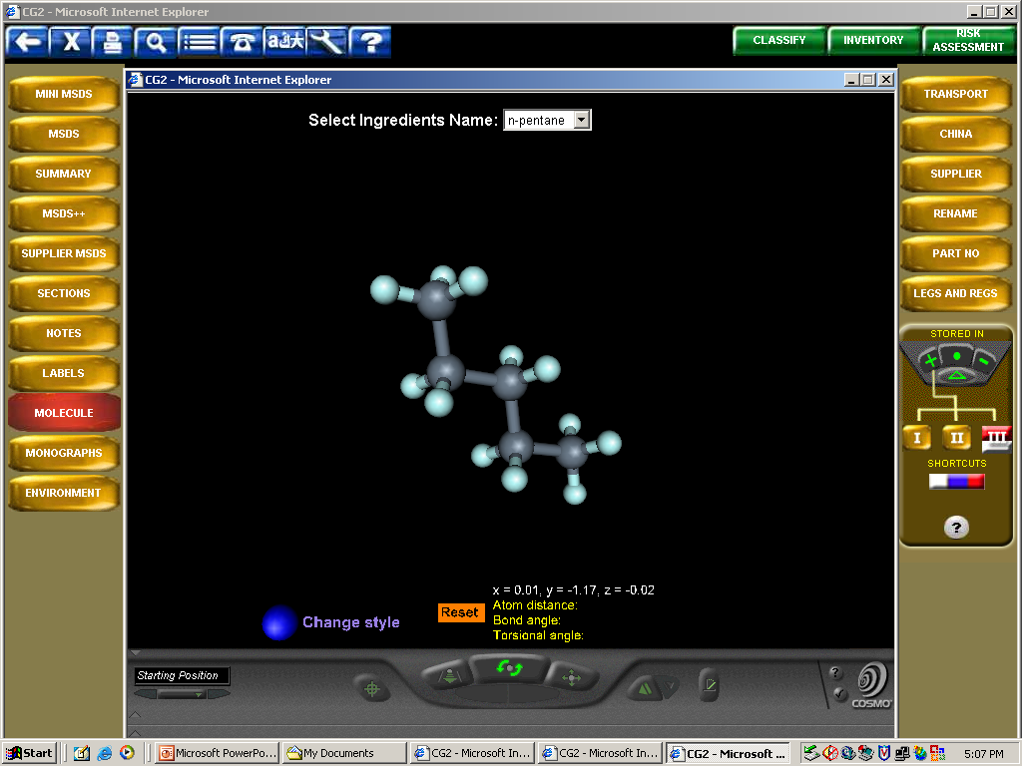
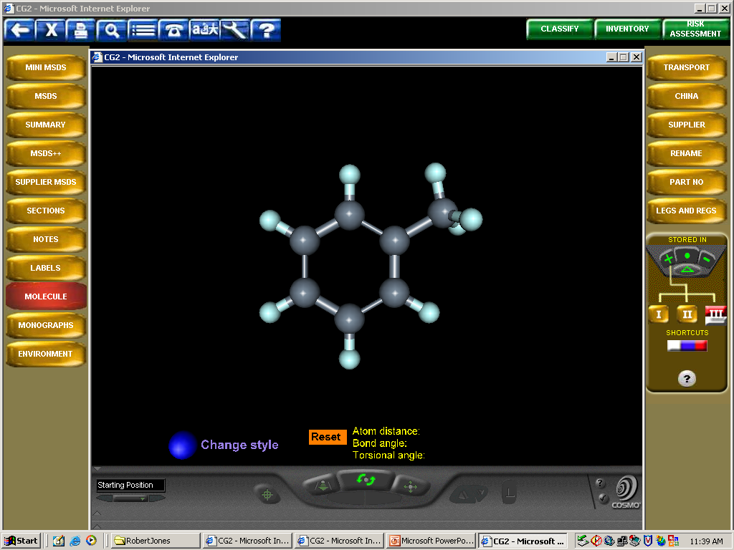
Oil is composed primarily of hydrocarbons
HYDROCARBONS
ALKANES,
CYCLOALKANES
ALKENES,
ALKYNES
(refined products)
AROMATICS
Notes:
→The hydrocarbons found in crude oil are characterized by their structure. We will talk briefly about two groups alkanes and aromatics
Alkanes = saturates/paraffins
Cycloalkanes = napthenes
Alkenes = olefins

Slide 17
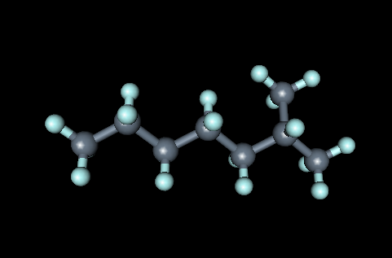
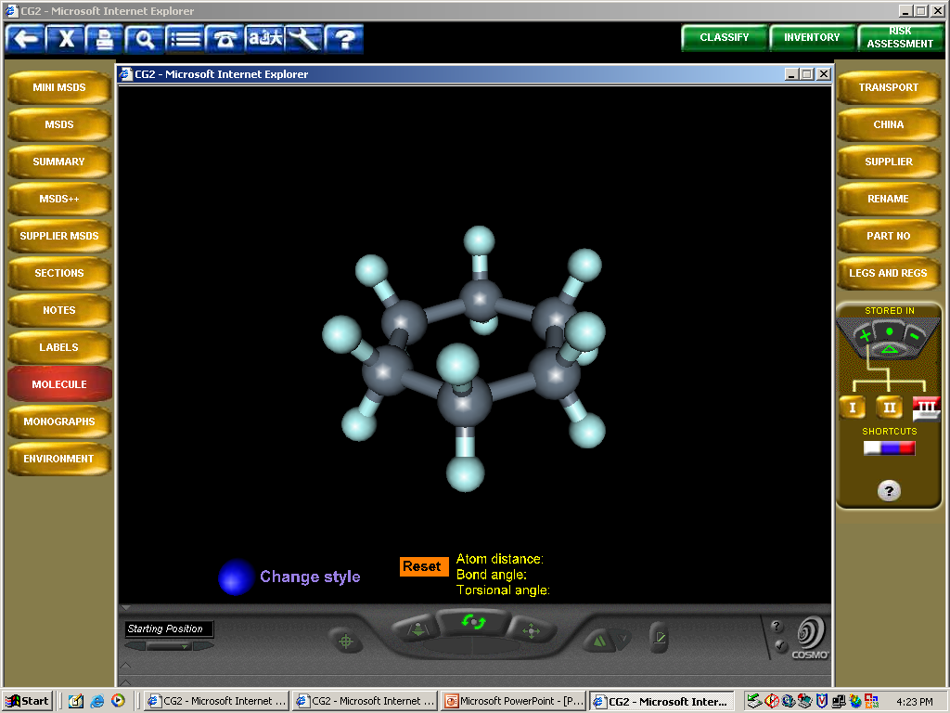
Alkanes & cycloalkanes
Name | Molecular Formula
Methane | CH₄
Ethane | C₂H₆
Propane | C₃H₈
Butane | C₄H₁₀
Pentane | C₅H₁₂
Hexane | C₆H₁₄
Heptane | C₇H₁₆
Octane | C₈H₁₈
Nonane | C₉H₂₀
Decane | C₁₀H₂₂
All single-bonded carbon chains (saturated hydrocarbons)
Arranged in straight and branched chains, (or rings)
Alkanes comprise ~15% to 55% of the oil volume
Biodegradable (mostly)
  2-6 day half life during DWH (Hazen et. al, 2010)
Notes:
→Most abundant group are the alkanes
Hydrocarbons containing only single bonds are called “alkanes” (saturates = hydrogen in every possible location) …
Alkanes are highly combustible and valuable as clean fuels – first four (methane, ethane, propane, butane are gases used directly as fuels)
Gasoline is a mix of alkanes from pentane-decane
Alkanes with higher values of n (number of Carbons) found in diesel fuel, fuel oil, petroleum jelly, motor oils and asphalt
Alkane derivatives are used in hundreds of products such as plastics, paints, drugs, cosmetics, detergents
→Why chemists love alkanes
-looking at weathering of oil (disappearance of alkanes relative to less biodegradable compounds gives information about age)
-fingerprinting of oil

Slide 18
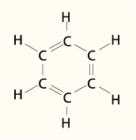
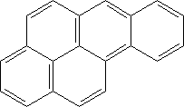
Aromatic Hydrocarbons
Include at least one benzene ring
10% to 50% of oil volume
Highly toxic
benzo[a]pyrene
Notes:
→The other branch of the hydrocarbon family found in oil is the aromatic branch.
They kind of look like the cycloalkanes, but they have the alternating double bonds in the ring so they have fewer hydrogens (this is a benzene ring)
6 C rings with alternating double bonds called “benzene rings” -- stable and hence these compounds can be persistent in marine environment
2nd largest class of compounds found in crude oils
Toxicity effects of oil is generally concerned with the aromatics

Slide 19
Aromatic Hydrocarbons – BTEX & PAHs
BTEX: Benzene, Toluene, Ethylbenzene, Xylenes
  One benzene ring
  Volatile organic compounds (VOCs)
  Most acutely toxic
  Light crude ~0.5-5%; gasoline ~40%
PAHs: Polycyclic aromatic hydrocarbons
  Fused benzene rings
  PAHs of three or more rings have low solubility and low vapor pressure
  Pose greatest chronic toxicity threat to environment
benzo[a]pyrene
Notes:
→Aromatic compounds can have one ring or multiple rings
Single ring compounds are often treated as a group and referred to as BTEX
More toxic (carcinogens) but less persistent (high solubility, high vapor pressure, biodegradable)
Multi-ring aromatics are called “polycyclic aromatic hydrocarbons” or PAHs

Slide 20
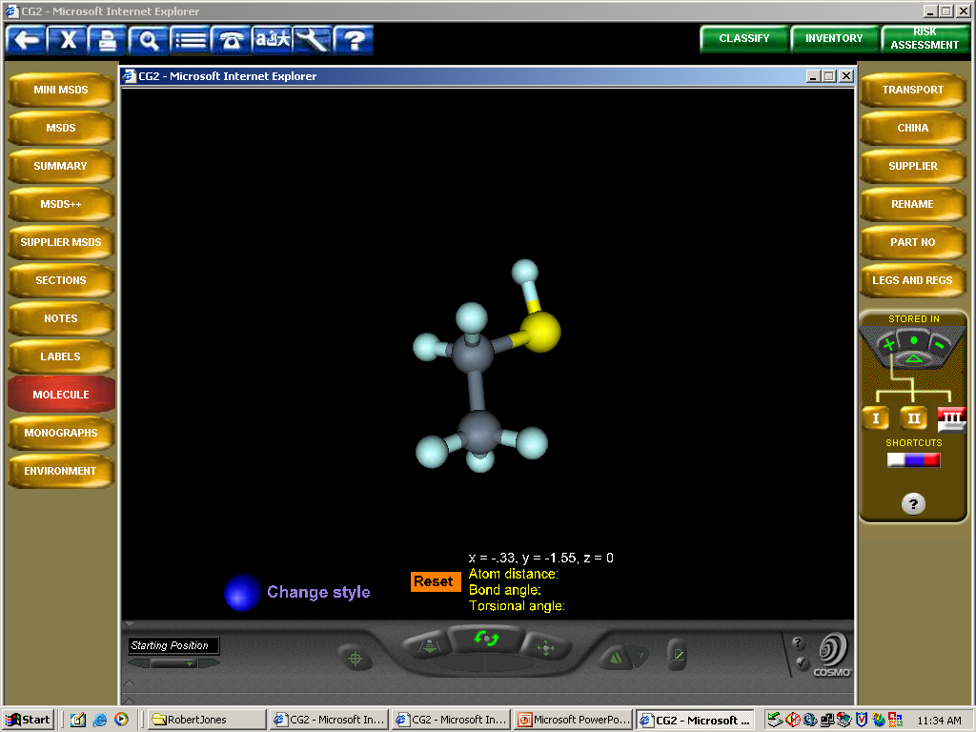
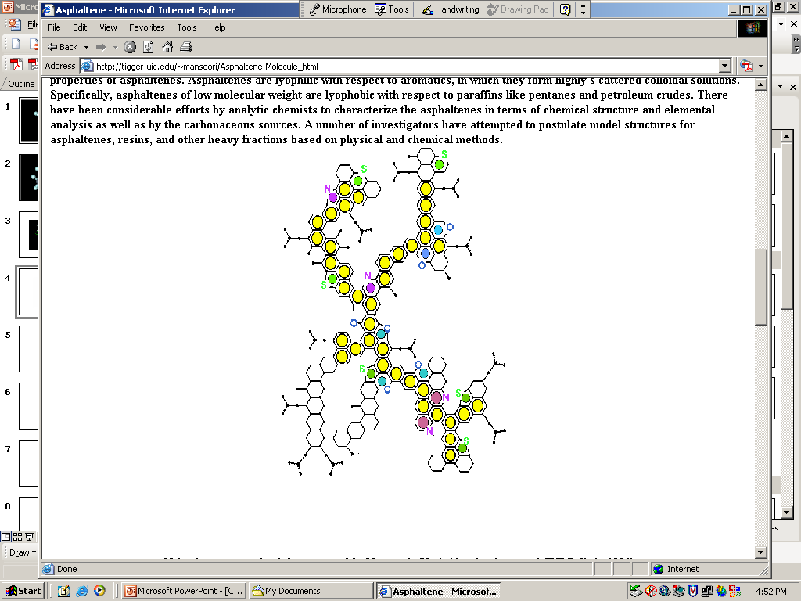
Non-hydrocarbon Organic NSO
(Nitrogen, Sulfur, Oxygen)
Notes:
→Finally the NSOs or “polar compounds” (resins and asphaltenes)
More abundant in dense and viscous crudes (“heavy crude oils”)
Have a significant molecular charge due to bonding with elements such as N,S,O
Polarization of these compounds means they behave differently then hydrocarbons under some circumstances
Larger polar compounds are “asphaltenes” – used for asphalt ;)
If abundant they can have a significant effect on oil behavior

Slide 21
Typical Composition of Fuel Oils
Gasoline
  C4 to C12
  Rich in straight and branched alkanes (paraffins), cycloalkanes (naphthenes), alkenes (olefins), and aromatics
Kerosene (some jet fuels)
  C12 to C20
  Rich in straight and branched alkanes (paraffins), and cycloakanes (naphthenes)
Diesel (Fuel Oil No.2)
  C12 to C20
  Rich in straight and branched alkanes (paraffins), cycloalkanes (naphthenes), aromatics
Intermediate Fuel Oils (IFOs)
  Blend of low boiling products and residuum
  Alkanes, Aromatics, PAHs, NSOs

Slide 22
Physical Properties of Oil
  Density
  Viscosity
  Pour point
  Surface tension
  Flash point
  Boiling point
Notes:
→Talk about some measured physical properties of oil that affect its behavior

Slide 23

Density, or…
Notes:
Lemons float, limes sink

Slide 24
Density
(will it float?)
Density is mass per unit volume
Specific gravity
  Ratio of masses between a material and freshwater of the same volume & temperature
  Spg < 1.0 will float in freshwater
°API gravity
  Used by the U.S. petroleum industry
  °API = (141.5/spg) - 131.5
  °API > 10.0 will float in freshwater
Notes:
Density is a property used by the petroluem industry to define light and heavy crude oils – it is also a really important property for determining how a particular oil will behave
You might see it reported 3 different ways…
The specific gravity must be measure at 15°C.
SG = rho_oil/rho_water: if < 1 then density less than freshwater
Higher API = less dense

Slide 25
Specific & °API Gravities
Material | Specific Gravity | °API gravity | Floats or sinks in SW
Freshwater | 1.0 | 10 | Floats
Seawater | 1.02-1.03 | 7-9 | N/A
Most oils | 0.78-1.0 | 10-50 | Float
Notes:
Higher API = less dense
Freshwater has an API gravity of 10.0
Seawater (ocean) has an API gravity of 6.0
Most crude oils API range from 10 to 30
Gasoline has API 55 - 60
Can add … gasoline with API in the 70s
Diesel with API in the mid 30s
Dense refined fuel like a Bunker C will have API in the low teens or less
Light crude oil is defined as having an API gravity > 31.1 °API
Medium oil is defined as having an API gravity between 22.3 - 31.1 °API
Heavy crude oil is defined as having an API gravity < 22.3 °API

Slide 26
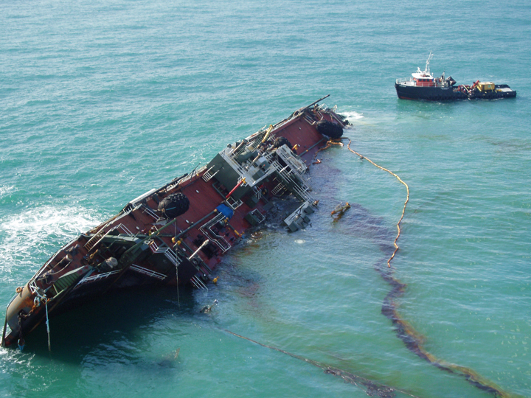
T/B DBL-152

Slide 27
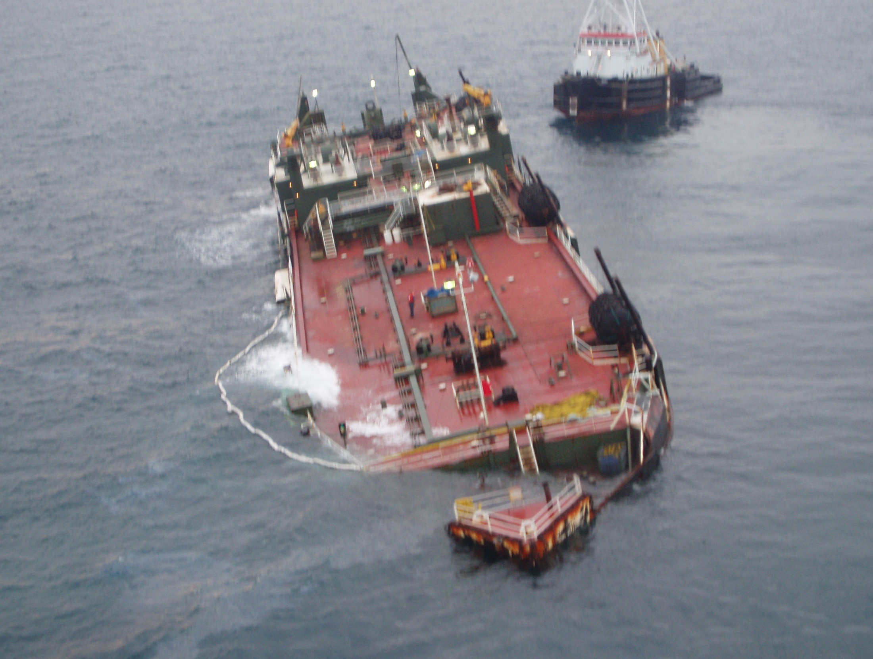
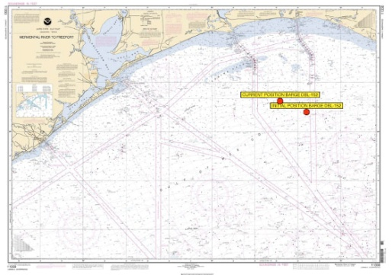
Barge DBL-152
November 11, 2005
Allision with oil rig debris sunk by Hurricane Rita
≈ 30 miles (≈ 50 kilometers) offshore of Port Arthur, TX
3 million gallons (71,400 barrels)
Slurry Oil
  Denser than seawater
  Viscosity of a medium crude oil
Depth: approx. 50 ft (15 meters)
DBL-152 Cargo
API barrels
24.6 1,870
9.7 10,300
3.9 41,950
3.8 50,700
-2.3 15,500
Receiving water ≈ API 9.7

Slide 28
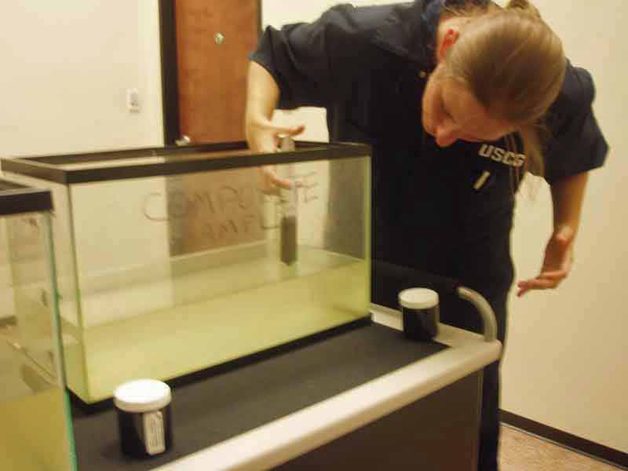
Notes:
Oil spill science demonstration in the Command Post using site water and DBL-152 source oil.

Slide 29
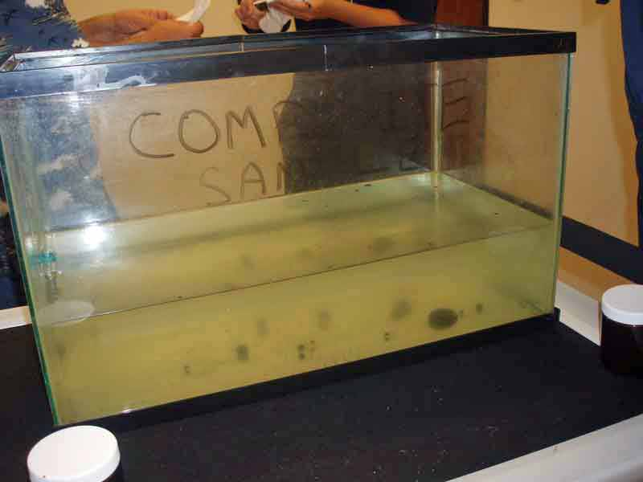
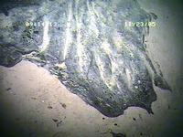

Slide 30
Some CA Crudes & Their ºAPI Gravities
Coal Oil Point Seep (11.7)
Platform Irene (11.2)
Hondo (19.6)
Platform Gail (20.6)
Carpinteria (22.9)
Point Aguello Light (30.3)
Pitas Point (38.0)
Notes:
Taken out of ADIOS II library
Even within California a wide range … but note, they all float!

Slide 31
Oil Types
Group 1 Gasoline Products
Group 2 Diesel-like Products/Light Crude
Oils
Group 3 Medium Crude Oils/Intermediate
Products
Group 4 Heavy Crude Oils/Residual
Products
Group 5 Non-floating Oils

Slide 32
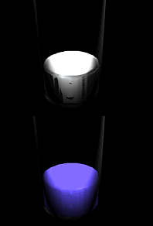
Viscosity
(will it be a liquid or not?)
  Measure of a fluid’s resistance to flow & spread
  Decreases with temperature
  Increases as oil weathers (ages)
  Affects oil’s behavior on water: spreading, dispersion, emulsification
  Affects penetration of shorelines
  Affects response options
Notes:
Viscosity decreases with an increase in temperature. It also increases as the oil weathers.
You can expect an order of magnitude change in the viscosity if the temperature change is about 40°C (100°F).
For example, if an oil has a viscosity of 8,600 cSt at 50°C, what is the viscosity at 10°C?
Lower the viscosity, more readily it flows
Determined by proportion of lighter and heavier fractions that it contains – greater the percentage of light components such as saturates (alkanes) and the lesser the amount of asphaltenes, the lower is the viscosity

Slide 33
Viscosities of Common Items
Fluid Viscosity (in cP)
Water 1
Diesel Fuel 10
Olive Oil 100
Glycerin or Castor Oil 1,000
Honey 10,000
Molasses 100,000
Peanut butter 1,000,000
Notes:
Dynamic viscosity (cP) – kinematic = visc/rho
cP = grams/(cm s) (at ~20C/70F)
cP = cS * rho
IFO 380 = 380 cS at 50C (rho = 991 kg/m3)

Slide 34
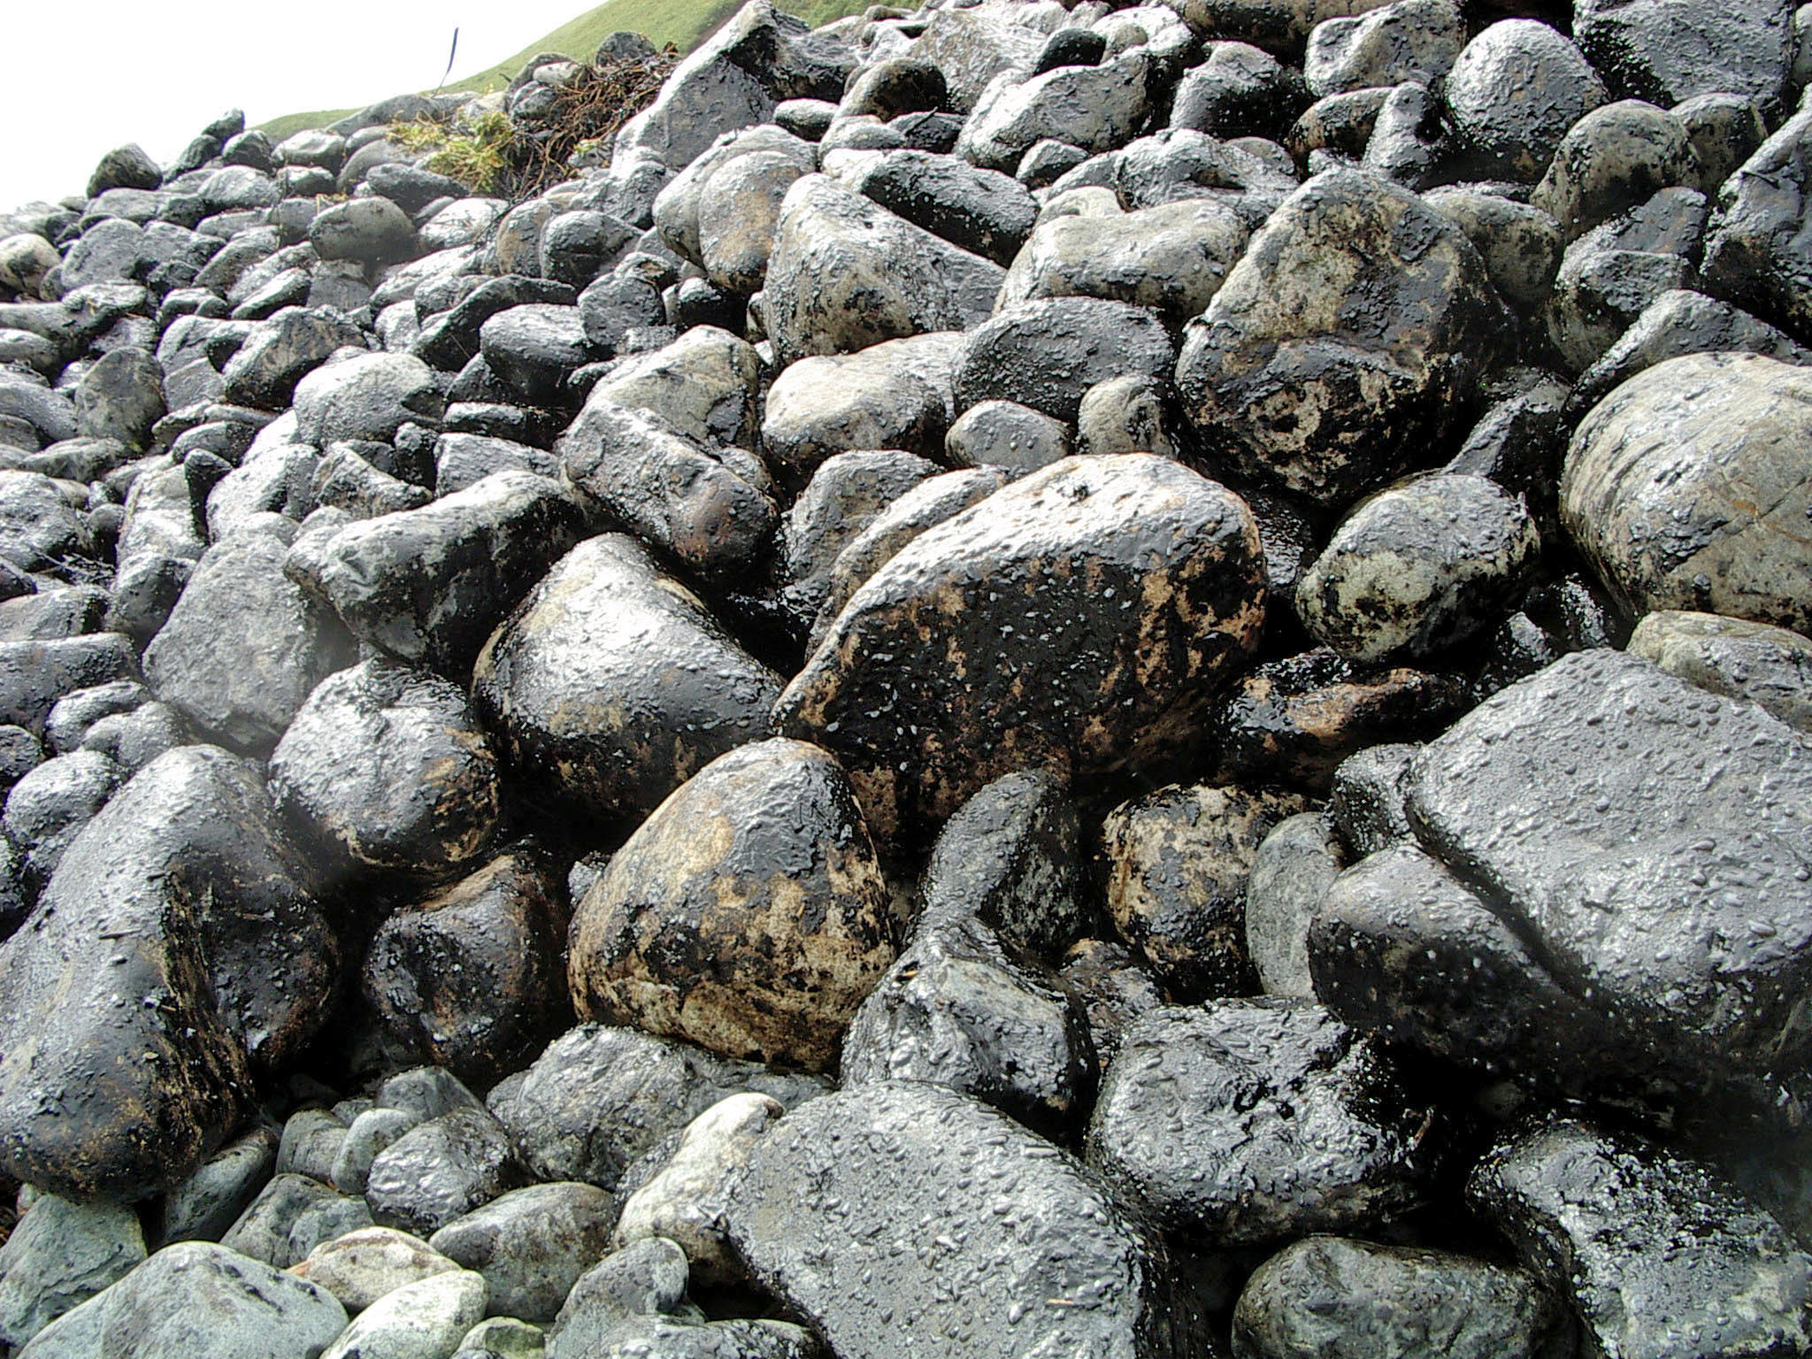
M/V Selendang Ayu
Notes:
Low viscosity and high porosity substrate makes for lots of cleanup effort and is very different operationally than…

Slide 35
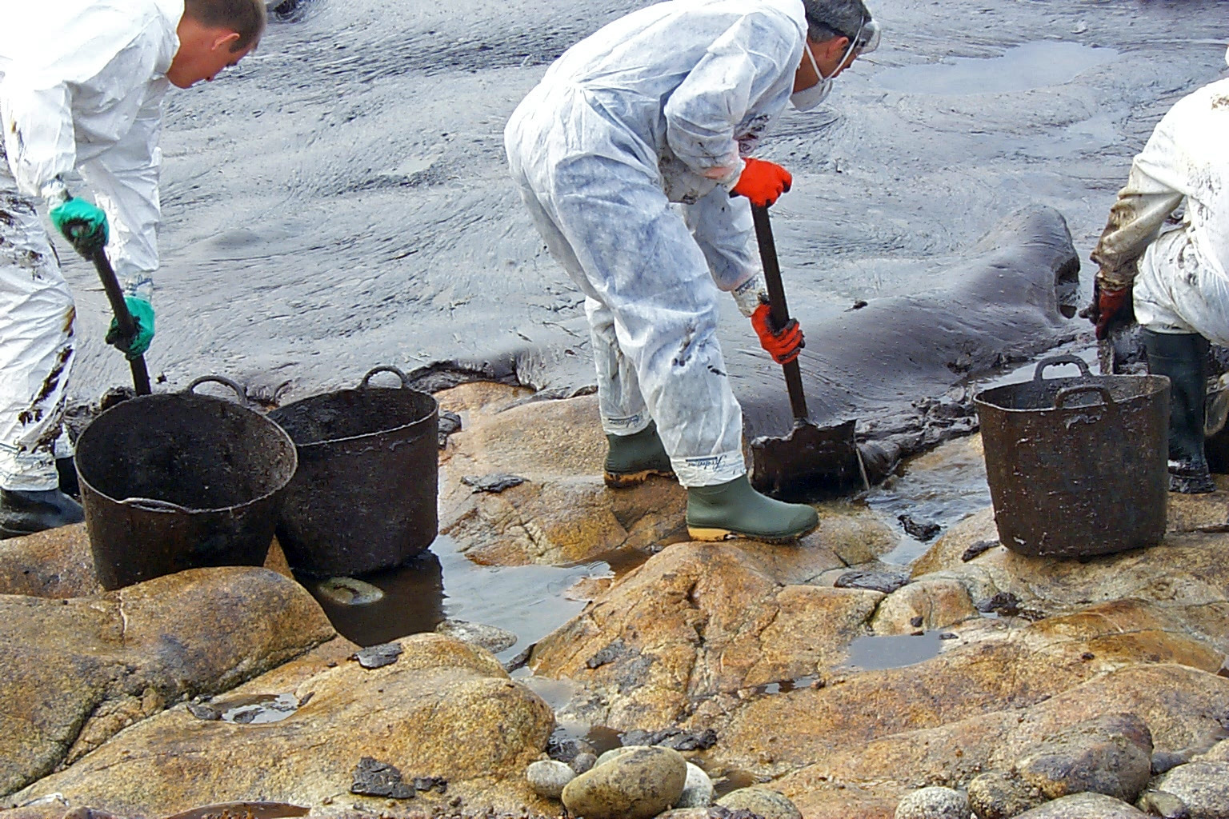
T/V Prestige
Notes:
… high viscosity oil on a low porosity shoreline.

Slide 36
Pour Point
(when will it flow?)
  Temperature above which an oil will flow
  If ambient temperature is above pour point the oil will behave as a liquid
  If ambient temperature is below pour point the oil will behave as a semi-solid
  A subjective “measurement”, lab & field data often don’t match up well
Notes:
The lowest temperature below which the oil can not be poured (not movement observed)
Similar to melting point
Measurement can be highly variable (plus or minus 10°).
The lowest temperature below which the oil can not be poured (no movement observed)
Measurement can be highly variable (plus or minus 10°)
What happens to an oil around its pour point?
The minimum temperature at which a liquid will flow
Need to know pour point for response options if oil has a high pour point.

Slide 37
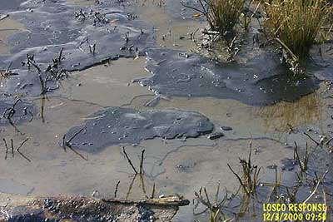
Notes:
Example from the Westchester spill of a Nigerian crude oil in the Mississippi River that had a “low” pour point of 45°F. At nighttime, temperatures went below the pour point and the stranded oil “solidified.” During the day, however, when the air temperatures warmed, the oil was a liquid.

Slide 38
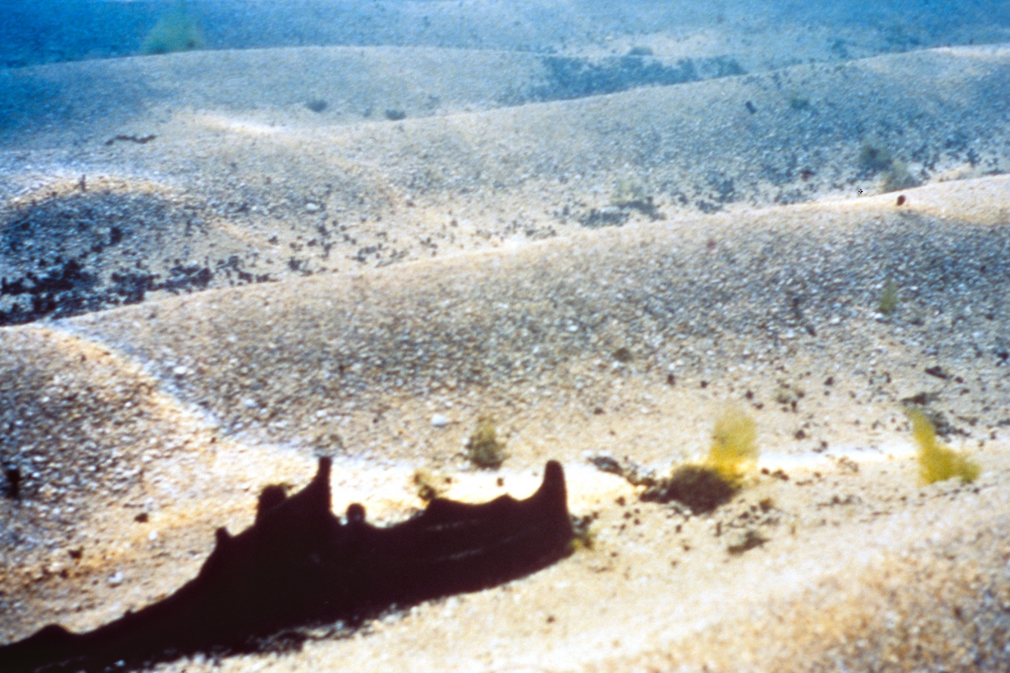
Notes:
Incident: T/B Morris J. Berman
Location: San Juan, PR
Date: January 7, 1994
Oil type: Heavy fuel oil
Volume spilt: 750,000 gallons (19,000 bbls)
Density: API 9.5º (Spec. Grav. = 1.005)
As the oil warmed in the afternoon sun, the sediment settled through the oil. It became buoyant and flowed upwards.
Also, turbulence from afternoon winds increased remobilization.

Slide 39
Flash Point
(when will it ignite?)
The lowest temperature (at one atmosphere pressure) at which vapors above an oil ignite in air when exposed to a flame or spark
FP rises quickly as oils weather
Important implications for safety and for in-situ burning…
Notes:
The lower the flash point the greater the hazard.
The higher the flash point the harder to ignite.
Flash point alone is not adequate to describe flam
The lowest temperature of the liquid at which the vapor/air mixture will ignite.
The lower the flash point the (greater/less) the hazard?
The higher the flash point the (easier/harder) to ignite for an in-situ burn?
mability hazard-wind and oil thickness can reduce hazard on the water. If FP below ambient temp, vapors in vessel can be ignited by an ignition source.

Slide 40
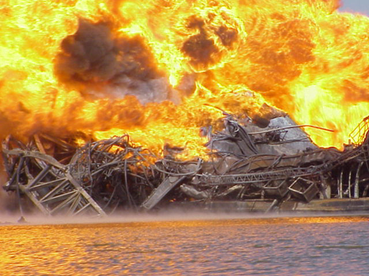
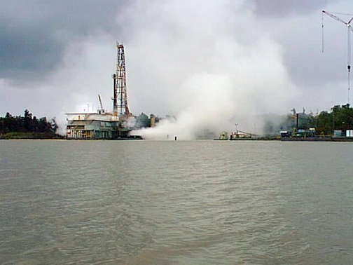
Falcon 17 Wild Well Release (Morgan City, Louisiana)
Notes:
June 25, 1999, the NOAA SSC received a report from MSO Morgan City that the crew of the Rig Falcon 17 had evacuated the rig because extremely high-pressure readings showed a potential for a blowout. The well had the possibility of releasing natural gas condensate, crude oil, and drilling mud. The location of the incident is just south of Amelia, Louisiana in Bayou Chene.
At 0920 MSO Morgan City notified the SSC that the rig has blown and requested a plume trajectory

Slide 41
Refined Products: Fuel Oils
Gasoline
  Distillate fuel, contains 4-12 carbons
  Low flash point, low viscosity
Diesel oil (marine & automotive)
  Also known as No. 2 fuel oil
  Distillate fuel, contains 12-20 carbons
  High flash point, low viscosity
Intermediate fuel oils, e.g. IFO 180 & 380
  Generally same characteristics as No. 6 fuel oil
  Often blended with distillate fuel
  High flash point, high viscosity

Slide 42
Pop Quiz Time!
As temperature decreases, viscosity decreases or increases?
Would you expect an oil with an °API gravity of 25 to float or sink in freshwater?

Slide 43
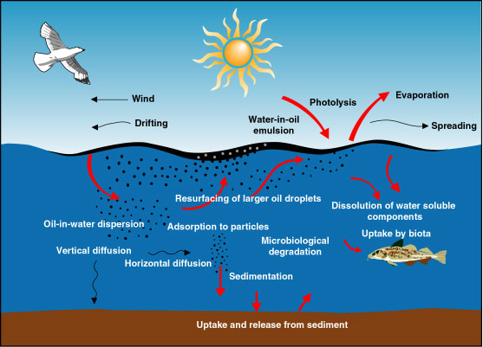
What Happens When Oil Spills?
Processes that govern oil fate:
  Spreading
  Oil weathering
  Transport
Cartoon from SINTEF website
http://www.sintef.no/static/ch/environment/oil_weathering_model.htm
Notes:
The fate and transport are governed by horizontal spreading of the surface slick due to gravity
Changes in physical and chemical properties due to weathering
Transport: advection due to currents and winds and turbulent diffusion

Slide 44
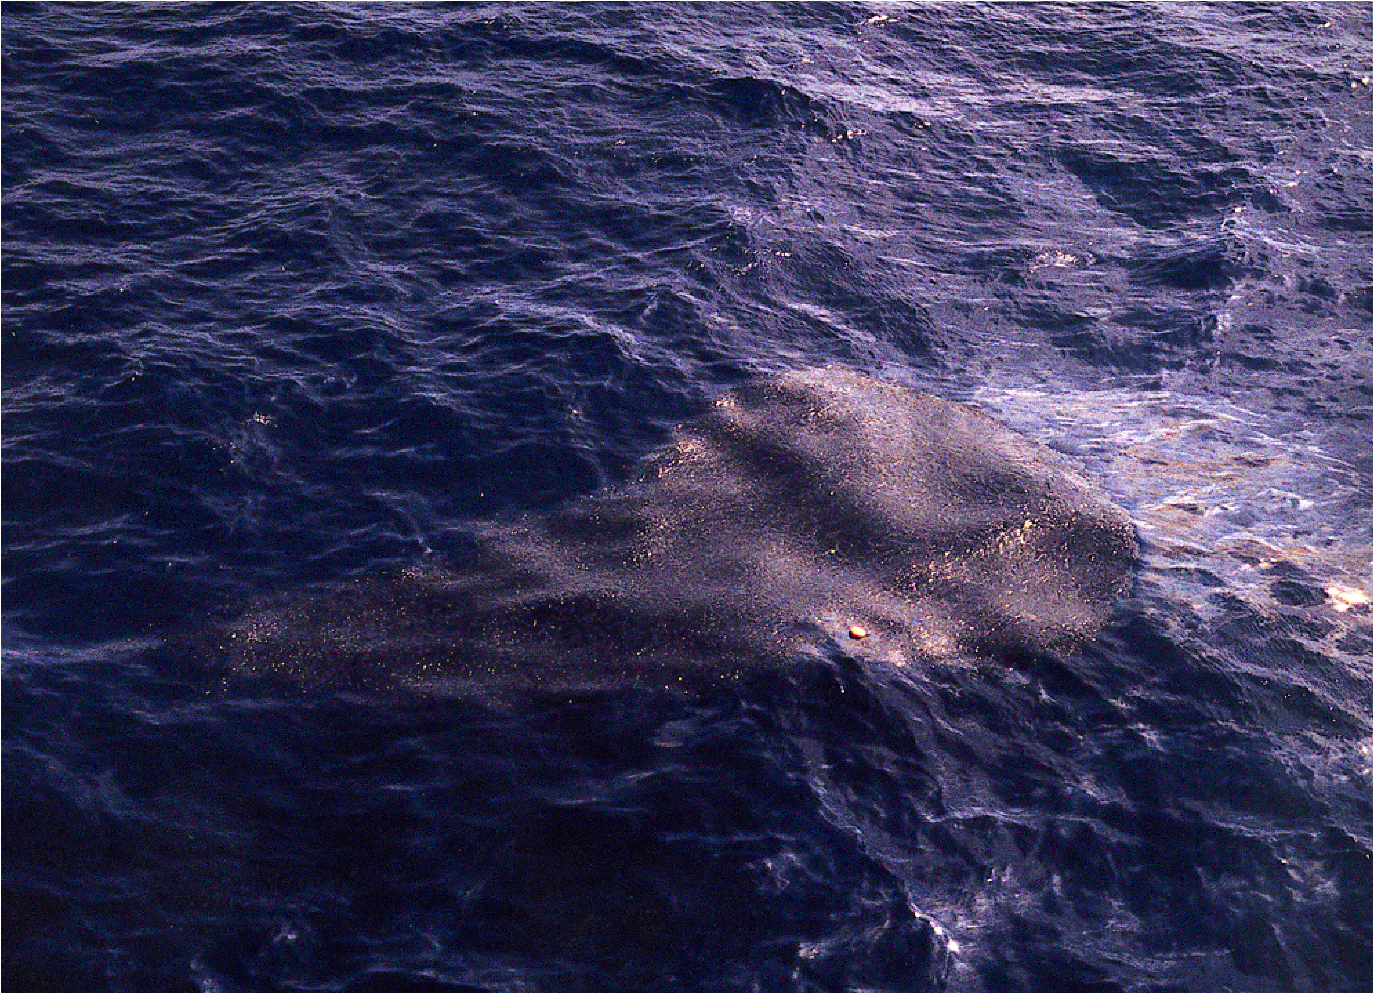
Over time, slicks are torn into smaller & smaller pieces…

Slide 45
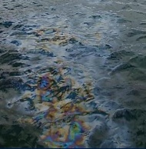
Spreading
Quick process (usually <1hr)
Initially driven (mostly) by gravity & oil viscosity
Significantly increases the area of spilled oil
Speed of spreading controlled by oil type, volume, wind, temperature
Within a few hours, slicks begin to break up
Notes:
Most oil will float on the sea surface where it will quickly spread under the influence of gravity
For oil spill response it is important as it quickly causes a significant increase in the area of the spilled oil and key variables in weathering/transport models
1.5 gallons at 1 micron thickness would cover football field
– mechanical cleanup requires thicknesses > ~10 microns
Initially driven…determines footprint
Under natural conditions spreading won’t stop when a terminal thickness is reached, rather the slick will begin to…
Spreading highly non-uniform…what is often seen is elongated slicks with thin sheens trailing behind thick sections – not explained by 2D models which are slowly being replaced with 3D “shear spreading” models – return to that in next slides
The slick does not spread uniformly but will often have a thick part surrounded by a larger but thinner sheen. Note that about 90% of the oil is found in 10% of the slick area.
The spreading process occurs quickly, and for most spills, occurs mostly within the first hour. In the open ocean, other processes (i.e., winds, currents and turbulence) will quickly move the oil.
Spreading will occur quicker for lighter and/or less viscous oils in warm water temperatures.
The slick does not spread uniformly but will often have a thick part surrounded by a larger but thinner sheen. Note that about 90% of the oil is found in 10% of the slick area.
thin film (a few microns thick)
under influence of winds, wave action and water turbulence (long-term spreading processes)
Spreading is highly non-uniform with large variations in the thickness of the oil
Elongated slicks with trailing thin sheens
Traditional 2D spreading models (Faye/Holt) being replaced by “shear spreading” models – oil is modeled as a distribution of droplets, natural dispersion mixes some droplets into the water column – most of the droplets resurface but on variable time scales related to the droplet size
Oil spreading therefore determined by droplet size distribution and shear diffusion processes

Slide 46
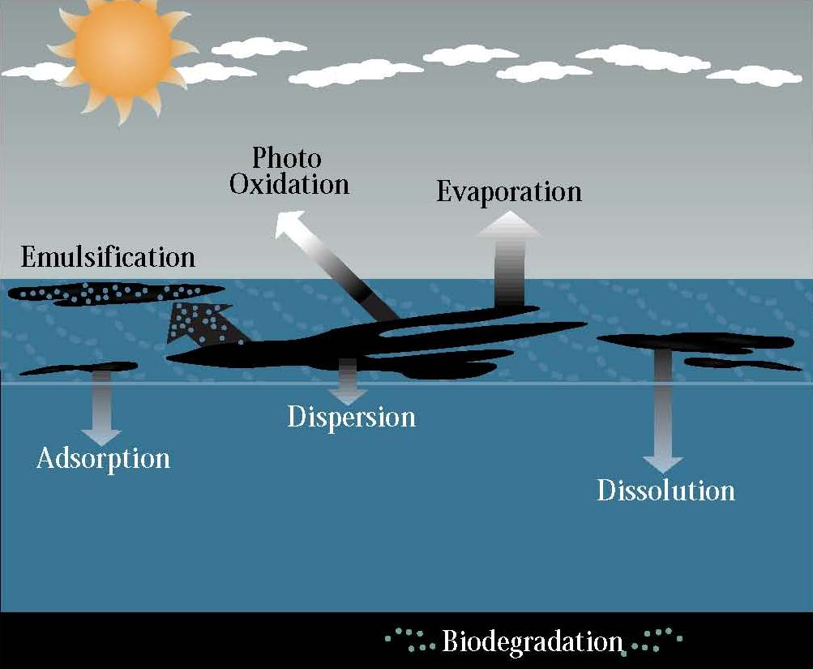
“fresh oil” → tars, asphalts, etc.
Weathering
Notes:
Evaporation
Often the most significant “loss” mechanism
Factors: oil type, surface area, solar radiation, wind speed, water temperature
No. 6 fuel oil - 2% loss in 40 hours
Crude oil - ≤ 25% loss in 24 hours
Gasoline - ≤ 50% loss in 10 minutes
Dispersion
Oil droplets moving into the water column
Can be a significant loss mechanism
Larger droplets (> 0.1mm) will resurface
Factors for physical dispersion: oil type, energy available, slick thickness
Emulsification
Water droplets moving into the oil
Not well understood
Oil must be partially “weathered”
Oil must have high wax & asphaltine content (>5%)
Can be 70-90% water
Can result in significant color changes
Adsorption
Sticking to another substance (e.g. sediment)
High sediment loads (>500 g/m³) can cause oil to sink within hours
Relatively minor mechanisms
Photo oxidation – Results in soluble products or persistent tars
Dissolution – <1-2% will dissolve in water
Biodegradation – Very slow process where naturally-occurring bacteria eat oil compounds
Photo-oxidation:
Hydrocarbon reacts with oxygen and either breaks down into soluble products or combines to form persistent tars.
Minor contributor - but may influence skinning or tarball formation

Slide 47
Weathering:
Changes in Oil Chemistry
Flammable >>> Nonflammable
Liquid >>> Semisolid or Solid
Smelly >>> No Odor
Toxic >>> Less Toxic
Notes:
Density increases slightly but likely remain buoyant.
Viscosity increases by several orders of magnitude.
Oil film forms a crust (skinning), physical barrier.

Slide 48
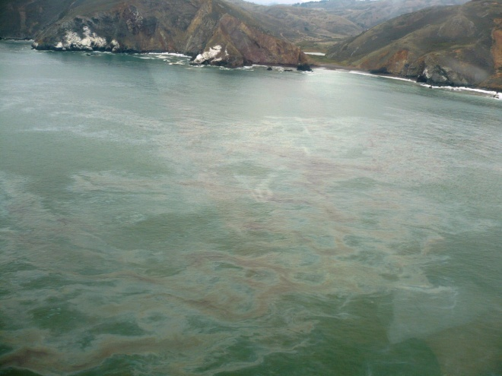
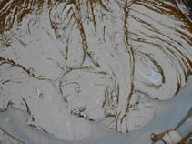
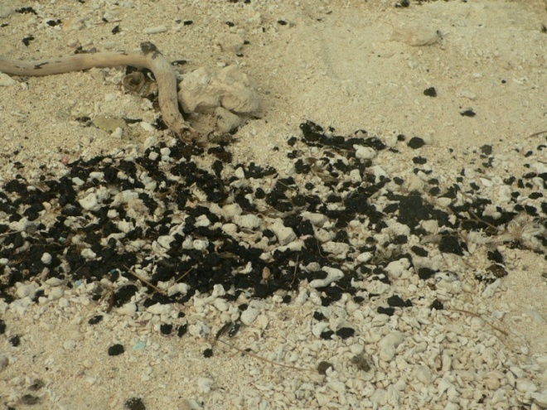
Processes in Oil Weathering
hours
Evaporation
Dispersion
Dissolution
Emulsification
Sedimentation
Photo-oxidation
Biodegradation
days
weeks
years
time
Notes:
When crude oil or refined products are spilled into the ocean, they immediately proceed to interact with the environment and undergo a series of physical, chemical and biological processes (collectively termed “weathering”) that change their composition and environmental impact.
Weathering processes occur at different rates but begin immediately following a spill. Rates are also not consistent throughout the duration of the spill and are highest immediately after the spill.
Primary processes ordered by the timescale on which they are important from hours to days to weeks.
Through these processes, the volume of oil progressively reduces as the slick approaches the shoreline.

Slide 49
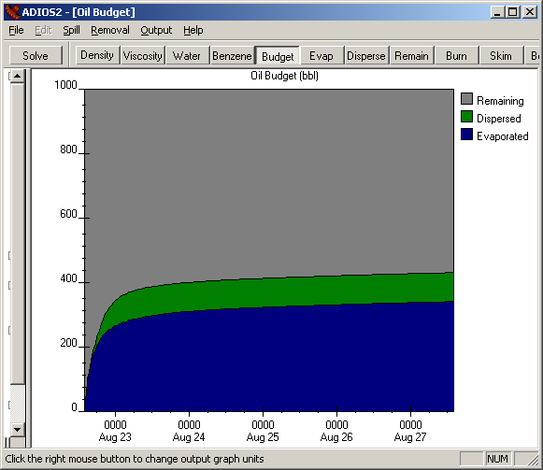
Evaporation
Often the most significant “loss” mechanism
Function of environmental conditions (e.g. temperature, wind speed) & oil type
Small impact on density
Significant impact on viscosity
Notes:
Evaporation is probably one of the processes that we are best at estimating.
Possible to lose half of a light crude oil spill due to evaporation
Rapid immediately after a spill then slows considerably (80% occurs in first few days) – graph: in first day lose ~25% due to evaporation
Evap changes the chemical mixture of the slick as the lighter components evaporate more quickly than the heavier hydrocarbons
If 40% (by weight evaporates) viscosity can increase by 1000fold (density increase by 10%)

Slide 50
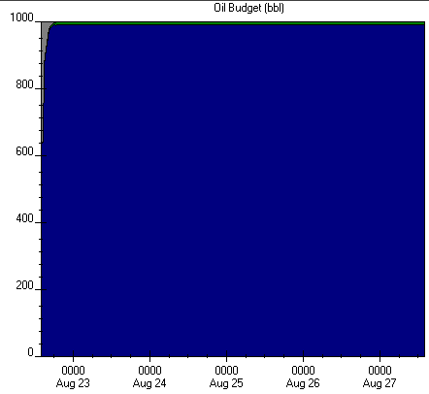
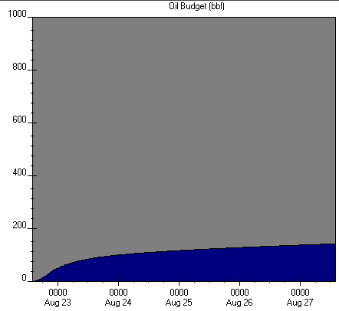
Evaporation Examples
  Gasoline - ≤ 50% loss in 10 minutes
  Crude oil - ≤ 25% loss in 24 hours
  No. 6 fuel oil - 2% loss in 40 hours
Gasoline
LA crude
No. 6 Fuel Oil
Notes:
Low API oils (gasoline-diesel) will evaporate quickly
Most important process for light fuels like gasoline, and jet fuels.
**Determines time scale of problem.
ADIOS 5-day budget
10 knot winds
50°F water
1000 barrel instantaneous release

Slide 51
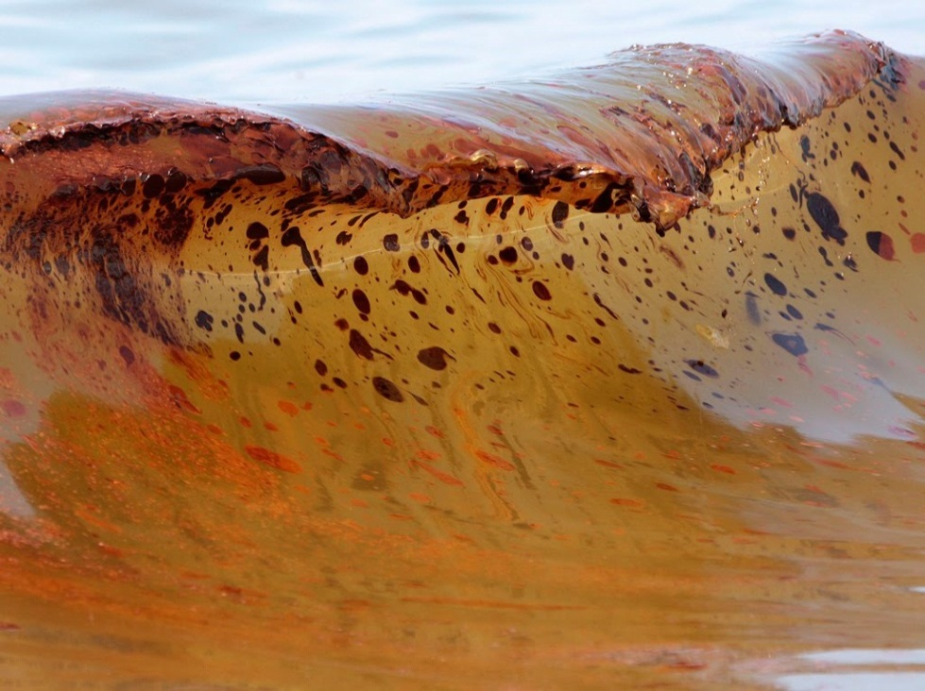
Dispersion
Another major removal mechanism
Dependent upon:
  Oil type (viscosity, surface tension)
  Environmental conditions (wave energy)
Droplets 50-70 µm in diameter are not likely to resurface due to turbulence
Photo credit: Dave Martin/AP
Notes:
Light oils will disperse more easily. Oil droplets the diameter of human hair will not resurface in natural environment.
Oil droplets moving into the water column:
Can be a significant loss mechanism
Larger droplets (> 0.1mm) will resurface. <50-70 µm are not likely to resurface due to turbulence
Factors for physical dispersion: oil type, energy available, slick thickness
Decreases as viscosity increases
Small oil droplets moving into the water column
Larger droplets (greater than .1mm) will resurface
Factors: oil type, energy available, slick thickness
Can be a significant loss mechanism
Other major removal mechanism.
Depends on the viscosity and sea conditions.
Droplets 50 to 70um in diameter are not likely to resurface due to turbulence.

Slide 52
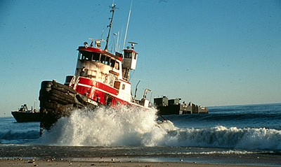
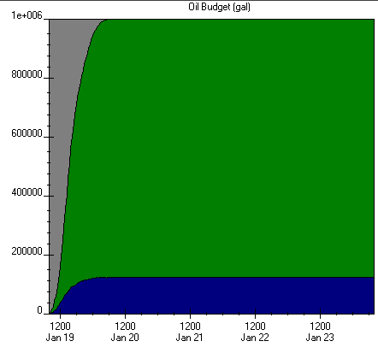
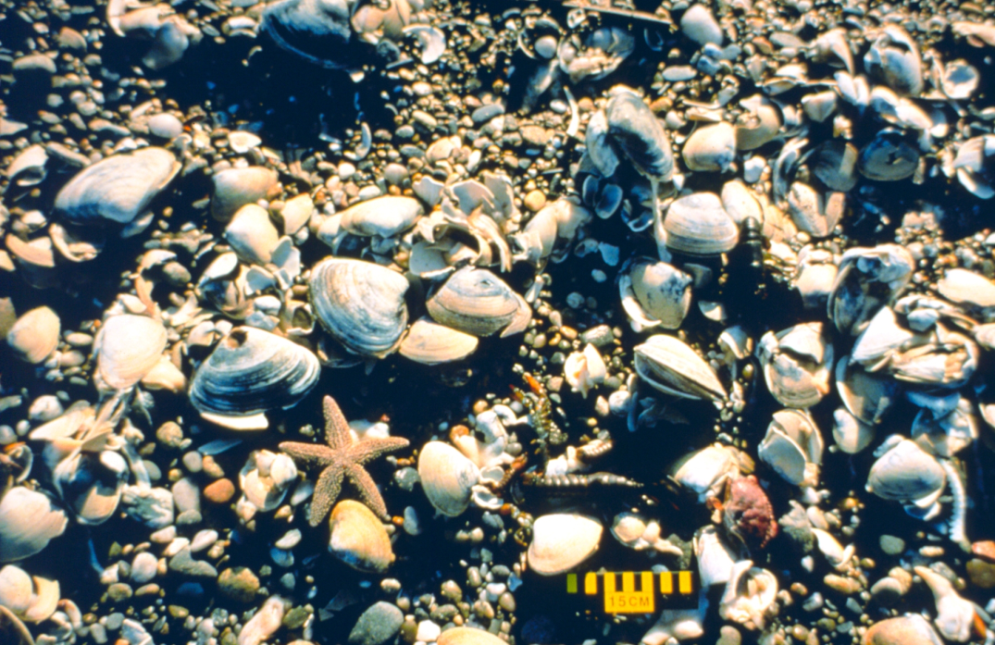
North Cape Spill – Jan 1996
Notes:
The barge North Cape ran aground during a large storm on January 19, 1996 on the south coast of Rhode Island. Approximately 828,000 gallons of home heating oil (No. 2 fuel oil) was spilled into the surf zone where waves reached 15-20 feet in height. The heavy surf entrained much of the oil into the water column. that large numbers of lobsters, surf clams, and other organisms washed up on the beaches
This mixing process resulted in high concentrations of polynuclear aromatic hydrocarbons (PAHs) throughout the water column, sufficient to induce mass mortality of benthic marine animals suffering from narcosis.

Slide 53
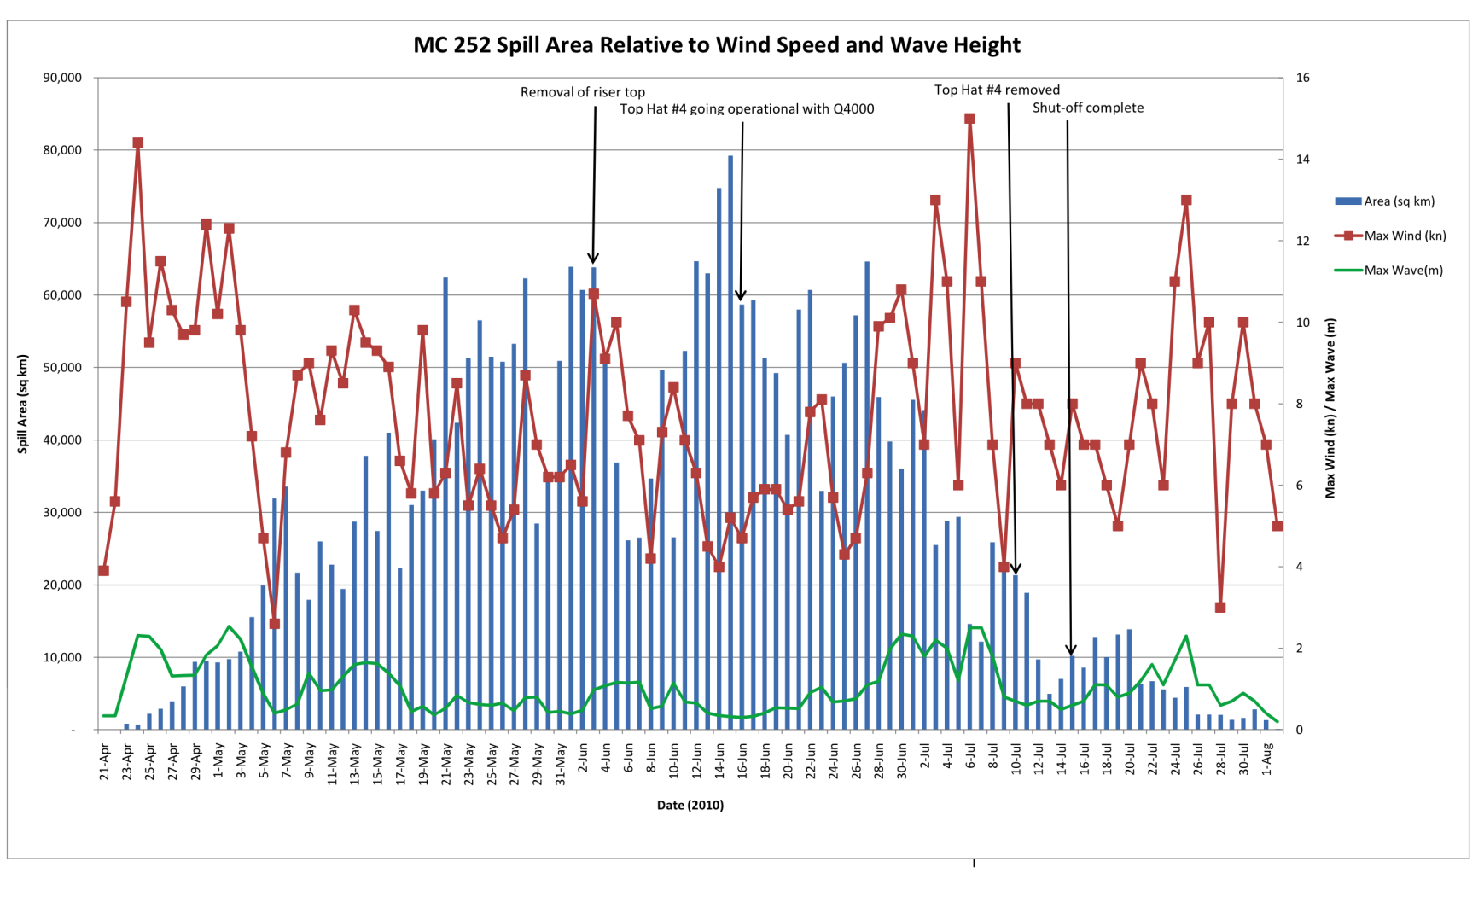
Another example of Dispersion
Notes:
This is from DWH. It shows the relationship between wind speed, wave height, and amount of oil on the surface. Dispersion is the major reason for this, evaporation is a secondary player (it too increases with wind speed). Remember it was leaking until it wasn’t. The other thing to point out is that it appears that the slick size reached a steady state. That means it was going away at the same rate it was coming out. So where did all the oil go?

Slide 54
Dissolution
Closely related to dispersion as dissolution occurs from the oil droplets. When and where you find subsurface oil droplets, expect to find dissolved fractions of oil
What goes into solution is toxic
Less than 0.1% (very heavy oil) to 2% (gasoline) of the spilled oil volume actually dissolves into the water column
Usually very low concentrations because you have a lot of water compared to the volume of hydrocarbons going into solution
Notes:
So how big a deal is this? When will it be a big deal?
Portion of oil that “dissolves” into the water
Not a very significant factor
Factors: oil type, energy, degree of dispersion
Concentrations rarely > 1ppm (ITOPF, 1986)
Dissolution:
Closely related to dispersion as dissolution occurs from the oil droplets.
Similar time scales as dispersion.
Less than 0.1 (very heavy oil) to 2% (gasoline) of the spilled oil volume actually dissolves into the water column.

Slide 55
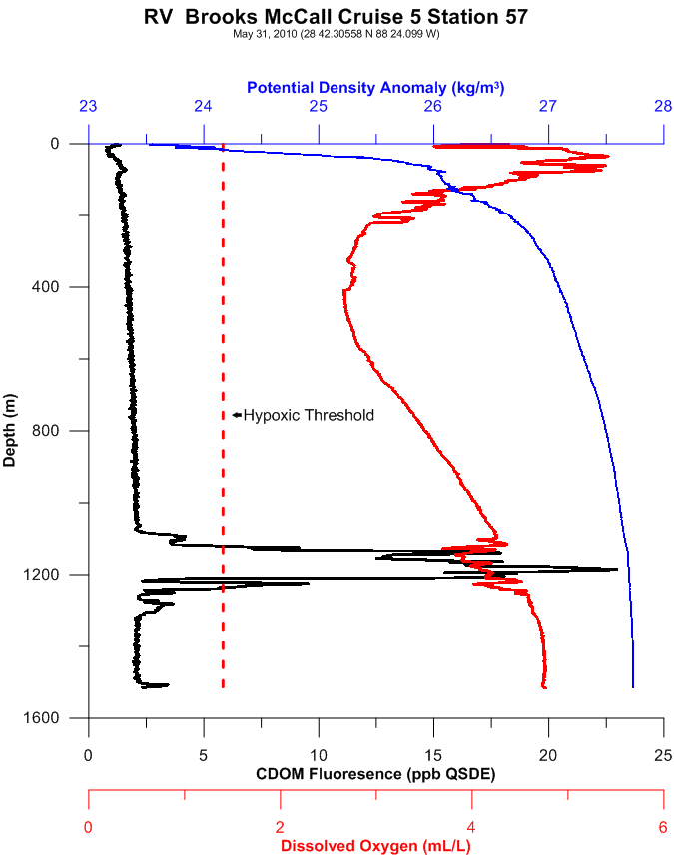
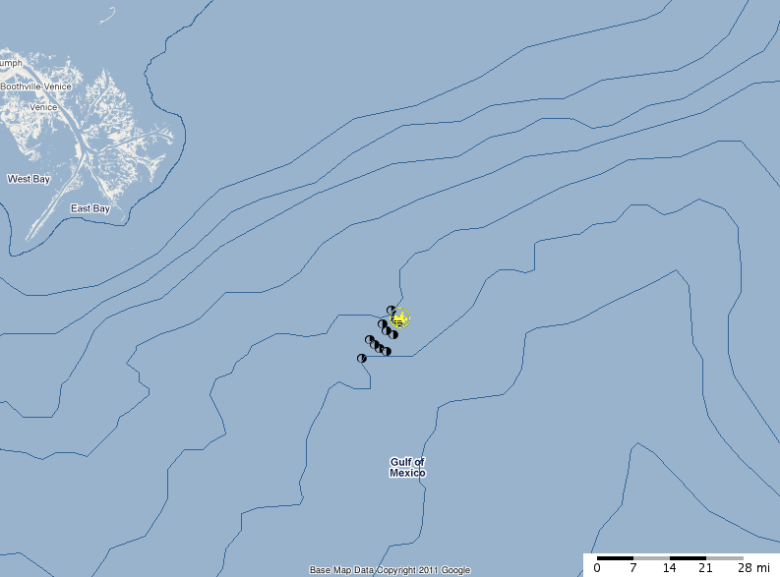
Deepwater Horizon: Dispersed/dissolved oil plume
Results from R/V Brooks McCall, May 31
Notes:
• Fluorometry measurements show a recurring anomaly attributable to oil that first appears at approximately 1000 m and is attenuated beyond 1300 m depth.
• The fluorometric anomaly is strongest near the release site, generally decreasing with distance, and trending primarily southwest to northeast consistent with the water movement along the isobath
CTD DO2 measurements show anomalies that begin around 1000 m and extend to 1300-1400 m.

Slide 56


Emulsification
  “Mousse”
  Water droplets suspended in the oil
  Oil must be partially “weathered”
  Oil must have high wax & asphaltene content (>5%)
  Can be 70-90% water
  Can result in significant changes in color & volume (3-4x)
  Usually more viscous & persistent than original oil
Notes:
Process in which seawater droplets become suspended in oil
Depends on oil composition (NSOs) and the turbulent regime of water mass
Water-in-oil emulsions may be very persistent or my separate under calm conditions
Oil sometimes must weather before forming a “stable” emulsion
Emulsion can be 70% to 90% water (increases spill volume)
Affects density and viscosity
NSO =hydrocarbon compounds that contain nitrogen, sulfur, and oxygen. NSOs play a role in forming “stable” emulsions (Mousse)

Slide 57



Emulsification
Notes:
An emulsion is a mixture of two liquids that normally can't be combined. Combining oil and water is the classic example. Emulsifying is done by slowly adding one ingredient to another while simultaneously mixing rapidly. This disperses and suspends tiny droplets of one liquid through another.
In an emulsion, one liquid (the dispersed phase) is dispersed in the other (the continuous phase).
Energy input through shaking, stirring, homogenizing, or spraying is needed to form an emulsion. Over time, emulsions tend to revert to the stable state of the phases comprising the emulsion; an example of this is seen in the separation of the oil and vinegar components of vinaigrette, an unstable emulsion that will quickly separate unless shaken continuously.
Mayonnaise is made by slowly adding oil to an egg yolk, while whisking vigorously to disperse the oil. The oil and the water in yolks form a base of the emulsion, while the lecithin from the yolks is the emulsifier that stabilizes it.

Slide 58
Sedimentation
  Very few crudes sink on their own
  A adhesion of oil to solid particles in the water column
  High sediment loads (>500 g/m³) can cause oil to sink within hours
  Mostly occurs in muddy rivers
  Can occur when oil/sand mix in the surf zone
A) 10,000 g/m³
B) 1000 g/m³
C) 100 g/m³
D) 10 g/m³
E) 1 g/m³
Notes:
Very few crudes are dense enough (or weather sufficiently) that they will sink in seawater
Sinking usually occurs due to adhesion of oil to solid particles in the water column
Mainly occurs in coastal zone and shallow waters where particulates are abundant and mixing rates are high
Some heavy refined products will sink in fresh or brackish water
Oil stranded on sandy shorelines often becomes mixed with sand and other sediments. If this mixture is subsequently washed off the beach back into the sea it may then sink

Slide 59

Biodegradation
Sea water contains a range of micro-organisms that can partially or completely degrade oil
Many types of microbes exist – each tends to degrade a particular group of compounds
Some compounds are resistant and may not degrade
Notes:
Sea water contains a range of micro-organisms or microbes that can partially or completely degrade oil to water soluble compounds and eventually to carbon dioxide and water.
Many types of microbe exist and each tends to degrade a particular group of compounds in crude oil.
However, some
Process where naturally occurring bacteria consume hydrocarbons as a food source.
Occurs on the surface, in the water column, in sediments and on shore
Slow process (months)
compounds in oil are vry resistant to attack and may not degrade.
Biodegradation:
Ultimate fate of most oil spilled into the marine environment.
Controlled by:
Presence of HC degraders
Oil composition
Nutrients
Oxygen
Bioavailability
Temperature

Slide 60


...Eventually forming tarballs
...that are difficult to track by air & boat.

Slide 61



Tarballs are very persistent in the marine environment and can travel hundreds of miles
Notes:
Nestucca event

Slide 62


ADIOS Oil Weathering Model

Slide 63
Rules of thumb to remember
  High API oils (gasoline, jet fuel, No. 2 diesel) – Are toxic, form thin sheens, and evaporate quickly
  Medium API oils (medium crudes like ANS) – Are a mix of toxic elements and will coat/smother, will be brown/orange, and sticky
  Low API oils (IFO 300+, No. 6 oils) – Are thick, black, viscous, persistent, form tarballs, and may sink

Slide 64
Notes:
Relatively fresh Selendang Ayu oil. Notice the irridescence and liquid shinyness.

Slide 65

Notes:
Weathered Selendang Ayu oil. Appears much more viscous and has duller appearance except where some underlying fresher oil has leaked out on the right.

Slide 66

Notes:
Heavily weathered Selendang Ayu oil. Not shiny at all, lost of sediment mixed in. Viscosity is probably close to a pavement-like consistency.

Slide 67


Slide 68
Another Pop Quiz!
In the initial stages of a spill (minutes) the dominant process moving the oil will be _________?
The dominant weathering process for gasoline will most likely be ___________?
spreading
evaporation

Slide 69
Questions?
Jordan Stout
NOAA Scientific Support Coordinator
Tel: (510) 437-5344
Mobile: (206) 321-3320
24-hour: (206) 526-4911
E-mail: jordan.stout@noaa.gov
NOAA
Emergency Response Division
www.response.restoration.noaa.gov
Notes:
Oils & their properties

