Slide 1
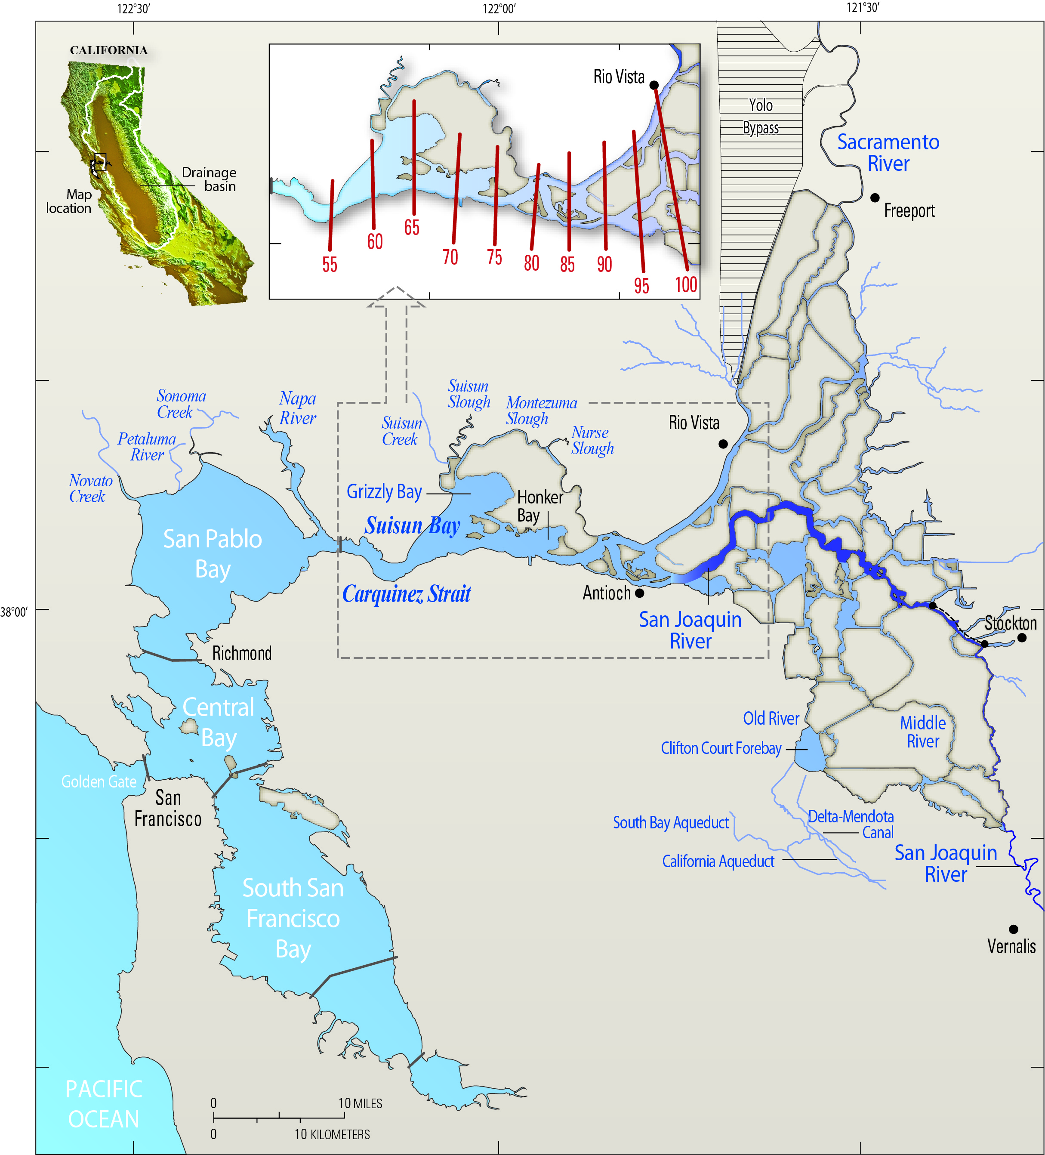

Slide 2
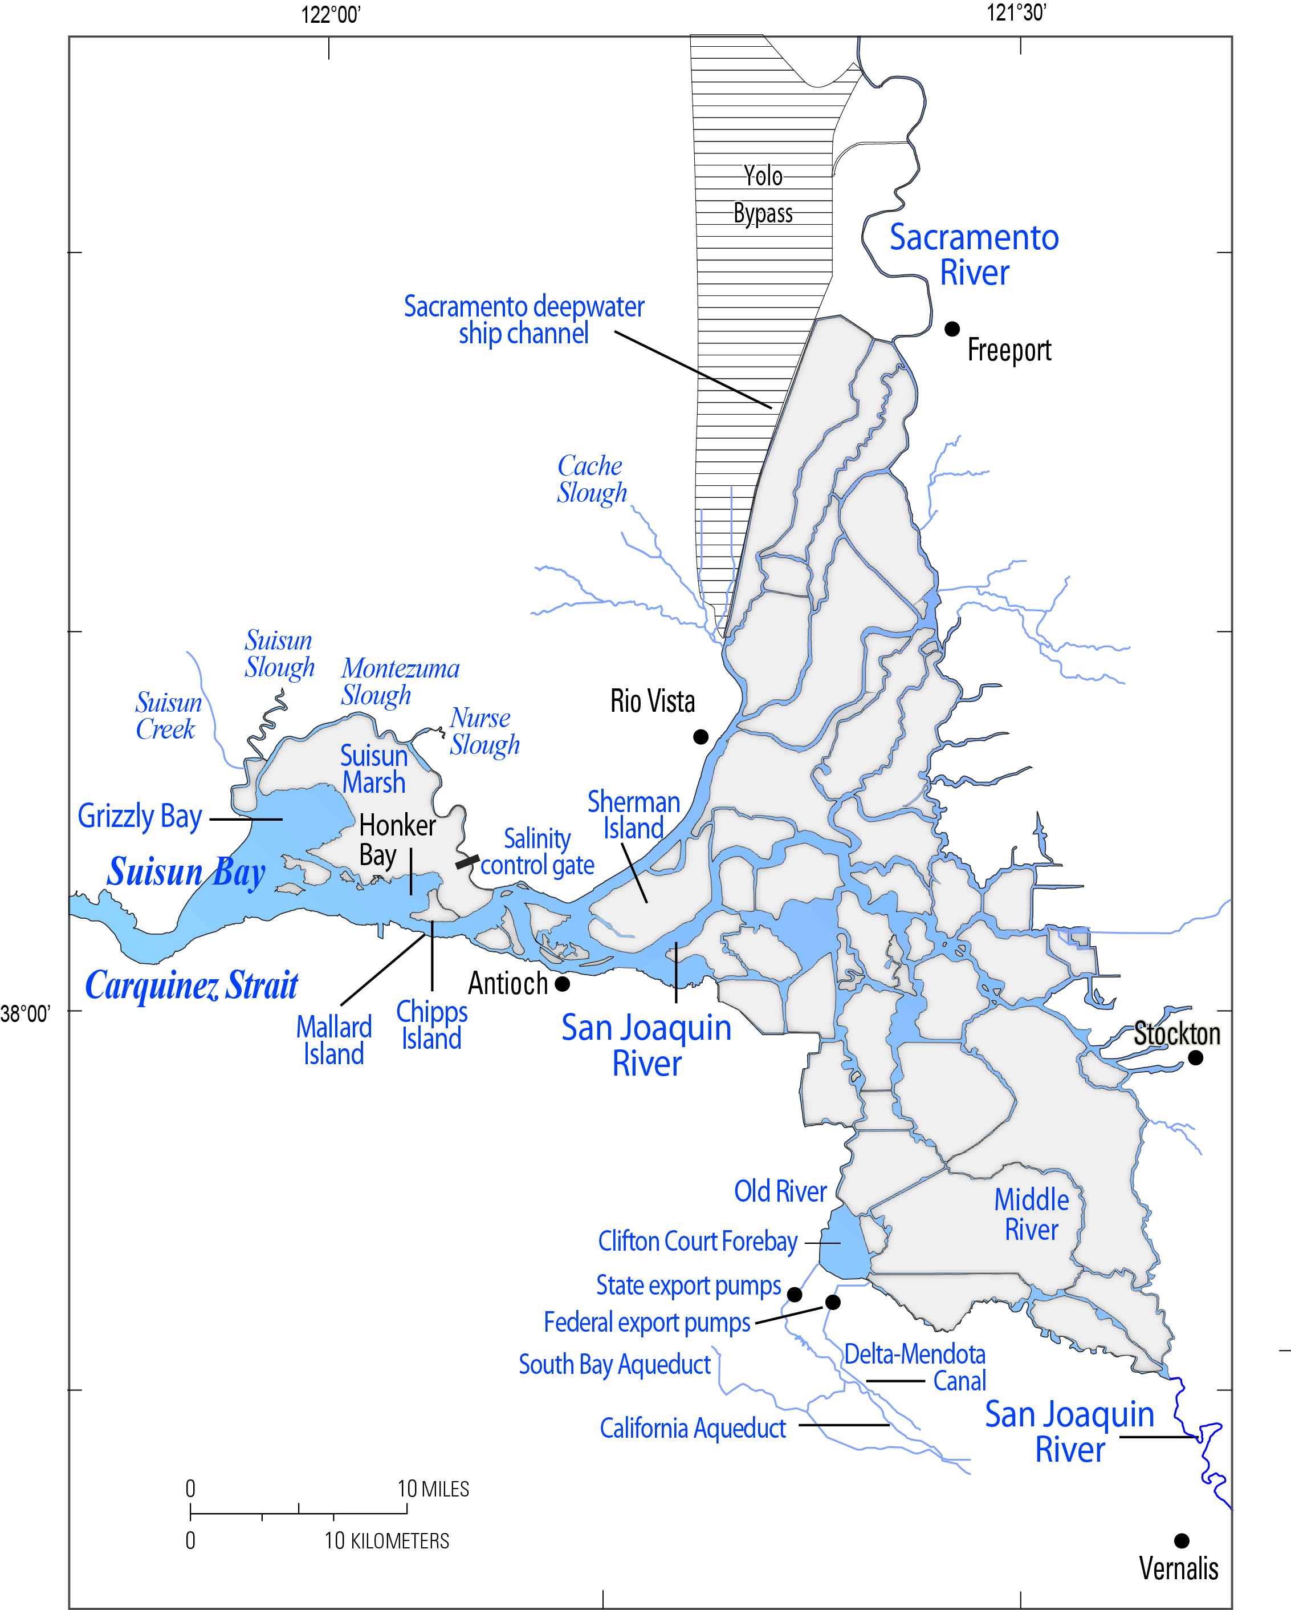
Fig. 3

Slide 3
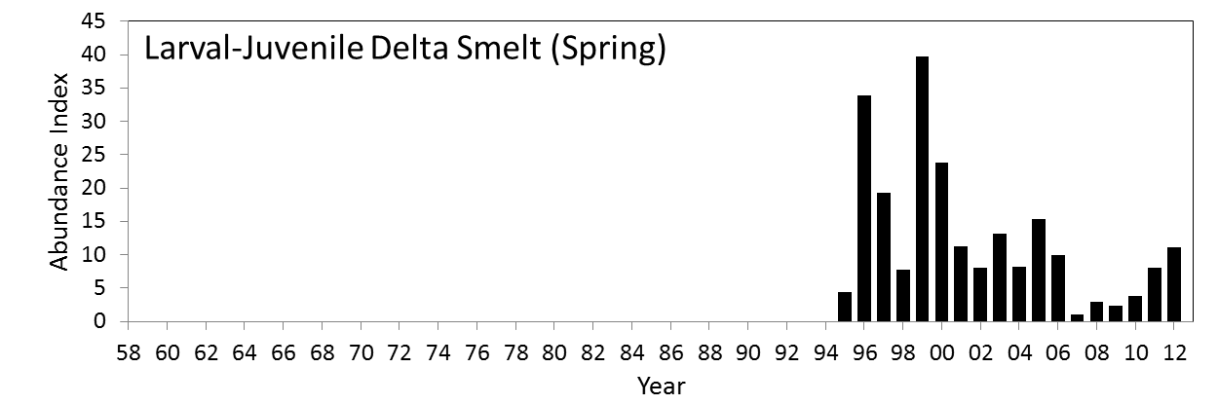
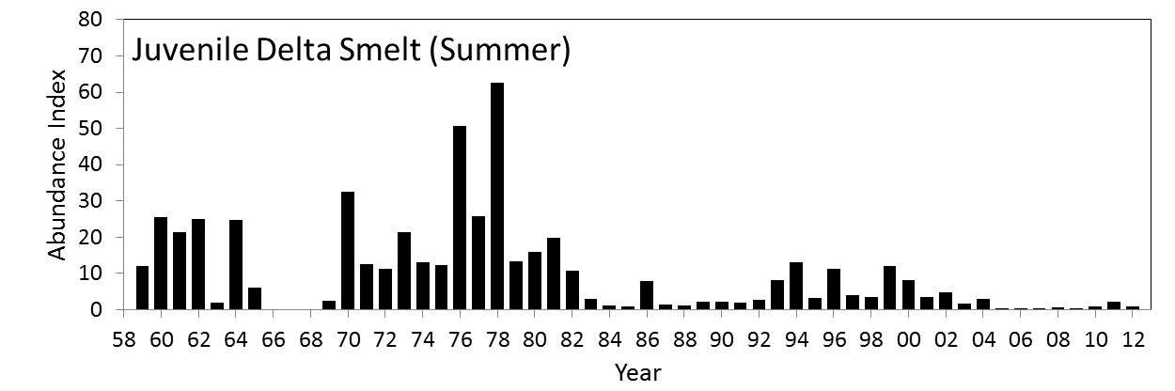
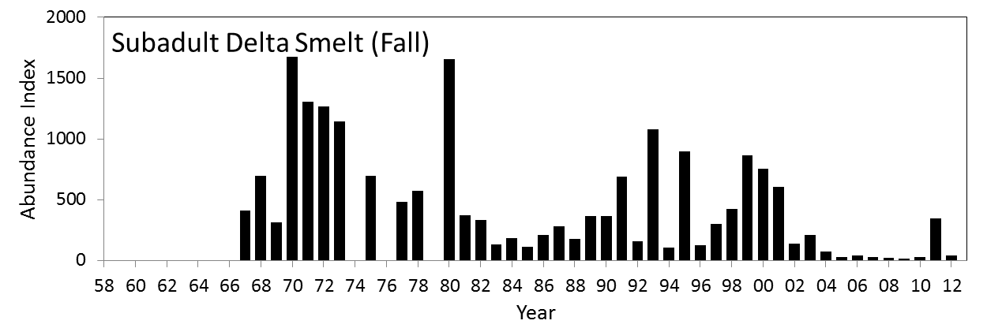
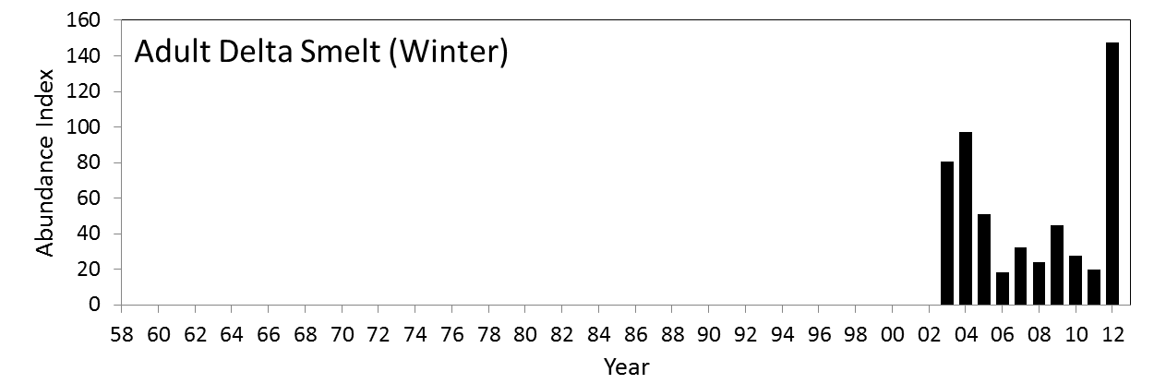

Slide 4
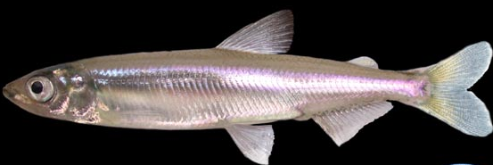
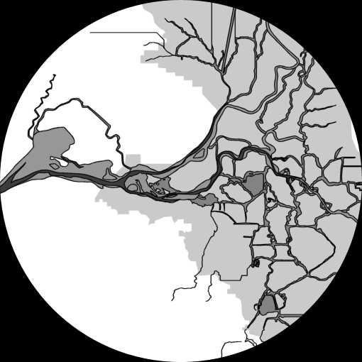

Winter
Upstream migration
after first flush
Fall
Spring
Maturation in low
salinity zone
Spawning in
fresh water
Summer
Migration to and rearing in
low salinity zone

Slide 5
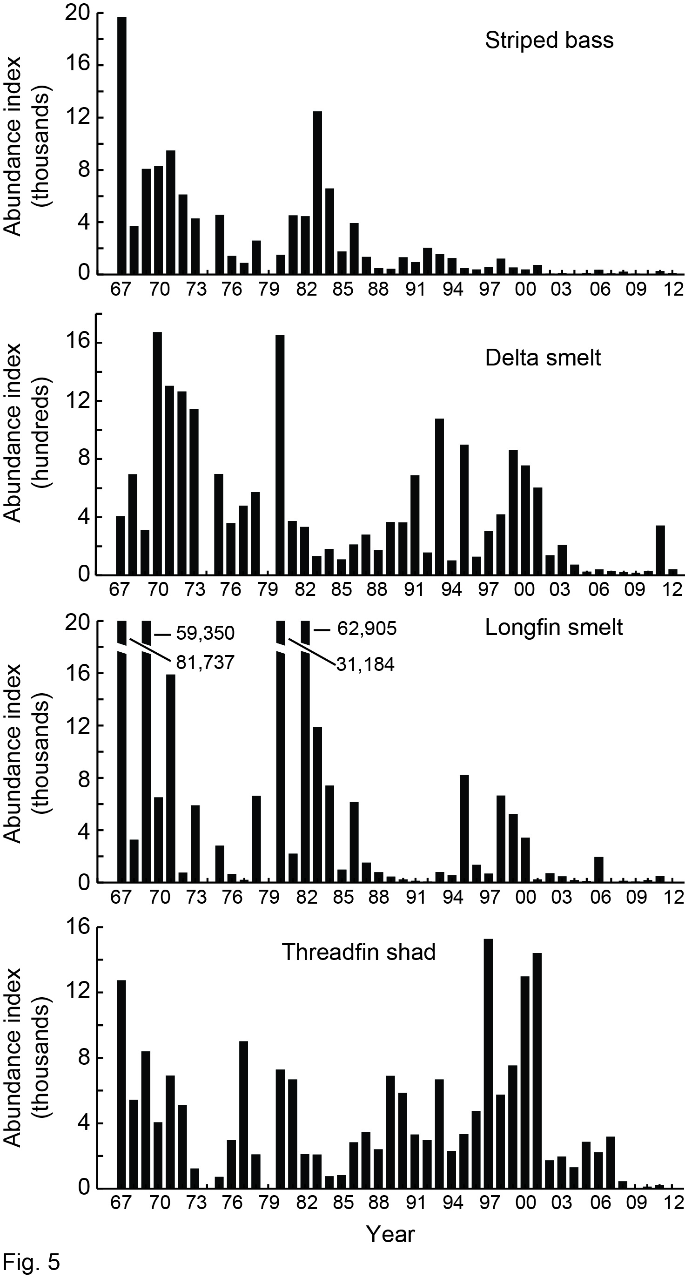
Fig. 5

Slide 6
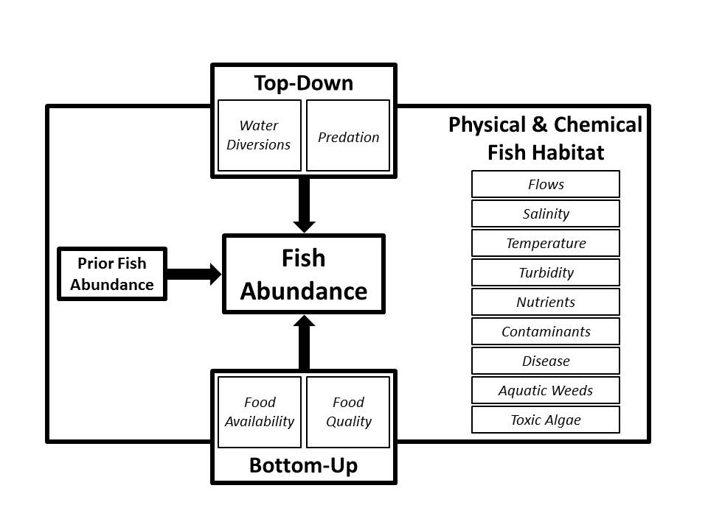

Slide 7
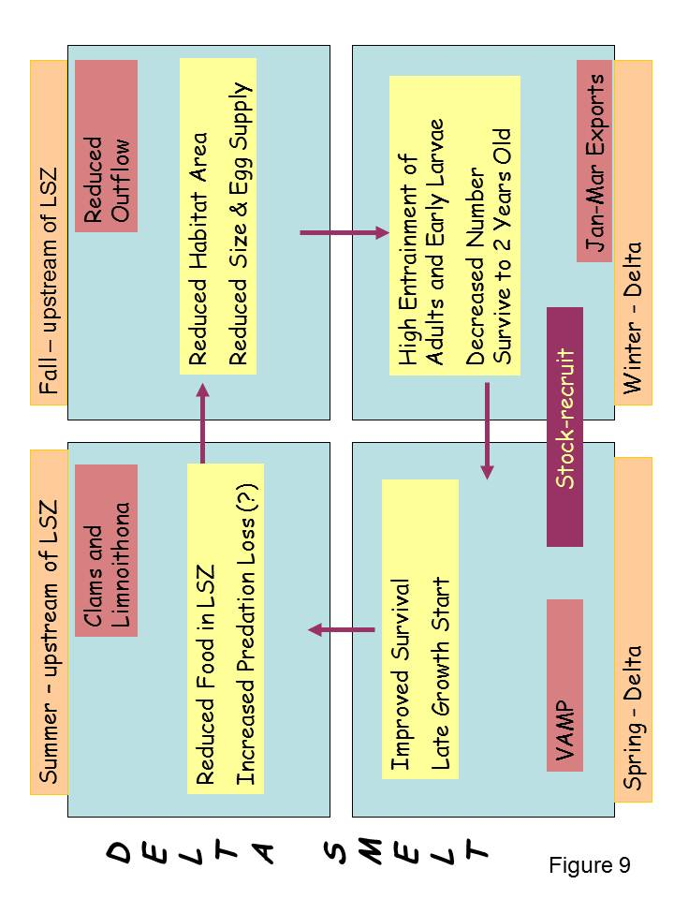

Slide 8
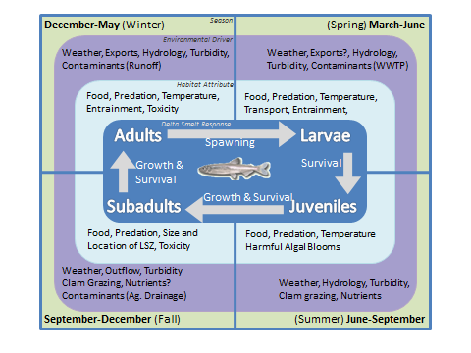

Slide 9
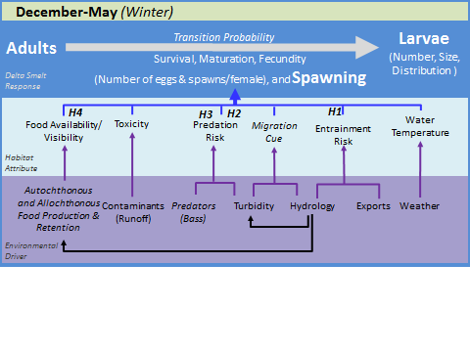

Slide 10
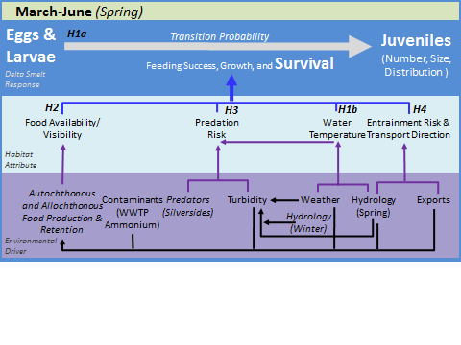

Slide 11
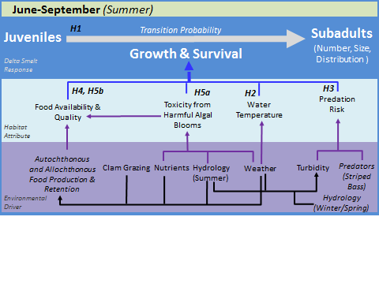

Slide 12
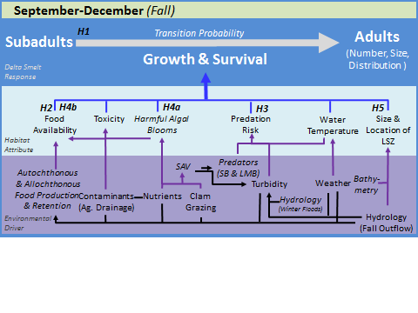

Slide 13
>6 ppt
1-6 ppt
<1 ppt
CS-SRDWSC
Year
2005
2010
2006
2011

Slide 14
>6 ppt
1-6 ppt
<1 ppt
CS-SRDWSC
Year
2005
2010
2006
2011

Slide 15
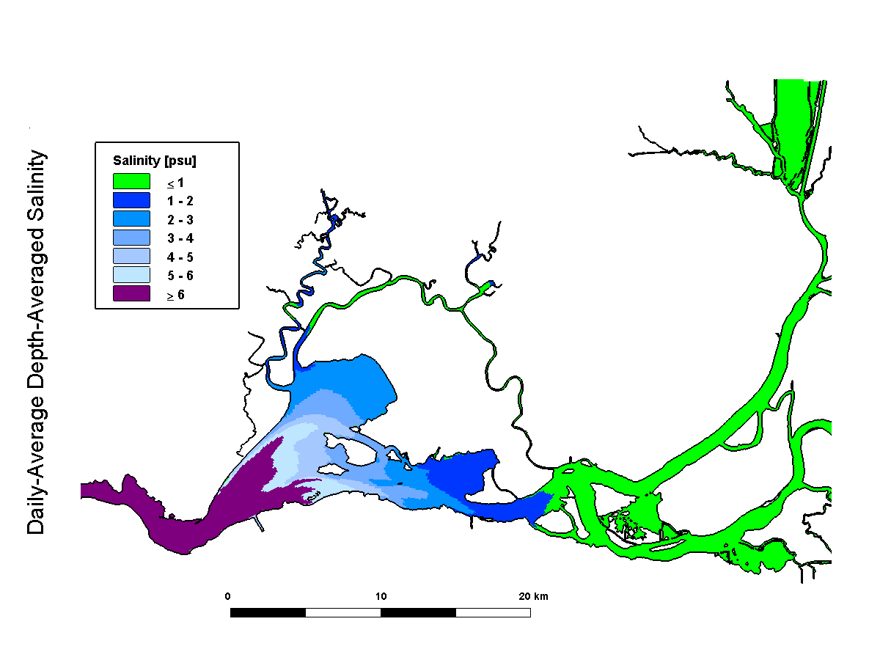
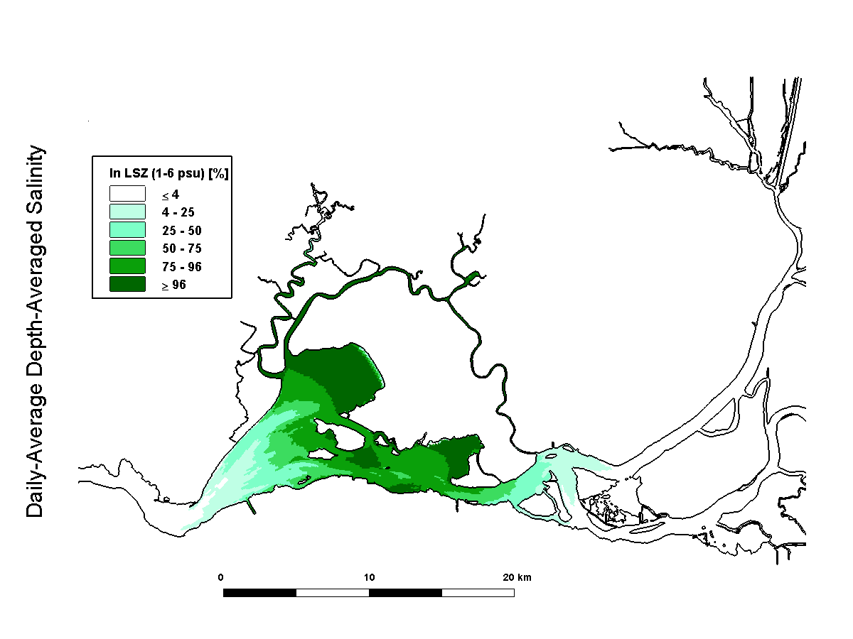

Slide 16
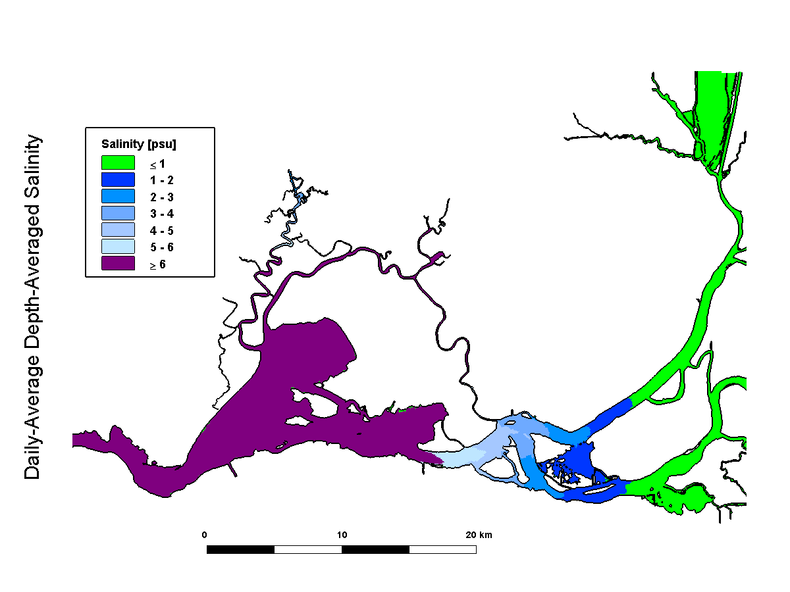
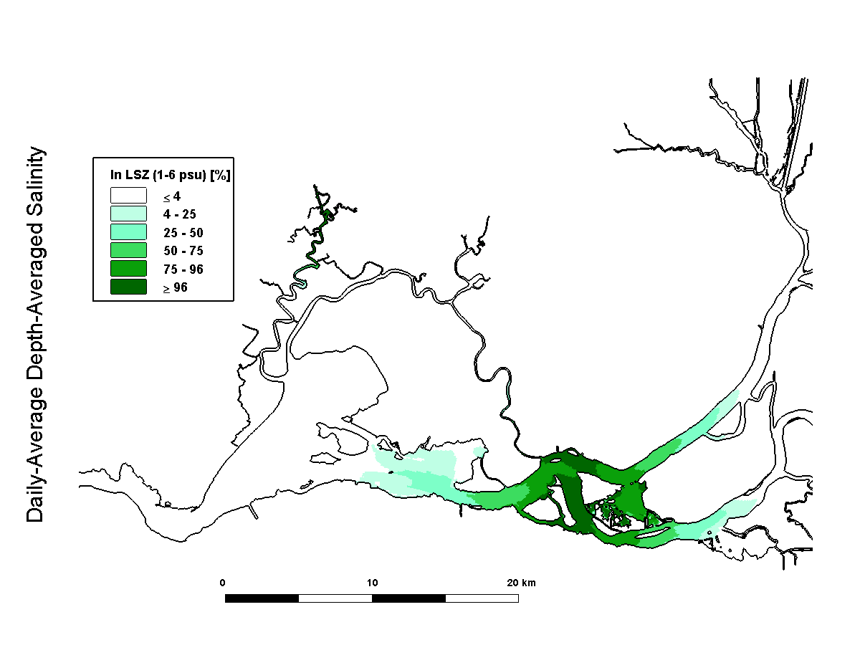

Slide 17
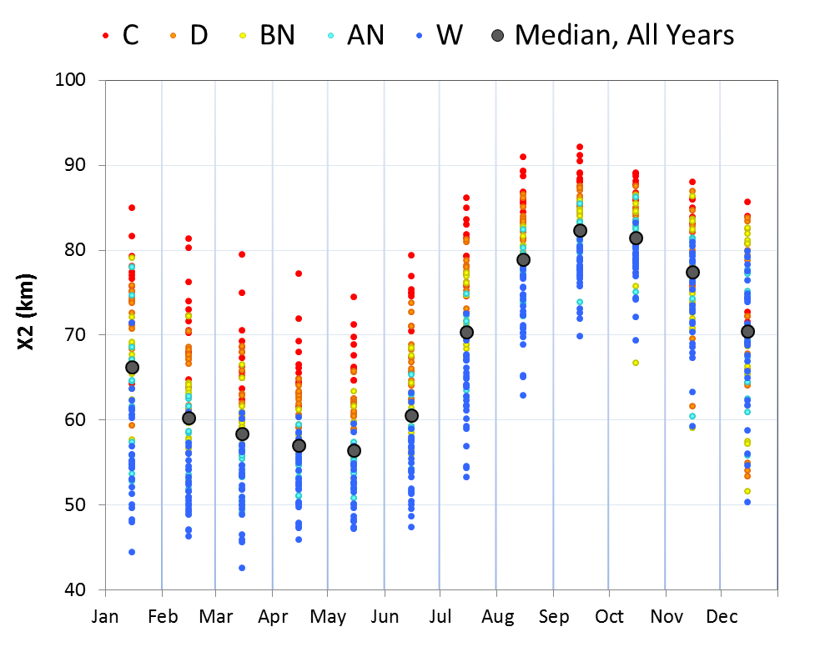

Slide 18
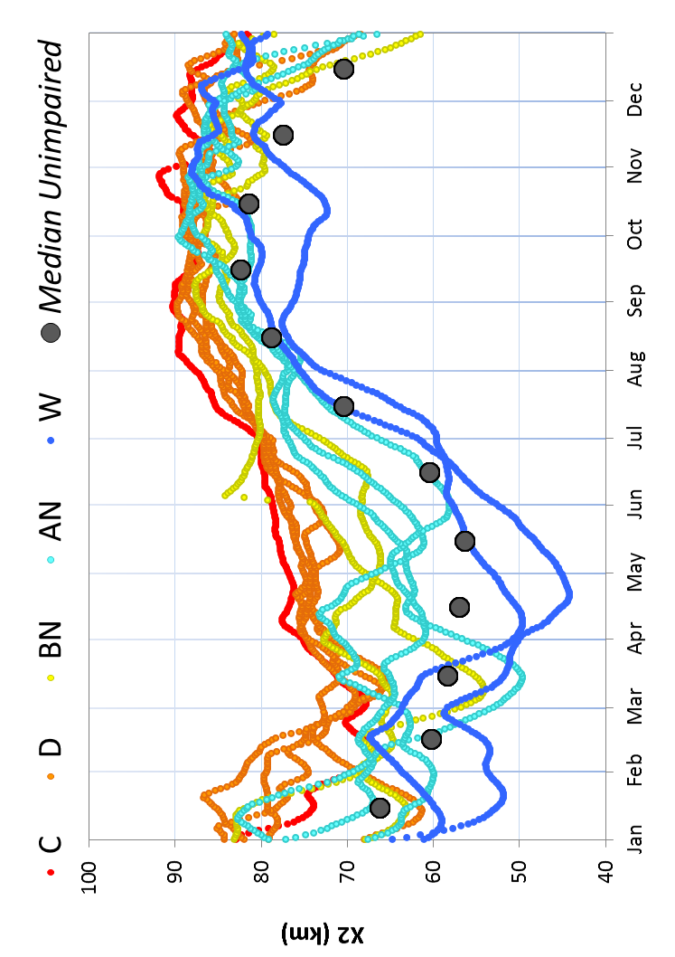

Slide 19
>6 ppt
1-6 ppt
<1 ppt
CS-SRDWSC
Year
2005
2010
2006
2011
Notes:
Figure L.8. Box plots of Secchi depth by survey and salinity interval/region for the 20mm Survey, 2005, 2006, 2010 and 2011.

Slide 21
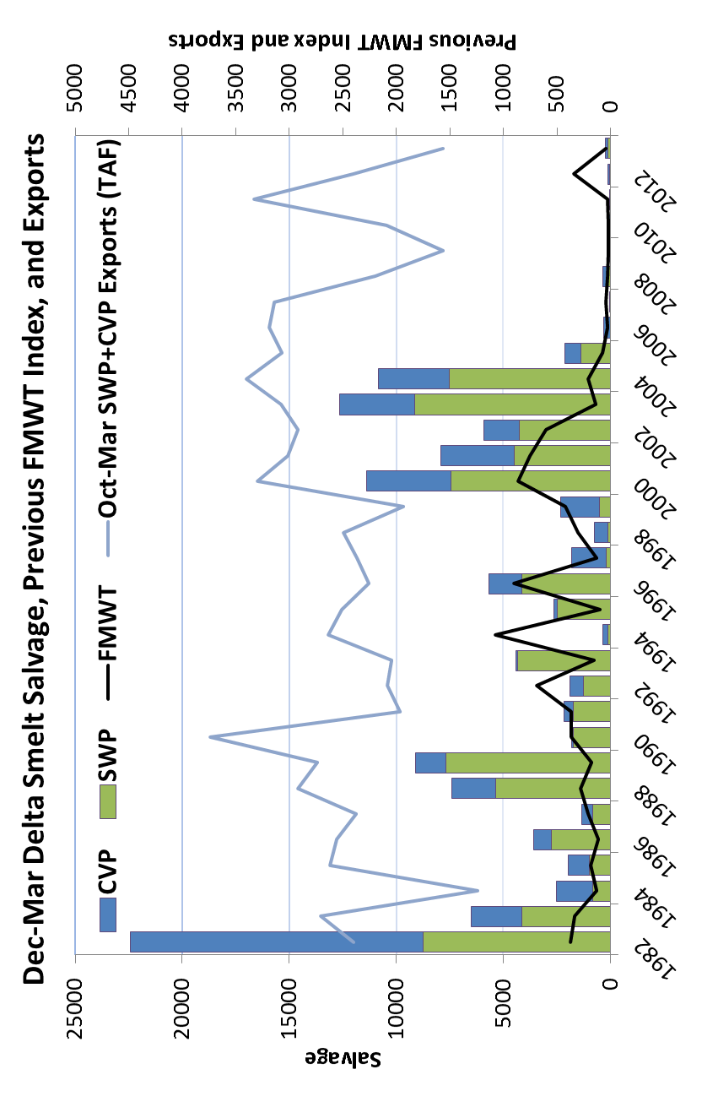

Slide 22
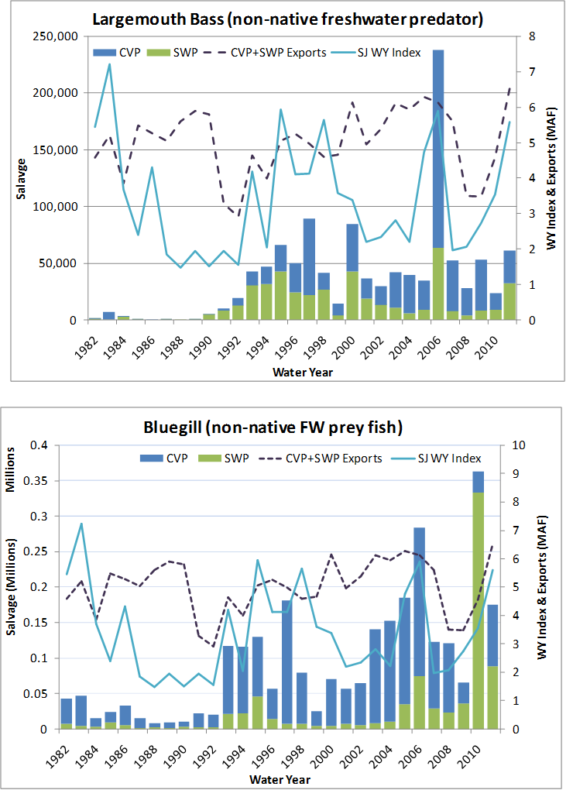

Slide 23
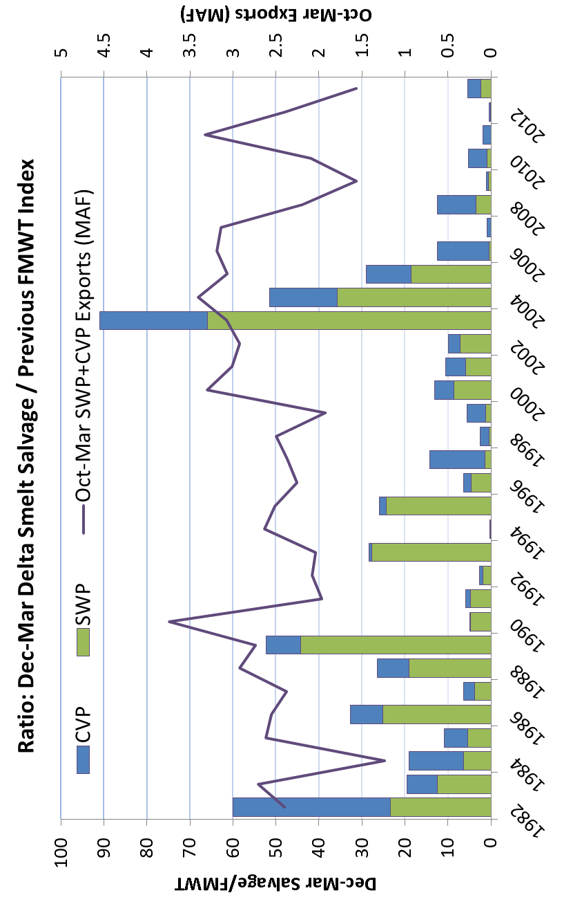

Slide 24
Notes:
Figure L.13. Line plot of Sacramento River flows at Rio Vista, San Joaquin River flows at Vernalis, Qwest, Old and Middle River flows, and total exports for 2005, 2006, 2010 and 2011. Data are from corrected Dayflow.

Slide 26
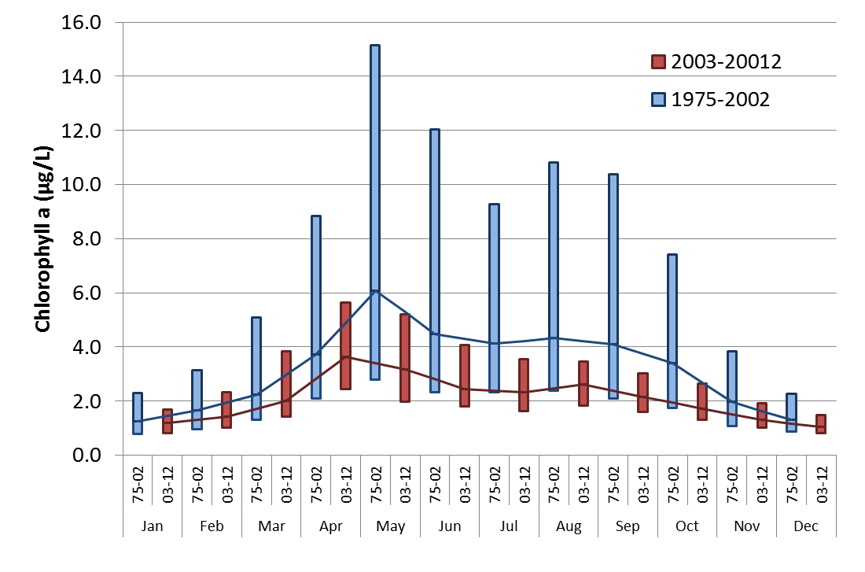

Slide 27
>6 ppt
Year
2005
2010
2006
2011
1-6 ppt
Year
2005
2010
2006
2011
<1 ppt
Year
2005
2010
2006
2011
Jan
Feb
Mar
Apr
May
Jun
Jul
Aug
Sep
Oct
Nov
Dec
Month

Slide 28
>6 ppt
Year
2005
2010
2006
2011
1-6 ppt
<1 ppt
Jan
Feb
Mar
Apr
May
Jun
Jul
Aug
Sep
Oct
Nov
Dec
Month

Slide 29
Year
2005
2010
2006
2011
Jan
Feb
Mar
Apr
May
Jun
Jul
Aug
Sep
Oct
Nov
Dec
Month

Slide 30
Year
2005
2010
2006
2011
Jan
Feb
Mar
Apr
May
Jun
Jul
Aug
Sep
Oct
Nov
Dec
Month

Slide 31
Year
2005
2010
2006
2011

Slide 32
Year
2005
2010
2006
2011
Jan
Feb
Mar
Apr
May
Jun
Jul
Aug
Sep
Oct
Nov
Dec
Month

Slide 33
2005
<20mm FL
2006
Stomach contents by percent weight
2010
2010
2011
Region
Pseudo. spp.
A. sinensis
S. doerri
Tortanus spp.
E. affinis
Other calanoids
Other cyclopoids
Limno. spp.
Harpacticoids
Copepod nauplii
Cladocerans
Mysids
Amphipods
Cumaceans
Fish
Other

Slide 34
2005
>6 ppt
2006
Stomach contents by percent weight
2010
2011
Month
Pseudo. spp.
A. sinensis
S. doerri
Tortanus spp.
E. affinis
Other calanoids
Other cyclopoids
Limno. spp.
Harpacticoids
Copepod nauplii
Cladocerans
Mysids
Amphipods
Cumaceans
Fish
Other

Slide 35
2005
1-6 ppt
2006
Stomach contents by percent weight
2010
2011
Month
Pseudo. spp.
A. sinensis
S. doerri
Tortanus spp.
E. affinis
Other calanoids
Other cyclopoids
Limno. spp.
Harpacticoids
Copepod nauplii
Cladocerans
Mysids
Amphipods
Cumaceans
Fish
Other

Slide 36
2005
<1 ppt
2006
Stomach contents by percent weight
2010
2011
Month
Pseudo. spp.
A. sinensis
S. doerri
Tortanus spp.
E. affinis
Other calanoids
Other cyclopoids
Limno. spp.
Harpacticoids
Copepod nauplii
Cladocerans
Mysids
Amphipods
Cumaceans
Fish
Other

Slide 37
2005
CS-SRDWSC
2006
Stomach contents by percent weight
2010
2011
Month
Pseudo. spp.
A. sinensis
S. doerri
Tortanus spp.
E. affinis
Other calanoids
Other cyclopoids
Limno. spp.
Harpacticoids
Copepod nauplii
Cladocerans
Mysids
Amphipods
Cumaceans
Fish
Other

Slide 38
>6 ppt
2012 Age-1 fish
1-6 ppt
Stomach contents by percent weight
<1 ppt
CS-SRDWSC
Month
Pseudo. spp.
A. sinensis
S. doerri
Tortanus spp.
E. affinis
Other calanoids
Other cyclopoids
Limno. spp.
Harpacticoids
Copepod nauplii
Cladocerans
Mysids
Amphipods
Cumaceans
Fish
Other

Slide 39
FMWT
TNS
FMWT in previous year

Slide 40
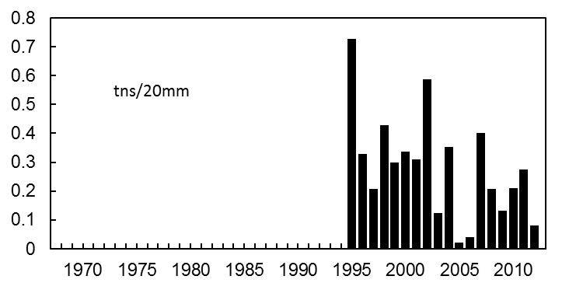
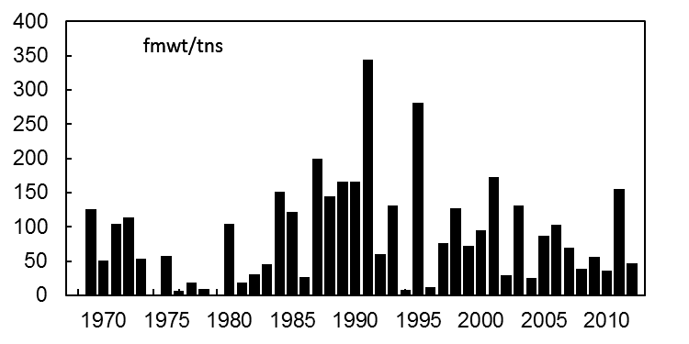
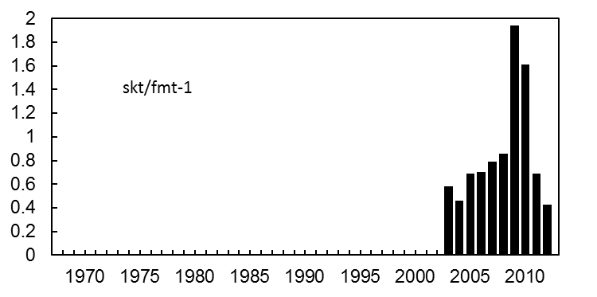
TNS/20 mm
Survival index
FMWT/TNS
Survival index
SKT/FMWT_{year-1}
Survival index

Slide 41
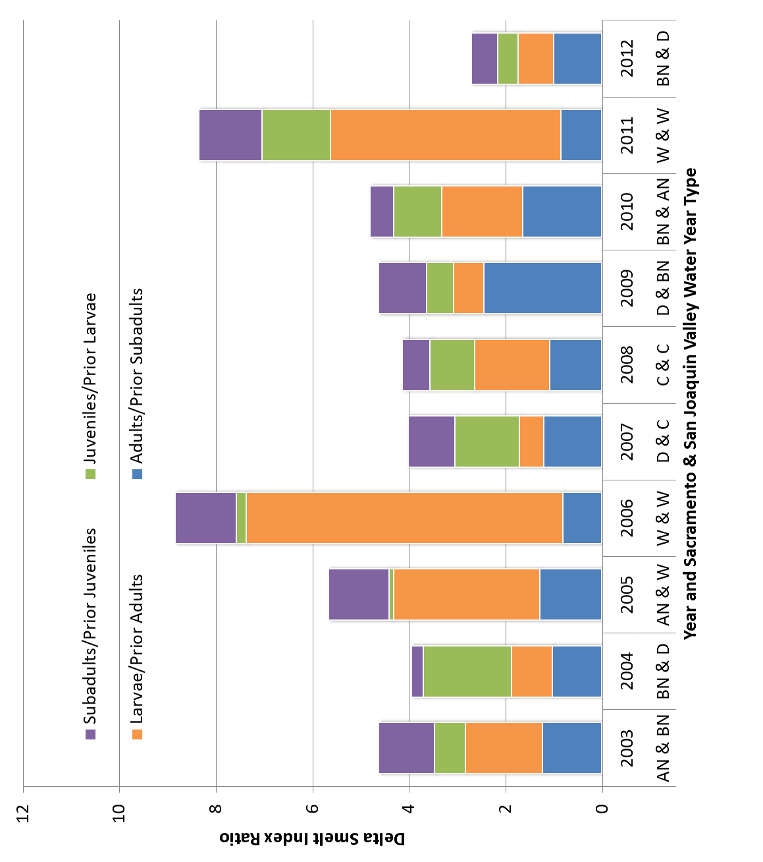

Slide 42
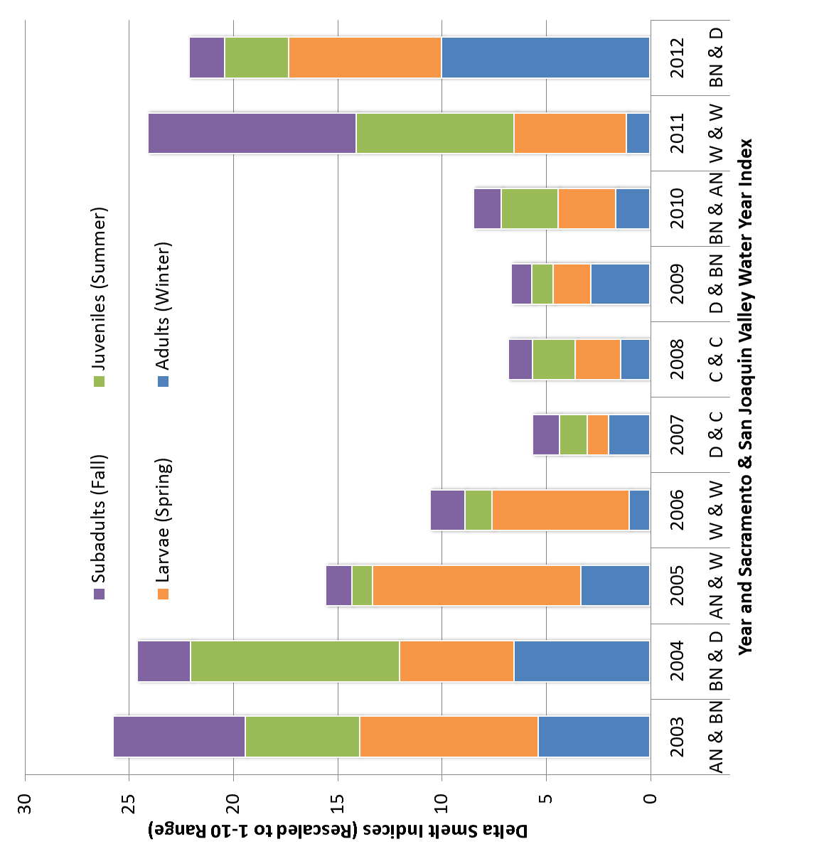

Slide 43
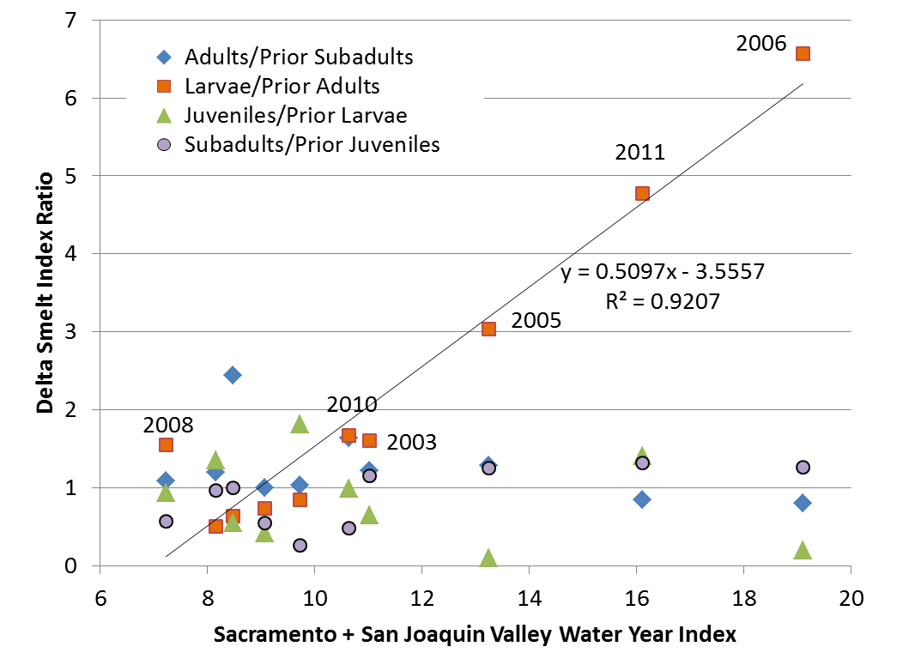

Slide 44
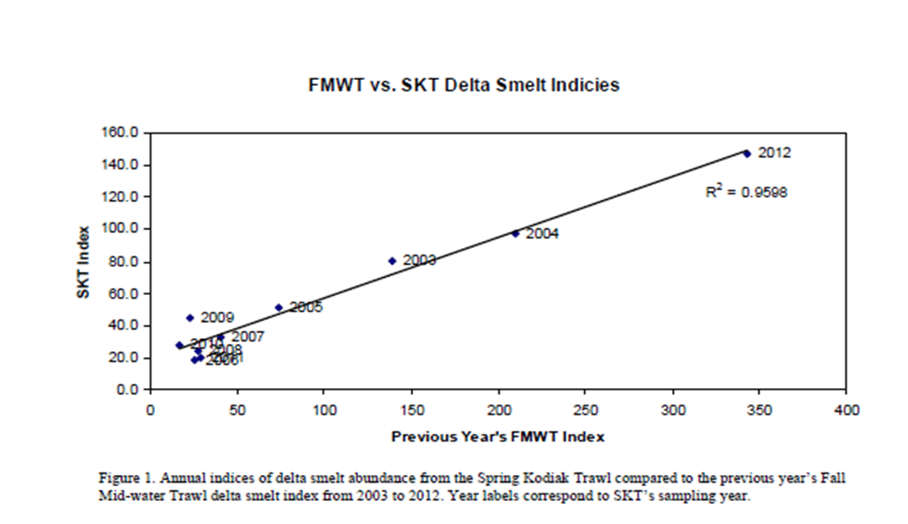

Slide 45
2005
20 mm Survey
2006
2011
2010
SKT

Slide 46
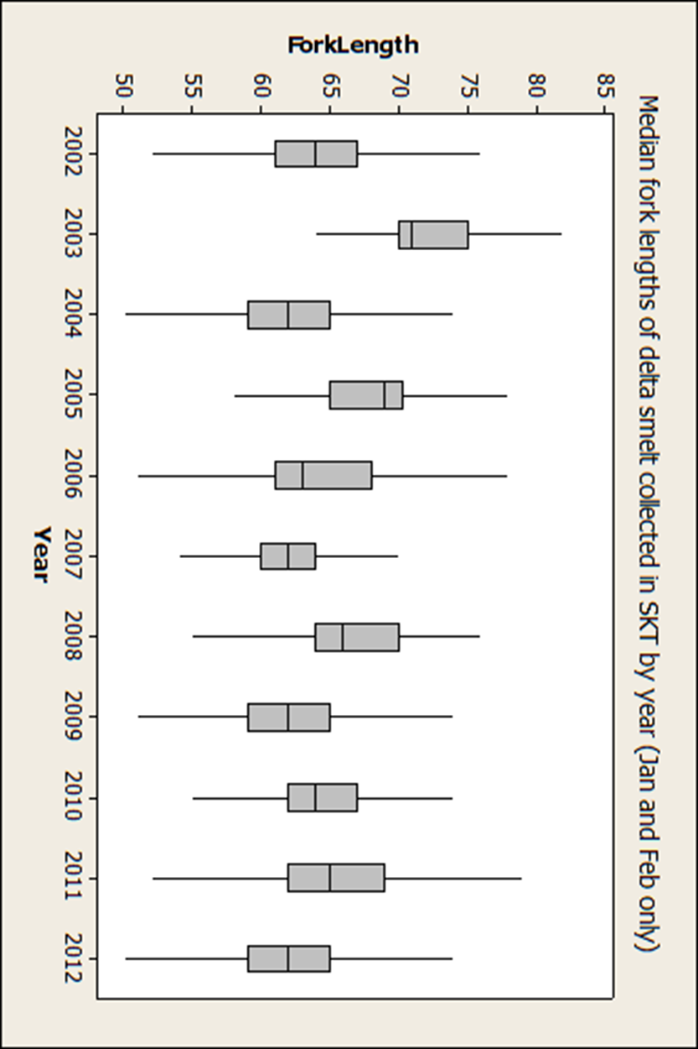

Slide 47
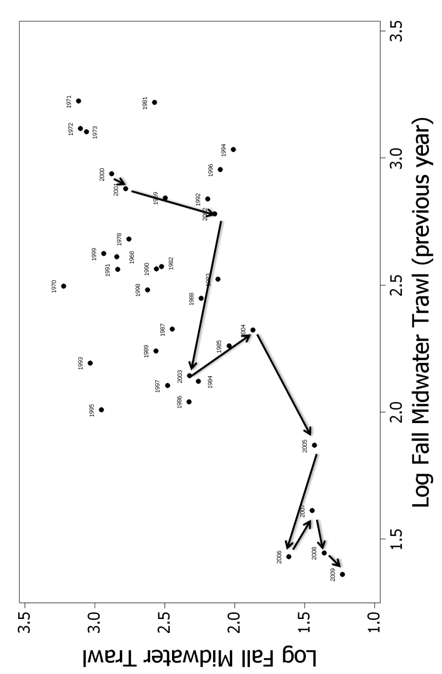

Slide 48
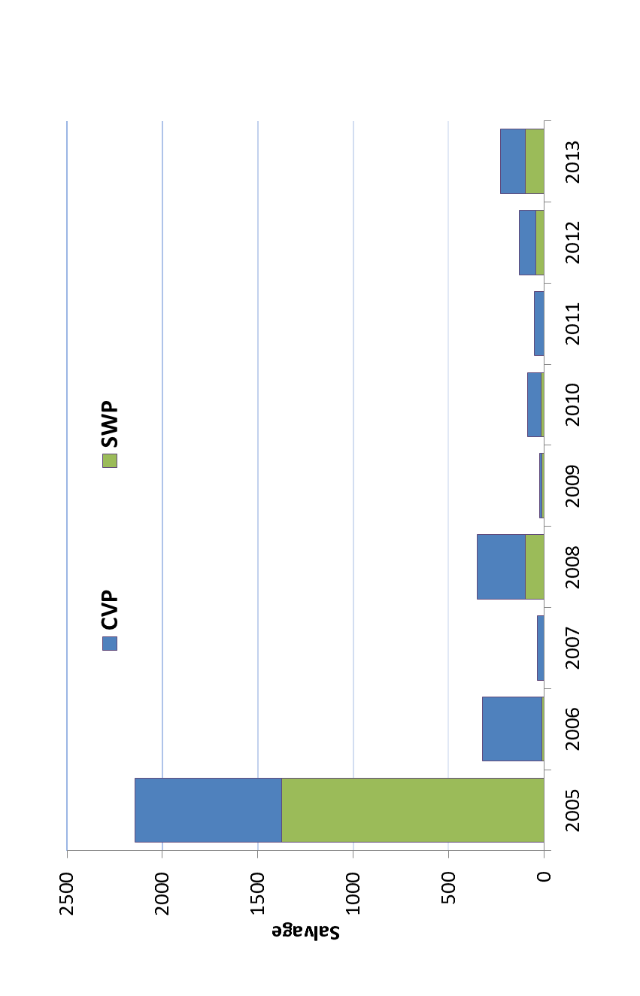

Slide 49
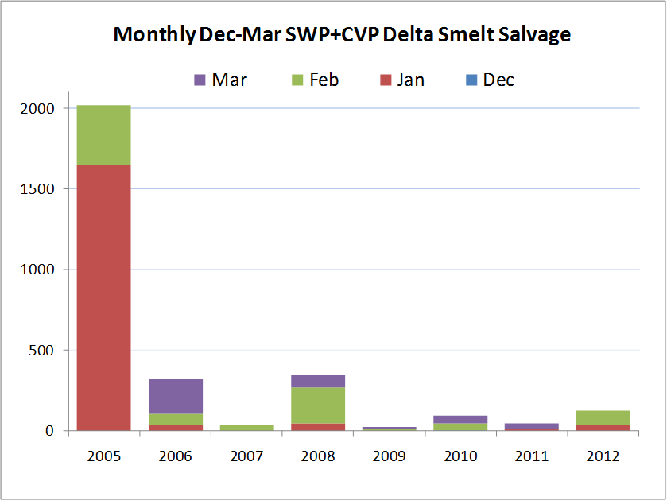

Slide 50
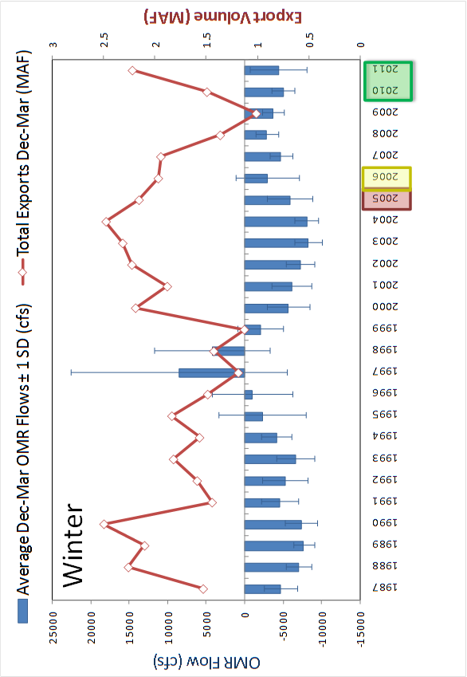

Slide 51
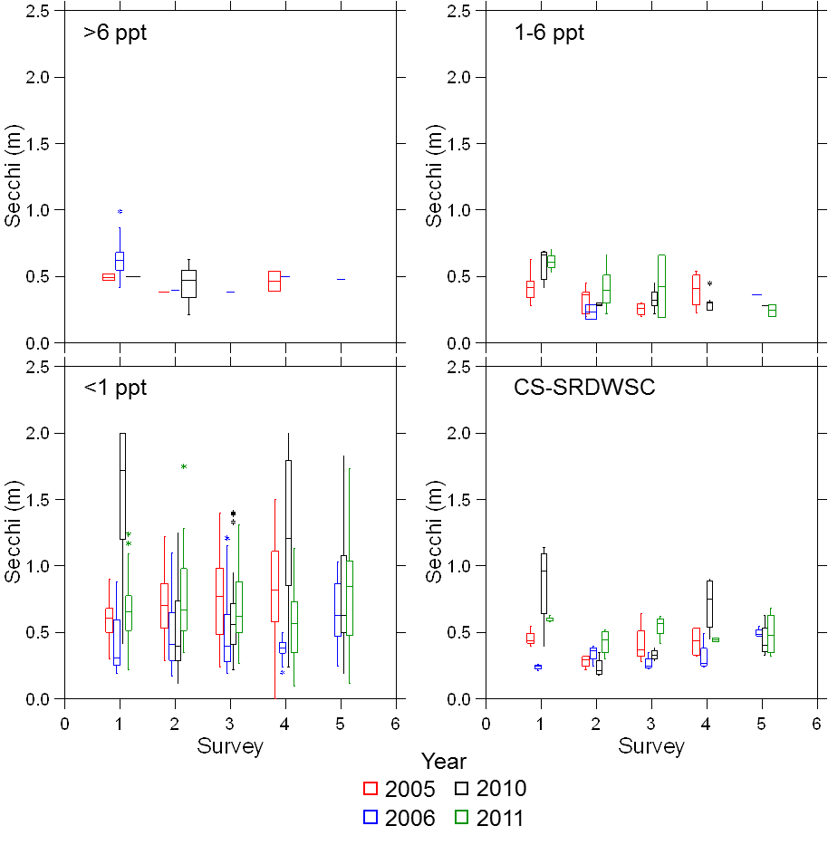

Slide 52
Notes:
Figure L.5. Individual female lengths by calendar day for stage 4 and 5 females collected in the Spring Kodiak Trawl January through May, 2005, 2006, 2010 and 2011. These data include both monthly distribution survey fish and directed survey fish. The directed survey (targeting smelt spawning areas) was discontinued after January 2010. May need to add spent females to improve sample size later in the year.

Slide 53
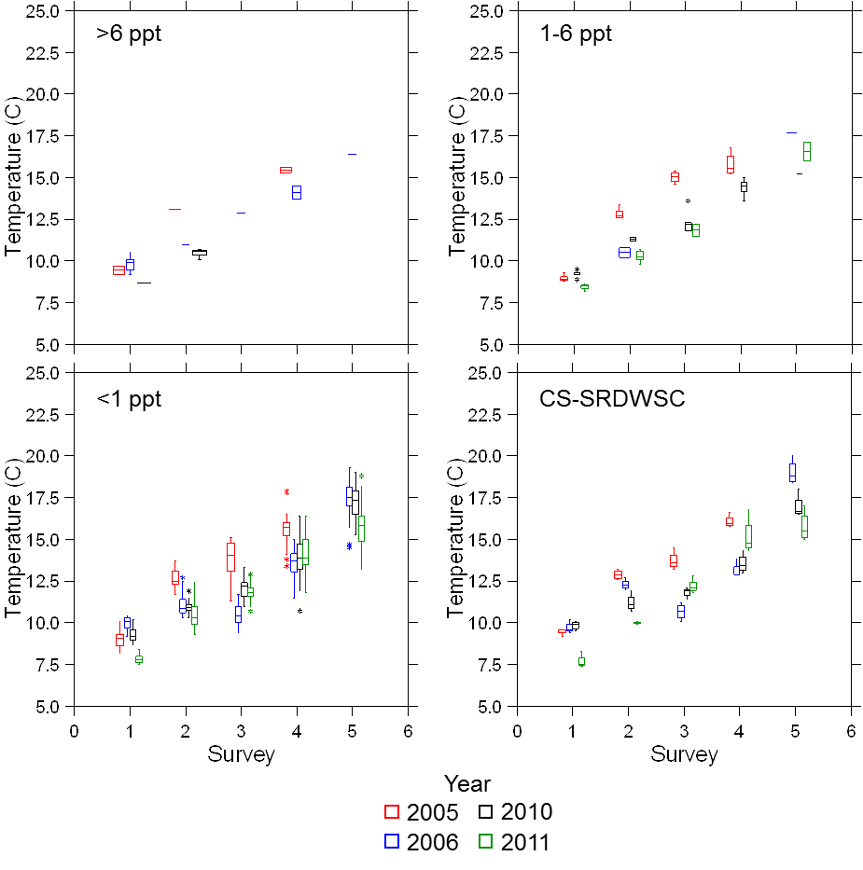

Slide 54
Notes:
Figure 23 (L.6). Mean daily temperatures (°C) at Rio Vista from February 1 through June 30, 2005, 2006, 2010, 2011.

Slide 55
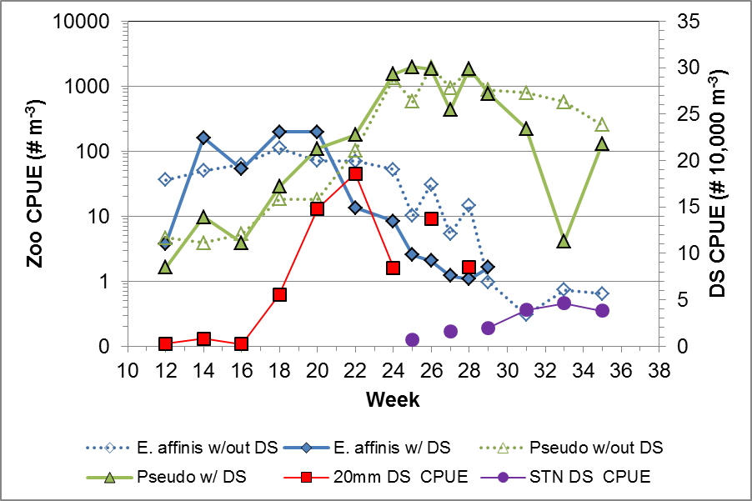
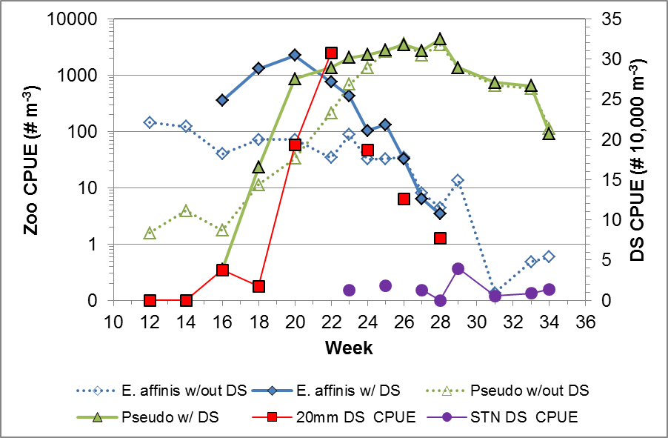
2005
2006
Notes:
Figure 26?(L.9). Densities by calendar week of Eurytemora affinis and Pseudodiaptomus forbesi from mesozooplankton sampling by the CDFW 20mm and Summer Townet surveys, 2005, 2006, 2010 and 2011. continued…

Slide 56
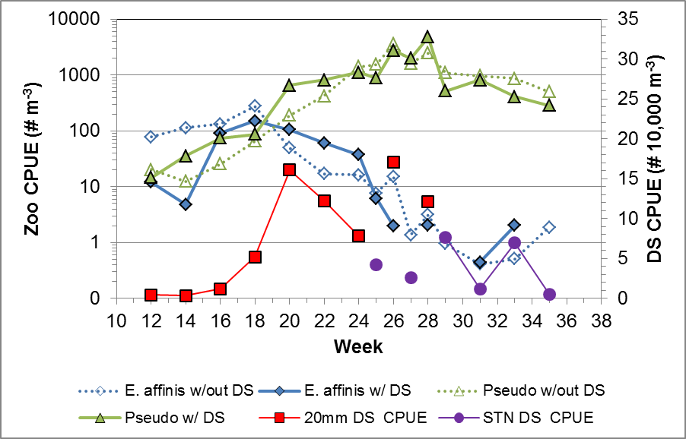
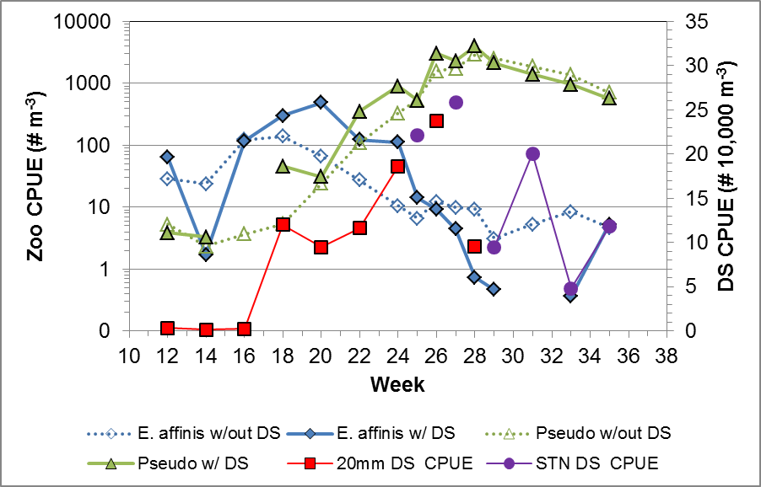
2010
2011
Notes:
Figure 26(L.9) continued. Densities by calendar week of Eurytemora affinis and Pseudodiaptomus forbesi from mesozooplankton sampling by the CDFW 20mm and Summer Townet surveys, 2005, 2006, 2010 and 2011.

Slide 57
Notes:
Figure L.12. Scatter plot of Mississippi silverside catch plotted on Secchi depth (cm) at location of capture from the Spring Kodiak Trawl Survey, 2005, 2006, 2010 and 2011.

Slide 58
Notes:
Figure L.10. Monthly length frequency of Mississippi silversides captured by the Spring Kodiak Trawl during distribution sampling March – May in the Sacramento River and Cache Slough sampling stations only, 2002-2012. The months and geographic range were selected to overlap with that of delta smelt larvae as they hatch and begin to grow.

Slide 59
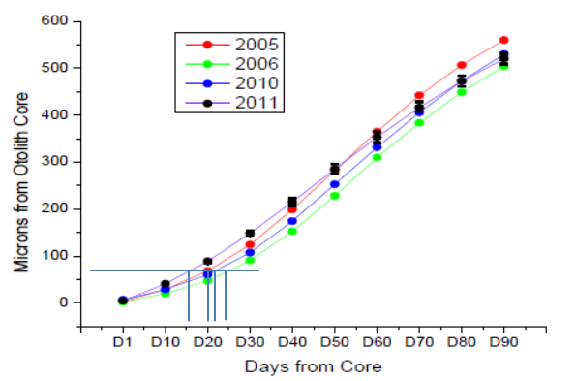
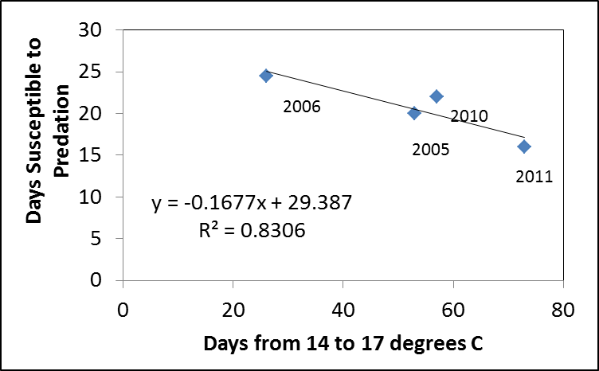
a
a
b
b
Notes:
Figure L.11. a ) Otolith growth (microns from core) in relation to days post-hatch for years 2005, 2006, 2010 and 2012 (Source Cook et al. 2012 poster). Assume that growth to 10 mm occurs in about 20 days on average, then identify approximate median in microns from otolith (horizontal line), then project vertical lines from where median crosses growth curves to determine variation in days to achieve 10 mm (vertical blue lines); b ) results from a) plotted on the annual duration of optimal temperatures, which depicts the mean number of days susceptible to predation goes down for the population as the days of optimal temperature increases.

Slide 60
>6 ppt
1-6 ppt
<1 ppt
CS-SRDWSC
Year
2005
2010
2006
2011

Slide 61
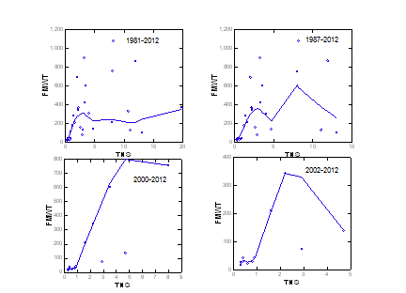

Slide 62
>6 ppt
1-6 ppt
<1 ppt
CS-SRDWSC
Year
2010
2011

Slide 63
>6 ppt
1-6 ppt
<1 ppt
CS-SRDWSC
Year
2005
2010
2006
2011
Secchi depth data collected during the Summer Townet Survey. Surveys are conducted biweekly June-August.

Slide 64
Year
2005
2010
2006
2011
Jan
Feb
Mar
Apr
May
Jun
Jul
Aug
Sep
Oct
Nov
Dec
Month

Slide 65
>6 ppt
Year
2005
2010
2006
2011
1-6 ppt
<1 ppt
Jan
Feb
Mar
Apr
May
Jun
Jul
Aug
Sep
Oct
Nov
Dec
Month

Slide 66
Year
2005
2010
2006
2011

Slide 67
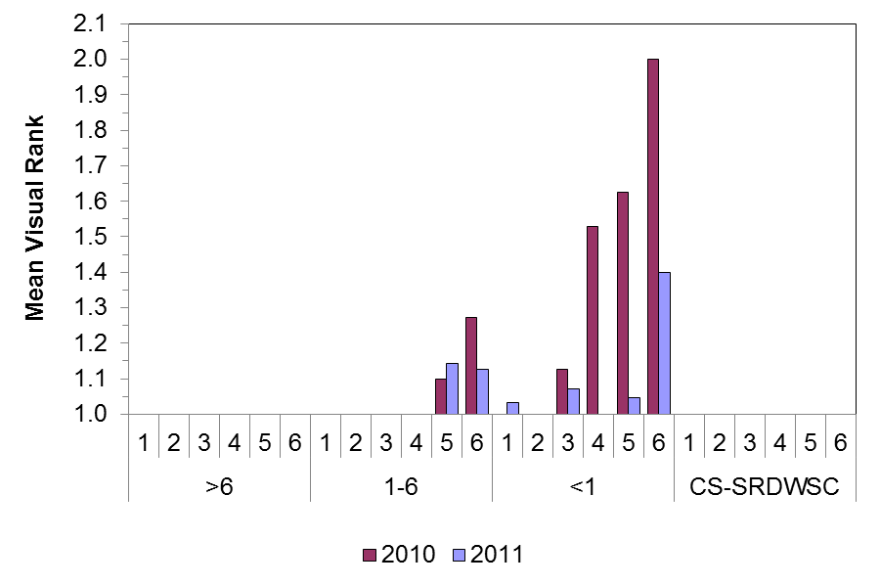
Notes:
Microcystis

Slide 68
